Slide 1
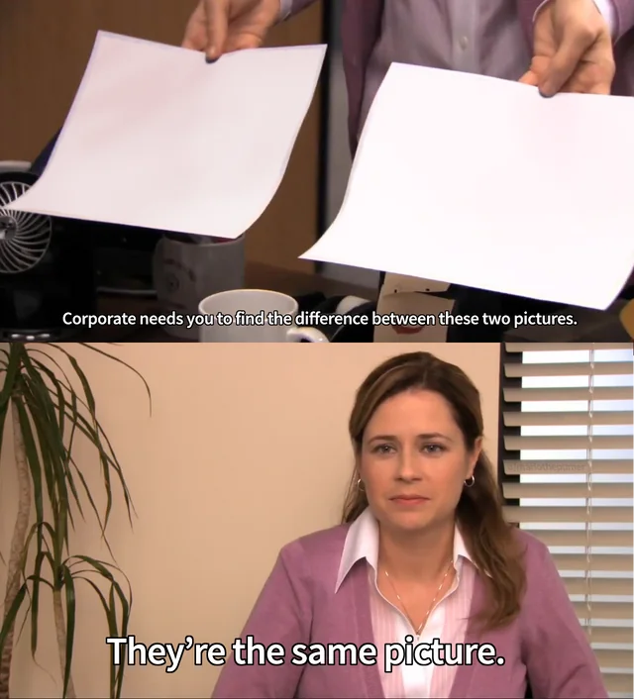
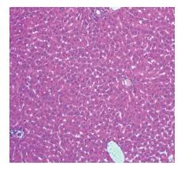
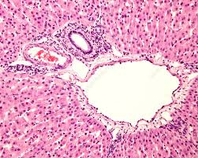
Histology
Intro to
Megan Cooper, Doctorials 2024

Slide 2
What is Histology?
The study of microscopic structures of tissues
How cells are arranged to optimize functions specific to each organ as well as pathologic states
Notes:
More than just pink & purple images !
Histology is looking at the microscropic structure of a tissue
In normal tissues can see how cells are arranged in order to give a tissue its specific function
In disease can see how the normal structure is interrupted
Many changes occur at the cellular level when pathologies are present
The more you practice looking at the images the more comfortable you will be

Slide 3
Learning Objectives
Briefly outline what occurs to pathological specimens once they are sent to the lab and how slides are made
Explain, in depth, how to approach interpreting histological slides in terms of envisioning them as 3D tissues
Explain in depth the 4 basic tissue types, their key histological components, and how to differentiate them in histological images
Give pictorial examples of normal and diseased histological tissue
Megan Cooper, Doctorials 2024

Slide 4
Learning Objectives
Briefly outline what occurs to pathological specimens once they are sent to the lab and how slides are made
Explain, in depth, how to approach interpreting histological slides in terms of envisioning them as 3D tissues
Explain in depth the 4 basic tissue types, their key histological components, and how to differentiate them in histological images
Give pictorial examples of normal and diseased histological tissue
Megan Cooper, Doctorials 2024

Slide 5
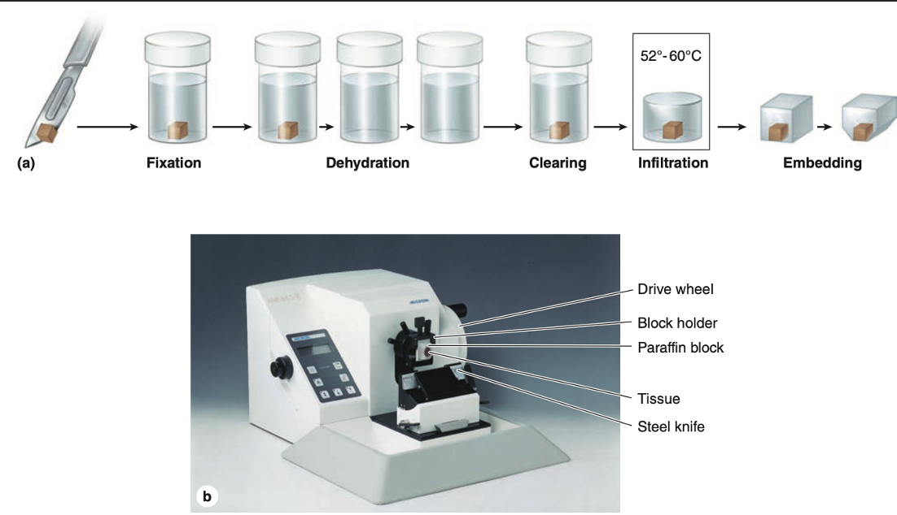
How Slides are Prepared
Fixation
PRESERVE tissue - Fixed commonly with formalin (37% formaldehyde) to prevent decay
Processing
Dehydration – using alcohol to remove water and formalin from tissue
Clearing – organic solvents remove the alcohol
Infiltration – paraffin replaces solvents
Embedding – embedding agents like paraffin wax enclose the specimen in a block
Trimming – remove excess wax to expose tissue
Sectioning
Thin tissue sections are sliced from the block and placed on a slide
Staining
See next slide
Megan Cooper, Doctorials 2024
Junqueira’s Basic Histology, CH 1
Notes:
Samples of tissue obviously cant be viewed under light microscope
Need to prep tissue, and create thin slices so can be examined with transmitted light
Ideally tissue slice preserved so tissue on slide same structural features had in the body
- Often not feasible -> prep process removed lipids, distorts structures
Fixation: Point Is to preserve the structure as close as possible to its living state. Fixing agent formalin reacts with NH3 group of proteins to prevent breakdown. Prevent degredation by enzymes released from cells or microorganisms
Dehydration – series of stronger concentrations alcohol until 100% removes all water
Clearing – organic solvents replace alcohol because mix with paraffin aswell as alcohol – tissue clear appearance
Infiltration – tissue -> heated melted paraffin until replaces solvent after evaporation
Embedding -> infiltrated tissue placed in mold with melted paraffin and hardens
Trimming: paraffin block trimmed to expose tissue for sectioning or slicing on microtome
EMBEDDING AND SECTIONING
To permit thin sectioning, fixed tissues are infiltrated and embedded in a material that imparts a firm consistency. Embedding materials include paraffin
Sectioning slices 3-10 um thickness (micrometer) 1/1000 mm
Staining:
Most cells and extracellular material are completely color- less, and to be studied microscopically tissue sections must be stained (dyed).
- SEE NEXT SLIDE

Slide 6
How Slides are Prepared: Staining
Haematoxylin
Basic/Cationic
→ Interact with anions
Limited interaction in cell
“basophilic”
Eosin
Acidic/Anionic
→ Interact with cations
“acidophilic”
Many, many structures (non-specific)
H&E
Most commonly used histological staining procedure
Heterochromatin and nucleoli
Ie. Collagen
Notes:
Most cells and extracellular material are completely color- less, and to be studied microscopically tissue sections must be stained (dyed).
Cell components, such as nucleic acids with a net negative charge (anionic), have an affinity for basic dyes and are termed basophilic; Haematoxylin: good for staining nuclei (DNA), RNA rich cytoplasm (DNA, RNA – acids)
- DARK PURPLE
cationic components, such as proteins with many ionized amino groups, stain more readily with acidic dyes and are termed acidophilic. Eosin: good for staining cytoplasm (mitochondria, collagen)
PINK
Reference: Jackie Yang Doctorials 2019-2020 (Ross & Pawlina)

Slide 7
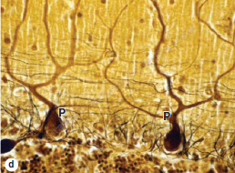
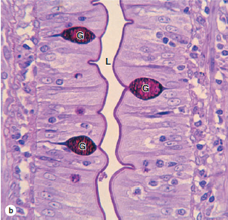
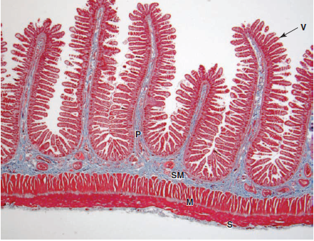
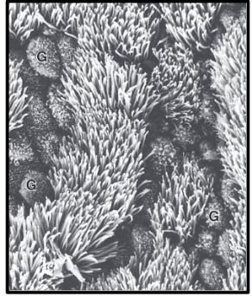
Other Staining Methods
Periodic Acid Schiff
Starch
Mucin granules
Glycogen deposits
Masson’s Trichrome
Red: keratin and muscle
Blue/green: collagen and bone
Light red/pink: cytoplasm
Dark brown/black: nuclei
Silver
Neurons
Electron Microscopy
Transmission
Scanning
Megan Cooper, Doctorials 2024
Notes:
Just showing examples that there are other staining techniques for other specific applications
Reference: Junqueira’s Basic Histology Text and Atlas
PAS: Epithelium of SI showing glycoproteins
Masson’s: Jejunum
Silver: Dendrites of neuron
Electron microscopy: Bile canaliculi

Slide 8
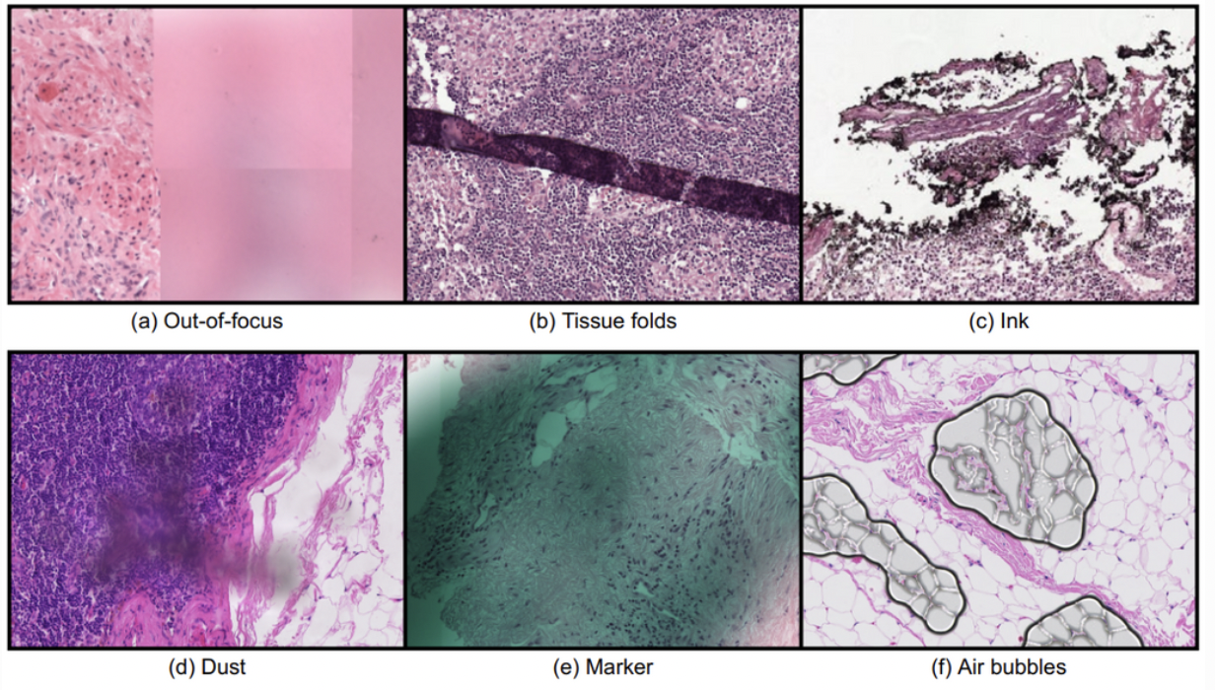
Components that CAN’T be Visualized
Lost structures vs Artifacts
Lost structures – depends on process
Neutral lipids
Glycogen
Proteoglycans and glycosaminoglycans
Artifacts – preparation errors
Air bubble
Lifting/folding of tissue
Slides are not always perfect! Look at multiple slides
Megan Cooper, Doctorials 2024
Notes:
Ideally tissue slice preserved so tissue on slide same structural features had in the body
Often not feasible
Sometimes things are removed -> prep process removed lipids, distorts structures
Other times we introduce something -> Artifact
Artefact – any non-natural feature of structure accidentaly introduced into something being observed or studied
Relevence – confusion with normal structures or pathologic changes
Comproimise actuate diagnosis
Picture: https://www.computationalpathologygroup.eu/projects/artifact_detection/

Slide 9
Learning Objectives
Briefly outline what occurs to pathological specimens once they are sent to the lab and how slides are made
Explain, in depth, how to approach interpreting histological slides in terms of envisioning them as 3D tissues
Explain in depth the 4 basic tissue types, their key histological components, and how to differentiate them in histological images
Give pictorial examples of normal and diseased histological tissue
Megan Cooper, Doctorials 2024

Slide 10
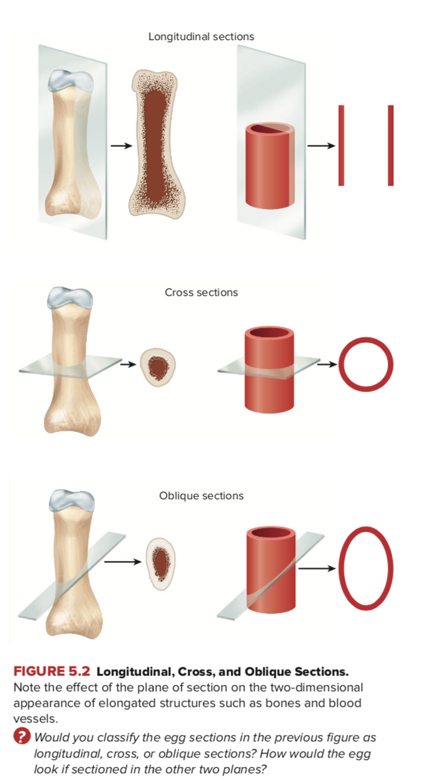
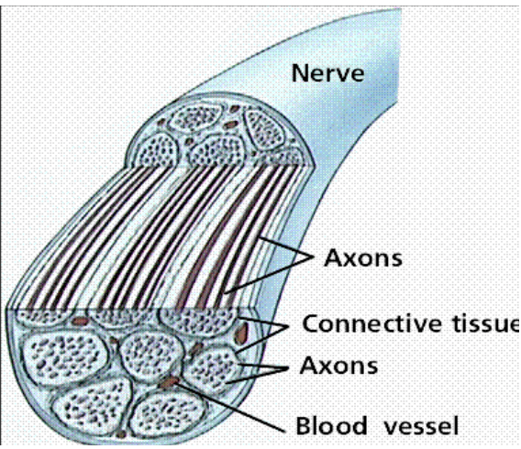
Visualizing 3D as 2D
Histological slides take 3D organs/specimens, and portray them as 2D on a slide
Depending on how a specimen is cut, the same specimen tissue may appear different
This concept is portrayed well is certain tissues e.g. skeletal muscles and blood vessels
Megan Cooper, Doctorials 2024

Slide 11
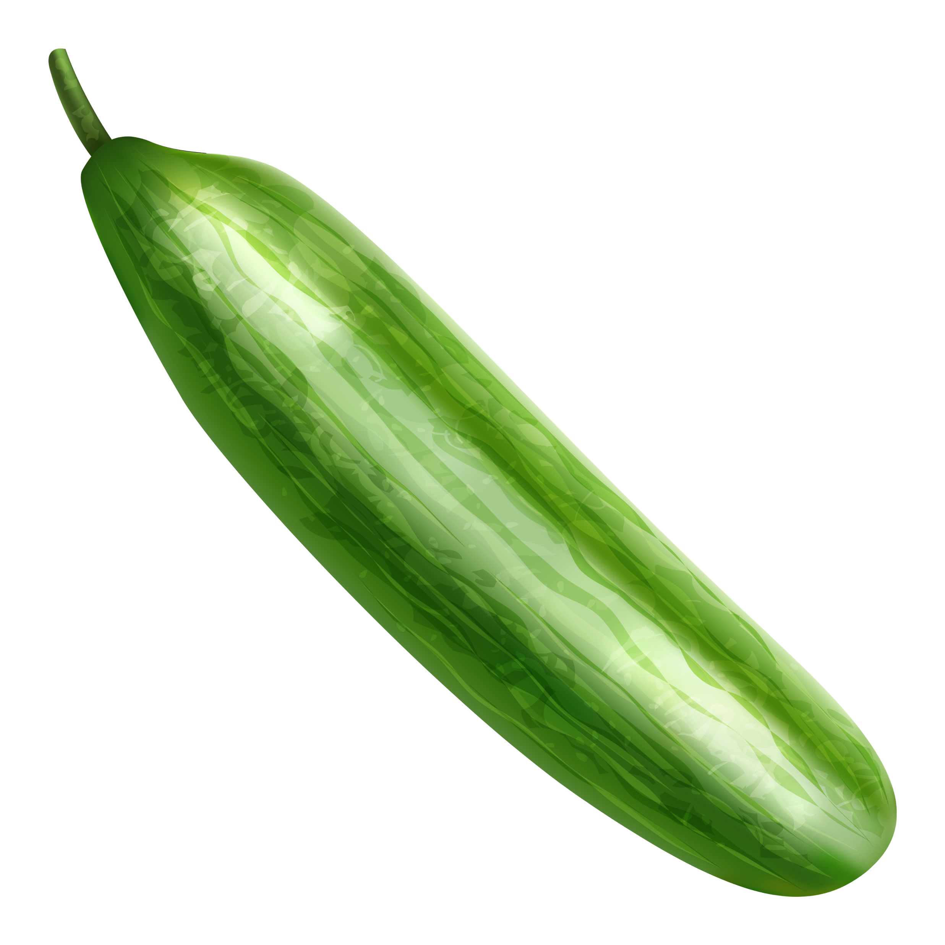
Visualizing 3D as 2D
Cross Sectional Cut
The fibers are coming out of the screen towards you, and into the screen away from you
Longitudinal Cut
The fibers are moving across the screen, left to right
This Photo by Unknown Author is licensed under CC BY
This Photo by Unknown Author is licensed under CC BY-NC
Megan Cooper, Doctorials 2024

Slide 12
Visualizing 3D as 2D
Cross Sectional Cut
The fibers are coming out of the screen towards you, and into the screen away from you
Longitudinal Cut
The fibers are moving across the screen, left to right
Megan Cooper, Doctorials 2024
Notes:
Skeletal Muscle

Slide 13
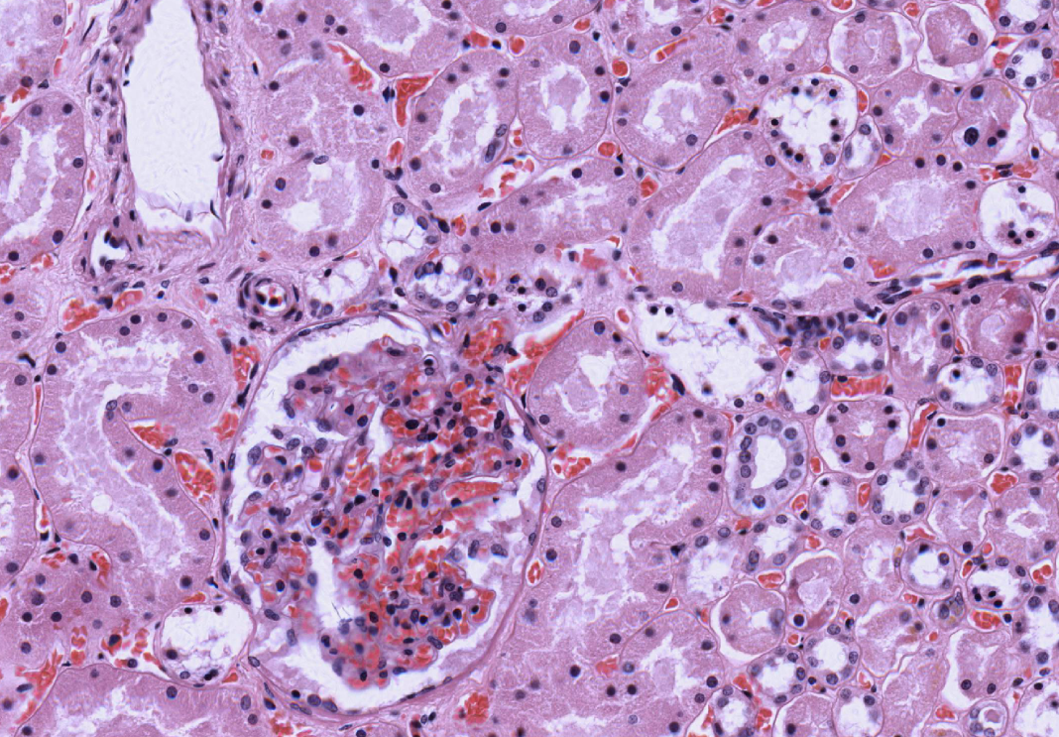
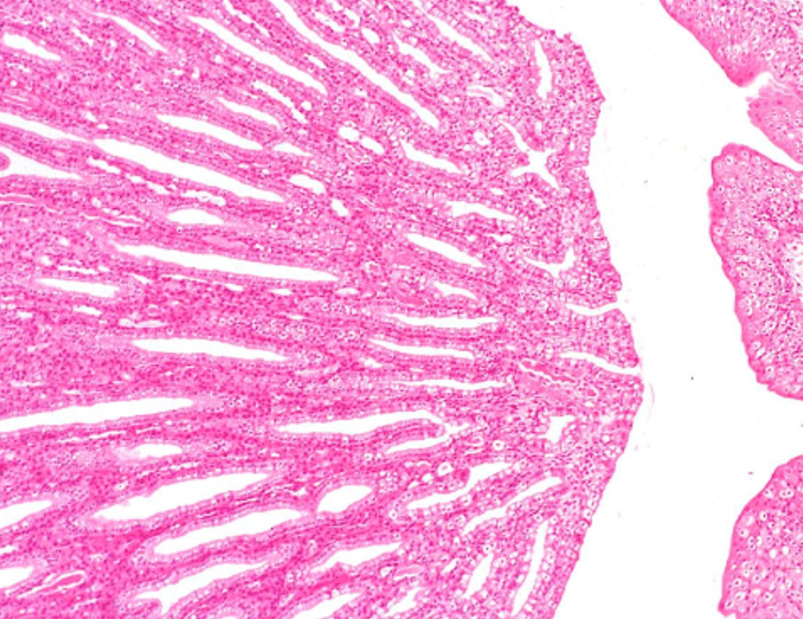
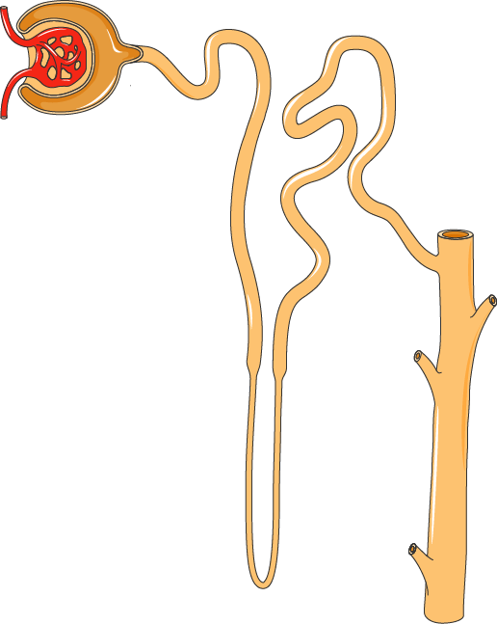
Visualizing 3D as 2D
Cross Section
Longitudinal
Megan Cooper, Doctorials 2024
Notes:
Kidney
Left:
Cross section of tubules of kidney. Can see circular shapes of the tubules (imagine looking down at a bunch of straws). Can see renal corpuscle (glomerulus + Bowman’s capsule)
Right:
Longitudinal cut. Can see direction tubules are going and the way fluid would flow through

Slide 14
Learning Objectives
Briefly outline what occurs to pathological specimens once they are sent to the lab and how slides are made
Explain, in depth, how to approach interpreting histological slides in terms of envisioning them as 3D tissues
Explain in depth the 4 basic tissue types, their key histological components, and how to differentiate them in histological images
Give pictorial examples of normal and diseased histological tissue
Megan Cooper, Doctorials 2024

Slide 15
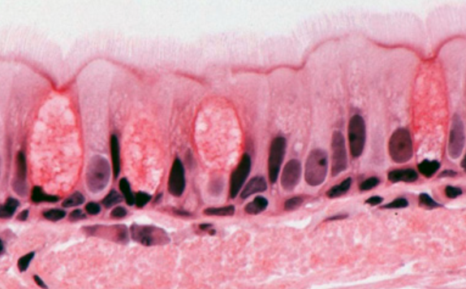
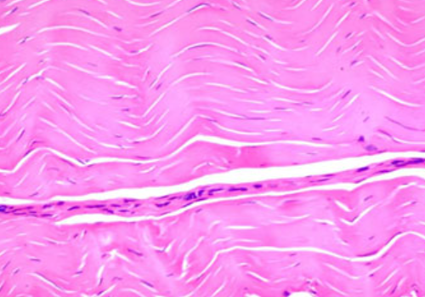
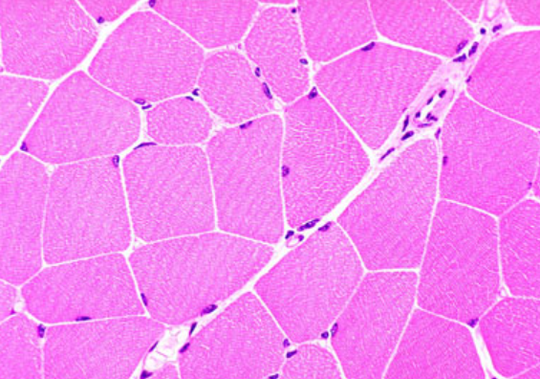
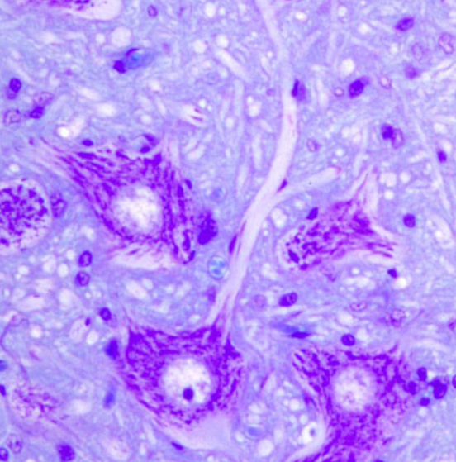
4 Types of Primary Tissue
Epithelial
Lines the bodies cavities and surfaces
Connective Tissue
Loose and dense CT
Muscle
Skeletal
Smooth
Cardiac
Nervous Tissue
Neurons and neuroglia
Megan Cooper, Doctorials 2024
Notes:
Reference: http://medcell.med.yale.edu/histology/histology.php
Generally ,
tissues can be said to consist of both cells and an extracellular matrix (ECM). ECM is composed of both protein fibers (collagen, elastic, reticular fibers) and ground substance (glycosaminoglycans [GAGs], proteoglycans, and multiadhesive glycoproteins).

Slide 16
1) Epithelial Tissue
Covers bodies surfaces and cavities
3 KEY FEATURES
Cell junctions connect the epithelial cells closely
Demonstrate polarity (they have a top and bottom e.g. apical and basal surfaces)
Basal surface attached to basement membrane
Some Functions
Transportation
Secretion
Absorption
Protection
Receptor function
There are varying types of epithelial tissue located in different parts of the body, so let’s explore the differences
Megan Cooper, Doctorials 2024
Notes:
Epithelial cells cover our body surfaces that typical come in contact with external environments like on the skin, lining our mouth, gut, and bladder etc
Key features
Cell junctions e.g. gap junctions connect them
Polarity meaning the top and bottom are different
Basal surface attached to basement membrane which will be discussed later

Slide 17
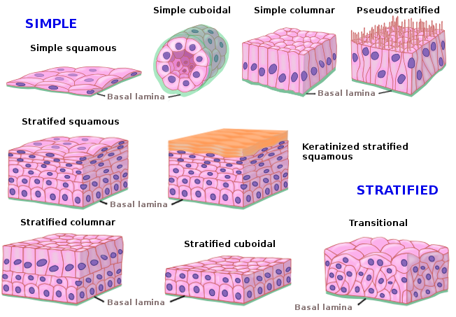
Classification
First, how many layers of cells?
Simple – 1 layer
Stratified -- >1 layer
Pseudostratified – 1 layer but looks like many layers
Second, what is cell shape?
Squamous – flat
Cuboidal – cube
Columnar – tall, rectangular
Other classifications
Transitional
Notes:
Say number of layers then the shape in naming convention

Slide 18
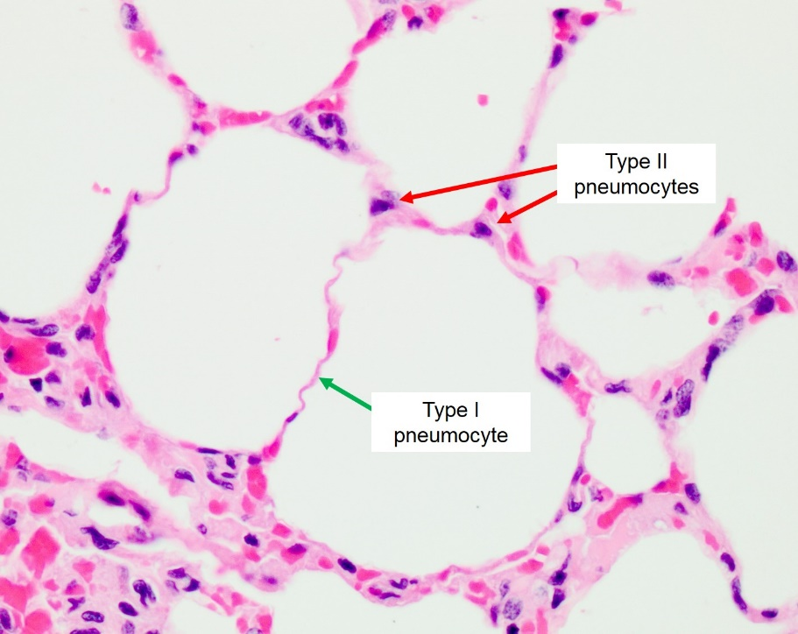
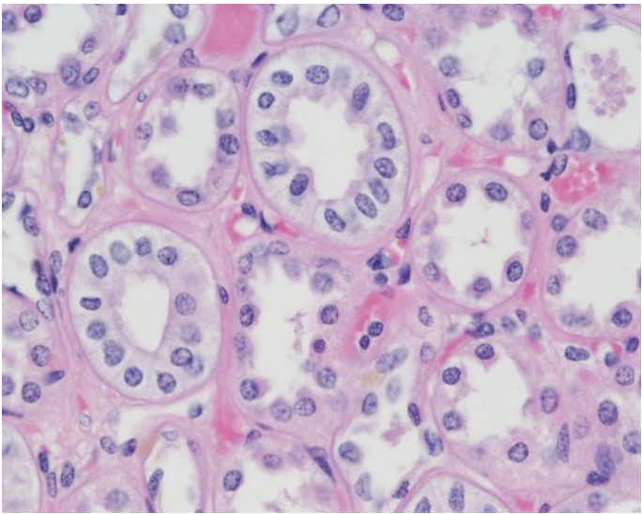
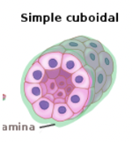
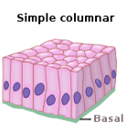
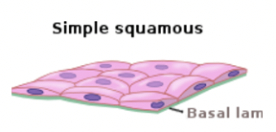
Comparisons
Simple Squamous
Simple – single layer
Squamous – flat
Single layer of flat cells
Function: Semipermeable barrier between cells
Simple Cuboidal
Simple – single layer
Cuboidal – cubes
Single layer of cube like cells
Function: Lines secretive and absorptive surfaces. Forms walls of secretory and excretory ducts
Simple Columnar
Simple – single layer
Columnar – tall
Single layer of tall cells
Function: Lines secretive and absorptive surfaces. Propulsion of mucus
Alveoli Kidney Intestine
Megan Cooper, Doctorials 2024

Slide 19
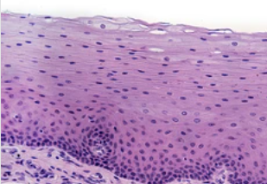
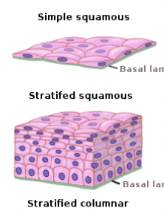
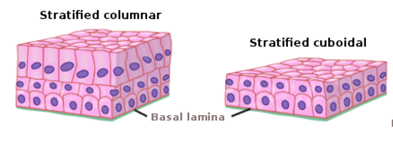
Comparisons
Stratified Squamous
Stratified – multiple layers
Squamous – flat
Multiple layer of flat cells
Functions as barrier
Stratified Cuboidal and Columnar less common
Skin (Keratinized stratified squamous epithelium)
Megan Cooper, Doctorials 2024
Notes:
Stratified cuboidal and stratified columnar are rare forms of epithelial cells and are not commonly seen
Keratinized stratified squamous: deposits of keratin on the surface

Slide 20
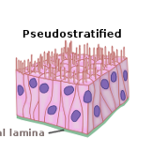
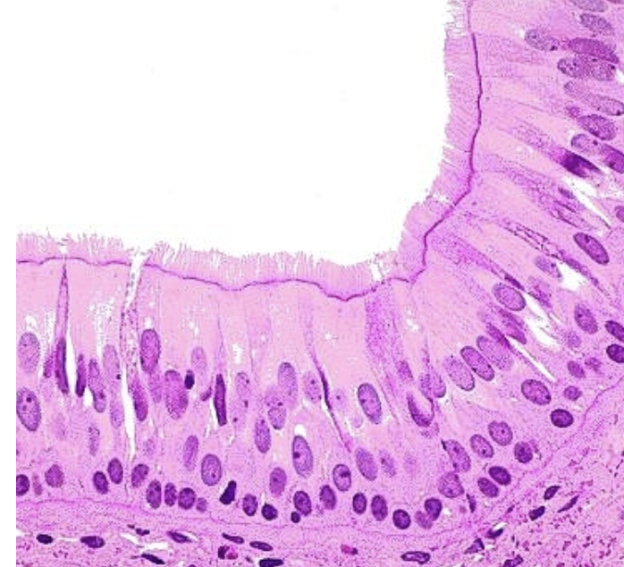
Pseudostratified Columnar with Cilia
Single layer of irregular shaped and differently sized columnar cells
Nuclei at different levels, Often ciliated
Respiratory epithelium
Megan Cooper, Doctorials 2024
Notes:
Note the tall cells but obscure outline, and the nuclei at different levels
All line up at same basement membrane but their tops at different level – like lining up kids in elementary school classroom some are tall, some short
Respiratory epithlium e.g. trachea contains cilia to move mucous out which helps protect the tissue

Slide 21
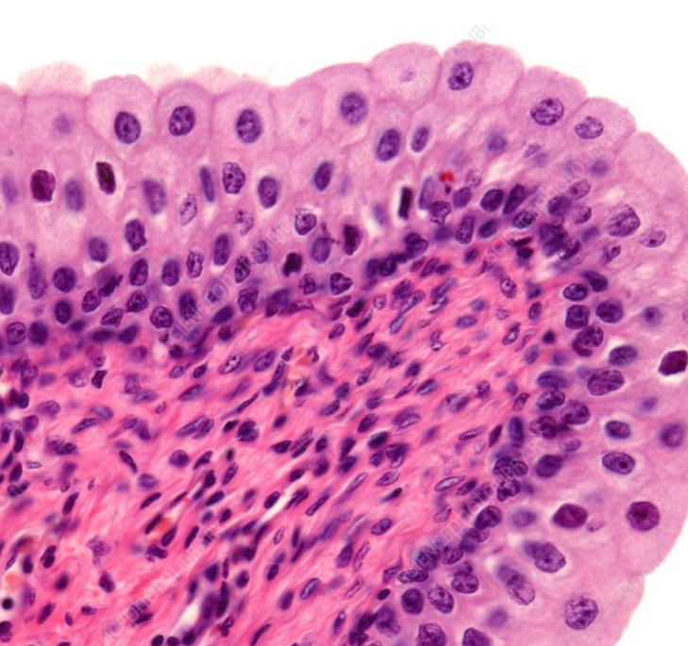
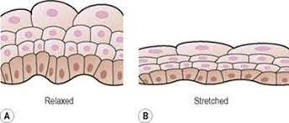
Transitional Epithelium
Found only in the urinary system (ureter, bladder wall, urethra)
Switch from cuboidal to squamous depending on stretch of structure (full vs empty bladder)
Dome shaped cells in the top layer flatten when stretched
Megan Cooper, Doctorials 2024

Slide 22
2) Connective Tissue
Supports and physically connects other tissues/cells to form functional organs
Sparse Cells, predominate ECM component
The ECM consists of Protein fibers and ground substance
Protein Fibers: elastin, collagen, reticular fibers
Ground substance: gel like substance that contains proteoglycans, glycosaminoglycans, glycoproteins
2 Major Types
Connective Tissue Proper– Predominate cell = Fibroblasts + ECM fibers
Loose – few fibers but many nuclei
Dense – many fibers but few nuclei
Regular
Irregular
Specialized
Cartilage
Bone
Blood
Lymphatic
Adipose
Megan Cooper, Doctorials 2024
Notes:
The next primary Tissue we will discuss is connective tissue
tissues can be said to consist of both cells and an extracellular matrix (ECM).
ECM is composed of both protein fibers (collagen, elastic, reticular fibers) and ground substance (glycosaminoglycans [GAGs], proteoglycans, and multiadhesive glycoproteins).
- The ground substance is an aqueous gel of glycoproteins and proteoglycans that occupies the space between cellular and fibrillar elements of the connective tissue
In connective tissue (CT), the ECM component predominates relative to the cellular component. In other words, cells tend to be widely separated among ECM fibers and ground substances.
CT is composed of cells and extracellular matrix (ECM), with the latter being its major constituent.
Various combinations of cells, fibers, and ECM components — both in numbers and types — create different types, or classifications
https://vmicro.iusm.iu.edu/hs_vm/docs/lab1.htm
Fibroblasts are by far the most common native cell type of connective tissue. The fibroblast synthesizes the collagen and ground substance of the extracellular matrix. These cells make a large amount of protein that they secrete to build the connective tissue layer. Some fibroblasts have a contractile function; these are called myofibroblasts.
Chondrocytes and osteocytes form the extracellular matrix of cartilage and bone

Slide 23
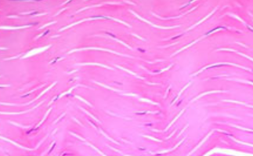
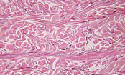
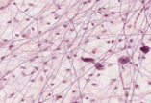
CT Proper: Dense vs Loose CT
Dense CT
Loose CT
Provides structural support and can be found under epithelial layers to attach them to underlying tissues
Dense Regular CT
Parallel bundles of collagen fibers
Mostly fibers, not many fibroblasts (cells)
Typically found in places where lots of tensile strength is needed like tendons and ligaments
Dense Irregular CT
Fibers in random directions
Many fibers, few nuclei
Typically found in places that must resist stretching forces in different directions like the dermis layer of skin, and digestive tract
Megan Cooper, Doctorials 2024
Notes:
Can see a clear difference in organization between the different types
Loose CT will be higher on ground substance and lighter on the fibres
Dense will be more dense bundles of fibres
Still have cells -> fibroblasts to support ECM

Slide 24
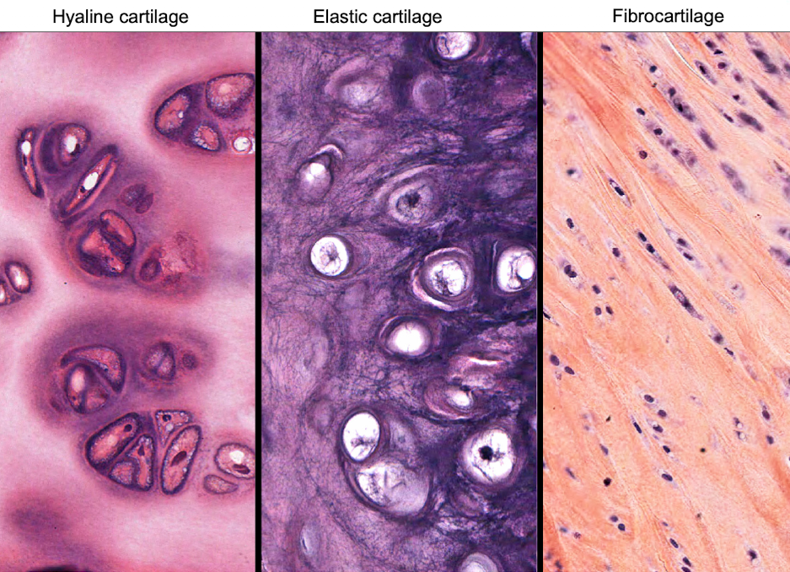
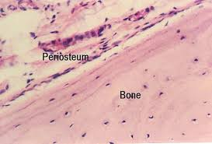
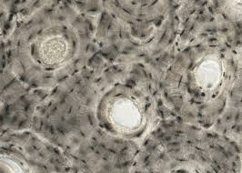
Specialized CT
Cartilage
Bone
Megan Cooper, Doctorials 2024
Notes:
Fibrous cartilage: alternating layers of dense collagen and hyaline cartilage matrix. Strongest of the three
Elastic cartilage: elastic fibers, giving elasticity
Hyaline cartilage: glassy appearance. Type 2 collagen. Basophilic ECF
Three kinds of cartilage are classified according to the abundance of certain fibers and the characteristics of their matrix:
Hyaline cartilage has a matrix composed of type II collagen and chondromucoprotein, a copolymer of chondroitin sulfates A and C with protein. Its high concentration of negatively-charged sulfate groups makes it appear intensely basophilic under H&E. This cartilage is found in the nose, tracheal rings, and where the ribs join the sternum.
Fibrocartilage is distinguished by its high content and orderly arrangement of type I collagen fibers. It is typically located in regions where tendons attach to bones, the intervertebral discs, and the pubic symphysis.
Elastic cartilage is characterized by the presence of abundant elastic fibers and is quite cellular. It is made up of type II collagen and is located in the auricle of the ear and the epiglottis.
Adipose cells don’t hold stain so theyre easy to spot
Blood cells are very unique as well

Slide 25
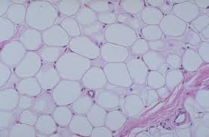
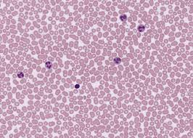
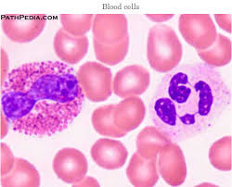
Specialized CT
Adipose
Blood
Megan Cooper, Doctorials 2024
Notes:
Fibrous cartilage: alternating layers of dense collagen and hyaline cartilage matrix. Strongest of the three
Elastic cartilage: elastic fibers, giving elasticity
Hyaline cartilage: glassy appearance. Type 2 collagen. Basophilic ECF
Three kinds of cartilage are classified according to the abundance of certain fibers and the characteristics of their matrix:
Hyaline cartilage has a matrix composed of type II collagen and chondromucoprotein, a copolymer of chondroitin sulfates A and C with protein. Its high concentration of negatively-charged sulfate groups makes it appear intensely basophilic under H&E. This cartilage is found in the nose, tracheal rings, and where the ribs join the sternum.
Fibrocartilage is distinguished by its high content and orderly arrangement of type I collagen fibers. It is typically located in regions where tendons attach to bones, the intervertebral discs, and the pubic symphysis.
Elastic cartilage is characterized by the presence of abundant elastic fibers and is quite cellular. It is made up of type II collagen and is located in the auricle of the ear and the epiglottis.
Adipose cells don’t hold stain so theyre easy to spot
Blood cells are very unique as well

Slide 26
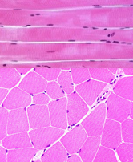
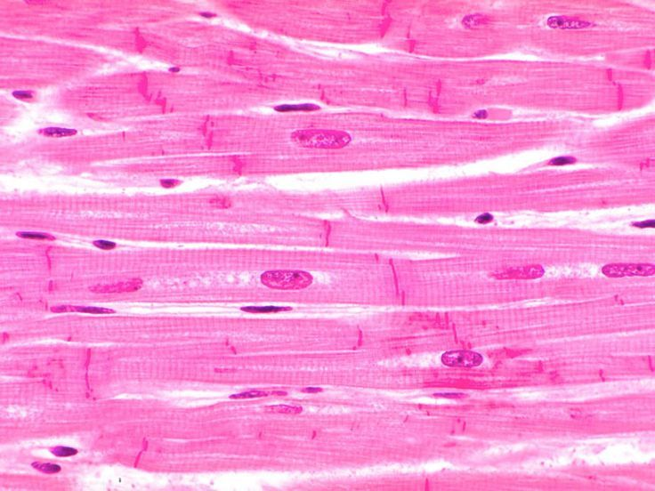
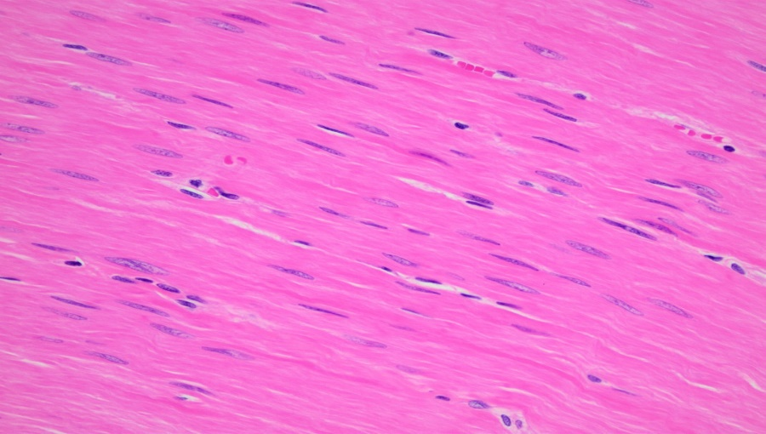
3) Muscle
Skeletal Muscle
Striated
Multi-nucleated
Nuclei on periphery
Smooth Muscle
Non-striated
Fusiform shaped
Single, centrally located nucleus
Cardiac Muscle
Striated
Intercalated discs (contain gap junctions)
Single, centrally located nucleus
Can be branched
Megan Cooper, Doctorials 2024
Notes:
Skeletal and cardiac are striated because they are made up of sarcomeres, which are contractile units
Skeletal muscle that is primarily involved in movement of bones (voluntary) Skeletal muscle tissue is distinctive due to its long, tube-shaped multinucleated fibers (cells) with visible cross-striations. The striations are the result of highly ordered actin and myosin filaments within sarcomeres
Cardiac muscle that enables the heart to beat so that blood can be circulated (involuntary)
Smooth muscle (visceral muscle) that provides tone and movement of hollow tubes and organs such as the intestines and uterus (involuntary) The actin and myosin filaments are organized as a lattice-like network that is connected to the sarcolemma via adhesion complexes called dense bodies. This organization allows the cells to twist as they contract, sometimes giving them a distinctive corkscrew appearance

Slide 27
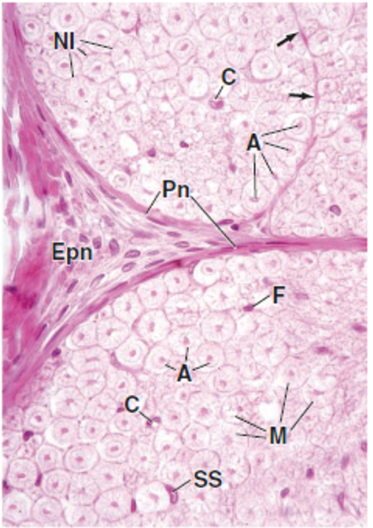
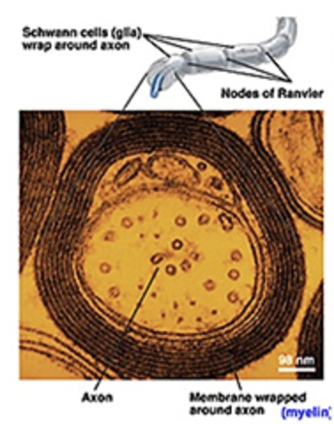
4) Nervous Tissue
Peripheral Nerve
Neuron
Megan Cooper, Doctorials 2024
Notes:
Broadly separated into neurons and glial cells (supportive)
Picture on Right: Peripheral nerve
A: axons
M: Myelin
C: capillary
SS: Schwann cell
Pn: perineurium
Epn: Epineurium
Nerve tissue is a complex organization of neurons, glial cells, vasculature, and connective tissue coverings.
Neurons are supported by glial cells, which are involved in nutrition, protection, and the formation of insulating sheaths.
Neurons are specialized to conduct impulses in response to stimuli or environmental signals. To carry out this function, neurons have distinctive morphologies (as seen in the striking images below), possessing long cytoplasmic extensions (axons and dendrites), which allow them to form hundreds of connections with other neurons and cell types

Slide 28
Almost Done!!
Megan Cooper, Doctorials 2024

Slide 29
Learning Objectives
Briefly outline what occurs to pathological specimens once they are sent to the lab and how slides are made
Explain, in depth, how to approach interpreting histological slides in terms of envisioning them as 3D tissues
Explain in depth the 4 basic tissue types, their key histological components, and how to differentiate them in histological images
Give pictorial examples of normal and diseased histological tissue
Megan Cooper, Doctorials 2024

Slide 30
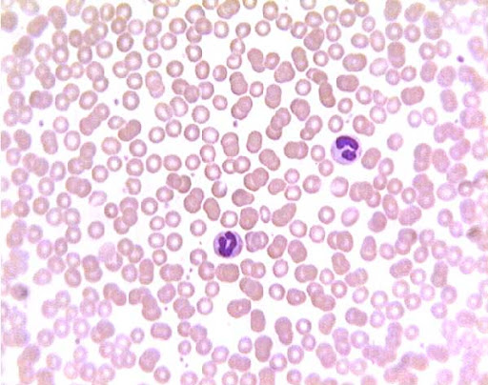
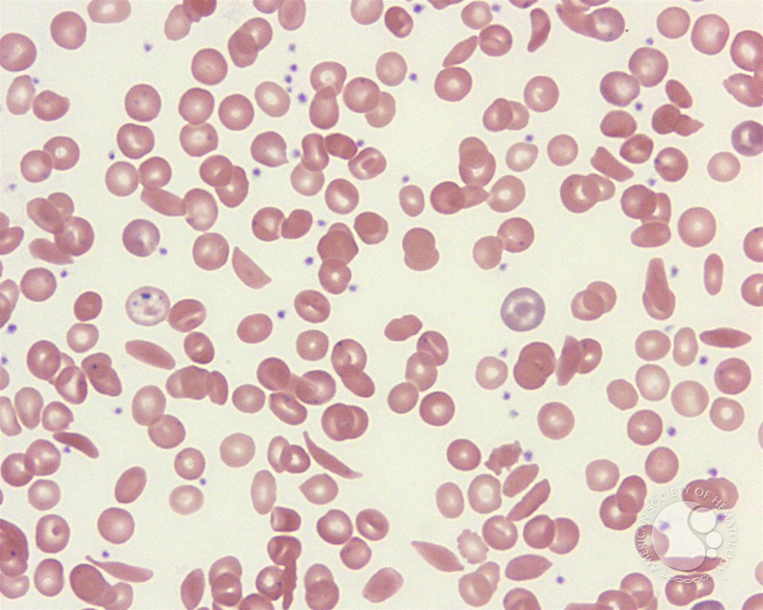
Sickle Cell Anemia (SCA)
Healthy blood smear
SCA
Megan Cooper, Doctorials 2024

Slide 31
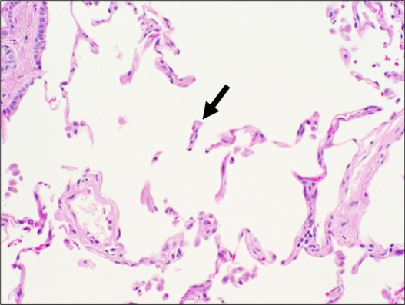
Emphysema
Healthy alveoli
Emphysema
Megan Cooper, Doctorials 2024
Notes:
Can see that the alveoli are not well defined, are occupying more space, and are essentially destroyed

Slide 32
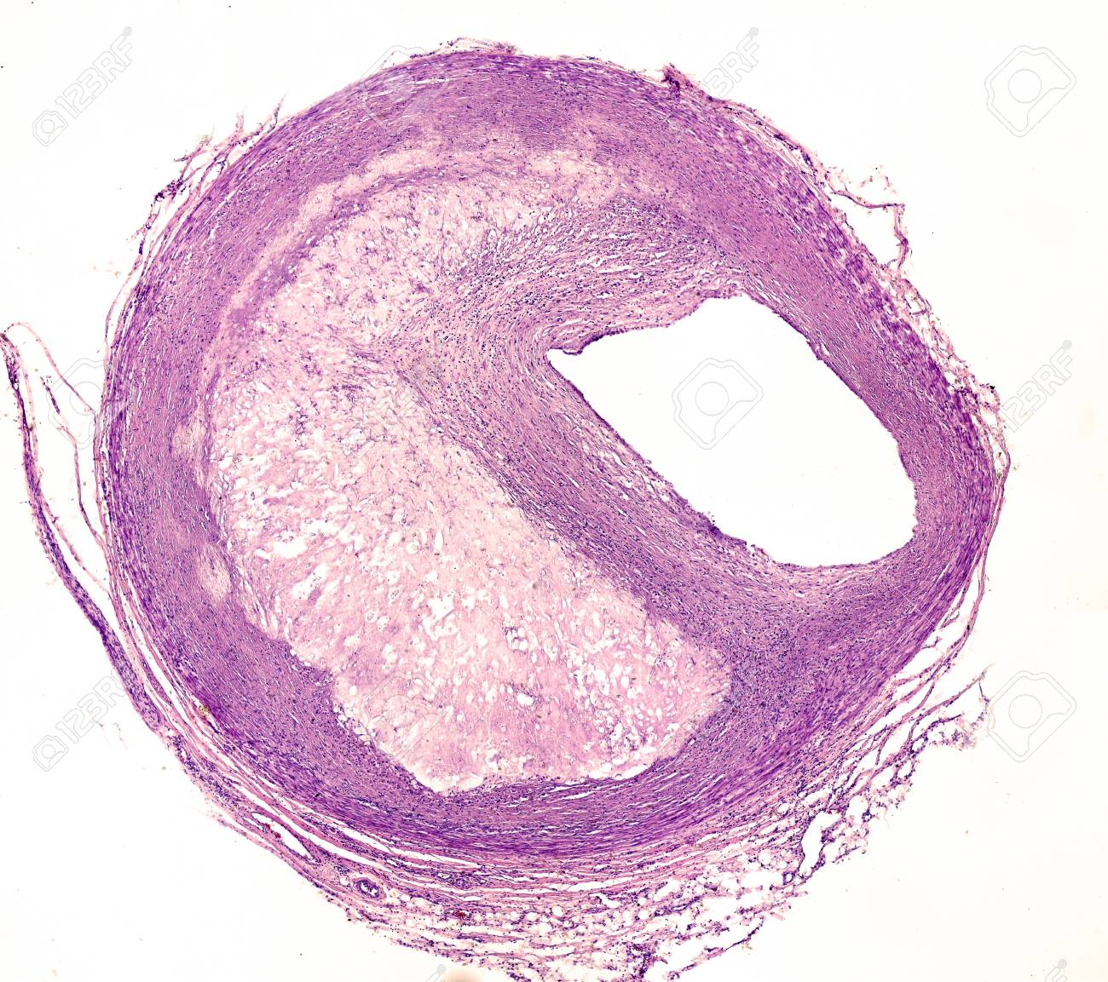
Atherosclerosis
Healthy artery
Atherosclerotic artery
Megan Cooper, Doctorials 2024
Notes:
Can see the wide lumen on the left, and the large plaque buildup on the right that narrows the artery

Slide 33
Atherosclerosis -> Thrombosis. Heart Attack
Megan Cooper, Doctorials 2024

Slide 34
Take away points
Histology is all about pattern recognition
The way you become better at recognizing the different slides is through PRACTICE
Try to identify the organ/tissue you’re looking at first
Then get comfortable identifying the different parts of the tissue like the connective tissue, the specific epithelium that’s there, different types of muscle, etc.
Professor Sheehan is the histology queen
Everything you will need to know about histology should come from her
UWO slide box and Yale histology are good supplementary materials if you find yourself wanting to look at more images
And of course feel free to reach out to me on Facebook, or email be at 22186476@studentmail.ul.ie if you find yourself having any questions or needing anything
Megan Cooper, Doctorials 2024

Slide 35
Thanks and Good Luck!
Megan Cooper, Doctorials 2024

Slide 36
References
Ross & Pawlina Histology: A Text and Atlas with correlated cell and molecular biology
UWO Slidebox http://slides.uwo.ca/
Yale Histology http://medcell.med.yale.edu/histology/histology.php
Parry, Nicola. “Histology Slide Preparation: 5 Simple Steps.” Bitesize Bio https://bitesizebio.com/13398/how-histology-slides-are-prepared/
Yang, Jackie Doctorials 2019
Kaur, Manpreet Doctorials 2020
https://vmicro.iusm.iu.edu/hs_vm/docs/lab3_2.htm
Megan Cooper, Doctorials 2024

