Slide 1
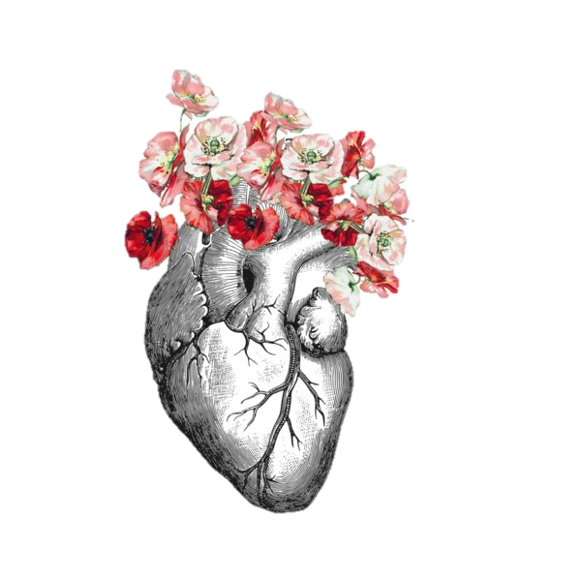
Y2 Cardiology – Part I
Kaitlyn Lee, 21172862@studentmail.ul.ie

Slide 2
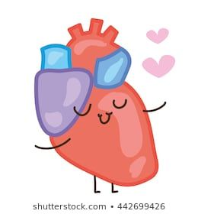
Tonight’s Agenda
Acute Coronary Syndrome & Myocardial Infarctions
Congenital Heart Defects
Inflammatory Cardiac Diseases
Murmurs
Arrythmias & Atrial Fibrillation
Anti-Arrhythmic Therapies
Notes:
Agenda made by previous years, lots of bits honestly not relevant also some overlap with next week
Left in all content slides but will be focusing on what I think is relevant for PBL/GEMS specifically

Slide 3
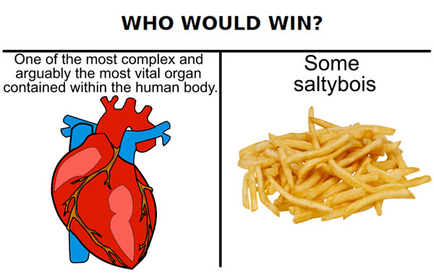
ACS & MI
Notes:
Acute coronary syndrome = STEMI and NSTEMI Mis and unstable angina

Slide 4
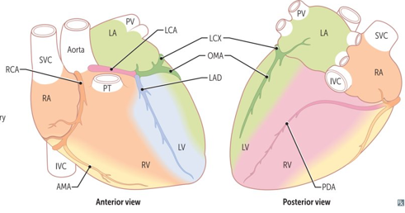
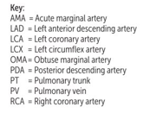
Anatomy - Coronary Vessels
AORTA
RCA
AMA
PDA (~90%)
LCA
LAD
LCX
PDA (~10%)
OMA
The coronary arteries arise from the base of the ascending aorta - RCA and LCA ​
LCA branches - LAD, OMA, LCA and PDA (8%) ​
RCA branches - AMA, PDA (85%)​
PDA has codominant circulation in 7%
(this is right domiant)
“Dominance” = PDA
Right dominant (~85%) = PDA from RCA
Left dominant (~8%) = PDA from LCX
Codominant (~7%) = PDA from both RCA and LCX
First Aid (2020)
Notes:
LAD and its branches supply apex of the heart
Coronary arteries are found on the epicardial layer and provide blood supply to different regions of the heart & its components
LAD and its branches supply the apex of the heart
PDA and its branches supply the inferior wall and septum
RCA supplies the SA node and the blood supply is independent of dominance
Left circumflex supplies blood to the lateral wall of the left ventricle
Coronary blood flow peaks in early diastole and decreases in systole (which is opposite to what happens in the rest of the body) → myocardial contraction in systole decreases coronary blood flow
In tachycardia you have decreased coronary flow because there is decreased time in diastole

Slide 5
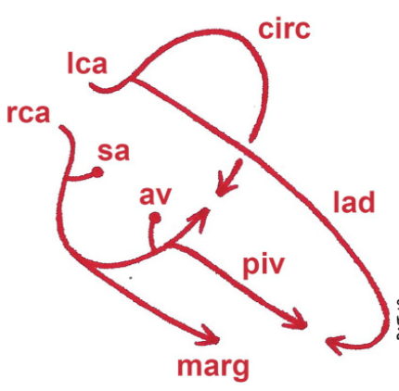
Blood supply of the Heart – SA +AV node
SA node: supplied by RCA in 60% of people, and Left Circumflex (LCX) of LCA in 40% of people …this has nothing to do with heart dominance
What does ‘heart dominance’ mean?
Where the posterior descending/interventricular artery arises from
Affects what is supplying the AV node
AV node: supplied by the PDA
Right dominant: PDA arises from the RCA - in 85% of people Left dominant: PDA arises from the LCX - in about 8% of people
Codominant: PDA arises from both - in about 7% of people

Slide 6
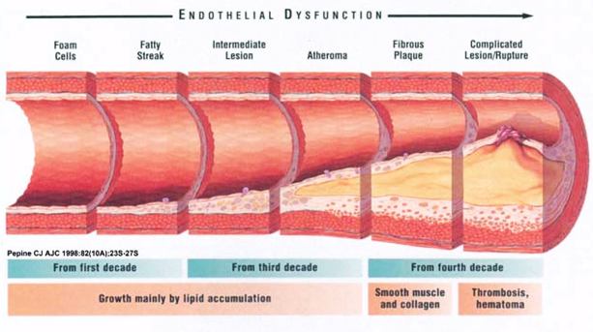
Atherosclerosis - Atheroma Development
Disease of elastic arteries and large + medium muscular arteries → form of arteriosclerosis caused by buildup of cholesterol plaques
Abdominal aorta > coronary artery > popliteal artery > carotid artery
Formation of Atheroma
1) Excess LDL accumulating in tunica intima
2) LDL undergoes oxidation
3) In response, endothelium and smooth muscles cells secrete substances that attract monocytes that then get converted to macrophages
4) Macrophages ingest oxidized LDL particles = called FOAM cells (due to appearance)
5) T cells follow the monocytes into the inner lining of the artery
6) Together, the foam cells, macrophages, and T cells form a FATTY STREAK (which is the beginning of atherosclerotic plaque)
7) Macrophages secrete chemicals that causes smooth muscles cells of tunica media to migrate to the top of the atherosclerotic plaque, forming the FIBROUS PLAQUE
Notes:
Atheromas only occur in arteries because:
1) they have high pressure (which cause the lesions/dysfunction of the blood vessel walls)
2) arteries contain oxygen (which is needed in the oxidation of LDL)
Causes of Atherosclerosis:
- Trauma/Hypertension
- Smoking (circulating free radicals)
- Increased LDL (Hyperlipidemia)
- Diabetes
- Homocysteinemia (genetic condition)
Result:
= Macrophages, smooth muscle cells, lymphocytesand extracellular matrix form a fibrous cap, which covers a necrotic center, consisting of foam cells, free cholesterol crystals, and cellular debris.
Extra resource:
Amboss https://next.amboss.com/us/article/9L0N-g?q=atherosclerosis#Z70388267e8776e5f56f591fdecb10a49

Slide 7
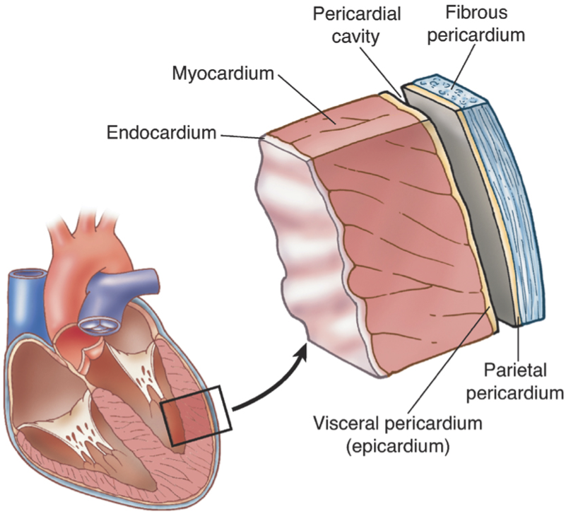
Angina
 | STABLE | UNSTABLE | PRINZMETAL (VARIANT)
Factors | - Exertion - Emotional Stress - Usually secondary to atherosclerosis | - At rest | - Spontaneous & at rest - Smoking is risk factor - Triggers = cocaine, alcohol, triptans
Pathology | - Atherosclerosis of coronary arteries >70% stenosis - Subendocardial ischemia | - Rupture of atherosclerotic plaque with thrombosis and incomplete occlusion of coronary artery - Subendocardial ischemia | - Coronary artery vasospasm - No atherosclerotic plaque narrowing - Transmural ischemia
Type of Injury | Reversible | Reversible | Reversible
ECG | ST depression | - ST depression (+/-) - T wave inversion (+/-) | Transient ST elevation
Relievers | - Rest - Nitroglycerin (GTN) | Nitroglycerin (GTN) | - Nitroglycerin (GTN) - Calcium Channel Blockers (CCBs)
Q: What is the difference between ischemia & necrosis?
Q: How does nitroglycerin/GTN help relieve angina?
FA (2020) & Pathoma
Notes:
Angina = chest pain due to ischemic myocardium secondary to coronary artery narrowing or spasm
Acute coronary syndrome (ACS) = is caused by anything that causes a mismatch in myocardial oxygen demand and myocardial oxygen consumption
Angina is chest pain, it falls under the category of ischemic heart disease
There are 3 main types of angina: stable, unstable & prinzmetal (variant or vasospastic)
~70% of the lumen of the coronary artery being occluded is when you see symptoms because distal arterioles usually dilate to maintain flow
Ischemia = decreased blood flow through an organ which arises due to decreased arterial perfusion (e.g. atherosclerosis), decreased venous drainage or shock (hypotension)
Necrosis = death of large groups of cells followed by acute inflammation & is ALWAYS due to some pathologic process (never physiologic) → causes ischemic infarcts
Nitroglycerin/GTN (nitrates) = vasodilators that cause venous dilation via increasing NO in vascular smooth muscle (increased cGMP via activated guanylyl cyclase) and smooth muscle relaxation. Increases oxygen supply by dilation of large epicardial coronary arteries, decreases preload and decreases myocardial O2 demand to relieve angina

Slide 8
Myocardial Infarction (MI)
Myocardial infarction (MI) = necrosis of cardiac myocytes
Causes:
Rupture of atherosclerotic plaque +/-
Thrombosis superimposed on atheroma & complete occlusion of a coronary artery (most common)
Hemorrhage into plaque
Associated vasoconstriction (coronary vasospasm)
Vasculitis (e.g., Kawasaki disease)
Signs & symptoms:
Crushing chest pain (does not resolve to sublingual GTN) >20 mins
Pain radiating to left arm, neck, jaw → WHY?
Autonomic symptoms (pale & clammy, diaphoresis)
Atypical symptoms (dyspnea, fatigue, presyncope or syncope)
Diagnosis:
ECG & serum cardiac markers can be used to diagnose (ECG alone cannot diagnose an MI)
ST Elevated MI (STEMI)
Non-ST Elevated MI (NSTEMI)
Cardiac biomarkers = Troponin I & CK-MB
Kumar & Clark (2012) & Pathoma
Notes:
Acute coronary syndrome = includes unstable angina, STEMI & NSTEMI
Pain because pericardium innervated by phrenic nerve (C3,4,5) → referred visceral pain

Slide 9
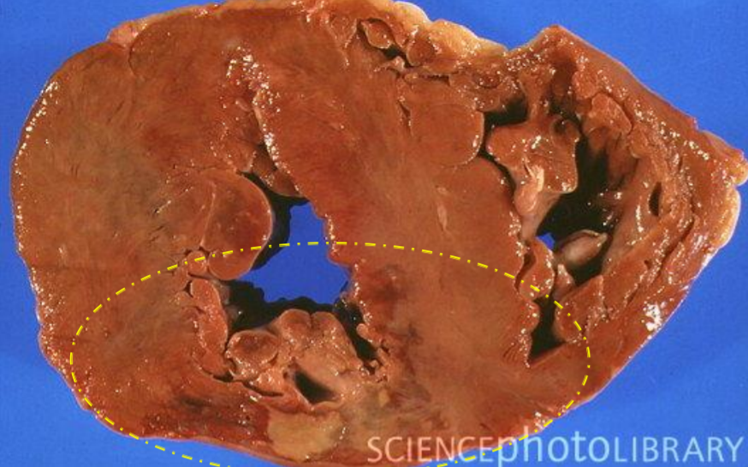
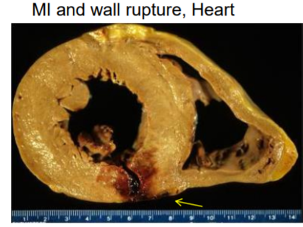
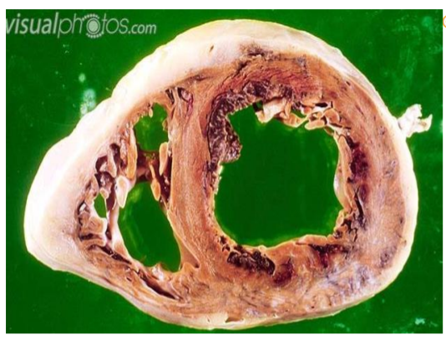
Types of MI
Transmural infarct = results from complete occlusion of a major extramural coronary artery, affects whole wall
Consequence of atherosclerosis
Most affect left ventricle
Subendocardial infarct = results from increased cardiac demand with limited supply due to atherosclerotic plaques, limited to inner one third of ventricular wall
Subendocardium is most sensitive region of myocardium

Slide 10
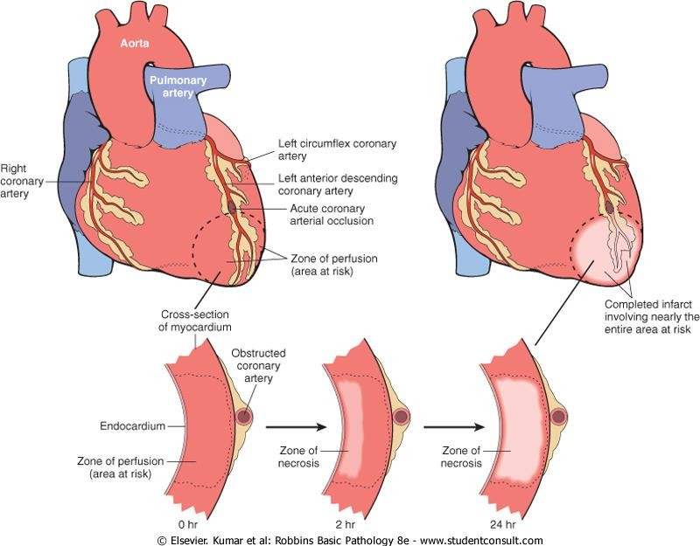
Myocardial Infarction (MI)
Complete vessel occlusion initially causes ischemia of myocardial tissue
Subendocardial Infarct → NSTEMI
Limited to inner 1/3 of ventricular wall
Persistent ischemia → subendocardial necrosis
ST depression (subendocardial ischemia) & T wave inversion
Transmural Infarct → STEMI
Complete occlusion of a major extramural coronary artery
May lead to rupture of myocardium
Most transmural infarcts affect left ventricle
ST elevation, Q waves
Kumar & Clark (2012) & Pathoma
Notes:
Subendocardial myocardium is initially affected → through subepicardial myocardium (transmural Q wave myocardial infarction)
Other ischemic ECG changes = hyperacute T waves (prior to ST elevation in transmural infarct), poor R wave progression (anterior ischemia, prior infarcts)
Other causes of ST segment elevation = ELAVATION
Electrolyte imbalance
LBBB
Aneurysms of LV
Ventricular hypertrophy
Arrythmias
Takotsubo cardiomyopathy
Injury (MI/cardiac contusion)
Osborne waves
Non-atherosclerotic (Prinzmetal)

Slide 11
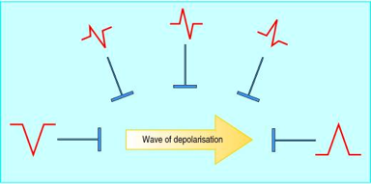
ECG Basics
Provides a view of the heart’s electrical activity from 12 different ‘views’ and recorded as an ECG.
Directions of waveform deflections depends on if the impulse is travelling towards or away from electrode.
Travelling towards=positive deflection
Travelling away=negative deflection
Travelling perpendicular=equiphasic deflection
Notes:
Electrocardiograms!
Provide a picture of the electrical activity of the heart from a number of different perspectives.
The directions of the deflections tells us if the action potential is moving towards, away, or perpe ndicular to the electrode.

Slide 12
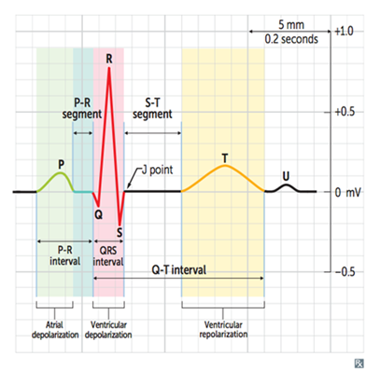
ECG
P wave - atrial depolarization
QRS - ventricular depolarization
T wave - ventricular repolarization

Slide 13
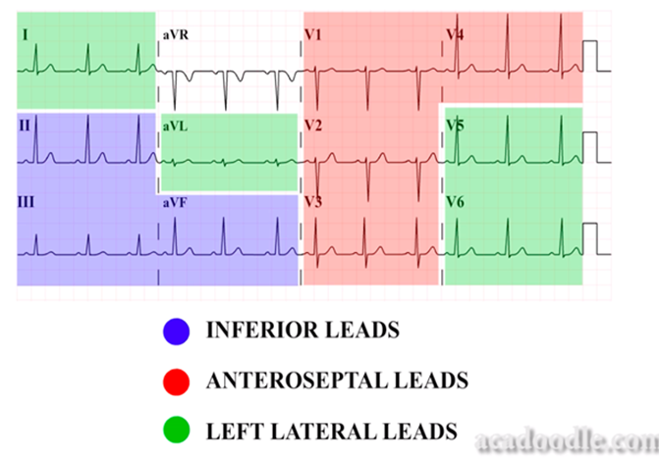
Myocardial Infarction – ECG Changes
Left Anterior Descending Artery (LAD) = anterior wall & anterior septum of LV (45% of cases)
Right Coronary Artery (RCA): SA node, posterior wall & posterior septum, papillary muscles of LV (2nd most common)
Left Circumflex Artery (LCX) = lateral wall of LV
View of the Heart | Leads | Supplying Coronary Artery
Inferior | II, III, aVF | Right Coronary
Lateral | I, aVL, aVR, V5, V6 | Left Circumflex
Anterior | V3, V4 | Left Anterior Descending
Septal | V1, V2 | Left Anterior Descending
Q: If a patient has an infarct in the RCA, what clinical & ECG findings may be present?
The ECG Made Easy (2013) & FA (2020)
Notes:
ECG changes occur in leads overlying the areas of ischemia/infarction
ANSWER TO Q: Infarct in RCA may cause nodal dysfunction and therefore you may see bradycardia and/or heart block (remember that the SA node is the main pacemaker of the heart)

Slide 14
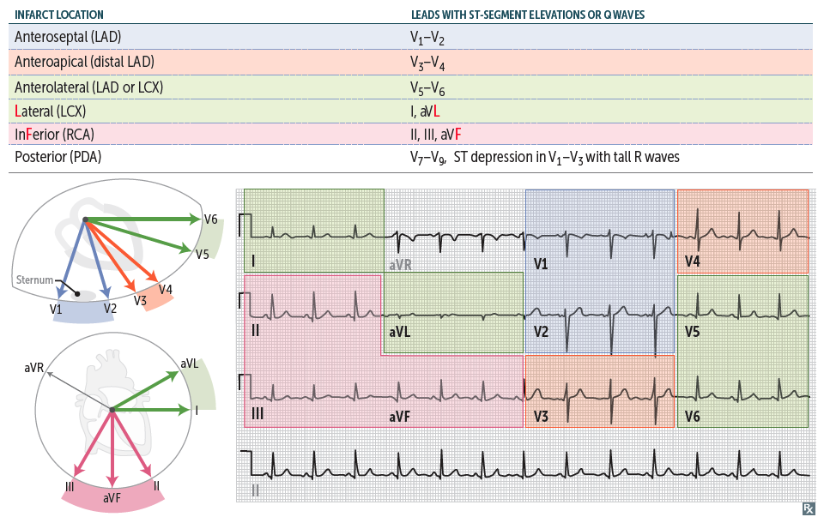
Myocardial Infarction – ECG Changes
First Aid (2020)

Slide 15
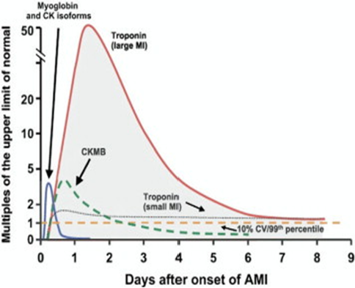
Cardiac Biomarkers
Amboss (2021)
Notes:
CARDIAC BIOMARKERS = group of cardiac-specific and nonspecific proteins that are released when cardiac myocytes undergo stress or injury
NOTE all cardiac biomarkers require clinical context for interpretation
Cardiac enzymes
Cardiac troponin I/T (isoforms)
Most sensitive and specific – most important biological marker of myocardial necrosis
Detectable within 2-4 hours, peaks within 48 hours
Can be elevated in other conditions (PE, myocarditis)
Stays elevated x 1week
Troponin I - max at 24 h; troponin T - max 12-48h
Cardiac troponin I
Rises after 4h -> peaks at 24h -> elevated for 7-10d
CK-MB
Result of muscle breakdown
Rise within 2-4h, peaks 24-48h but returns to normal by 72h
Less specific but useful for diagnosing repeat MI – not as commonly used clinically nowadays
Myoglobin
Main oxygen carrier in muscle
Rises and falls earlier than CK-MB and troponin
Not really used for detection of cardiac events anymore
LDH
Catalyses conversion of pyruvate to lactate
High in tissue breakdown
Could indicate many other things
Cancer, HIV, meningitis, encephalitis
Raised during MI but not as specific as troponin
Unchanged levels of troponins and creatinin kinase over a period of 2 days excludes diagnosis of MI

Slide 16
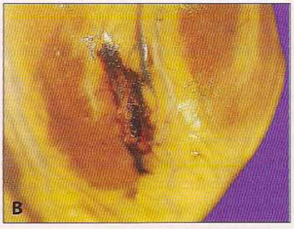
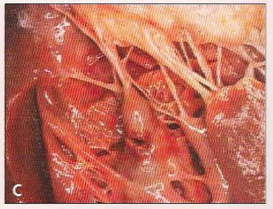
Myocardial Infarction – Progression
0-4 hours
No gross or microscopic changes
Complications = cardiogenic shock (massive infarct), CHF, arrythmia (ventricular)
4-24 hours
Dark discolouration
Complications = arrythmia (ventricular)
1-3 days
Yellow pallor
Neutrophils
Coagulative necrosis
Complications = fibrinous pericarditis
4-7 days
Yellow pallor
Macrophages
1-3 weeks
Months
Red border (granulation tissue enters from edge of infarct)
Grey/white scar
Complications = ventricular free wall rupture, intraventricular septum rupture, papillary muscle rupture
Granulation tissue with plump fibroblasts, collagen & blood vessels
Fibrosis
Complications = mural thrombus, Dressler syndrome
Fibrous Pericarditis
Ventricular Free Wall Rupture
Rupture of papillary muscle
Q: What is the leading cause of death post-MI?
FA (2020) & Pathoma
Notes:
Key finding in coagulative necrosis → removing from nucleus
4-12h = grossly mottled with necrosis, edema & hemorrhage
12-24h = gross hyperemia with tissue inflammation
Fibrinous pericarditis = occurs days after MI (post-cardiac injury MI), extensive inflammation, presents as chest pain and friction rub
Contrast with Dressler syndrome = autoimmune fibrinous pericarditis that can occur several weeks to months post-MI
Neither form of pericarditis are life threatening; treat with NSAIDS & steroids
Ventricular free wall rupture can lead to cardiac tamponade (Compression of the heart by fluid (e.g. blood, effusions) in the pericardial space. Causes decreased cardiac output. ​)
Happens more in inferior MIs because posteromedial papillary muscle has single blood supply
IV septum rupture leads to shunt
Macrophage mediated structural degradation (more common in inferior MIs)
Papillary muscle rupture leads to severe mitral insufficiency (holosystolic murmur) & potentially fatal complication (acute life-threatening cardiogenic shock & pulmonary edema)
Complications of MI: CRASH PAD
Cardiac Rupture
Arrythmia
Shock
Hypertension/Heart failure
Pericarditis/PE
Aneurysm
DVT
ANSWER TO QUESTION: Ventricular arrythmias (ventricular tachycardia) → biggest fatal complication within first 4 days of infarction/ischemia

Slide 17
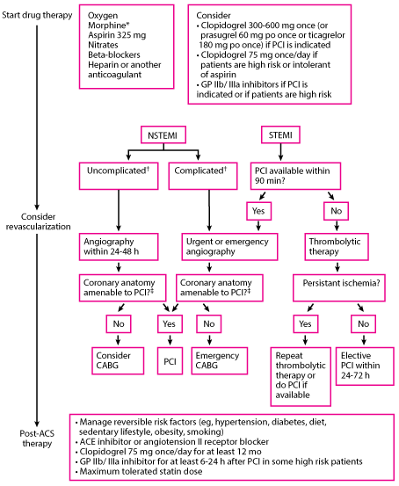
Immediate Treatment of MI
Immediate assesment (MONA)
Morphine
Oxygen
Nitrate
Aspirin (300mg)
Then stratify risk - NSTEMI vs STEMI
STEMI (ST elevation)
Rapid reperfusion (PCI Percutaneous Coronary Intervention) if immediately available v thrombolytics (drugs to break down clot)
NSTEMI (+/- St depression, minor ST elevation, T-wave inversion, Normal ECG)
Conservative v invasive. Surgical = CABG – (Coronary Artery Bypass Surgery)
Prevention
Beta blockers, Ace-inhibitors, Statins
Notes:
PCI – Done in Cath lab – usually enter through femoral or brachial and thread wire through vessels until they reach the heart.
Early treatment and intervention decreases mortality!
Meds:
Blood thinners = limit thrombosis
Supplemental O2 = minimizes ischemia
Nitrates = vasodilate coronary arteries
B-blockers = slows heart rate which decreases myocardial O2 demand and decreases risk of arrythmias
ACEi= decreases LV remodeling/dilation
Thrombolysis = TPA; STEMI goal <30 mins “door to needle” time
MONA = morphine, O2, nitroglycerine, aspirin
Revascularization can help bring blood back to the myocardium via surgical intervention
Percutaneous coronary intervention (PCI)/angioplasty = is an interventional cardiology technique aimed at relieving coronary stenosis via ballooning and stenting to reshape blood vessels and revascularize
Less invasive than open heart surgery & indicated when single or double-vessel occlusion or if patient is likely unable to tolerate open-heart surgery
Emergency angioplasty (STEMI) goal <90 min “door to balloon” time
Coronary stents – metal covered with drug-eluting polymer (i.e., sirolimus) that can expand vessel wall lumen by pushing plaques out of the way
Coronary artery bypass surgery (CABG) = open heart surgery, revascularization using bypass conduits
Usually grafted from saphenous vein
Greater ability to achieve complete revascularization
Indicated when there is triple-vessel or left main disease or plaque morphology is unfavorable for PCI
Stent complications = restenosis (from scar tissue) or thrombosis
Dual anti-platelet therapy is important for post-stent to prevent thrombosis
BIG complication of reperfusion = reperfusion injury
Reperfusion of irreversibly damaged cells results in Ca+ influx → leading to hypercontraction of myofibrils (contraction band necrosis)
Return of O2 and inflammatory cells may lead to formation of free radicals → further damages myocytes and leads to reperfusion injury

Slide 18
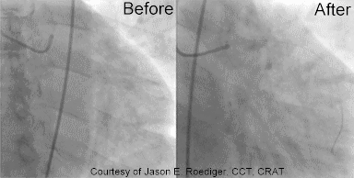
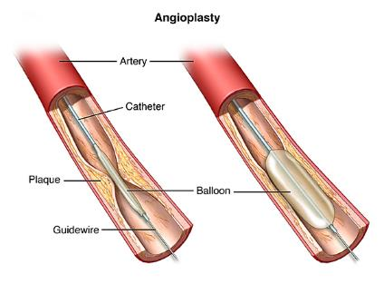
Reperfusion Therapy
THROMBOLYTICS (emergencies…)
Indications: ischaemic chest pain >30 mins that doesn’t resolve with GTN
- less than 12 hours from onset of pain
- no contraindications present
- ECG changes: ST elevation (>2mm) or new LBBB
- In NSTEMI, artery may not be fully occluded so thrombolytics may not indicated (but lumen narrowing still present so PCI may be indicated)
- Sooner administered the better, target time <30 mins after admission (thrombolysis window 12 hours)
- Repeat ECG at regular intervals after thrombolytics to check for ST elevation reduction
- Repeat cardiac enzymes to check for change
Contraindications: any bleeding risk, recent trauma/surgery/head injury
PCI (Percutaneous Coronary Angioplasty)
- all patients with a STEMI (ECG: ST elevation) within 120 minutes, if longer administer thrombolytics and then go for PCI
- Contrast injected first to determine the vessels that are narrowed
- If degree of narrowing great enough, then a stent is inserted to widen the vessel
Less invasive than surgery, done in interventional suite (Cath lab)
CABG (more common in the past)
Indications
- Triple vessel disease (stenosis of RCA, LAD, LCX)
- Fails medical management
- Surgery to increase blood flow to the myocardium, by connect the aorta/ branches of it to the arteries of the heart.
- Usually take a graft from the saphenous veins in the leg.
Notes:
LBBB (left bundle branch block)

Slide 19
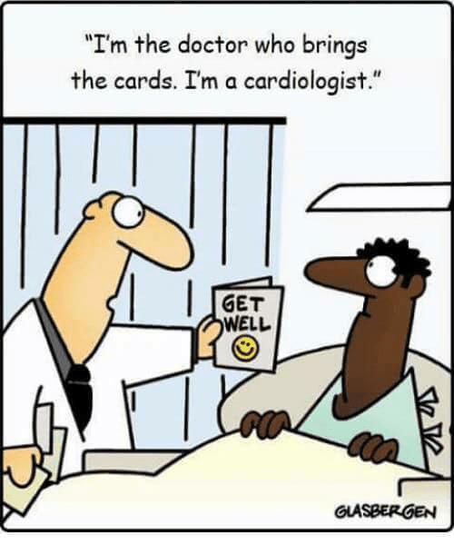
Congenital Heart Defects

Slide 20
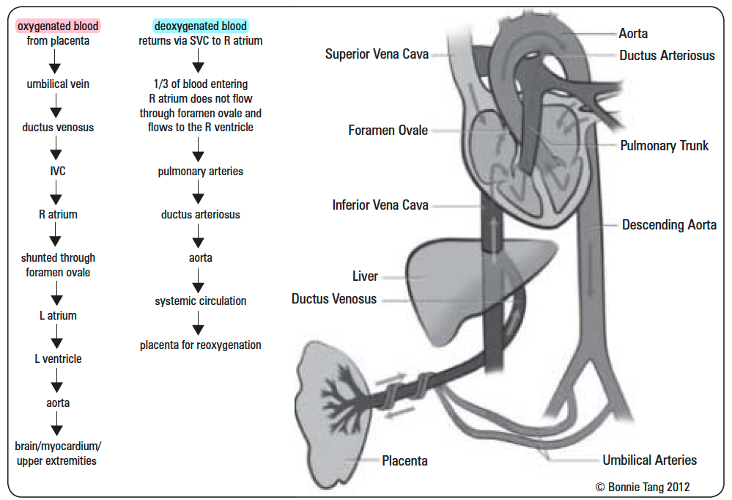
Review – Prenatal Circulation
Toronto Notes (2017)
Notes:
Before Birth:
Fetal circulation is designed so that oxygenated blood is preferentially delivered to the brain and myocardium
Shunting of deoxygenated blood → ductus arteriosus (connection between pulmonary artery & aorta)
Shunting of oxygenated blood → foramen ovale (connection between R and L atria) and ductus venosus (connection between umbilical vein and IVC)
After Birth:
When a baby takes its first breath outside the womb, the lungs open up → pulmonary resistance decreases → pulmonary blood flow increases
There is a separation of the placenta (which is low resistance) and systemic circulation (which becomes high resistance) → causes closure of ductus venosus
Increased pulmonary flow causes increase in left atrial pressure → closure of foramen ovale
Increased O2 concentration in blood after the baby’s first breath → decreased prostaglandins → ductus arteriosus closure
Closure of fetal shunts and changes in vascular resistance = infant circulation assumes normal adult flow

Slide 21
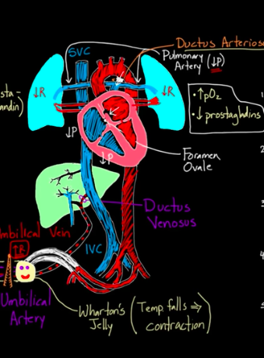
CHANGES IN FETAL CIRCULATION AT BIRTH
Baby is out & umbilical cord is clamped
Hypoxia > increase blood CO2
Triggers respiratory center in the medulla
Stimulate diaphragm to take first breath
Closure of umbilical vein → ligamentum teres (“round ligament of the liver”), and
Ductus venosus → ligamentum venosum
Smooth muscle contraction
Clearance of fetal lung fluid (decreased resistance in lung capillaries)
Closure of foramen ovale → fossa ovalis
Closure of ductus arteriosus → blood flowing through lungs → increased pressure in left atrium
1 year for complete fusion
Closure of ductus arteriosus → ligamentum arteriosum
Smooth muscle contraction from decrease in maternal supply of prostaglandin E1/E2
Bradykinin
1-3 months for complete closure
Closure of umbilical arteries → medial umbilical ligaments
Smooth muscle contraction due to decreased prostaglandins
Notes:
Just another slide on Fetal Circulation in case it clarifies anything for you!
https://www.youtube.com/watch?v=jFn0dyU5wUw – good khan academy video
-Umbilical cord (including umbilical vein surrounded by Wharton’s jelly which contracts in response to a drop in temperature) is clamped - baby takes 1st breath -> alveolar stretch -> deformations in type II cells
-Decreased pulmonary & increased systemic vascular resistances
-loss of blood flow through placenta - doubles systemic vascular resistance - increases P in aorta, LV, LA
-O2 rushes into lungs -> decreases intrathoracic P, lungs expand
-requires >25 mmHg (often close to -60 mmHg for 1st inspiration) of -‘ve inspiratory P to oppose the effects of surface tension of viscous fluid in the lungs & open the alveoli for the 1st time)
-High PO2 dilates pulmonary arterioles + decreases pulmonary vascular resistance (ie. easier for blood to flow through lungs, more blood enters pulmonary A, lungs, & LA)
-decreased BP in Pulmonary A, RA, RV
-Foramen Ovale closes:
-high LA P > low RA P - due to changes in pulmonary & systemic resistances
-reverse in blood flow -> pushes foramen ovale valve (L) closed against intraatrial septum
-permanent closure forms w/n months-year; higher LA pressure keeps it closed
-becomes Fossa ovalis
-Ductus Arteriosus closes:
-Increased systemic resistance -> increases aortic P & decreased pulmonary resistance -> decreases pulmonary arterial P = blood flows backwards from aorta into pulmonary artery through ductus arteriosus (like fetus)
-after a few hours, the muscular wall of DA constricts due to high PO2 (100mHg neonate vs 15-20mmHg as fetus)
-w/n 1-8d all blood flow through DA stops - functional closure
-w/n 1-4mo fibrous tissue growth occludes DA
-PGs vasodilate - treat PDA w/ Indomethacin
-becomes Ligamentum arteriosum
Treat PDA: indomethacin (NSAID) 🡪 nsaids are actually teratogenic in third trimester due to potential preterm closure of DA (NSAIDS inhibit PG synthesis)
-Ductus Venosus closure:
-Blood flow through umbilical V ceases but most of portal blood flows through ductus venosus
-w/n 1-3h the muscular wall of DV contracts, closes, & stops flow
-portal venous pressure rises from 0 to 6-10mmHg - enough to force blood through liver sinuses
-becomes Ligamentum venosum

Slide 22
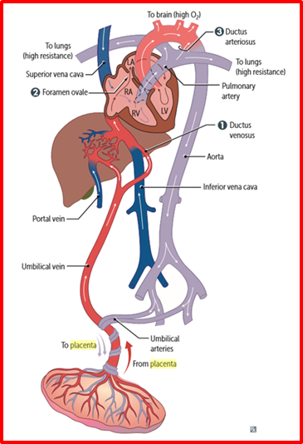
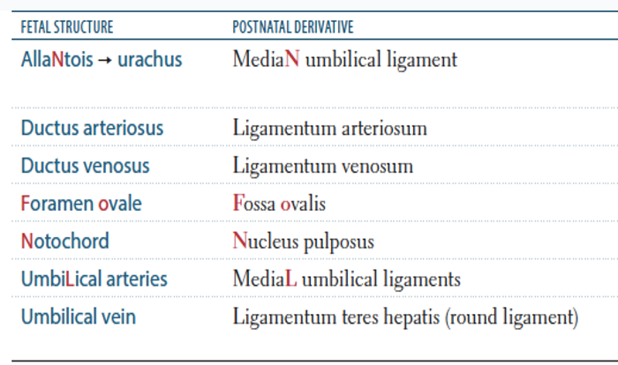
Circulatory Changes at Birth
Derivatives:
Notes:
2 MediaL umbilical ligaments (from UmbiLicaL Arteries)
1 MediaN umbilical ligament (from AllaNtois)

Slide 23
Congenital Heart Defects
CYANOTIC CONGENITAL HEART DISEASE
Right → Left Shunts
Early cyanosis (blue babies)
Often diagnosed prenatally or immediately after birth
Truncus arteriosus
Transposition of Great Vessels
ACYANOTIC CONGENITAL HEART DISEASE
Left → Right Shunts
Acyanotic at birth
Cyanosis may occur later in life (years)
Atrial Septal Defect (ASD)
Patent Ductus Arteriosus (PDA)
Tricuspid atresia
Tetralogy of Fallot (ToF)
Total Anomalous Pulmonary Venous Return (TAPVR)
Ventricular Septal Defect (VSD)
Coarctation of Aorta
Eisenbenger Syndrome
Ebstein Anomaly
FA (2020) & Pathoma
Notes:
Congenital heart defects arise during embryogenesis (weeks 3-8); most are sporadic
Cyanotic heart disease = blood bypasses the lungs so no oxygenation occurs → high levels of deoxygenated HgB enters the systemic circulation and causes cyanosis
Usually requires urgent surgery and/or maintenance of PDA
Acyanotic heart disease = blood passes through pulmonary circulation and oxygenation takes place so you have low levels of deoxygenated blood in systemic circulation (no cyanosis) but there is often obstruction occurring beyond the lungs

Slide 24
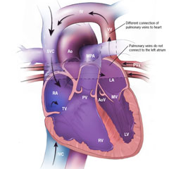
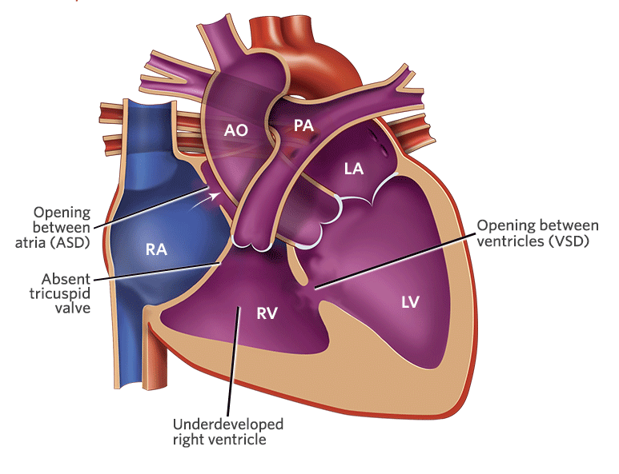
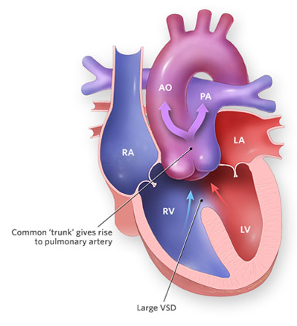
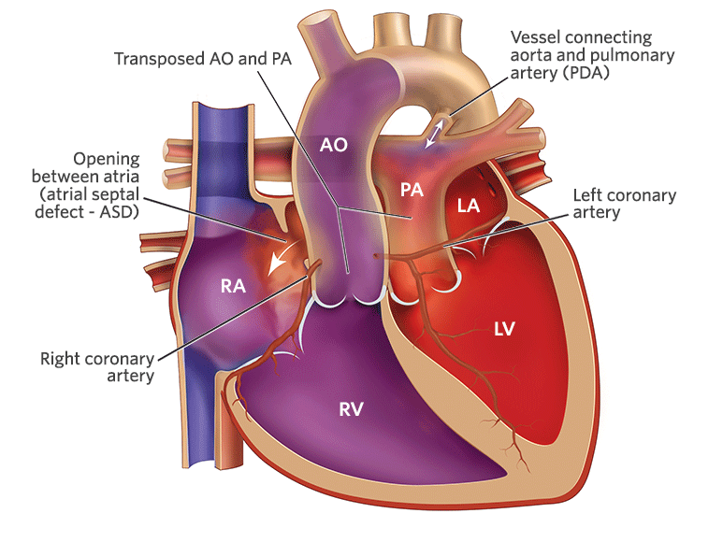
Cyanotic Heart Defects (R→L Shunt)
Truncus Arteriosus
Single large vessel arising from both ventricles
Truncus fails to divide into pulmonary trunk and aorta (failure of aortopulmonary septum formation)
Most patients have accompanying VSD
Transposition of Great Vessels
No aorticopulmonary septum spiraling → aorta leaves RV and pulmonary trunk leaves LV
Hypertrophy of RV, atrophy of LV
Associated with gestational diabetes
Not compatible with life unless shunt present
Tricuspid Atresia
Failure of tricuspid valve orifice to develop
Hypoplastic RV
Often associated with ASD but requires ASD & VSD for viability
TAPVR
Pulmonary veins drain into R heart circulation
Associated with ASD & PDA to allow for R→L shunting to maintain CO
FA (2020) & Toronto Notes (2017)
Notes:
Truncus Arteriosus = deoxygenated blood from RV mixes with oxygenated blood from LV before pulmonary and aortic circulations separate → early cyanosis
Potential for coronary ischemia with fall in pulmonary vascular resistance
Surgical repair within first 6 weeks of life
TOGV (transposition of great vessels) = Separation of systemic and pulmonary circulations
If PDA is present, KEEP IT OPEN!
PGE1 administration to maintain PDA until definitive surgical repair performed (balloon atrial septostomy)
Needs surgical intervention (arterial switch within first 2 weeks of life)

Slide 25
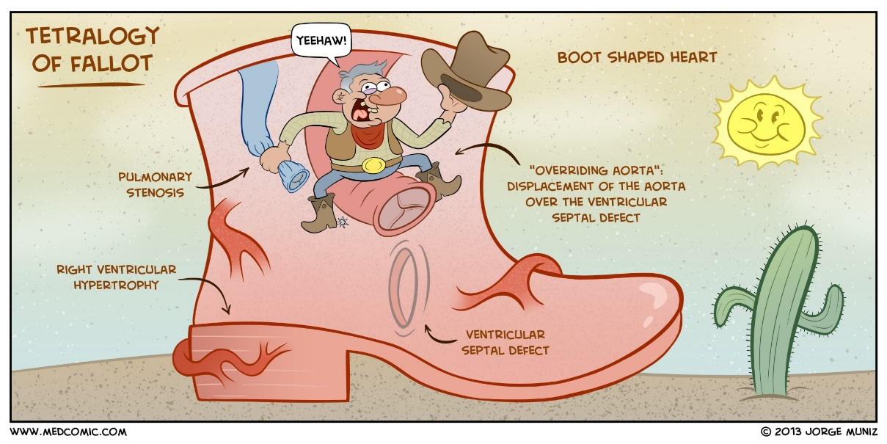
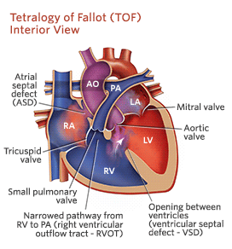
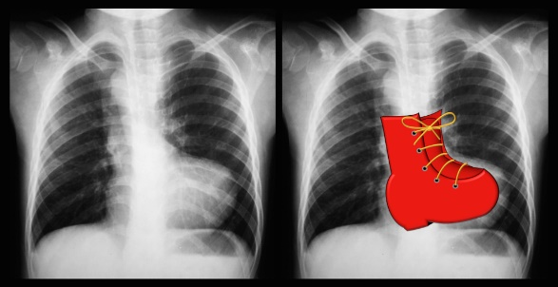
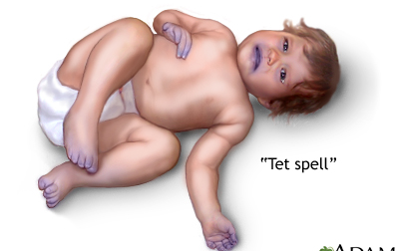
Tetralogy of Fallot
Tetralogy of Fallot: (4)
VSD (ventricular septal defect)
RVOTO (right ventricular outflow tract obstruction)
Aortic root overriding VSD
RVH (right ventricular hypertrophy)
Most common cyanotic heart defect
Anterosuperior displacement of infundibular septum (outlet septum)
Hypoxic “Tet Spells” (episodic cyanotic cpells):
Exertion (crying, fever, exercise) ↑ pulmonary vascular resistance and ↓ SVR = R→L shunting
Exacerbation of RV outflow obstruction
If severe, can cause ↓ LOC, seizures, death
FA (2020) & Toronto Notes (2017)
Notes:
Mean age of Dx = 2-4 months
Defect due to anterior and superior deviation of outlet septum leading to VSD, right ventricular outlet tract obstruction (pulmonary stenosis), over-riding aorta and right ventricular hypertrophy
VSD – can be membranous or muscular septum
RVOTO
Overriding aorta – aorta located right over the VSD rather than the left ventricle, resulting in blood flow from both ventricles entering into the aorta, decreases oxygenation of blood
Infants may initially have L→R shunt (no cyanosis), but RVOTO is progressive which eventually leads to increased R→L shunting with hypoxemia and cyanosis
Squatting (knee-chest position) increases SVR (systemic vascular resistance) which decreases R→L shunt (improves cyanosis)
Characteristic “boot shaped” heart on CXR
Early surgical correction is needed (4-6 months of age) if tet spells are severe

Slide 26
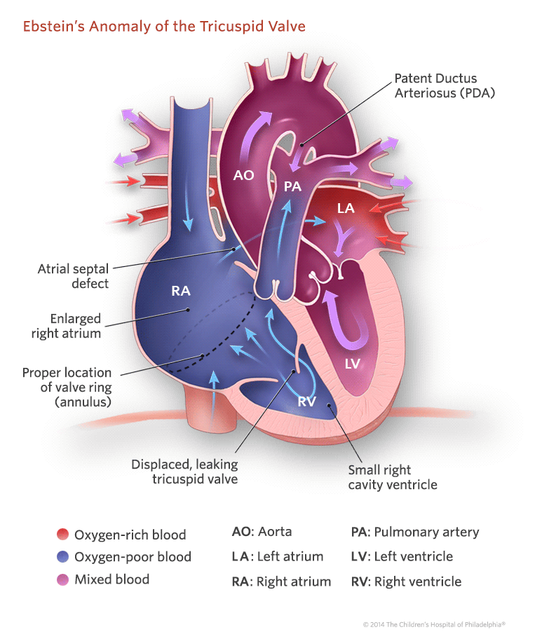
Ebstein Anomaly
Septal and posterior leaflets of tricuspid valve are malformed & displaced downwards into the RV
“Atrializing” the ventricle
RV dysfunction, tricuspid stenosis, tricuspid regurgitation, functional pulmonary atresia
Accessory conduction pathway (Wolff-Parkinson-White → arrythmias)
Associated with in utero lithium and benzodiazepine exposure
FA (2020) & Toronto Notes (2017)

Slide 27
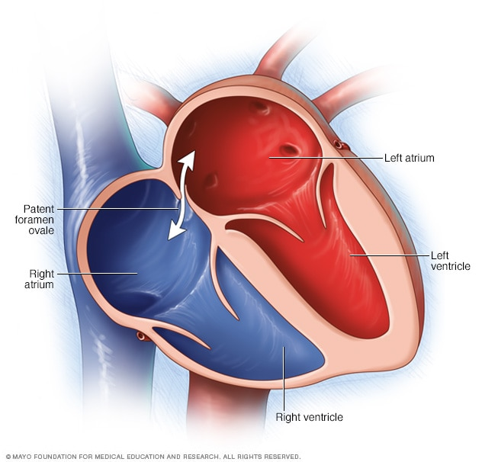
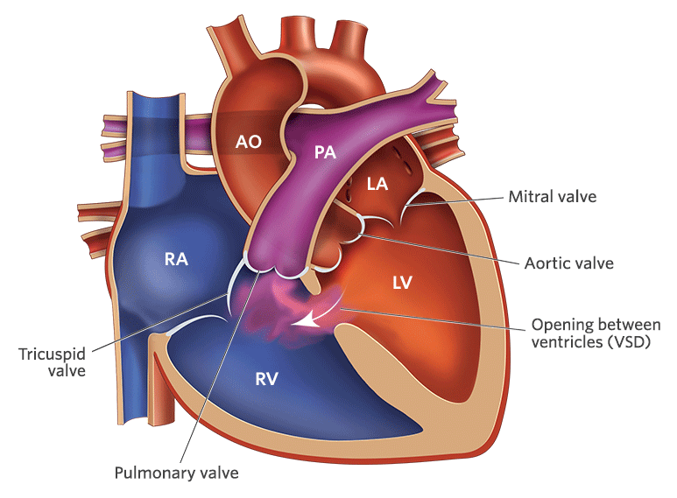
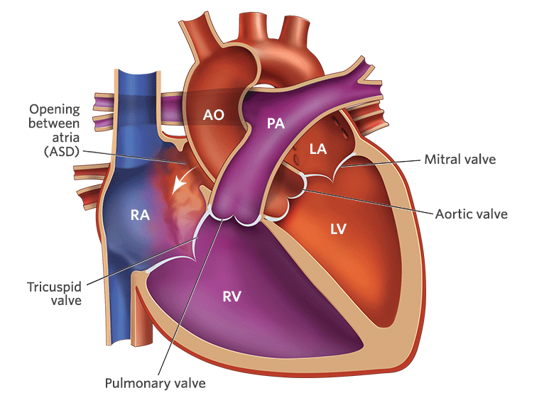
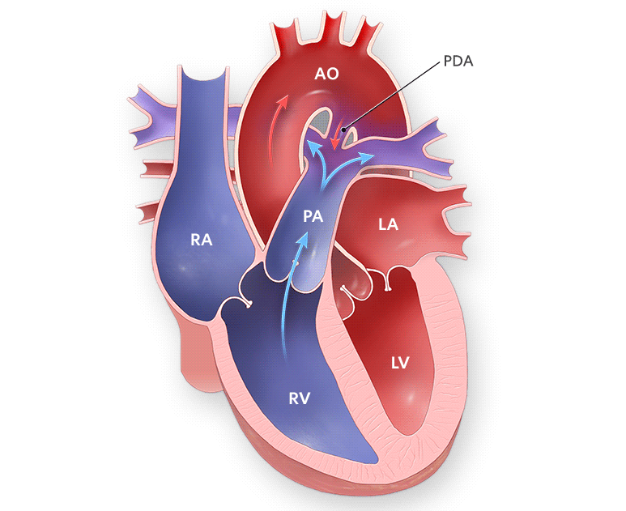
Acyanotic Heart Defects (L→R Shunt)
Ventricular Septal Defect (VSD)
Most common congenital defect
Most self-resolve, others → Eisenmenger complex + irreversible damage
Holosystolic murmur (LLSB) with thrill
Associated with Fetal Alcohol Syndrome
Atrial Septal Defect (ASD)
Ostium secundum defects most common
Ostium primum defects usually occur with other cardiac anomalies
Increased O2 sats in RA, RV, pulmonary artery
Associated with Down’s Syndrome
Loud S1, Wide, fixed S2
Patent Foramen Ovale (PFO)
Failure of foramen ovale to functionally close
Same findings as ASD (but is a distinct condition)
Patent Ductus Arteriosus (PDA)
Normal in utero, should close after birth
In neonate with PDA, shunt becomes L→R
Give PG_{E2} to keep open, give indomethacin to close
Associated with in utero infection with Rubella
Continuous “machine-like” murmur
VSD > ASD > PDA
FA (2020) & Toronto Notes (2017)
Notes:
VSD = holosystolic murmur best heard at left lower sternal border with thrill, small ones close spontaneously but moderate to large VSDs may be more complex and need surgical closure, membranous > muscular
Most commonly in membranous part of ventricular septum
Defect in ventricular septum - get left to right shunt with following consequences
Right ventricle volume overload - RV eccentric hypertrophy
Excessive pulmonary blood flow - increased pulmonary artery pressure - pulmonary hypertension
Decreased CO
LV volume overload - LV eccentric hypertrophy
Increased oxygen saturation in right ventricle and pulmonary artery
ASD
Impaired growth or excessive resorption of atrial septa in utero leads to atrial septal defects (asbsent atrial septa tissue)
Ostium primum atrial septal defect (ASD I) = incomplete fusion of septum primum and endocardial cushion
15-20% usually accompanied by other heart defects
Ostium secundum atrial septal defect (ASD II) = incomplete fusion of septum secundum
Approx. 70%, usually isolated
Typically a low pressure low volume minor left to right shunt - therefore patients asymptomatic
ASD -> oxygenated blood shunting from LA to RA -> increased oxygen saturation in right atrium -> increased oxygen saturation in RV and pulmonary artery
In more severe defects shunts may lead to supraventricular arrhythmias, pulmonary hypertension, and/or Eisenmenger syndrome
PATENT FORAMEN OVALE (PFO)
Prevalence = 25-30% of the general population
Associated with Loeys-Dietz syndrome - CT disorder
Pathophysiology
Failure of atrial septum primum to fuse with septum secundum following birth
Get persistence of foramen ovale and a mild left to right shunt
Usually asymptomatic until complications occur

Slide 28
Eisenmenger Syndrome
Uncorrected L→R shunt (VSD, ASD, PDA)
Increased pulmonary blood flow → pathologic remodeling of vasculature → increased pulmonary vascular resistance → PAH
RV hypertrophies (compensate) → shifts shunt to R→L
Variable age of onset, late cyanosis, clubbing, polycythemia
First Aid (2020)

Slide 29
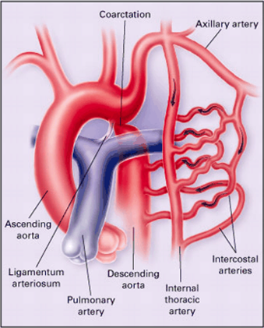
Coarctation of the Aorta
= Narrowing of the aorta, usually just distal to the ligamentum arteriosum
Narrowing causes increased resistance to blood flow and can lead to left ventricular hypertrophy
Congenital condition
Blood supply to the upper limb, head and neck is not compromised
May have HTN in upper limb
Blood supply to the rest of the body is reduced: weak, delayed femoral pulses
Hypotension in lower limb
Blood finds an alternative collateral route with less pressure
Goes through intercostal arteries and can cause rib notching with age
Notes:
Collateral routes:
Left subclavian → intercostal arteries (anterograde) → down the internal thoracic arteries → intercostal arteries (retrograde) → to descending aorta
Associated with bicuspid aortic valve, other heart defects and Turner syndrome

Slide 30
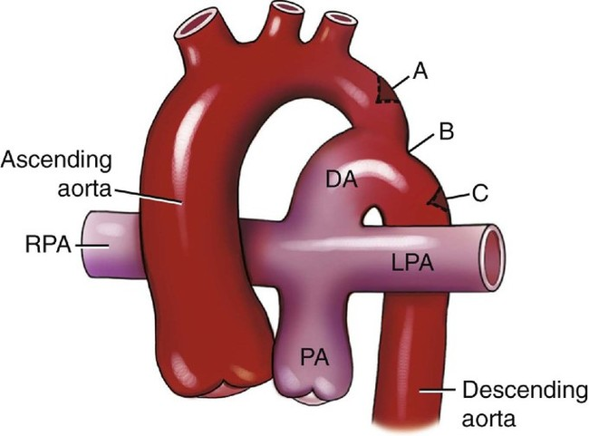
Coarctation of the Aorta
INFANTILE (A):
Associated with a PDA
Occurs after the aortic arch but before PDA
Lower extremity cyanosis
Associated with Turner syndrome
ADULT (C):
Occurs after the aortic arch
Hypertension in upper extremities, weak pulses in lower extremities
Discovered in adulthood
Collateral circulation develops across intercostal arteries → cause ‘notching of ribs’ on x-ray
Associated with bicuspid aortic valve
First Aid (2020)
Notes:
Coarctation of aorta = narrowing of the aorta, classically divided into infantile and adult forms
Infantile form = associated with PDA
Coarctation lies after (distal to) the aortic arch, but before (proximal to) the PDA
Presents as lower extremity cyanosis in infants (often at birth) and has association with Turner syndrome
Adult form = not associated with PDA
Coarctation lies after (distal to) aortic arch
Brachial-femoral delay
Collateral circulation → engorged arteries show “notched” pattern ribs on x-ray

Slide 31
Inflammatory Cardiac Disease
Notes:
Myocarditis (not mayocarditis lol) is inflammatory process involving the myocardium → cause of dilated cardiomyopathy

Slide 32
Pericardial Disease
Acute Pericarditis
Various causes
Coxsackie B
TRIAD: Chest pain, Friction rub, ECG changes
Constrictive Pericarditis
Chronic pericarditis → fibrosis, thickening & calcification of pericardium
Dyspnea, fatigue, palpitations, abdo pain, pericardial knock, may mimic CHF S&S
NORMAL BP, NO PULSUS PARADOXUS
Cardiac Tamponade
Major complication of pericardial effusion
Any cause of pericarditis (especially trauma, malignancy, aortic dissection)
BECK’S TRIAD: Hypotension, Increased JVP & Muffled Heart Sounds
Also tachypnea, dyspnea, shock, pulsus paradoxus
Toronto Notes (2017)
Notes:
Acute pericarditis can be caused by infectious agents, post-MI, post-cardiac surgery, metabolic disorders, neoplastic, AAA, various drugs (hydralazine, radiation), sarcoidosis, rheumatic conditions (SLE, RA)
Pericardial effusion can be transudative (serious), can be caused by CHF, hypoalbunemia, hypoproteinemia, hypothyroidism
Pericardial effusion can also be exudative (serosanguinous, bloody, purulent) due to causes of acute pericarditis
Pulsus paradoxus = inspiratory fall in systolic BP <10 mmHg during quiet breath

Slide 33
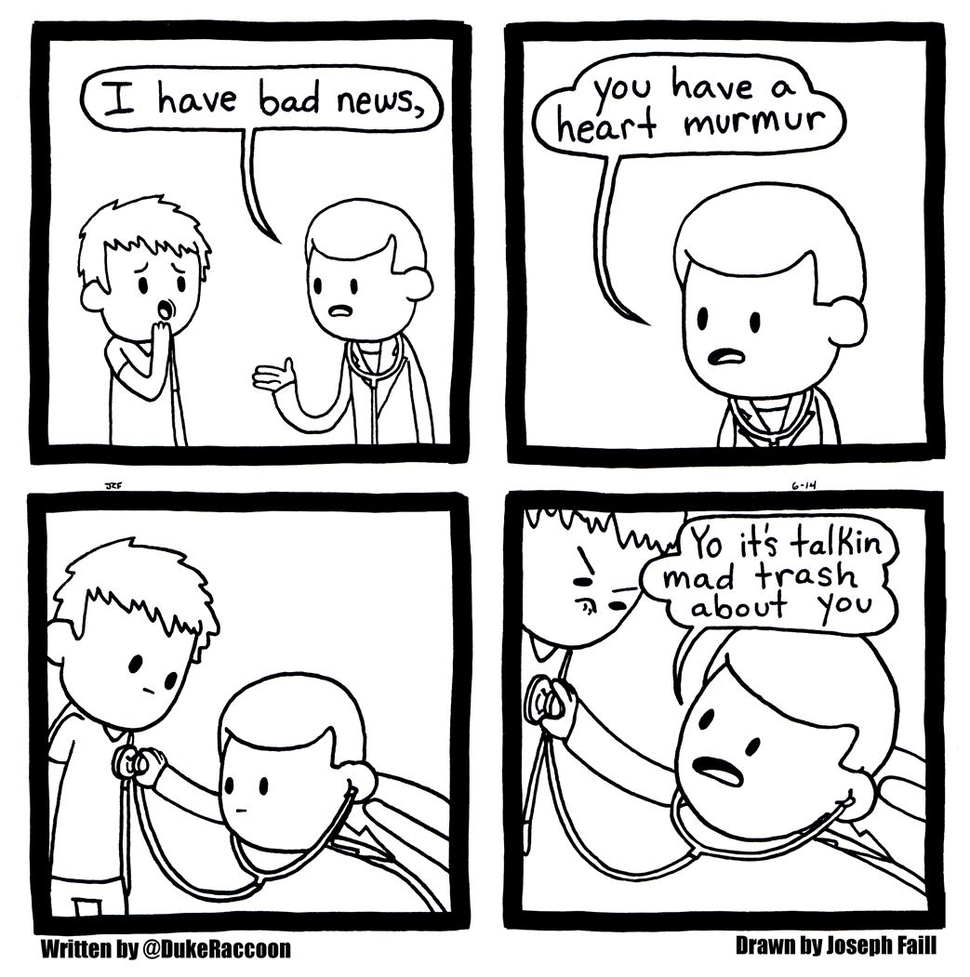
Cardiac Auscultation

Slide 34
Areas to Auscultate the Valves
‘However, NOT exactly where they are truly located’
Aortic area = 2nd ICS right sternal border
Pulmonary area = 2nd ICS left sternal border
Tricuspid area = 4th ICS left sternal border
Mitral area = 5th ICS MCL
(All Physicians Take Money or AParTMent)
How do we ausculate for each valve (location, bell/diaphragm, expiration/inspiration)?
Notes:
Relation to respiration
Inspiration increases murmur of right heart valve
On inspiration you suck air and blood into chest (negative pressure) so more blood returns to right side of the heart
Therefore more flow/turbulence so R sided murmurs louder in inspiration
Expiration increases murmur of a left heart valve
In expiration there is positive pressure in chest and pulmonary vessels are squeezed so more blood is pushed into left side of heart
Therefore in expiration L sided murmurs are louder
My Steps in ausculating for CS:
Mitral (MR:diaphragm @ 45' → MS:bell @ left lateral) - expiration
if any MR, check in axilla for radiation of the MR
Tricuspid (TS:bell @ 45' → TR:diaphragm @ 45') - inspiration
Pulmonary (PR:diaphragm @ 45' → PS:diaphragm @ 45') - inspiration
Aorta (AS:diaphragm @ 45' → AR:diaphragm @ leaning forward at LLSE 3-5 intercostal space)
Carotid artery (BRUITS both sides): bell
”area” describes the place where you auscultate to hear the valves, the valves location is marked by the solid ovals.

Slide 35
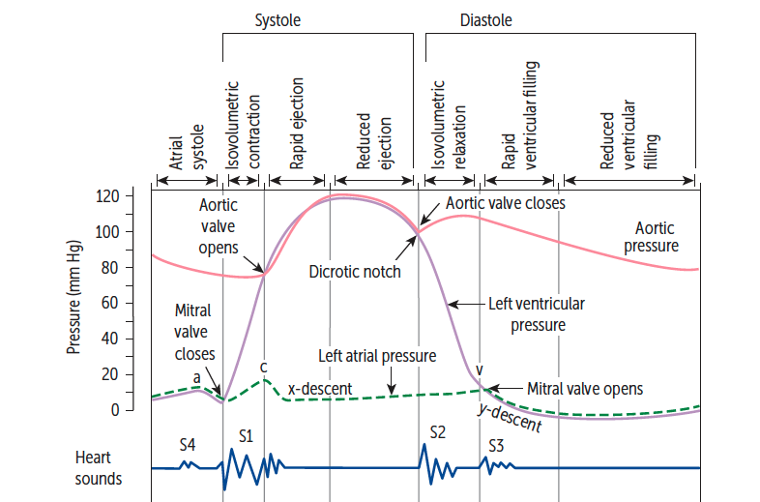
Cardiac Auscultation
S1 = mitral & tricuspid valves close → SYSTOLE (“LUB”)
Loudest @ mitral area
Low pitched
Precedes pulse
S2 = aortic & pulmonic valves close → DIASTOLE (“DUB”)
Loudest @ left upper sternal border (pulmonic)
Aortic may close before pulmonic (splitting)
S3 = early diastole, rapid ventricular filling phase
Loudest @ apex (left lateral decubitus)
Pathological = increased filling pressures (MR, AR, CHF, thyrotoxicosis)
Physiological = children/young adults, athletes, pregnancy
S4 = late diastole, “atrial kick”
Loudest @ apex (left lateral decubitus)
Stiff, noncompliant left ventricle → high atrial pressure
ALWAYS PATHOLOGICAL!
First Aid (2020)
Notes:
RECOMMEND: litmann stethoscope app good for auscultation sounds
S1 is the first heart sound, caused by closure of mitral and tricuspid valves
Marks start of ventricular systole
Peripheral pulse felt same time or shortly after
S2 is the second heart sound, caused by closure of aortic and pulmonic valves
Marks end of ventricular systole and start of diastole
Pulmonary valve may close just after the aortic valve & is prolonged during inspiration or by conditions that cause increased blood being pumped out of RV (S2 may sometimes be muffled or have a splitting)
S3 = can be pathological or normal (physiological
S4 = ALWAYS pathological
Extra heart sounds:
Click = systolic, pathological opening of aortic/pulmonic valve
Snap = diastolic, pathological opening of tricuspid/mitral valve

Slide 36
Splitting
Normal/Physiological Splitting
1) Right ventricle overfilled → increased ejection time → delayed P2
2) During inspiration, lungs expand → pulmonary circulation opens → decreased resistance towards forward flow → decreased impedance → prolonged flow of blood into pulmonary system
Wide Splitting
Conditions that delay RV emptying (pulmonary stenosis, RBBB)
Delayed pulmonic sound (more on inspiration)
Fixed Splitting
Heard in ASD → Increased RA and RV volumes → increased flow through pulmonic valve (regardless of breath) → pulmonic valve closure delayed
Paradoxical Splitting
Conditions with delayed aortic valve closure (stenosis, LBBB)
A2 and P2 reversed
On inspiration, P2 closes later and moves closer to A2
Paradoxically eliminates the split
First Aid (2020)
Notes:
What causes pulmonary valve to close? Pressure in right ventricle goes below pulmonary artery pressure

Slide 37
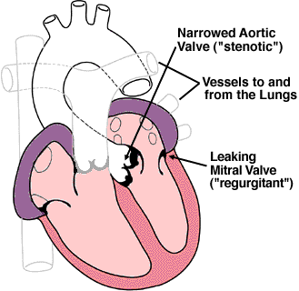
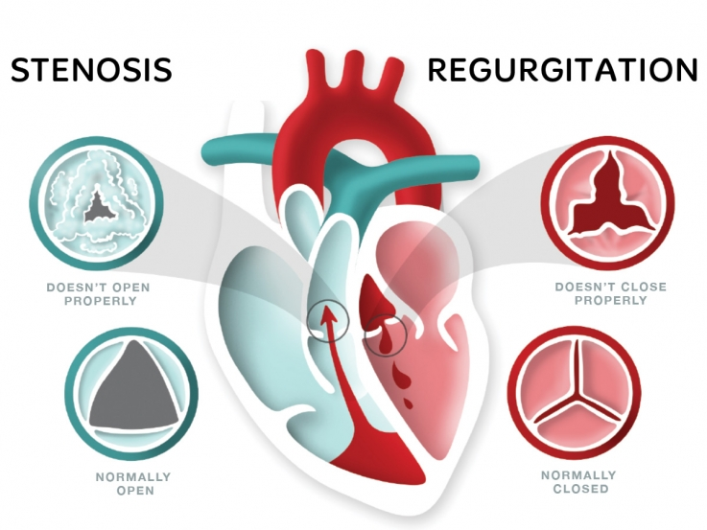
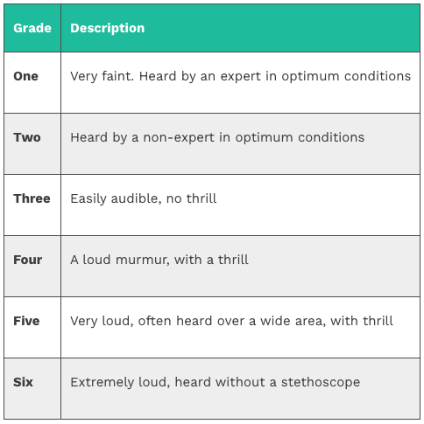
Murmurs – The Basics
Stenosis = valve doesn’t open normally
Regurgitation = valve doesn’t close normally (insufficiency)
Remember what happens in a normal cardiac cycle:
Systole = mitral & tricuspid close, aortic & pulmonic open
Diastole = aortic & pulmonic close, mitral & tricuspid open
Approach to Murmurs:
Site (loudest)
Radiation
Pitch (crescendo/decrescendo)
Inspiration/Expiration (or maneuvers/exercise)
Position
Character (timing & grade)
GeekyMedics (2021)
Notes:
RECOMMEND: clinical skills document on murmus
Timing = during systole or diastole
Grading murmurs = use Levine scale for grading cardiac murmurs according to intensity
Thrill = palpable vibration caused by turbulent blood flow through heart valve
HEART MURMURS = vibrations or sounds due to abnormal turbulence of blood flow or from vibrations in structures adjacent to an area of turbulent flow
Factors that may cause murmurs
Increased velocity of flow
Localised constriction of lumen through which blood is flowing; turbulence develops where lumen widens out again
Roughening of surface past which blood is flowing (e.g. Atheromatous plaque)
Decreased viscosity of blood
If valve is 'leaky' (regurgitant/incompetent) when will abnormal turbulent blood flow (murmur) arise?
When valve is closed
If valve is 'narrowed' (stenosed) when will abnormal turbulent blood flow (murmur) arise?
When valve is open

Slide 38
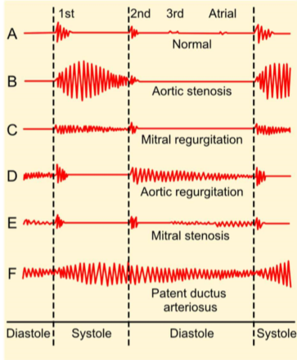
Grading and Character of Murmurs
Grade 1 = faintest murmur that can be heart under optimal conditions (very quiet room, relaxed patient, etc.)
Grade 2 = soft but readily audible murmur
Grade 3 = loudness equal to normal heart sounds
Grade 4 = very loud murmur that is palpable (thrill)
Grade 5 = louder still (thrill)
Grade 6 = murmur heard without a stethoscope
Character of Murmur
Loud or soft
Pitch - squeaking, rumbling, 'scratchy'
Duration
Pansystolic (holosystolic) = you can hear it throughout systole, all the way from S1 to S2
Early diastolic/systolic = just after S2/S1
Mid diastolic/systolic = halfway between S2 and S1/S1 and S2
Late diastolic/systolic = just before S1/S2
Continuous = begins with S1 and continues through S2 into diastole
Shape
Crescendo
Decrescendo
Crescendo-decrescendo
Decrescendo-crescendo
Notes:
simK sessions in clinical skills v good

Slide 39
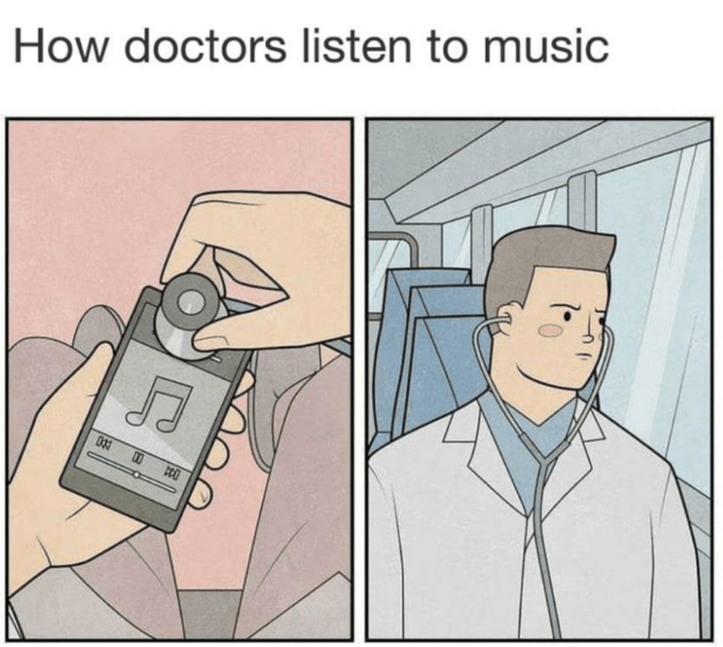
Murmurs – The Tricks
PASS & PAID
Pulmonary & Aortic Stenosis = SYSTOLIC
Pulmonary & Aortic Insufficiency = DIASTOLIC
OPPOSITE PASS/PAID for Mitral & Tricuspid:
Mitral & Tricuspid Stenosis = DIASTOLIC
Mitral & Tricuspid Insufficiency = SYSTOLIC
Since P/A valves have a nice mnemonic that fits, you think of them EARLIER than the M/T valves…
Pulmonary & aortic stenosis & regurgitation are EARLY systolic/diastolic murmurs
Mitral & Tricuspid Stenosis are MID-DIASTOLIC murmurs
Mitral & Tricuspid Insufficiency are PAN-SYSTOLIC murmurs
Murmurs that radiate = MRSA
Mitral Regurgitation → axilla
Stenosis of Aorta → carotids
CS GOAT Nazima (2021)
Notes:
Systolic murmurs are also called ejection murmurs
Pansystolic = holosystolic (heard throughout both systole & diastole)
Others to remember:
Other systolic murmurs = hypertrophic cardiomyopathy (HOCM)
Pansystolic murmurs = MR, TR & VSD
Early systolic + fixed split = ASD
Continuous machine-like murmur = PDA

Slide 40
Murmurs – Summary of Classification
Systolic Murmurs | Diastolic Murmurs | Pan/Holosystolic Murmurs
Pulmonary Stenosis Aortic Stenosis Mitral Regurgitation Tricuspid Regurgitation Mitral Valve Prolapse Aortic Valve Sclerosis Flow Murmur (Innocent) HOCM | Pulmonary Regurgitation Aortic Regurgitation Mitral Stenosis Tricuspid Stenosis | Mitral Regurgitation Tricuspid Regurgitation VSD
First Aid (2020)

Slide 41
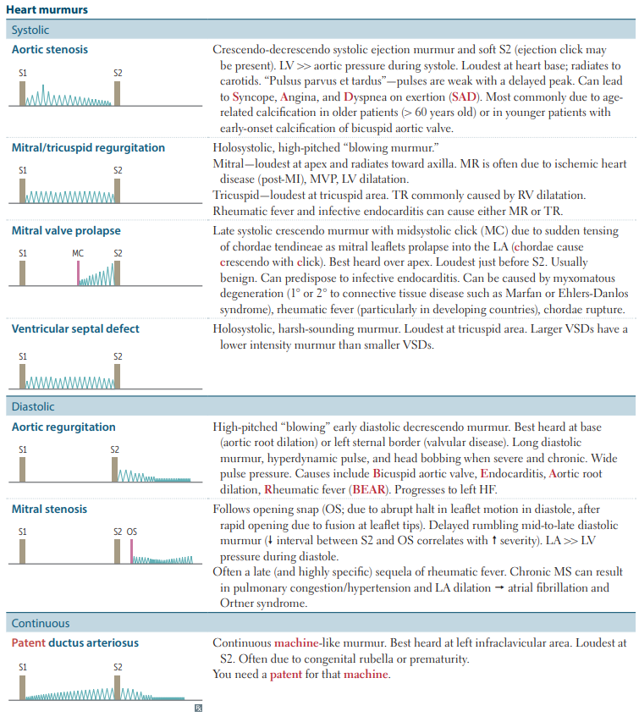
Murmurs
Notes:
Murmurs: where, when, why
Systolic murmurs (4)
Aortic stenosis
Crescendo decrescendo systolic ejection murmur and soft S2 (ejection click may be present)
Loudest at heart base, radiates to carotids
Mitral/tricuspid regurgitation
Holosystolic, high pitched 'blowing murmur'
Mitral = loudest at apex and radiates towards axilla
Tricuspid = loudest at tricuspid area
Rheumatic fever and infective endocarditis can cause either MR or TR
Mitral valve prolapse
Late systolic crescendo murmur with midsystolic click due to sudden tensing of chordae tendineae as mitral leaflets prolapse into LA
Chordae cause crescendo with click
Best heard over apex
Loudest just before S2
Usually benign
Ventricular septal defect
Holosystolic, harsh sounding murmur
Loudest at tricuspid area
Larger VSDs have lower intensity murmur than smaller VSDs
Diastolic murmurs (2)
Aortic regurgitation
High pitched 'blowing' early diastolic decrescendo murmur
Best heard at base (aortic root dilation) or left sternal border (valvular disease)
Long diastolic murmur, hyperdynamic pulse, and head bobbing when severe and chronic
Wide pulse pressure
Mitral stenosis
Follows opening snap (due to abrupt halt in leaflet motion in diastole, after rapid opening due to fusion at leaflet tips)
Delayed rumbling mid to late diastole murmur
Often a late (and highly specific) sequela of rheumatic fever
Continuous
Patent ductus arteriosus
Continuous machine like murmur
Best heard at left infraclavicular area
Loudest at S2
Often due to congenital rubella or prematurity
'you need a patent for that machine'

Slide 42
Systolic Heart Murmurs
Aortic Stenosis
Crescendo/decrescendo, loudest at apex
SAD (syncope, angina, dyspnea)
Pulmonary Stenosis
Associated with congenital heart defects, rheumatic fever, Turner’s syndrome & carcinoid syndrome
Severe stenosis may obscure A2 sound
Mitral Regurgitation
Holosystolic, high pitched “blowing” murmur
Loudest at apex, radiates to axilla (left lateral decubitus)
Tricuspid Regurgitation
Holosystolic, high pitched “blowing” murmur
Radiates to carotids
Pulsus parvus et tardus
Age-related calcification of aortic valve (patients >60y)
Associated with infective endocarditis & rheumatic heart disease
Loudest at tricuspid area
Commonly caused by RV dilation
Loudest at pulmonic area (LUSB)
Mitral Valve Prolapse
Late crescendo with midsystolic click loudest over apex
Can be caused by connective tissue disease or rheumatic fever
FA (2020) & Toronto Notes (2017)

Slide 43
Diastolic Heart Murmurs
Aortic Regurgitation
High-pitched “blowing”
Pulmonary Regurgitation
Mitral Stenosis
Characteristic “opening snap” (abrupt halt in leaflet motion)
Tricuspid Stenosis
Soft mid-diastolic murmur
Rare
Delayed rumbling mid/late diastolic
Decreased interval between S2-OS = increased disease severity
Late sequela of rheumatic fever
Early diastolic decrescendo
Wide pulse pressure
Often due to BEAR (Bicuspid aortic valve, Endocarditis, Aortic root dilation, Rheumatic fever) → Left HF
Caused by rheumatic fever (most common), congenital disease or infective endocarditis
Causes = pulmonary HTN, infective endocarditis, congenital valvular heart disease
Early decrescendo murmur, louder during inspiration
FA (2020) & Toronto Notes (2017)

Slide 44
Murmurs – “Innocent”
50-80% of children have audible murmurs at some point in childhood!
Most childhood murmurs are functional flow murmurs (“innocent”)
Normal anatomy/structure
Normal ECG
Audible/accentuated in high output states
5 Innocent Heart Murmurs:
Peripheral Pulmonic Stenosis/Pulmonary Flow Murmur = systolic; flow into pulmonary branch arteries from main, larger artery (neonates, usually disappears after few months)
Still’s Murmurs = flow across pulmonic valve leaflets (3-6y)
Venous Hum = altered flow in veins (inflaclavicular hum, 3-6y)
Pulmonary Ejection = flow through pulmonic valve (8-14y)
Supraclavicular Arterial Bruit = turbulent flow in carotid arteries (supraclavicular, any age)
Toronto Notes (2017)

Slide 45
Bedside Maneuvers for Murmurs
First Aid (2020)

Slide 46
Practice Question (past EMQ)
Match the following features to the corresponding congenital heart defect.
Continuous machine-like murmur
Pansystolic murmur at left sternal edge
Rib notching
Right ventricular hypertrophy without pulmonary hypertension
Coarctation of the aorta
Atrial Septal Defect
Ventricular Septal Defect
Patent Ductus Arteriosus
Patent Truncus Arteriosus
Teratology of Fallot
Transposition of the great vessels
Aortic regurgitation
Pulmonary stenosis
Notes:
ANSWERS:
D
C
A
F

Slide 47
Practice Question (past EMQ)
Match the following feature to the corresponding condition.
Atrial heart defect seen on ECHO
25-year-old drug user, murmur worsens with squatting & radiates to carotid
75-year-old man with blood pressure of 180/80mmHg
Pansystolic Murmur that radiates to axilla
Mitral regurgitation
Mitral stenosis
AV defect
Marfan’s syndrome
Bicuspid aortic valves
Mitral valve prolapse
Notes:
ANSWERS:
C
E
F
A

Slide 48
Quick Review - Basic Cardiac Conduction

Slide 49
Cardiac Cells
Contractile cells (“working cells”, 99% of all cardiac cells)
Atrial & ventricular myocytes
Contractility, conductivity & excitability
Contraction → generation of force
Intercalated disks and gap junctions allow rapid electrical impulse transmission to adjacent cells
Conducting cells (“electrical cells”, 1% of all cardiac cells)
Pacemaker cells
Specialized cells to generate and conduct action potentials
Automaticity, conductivity & excitability
Found throughout cardiac conduction system
Sinoatrial (SA) Node (60-100 BPM)
Atrioventricular (AV) Node (40-60 BPM)
Purkinje Fibres (20-40 BPM)
Latent Pacemakers (overdrive suppression from SA node)
Costanzo (2014)
Notes:
The heart consists of 2 kinds of muscle cells: contractile & conducting cells
SA NODE SETS THE PACE FOR THE HEART
Cells in SA node are not the only myocardial cells with intrinsic automaticity: latent pacemakers in AV node & bundle of his have pacemaker cells with potential for automaticity because SA node cells have highest rate and shortest action potential duration with shortest refractory period.
SA node driving HR and suppressing latent pacemaker cells is phenomenon called overdrive suppression.
Latent pacemaker cells ONLY take over if SA node firing decreases or stops

Slide 50
Cardiac Myocyte Action Potential
0 = VG Na+ channels open (Na+ IN)
1 = VG K+ channels (K+ OUT), inactivation of VG Na+ channels
2 = VG Ca²⁺ channels open (Ca²⁺ IN)
3 = VG slow K+ channels open (K+ OUT), VG Ca²⁺ channels close
4 = K+ channels open (K+ OUT)
McMaster Pathophysiology
Notes:
Phase 4 (resting phase): Resting membrane potential is -90 mV from constant leak of K+ via inward rectifier channels (Na+ and Ca++ channels are closed)
Phase 0 (depolarization): Action potential from nearby cardiomyocyte or pacemaker cell is propagated (gap junctions allow Na+ and Ca++ to leak into the cell) until the cell reaches threshold potential (-70 mV) → fast voltage-gated Na+ channels open allowing Na+ into the cell and rapid depolarization occurs → overshoots to a slightly positive potential (~ +20 mV)
At ~ -40mV, L-type Ca++ channels (long-opening) open and cause small but steady influx of Ca++ down its concentration gradient
Phase 1 (early repolarization): Voltage-gated Na+ channels closed and some voltage-gated K+ channels open
Phase 2 (plateau): Around 0 mV, L-type Ca++ channels are still open (still allowing for constant inward flux of Ca++) & K+ leaks out down its concentration gradient through delayed-rectifier K+ channels → causes excitation-contraction coupling and plateau is maintained
Phase 3 (repolarization): L-type Ca++ channels close, and there is persistent K+ outflow exceeding Ca++ inflow → brings cell back to -90 mV resting transmembrane potential
Normal transmembrane ionic concentration gradients are restored by returning Na+ and Ca++ ions to extracellular environment and K+ ions inside the cell via Na+/Ca++ exchanger, Ca2++ ATPase and Na+/K+ ATPase in sarcolemma
THIS ALWAYS COMES UP ON EMQ EXAMS!!! KNOW IT REALLY WELL!!

Slide 51
Pacemaker Cell Action Potential
4 = “Funny current” (I_{f}) Na+ channels slowly leaking Na+ inwards
0 = VG Ca2+ channels open
3 = VG Ca2+ channels close and K+ channels activate to increase K+ efflux
First Aid (2020)
Notes:
Phase 4 (pacemaker potential): Most negative value of membrane potential (-65 mV) = maximum diastolic potential (no technical “resting membrane potential” because cells are always firing)
Slow depolarization via opening of Na+ channels and inwards Na+ current (I_{f}, “funny current”)
I_{f} is turned on by repolarization from the preceding action potential → ensures each action potential will be followed by another
I_{f} and Na+ channels bring membrane to threshold potential (-40 mV) → T-type Ca++ channels opened for upstroke
Phase 4 depolarization sets heart rate!! Can be increased/decreased via influence of autonomic nervous system!!
Phase 0 (upstroke): depolarization via inward Ca++ current carried by L-type (primarily) and T-type Ca++ channels
Not as rapid depolarization as myocytes
Phase 3 (repolarization): Ca++ channels shut, K+ ion channels open (favoring electrochemical gradient) → repolarizes membrane potential
Phase 1 & 2 are absent
NOTE - all conducting system fibers have these characteristics - as you move away from SA node time required to reach threshold increases

Slide 52
Conduction Pathology & Arrythmias

Slide 53
What is a Conduction Block?
Conduction block = obstruction of delay in flow of electricity in the heart
Ischemia, fibrosis, trauma & drugs can cause transient, permanent, unidirectional or bidirectional blocks
Most common cause = refractory myocardium
If block occurs along specialized conduction system, distal zones can take over pacemaker control
Conduction blocks can lead to bradyarrythmias or tachyarrythmias
Toronto Notes (2020)

Slide 54
Common Abnormal ECG Tracings

Slide 55
Bradyarrythmias – AV Blocks
Second Degree AV Block – Mobitz II
Usually His/Purkinje disease (not in AV node)
Dropped beats that are not preceded by a change in the length of the PR interval (as in type I)
May progress to 3rd degree block
Symptomatic (dizziness, syncope, fatigue, bradycardia)
First Degree AV Block
Prolonged PR interval (>200 msec)
No “dropped beats” (all P waves conducted)
Benign, asymptomatic
No treatment required!
Second Degree AV Block – Mobitz I (Wenckebach)
Progressive lengthening of PR interval untila beat is ‘dropped’ (a P wave not followed by a QRS complex)
Usually asymptomatic & reversible
Variable RR interval with a pattern (regularly irregular)
Third Degree AV Block (Complete)
Usually His/Purkinje disease (not in AV node)
Atria & ventricles beating independently of each other (complete conduction failure)
Both P waves and QRS complexes are present but P/QRS waves are not rhythmically associated
Atrial rate>ventricular rate
Lyme disease can cause
FA (2020) & Toronto Notes (2017)
Notes:
How do you treat symptomatic AV blocks? → Pacemaker!

Slide 56
Bundle Branch Blocks
Bundle Branches deliver electrical impulses to right and left ventricles → ventricular depolarization (QRS complex)
FA (2020) & Toronto Notes (2017)
Notes:
Bundle Branches:
Divisions of Bundle of His → spread towards apex down interventricular septum
Left bundle branch → anterior & posterior fascicle transmitting conduction to LV
Right bundle branch transmits conduction to RV
His/Purkinje disease
May result in AV block (however single bundle branch block does NOT cause AV block)→ normal PR interval, but QRS prolonged
BBBs are often caused by slow progressive sclerosis/fibrosis (older patients) or structural heart disorders

Slide 57
Right Bundle Branch Block (RBBB)
Conduction through Right Bundle Branch is obstructed
Can be caused by right heart failure
Myocytes in left bundle branch will depolarize normally and spend longer to send impulses to right (right ventricular depolarization delayed)
QRS complex in V1 pointing up and rSR’ (“rabbit ears”/M) and in V6 pointing down (W)
LITFL (2021)

Slide 58
Left Bundle Branch Block (LBBB)
Conduction through Left Bundle Branch is obstructed
Can be caused by prior MI, cardiomyopathy
Myocytes in right bundle branch will depolarize normally and spend longer to send impulses to left (left ventricular depolarization delayed)
There QRS complex widens beyond 0.12 seconds
I, aVL, V5, V6 = left ventricle
Produces tall R waves in lateral leads (V5-V6) and deep S waves in precordial leads (V1-V3)
QRS in V1 pointing down (W) & V6 pointing up (M)
LITFL (2021)

Slide 59
AVNRT
AV Nodal Re-Entrant Tachycardia (AVNRT)
Re-entrant circuit using dual pathways close to AV node
Fast conducting beta-fibres & slow conducting alpha-fibres
Sudden onset/offset, often idiopathic, absence of structural heart disease
Tachycardia (150-250 bpm)
Supraventricular or ventricular premature beat
Toronto Notes (2017)

Slide 60
Wolff-Parkinson-White Syndrome
Syndrome is due to an abnormally fast accessory conduction pathway from the atria to ventricle via the bundle of Kent, which bypasses the slower AV node
Ventricles start to partially depolarize earlier → Delta Wave (ECG), widened QRS and shortened PR
Most common type of ventricular pre-excitation syndrome
May result in SVT
First Aid (2020)
Notes:
What is SVT? → Supraventricular Tachycardia
How do you treat SVT? → cardioversion or antiarrhythmic medication

Slide 61
WPW Syndrome ECG

Slide 62
Tachyarrythmias – Atrial Fibrillation
Disorganized atrial depolarization without effective atrial contraction
Ineffective atrial contraction leads to risk of clot formation (stasis)
Irregular, rapid ventricular response rate = loss of “atrial kick”
Can lead to systolic heart failure
Structural & electric remodeling
Risk Factors = PARASITE
Pulmonary
Anemia
Right heart failure
Atrial myxoma
Sepsis
Ischemia Thyroid
Ethanol (holiday heart syndrome)
Irregularly-irregular rhythm**
FA (2020) & Toronto Notes (2017)
Notes:
A. Fib = chaotic & erratic baseline with no discrete P waves between irregularly spaced QRS complexes
Atrial rate >300 bpm
Loss of atrial kick → decreased diastolic filling time → decreased preload (LVEDV) → decompensated Frank-Starling response → decreased stroke volume → decreased cardiac output → can lead to systolic HF
Structural remodeling = risk factors that can increase LVEDP and cause cellular hypertrophy/inflammation → increased LA pressure → increase LA wall stress & atrial dilatation → myocyte fibroblast proliferation & collagen deposition → structural remodeling
Fibrosis causes conduction slowing → promotes re-entry circuits and/or ectopy
Electric remodeling = changes in ion channel function promotes a.fib initiation and perpetuation
Can trigger ectopic beats rizing from pulmonary veins or other foci, or other SVTs
There are many risk factors for a.fib, but most common are hypertension & CAD
Complications = thrombosis (stroke), MI, HF

Slide 63
Tachyarrythmias – Atrial Fibrillation
Measuring Risk of Stroke with Atrial Fibrillation:
CHADS-VASC Score:
Congestive Heart Failure (+1)
Hypertension (+1)
Age >75 years (+2)
Diabetes (+1)
Stroke/TIA (+2)
Vascular disease (+1)
Age 65-74 (+1)
Sex (female +1)
Score >=2 → HIGH RISK of stroke: start warfarin or other anticoagulant therapy (NOAC, etc.)
Score 0-1 → aspirin therapy
Toronto Notes (2017)

Slide 64
Atrial Fibrillation
Notes:
No distinct P waves, “quivering”/fibrillatory waves

Slide 65
Summary – Atrial Fibrillation
Boards and Beyond (2020)
Notes:
Ideally, HR goal <110
Anticoagulation prevents development of thrombus/stroke
Drugs can be given to help slow AV node conduction
Restoration of sinus rhythm can be done via cardioversion (defibrillator to deliver synchronized shock, or chemical cardioversion via ibutilide)
Warfarin (goal INR 2-3), NOACS (factor X inhibitors), dabigatran (direct thrombin inhibitor), aspirin
Anticoagulation MUST be administered for a.fib even if the rate and rhythm are under control
Can also use antiarrythmic drugs… will talk about these in a bit

Slide 66
Tachyarrythmias - Atrial Flutter
Atrial Flutter
Caused by re-entry circuit that rotates around the tricuspid annulus
Less common than A. fib
Rapid succession of identical, back-to-back atrial depolarization waves
Sawtooth appearance
Definitive treatment is catheter ablation
First Aid (2020)

Slide 67
Atrial Flutter

Slide 68
Tachyarrythmias – Ventricular Fibrillation
Completely erratic ECG
No identifiable waveforms
Fibrillation of ventricles
FATAL without immediate ACLS and electrical defibrillation
Most frequent cause of sudden cardiac death (SCD)
FA (2020) & Toronto Notes (2017)
Notes:
Why is high frequency ventricular contractions a problem? → POOR CO

Slide 69
Ventricular Fibrillation
Notes:
Completely erratic rhythm with no identifiable waves – fatal arrythmia without immediate CPR and defib, shouldn’t really see this ever

Slide 70
QT Syndromes
Torsades de pointes
Prolonged QT interval
Polymorphic ventricular tachycardia
Sinusoidal waveform
QRS gets smaller & larger in “twisting” formation
Can progress to V.fib → cardiac arrest
Prolonged QT interval
Hypokalemia, hypomagnesemia, (rarely) hypocalcemia
Drug induced prolonged QT = ABCDE
AntiArrythmics (IA/III)
AntiBiotics (macrolides)
AntiCychotics (haloperidol)
AntiDepressants (TCAs)
AntiEmetics (ondansetron)
Treatment = magnesium sulfate
Mg2+ blocks influx of Ca2+ into cell
Recall that Ca2+ is important for phase 2 of ventricular depolarization
FA (2020) & Toronto Notes (2017)
Notes:
BIG w antipsychotics

Slide 71
Practice Question (past EMQ)
Match the following features to the corresponding ECG findings.
Ischemic heart disease leading to MI
Left ventricular hypertrophy
Low serum calcium
Hyperkalemia
Right bundle branch block
Prolongation of QT interval
Peaked (tall) T waves
ST elevation or Q wave before ST elevation
Wide QRS complex
Tall R waves or inverted T waves
Notes:
ANSWERS:
C
E
A
B
D

Slide 72
Practice Question (past EMQ)
Match the following features to the corresponding cardiac potential event.
Responsible for transient decrease in membrane potential after phase 1
Responsible for maintaining phase 2 (plateau)
Responsible for depolarization phase
Closes between phase 2 & 3
Responsible for phase 4 (resting membrane potential)
Inward rectifying K+ channels
VG-Ca+ channels
Transient K+ channels
VG-Ca2+ channels
VG-Na+ channels
Notes:
ANSWERS:
C
A
D
E
D

Slide 73
And another one…
Match the following features to the corresponding cardiac potential event.
Elongates plateau phase
Shortens depolarization phase
Decreases resting membrane potential
Hyperpolarization
Depolarization
G-protein potassium channel (I_{ado})
G-protein potassium channel (I_{ACh})
G-protein potassium channel (I_{k})
Inward rectifying K channel
Delayed outward rectifying K channel
Transient outward rectifying K channel
Voltage-gated sodium channel
Voltage-gated calcium channel
Notes:
ANSWERS:
H
F
D
C
G

Slide 74
Anti-Arrhythmic Treatments
Notes:
Not in pbl

Slide 75
Cardiac Autonomic Physiology
α1, α2, β1, β2 (β3)
In general:
α1 – vascular smooth muscle contraction α2 – decreased sympathetic outflow
β1 – increased heart rate, contractility, renin β2 – vasodilation and bronchodilation
FA (2020) & Toronto Notes (2017)

Slide 76
Cardiac Autonomic Physiology
Sympathetic Nervous System
↑ HR via:
↑ SA node stimulation (adrenergic → β1) – positive chronotropy
↑ AV node conduction (adrenergic → β1) – positive dromotropy
Directly acts on myocytes to ↑ contractility (adrenergic → β1) – positive inotropy
↑ SVR via:
↑ arteriolar vasoconstriction (α1 adrenergic)
↑ Blood Volume & Blood Pressure via:
↑ release of renin (β1)
Constriction of renal afferent arteriole
Directly stimulates renal tubular Na+ reabsorption
Parasympathetic Nervous System
↓ HR via:
↓ SA node stimulation (muscarinic → β1) – negative chronotropy
↓ AV node conduction (muscarinic → β1) – negative dromotropy
No effect on contractility
FA (2020) & Toronto Notes (2017)
Notes:
Heart is regulated by SNS and PSNS → together form cardiac plexus
Cardiac plexus controls HR and contractility of cardiac myocytes
Increasing contractility and HR = increased Cardiac Output
SYMPATHETIC INNERVATION
Sympathetic innervation of the heart is derived from upper thoracic part of spinal cord (T1-T5)
SA node innervated by postganglionic sympathetic fibres → norepinephrine released from N-terminals to increase HR by activating B1 adrenergic receptors in SA node → increased cAMP → opening of hyperpolarization-activated cyclic nucleotide-gated channels (HCN) which increases rate of spontaneous depolarization thereby increasing HR
HCN channels are mixed Na+/K+ channels that conduct funny current (pacemaker current) which is responsible for SA node firing
If causes steeper incline on graph of phase 4 of AP (more frequent depolarization = faster HR)
Elevation of HR = positive chronotropy
AV node = “relay station” for AV node impulses & slows them down
SNS speeds conduction through AV node and therefore increases HR
Activation of postganglionic sympathetic fiber to AV node, norepinephrine is also released from N-temrinals & diffuses across synaptic cleft to act on B1 receptors
AV node B1 receptor activation → opening of voltage-gated Ca++ channels → increases inward Ca++ current → steepens slope towards depolarization threshold and therefore more frequent depolarization and faster conduction through AV node which is called positive dromotropy
SNS directly acts on ventricular myocytes, causing them to contract more forcefully and increases CO
Norepinephrine released from postganglionic sympathetic nerve fiber → activates B1 adrenergic receptors in cardiomyocytes, which have 2 effects
Facilitate opening of Ca++ channels which increases inward Ca++ current
Also increase activity of sarcoplasmic endoplasmic reticulum calcium ATPase (SERCA) which increases Ca++ stored in sarcoplasmic reticulum therefore greater availability of Ca++ and greater crossbridge cycling therefore greater contractility = positive inotropy
PARASYMPATHETIC INNERVATION
Derived from vagus nerve (CN X)
Asymmetric (Right vagus has more effect on SA node, Left vagus has more effect on AV node)
SA node = N-terminal releases Ach onto SA node → binds to and activated muscarinic receptors (opposite effect of B1 receptor activation) → decreased cAMP and slows HCN channels and therefore decreases HR (more shallow phase 4 slope) = negative chronotropy
AV node = ACh released from N-terminus onto AV node → diffuses across synaptic cleft onto muscarinic receptors → slow opening of voltage-gated Ca++ channels, decreasing inward Ca++ current and decreases slope towards threshold (negative dromotropy) = longer pauses in AV node
PSNS does not innervate cardiac myocyte contractility
Effects on vascular tone:
SNS = on arterioles (determines SVR)
Degree of SNS stimulation is important
More SNS stimulation = more vascular tone (vasoconstriction)
Less SNS stimulation = less vascular tone
Short pre-ganglionic sympathetic fibres terminate in sympathetic ganglionic chain adjacent to spinal column → release ach → post-ganglionic sympathetic fibres onto blood vessels and release norepinephrine
Norepi binds onto a1 adrenergic receptors (strongly) and weakly to B2 adrenergic receptors located on smooth muscle cells → vasoconstriction at a1 receptors and B2 receptor activation causes vasodilation(but primary is vasoconstrictive) to increase vascular tone
Effects on blood volume:
SNS stimulates release of renin to activate B1 adrenergic receptors → RAAS → increases blood volume via Na+ resorption
SNS constricts renal afferent arteriole via a1 adrenergic receptors → decreases GFR → fluid retention
SNS directly stimukates renal tubular Na+ reabsorption

Slide 77
Another Reminder…
First Aid (2020)

Slide 78
Antiarrhythmic Drugs
Drugs used to “suppress” arrhythmias
Prevent formation of aberrant impulses
Can lead to cardiac arrest and death
Use in recurrent symptomatic arrhythmias, ventricular tachycardia as well as A.fib
Boards and Beyond (2020)
Notes:
Vaughan-Williams Classification of Antiarrythmic medication

Slide 79
Class I – Na+ Channel Blockers
CLASS I | Ia | Ib | Ic
Agents | Quinidine Procainamide Disopyramide | Lidocaine Mexiletine | Propafenone Flecainide Encainide
MOA | Moderate Na+ channel blockade Slows phase 0 upstroke Prolongs repolarization & slows conduction Increased ERP Increased QT interval | Mild Na+ channel blockade Shortens phase 3 repolarization (AP duration) | Marked Na+ channel blockade Greatly slows phase 0 upstroke Prolongs repolarization & slows conduction Significantly prolongs ERP
Indications | Atrial + ventricular arrythmias, SVT, VT | VT | SVT, VT, A.Fib
Side Effects | Torsades de pointes, diarrhea, Lupus-like syndrome, anticholinergic effects | Confusion, stupor, seizures, GI upset, tremor | Exacerbation of VT, negative inotropy, bradycardia, heart block
FA (2020) & Toronto Notes (2017)
Notes:
Sodium channel blockade (most to least) = Ic > Ib > Ia
ERP = effective refractory period

Slide 80
Class II – Beta-Blockers
Main effect on pacemaker cells (SA + AV nodes)
Block beta-adrenergic receptors
Decrease slope of phase 4 (↓ cAMP & ↓ Ca++ currents)
Decreased phase 4 depolarization
Clinical use = SVT, ventricular rate control for A. Fib and atrial flutter, HTN, CAD, acute MI/post-MI, CHF
Metoprolol → most commonly used, beta-1 selective, can cause dyslipidemia
Propanolol → can exacerbate Prinzmetal angina, can also be used for migraine prophylaxis & panic attacks
Carvedilol + Labetolol are non-selective alpha- & beta-antagonists
Labetaolol is safe to use in pregnancy.
Esmolol (very short-acting)
FA (2020) & Toronto Notes (2017)
Notes:
Side effects (general) = bronchospasm, negative inotropy, bradycardia, AV block, impotence, fatigue

Slide 81
Class III – K+ Channel Blockers
Blocks K+ channel
Prolongs phase 3 repolarization → prolongs refractory period
Increased AP duration & increased ERP
Increased QT interval
Can be used in SVT, VT, A.Fib
Amiodarone*, sotalol
Amiodarone has Class I, II & IV properties
Class I = prolongs QRS
Class II/IV = slows HR, delays AV conduction
Side effects of both = torsades de pointes, bradycardia, heart block, beta-blocker side effects
Amiodarone = highly lipid soluble, photosensitivity, pulmonary toxicity, hepatotoxicity, thyroid disease, increased INR
FA (2020) & Toronto Notes (2017)

Slide 82
Class IV – Ca2+ Channel Blockers
Blocks Ca++ channels
Slows phase 4 spontaneous depolarization therefore slowing AV node conduction
Slows HR and conduction velocity
Can be used in SVT, A.Fib (also used for HTN)
Verapamil and diltiazem
Side effects = bradycardia, hypotension, AV Block
Because both BB and CCBs lead to a decreased AV conduction they can eventually lead to a Type 1 AV block because of the prolonged PR interval, and/or Wenckebach (Mobitz I)
FA (2020) & Toronto Notes (2017)

Slide 83
Questions?

Slide 84
My Recommended Resources
Toronto Notes (get most up to date version)
FirstAid (get most up to date version)
UpToDate
Amboss
Litmann Stethoscope App (for auscultation)
Complete Anatomy App
Facebook: Kaitlyn Lee
Email: 21172862@studentmail.ul.ie

