Slide 1
Introduction to Microbiology
Doctorials 2023/2024

Slide 2
Learning Objectives
Classify the pathogens that cause human disease by size.
Explain what gram staining is and why some bacteria are gram-positive and others are gram-negative.
Explain, the mechanism of action of cell-wall synthesis inhibitors in both gram-positive and gram-negative bacteria, correlating the size of the antibiotic molecule to the porin size of select gram negative bacteria with increasing generations of antibiotics.
Explain the components of the outer membrane of gram-negative bacteria, emphasizing the role of endotoxin.
Briefly explain how exotoxins are different from endotoxin, particularly in that they are released and not inherent.
Explain why some bacteria are atypical and what this means for staining, as well as for antibiotic treatment. Particularly emphasize intracellular bacteria.
Explain why the immune response to extracellular bacteria is predominantly humoral, whereas to intracellular bacteria it is predominantly cell-mediated.
Explain that some bacteria are aerobic and others are anaerobic. Briefly indicate the common places/ infections whereby anaerobic infections are seen and why.

Slide 3
Learning Objectives
Explain the key differences between RNA and DNA viruses.
Explain why the immune response to viruses is predominantly cell-mediated.
Briefly explain the difference between genetic shift and genetic drift and how these influence the formation of the yearly influenza vaccine.
Briefly explain the key terms used in mycology and define what a dimorphic fungus is.
Mention that humoral and cell-mediated responses dominant clearance of fungi.
Define opportunistic infection, correlating the presence of systemic fungal infections with immunosuppression.
Classify parasites according to size from protozoa, helminths (trematodes, nematodes, cestodes), and ectoparasites. Indicate that these infections are particularly difficult for the body to eradicate without treatment.
Mention the role of eosinophils in fighting parasites.
Notes:
‹#›

Slide 4
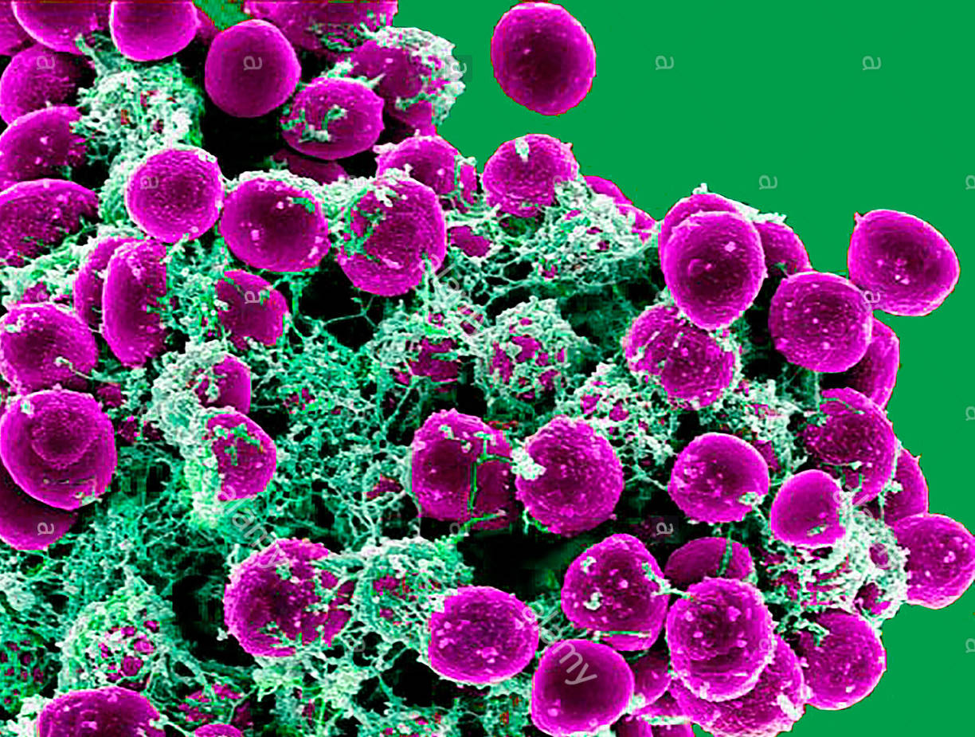
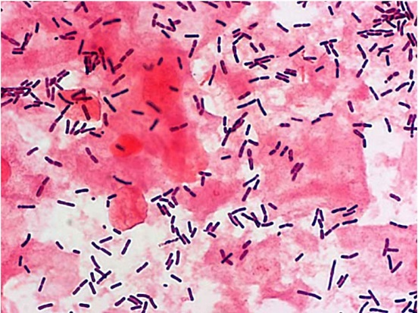
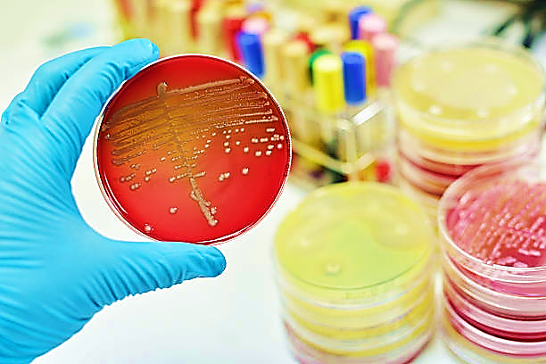
What is Microbiology?
Definition: the study of microorganisms (organism that cannot be seen by the naked eye)
The main pathogens encountered in clinically include:
1. Viruses 2. Bacteria 3. Fungi 4. Parasites (Helminths, Protozoa)
Bacteria and viruses are the most common
Diagnostic Testing/Laboratory Work-up:
Gram stain and cell morphology
Bacterial culture
Growth requirements and biochemical tests
Immunoassay
Antibiotic susceptibility
Nucleic acid tests (PCR)
Molecular methods: sequencing and genotyping
Notes:
Bacteria are generally cultured on agar plates in laboratories. The agar jelly may contain different nutrient mediums which certain bacteria will grow on, examples are:
Blood agar – bacteria and fungi
Chocolate agar - most bacteria
MacConkey agar – selective for lactose fermenters
Sabaraud agar - fungi
Psuedomonas selective
Chrome agar – GNB’s ( Gram Negative Bacteria e.g. E. Coli)
Immunoassay Example: would be an enzyme-linked immunosorbent assay (ELISA) – HIV
PCR Tests: used in STI screening for amplifying Chlamydia Tracomatis or Neisseria Gonorrhoea
Molecular methods: used in Enterics – Salmonella, Shigella, E. Coli
‹#›

Slide 5
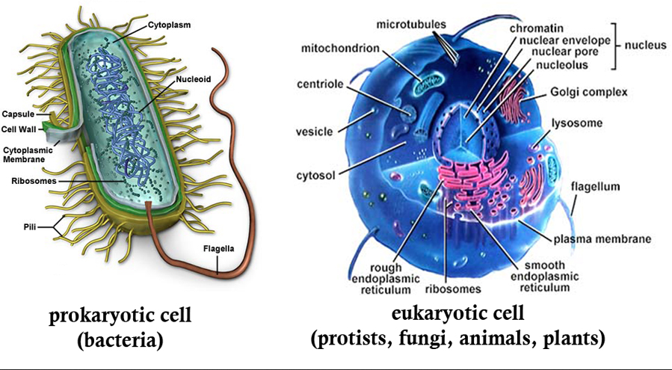
Prokaryotes vs. Eukaryotes
Notes:
Prokaryote:
Unicellular
Lack nucleus (have a nucleoid instead) and other complex cell organelles → Bacterium
DNA is circular
Eukaryotes:
Can be unicellular or multicellular
Have nucleus and other complex cell organelles (golgi apparatus, endoplasmic reticulum) → human/animal cell
DNA is linear

Slide 6
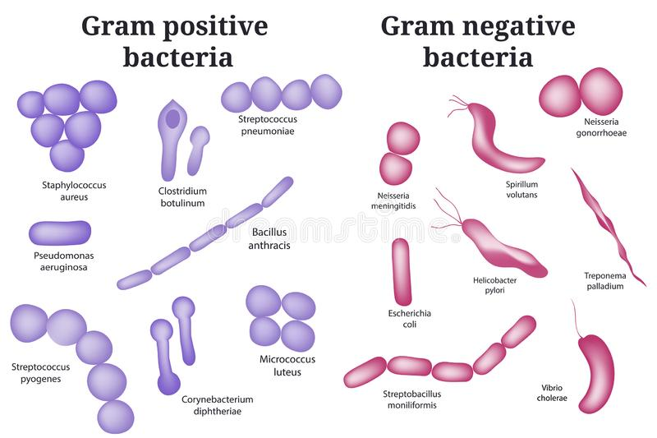
Bacteriology
Bacteria can be classified based on various characteristics including:
Gram Stain
Gram positive (+)
Gram negative (-)
Cell Morphology (Shape)
Cocci (round-shaped)
Bacillus (rod-shaped)
Spiral (spirochetes)
Comma (vibrio)
Arrangement (pairs, clusters, chains)
Appearance on agar (size, shape, colour of colonies)
Growth requirements (type of agar)
Metabolism (aerobes vs. anaerobes)
Notes:
Types of Bacteria
Gram-positive cocci:
Staphylococcus aureus – member of commensal microbiota, facultative anaerobe (makes ATP by aerobic respiration if oxygen is present, but is capable of switching to fermentation if oxygen is absent). Can cause illnesses such as meningitis, cellulitis, boils, pneumonia, osteomyelitis.
Streptococcus pyogenes – also known as group A streptococcus, aerotolerant, infection can result in pharyngitis. Certain strains of S. pyogenes release toxins which can lead to scarlet fever.
Streptococcus pneumoniae – α/β haemolytic, facultative anaerobe, responsible for most cases of community-acquired pneumonia, Usually found in pairs i.e. diplococci
Staphylococcus epidermidis – part of normal human flora on skin, it is a facultative anaerobe
Enterococcus faecalis – commensal bacterium which resides in gastrointestinal tract of animals and other mammals, can be found in a variety of nosocomial (hospital-acquired) infections.
Gram-positive rods:
Corynebacterium diphtheriae – causes diphtheria.
Bacillus cereus - facultatively anaerobic, motile, beta-hemolytic, spore forming bacterium commonly found in soil and food. Responsible for minority of foodborne illnesses.
Gram-negative cocci:
Neisseria meningitidis – tends to appear as diplococci, is oxidase positive, it is the main cause of bacterial meningitis in children and young adults.
Gram-negative coccobacilli:
Haemophilus influenzae - facultatively anaerobic, capnophilic (loves CO²). Can cause respiratory tract infections, like pneumonia, otitis media, epiglottitis, eye infections, bloodstream infections, and meningitis.
Haemophilus brucella – non-spore forming, non-motile. Causes brucellosis in humans and is associated with consumption of unpasteurised milk and soft cheeses from milk of infected animals, especially goats.
Gram-negative rods:
Legionella pneumophila – thin, aerobic, flagellated, non-spore forming. Causative agent of Legionnaire's disease
Enterobacteriaceae – include Yersinia, Salmonella, Shigella
Gram-negative comma:
Vibrio cholera – natural habitat is brackish water or saltwater. Leads to cholera in humans. Secretes cholera toxin, a protein which causes profuse watery diarrhoea. In order to colonise in gut, has toxin coregulated pilus.
Gram-negative helical:
Helicobacter pylori – microaerophilic bacteria usually found in stomach. 90% of duodenal ulcers and 80% of gastric ulcers are due to H. pylori infection. Risk of stomach cancer also increases.
Types of Agar
Nonselective Blood agar - bacteria and fungi
Chocolate agar - bacteria including Haemophilus and Neisseria gonorrhoeae
MacConkey agar Selective for gram-negative bacteria; differential for lactose-fermenting species Mannitol salt agar Selective for staphylococci; differential for Staphylococcus aureus
Xylose Lysine Deoxycholate agar Selective, differential agar for Salmonella and Shigella in enteric cultures
‹#›

Slide 7
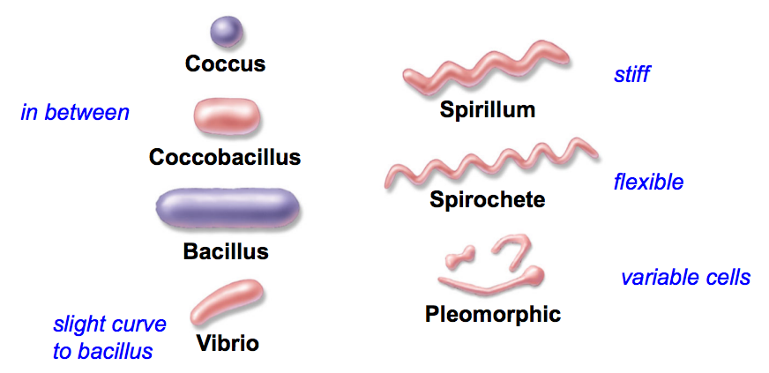
Cell Morphology
Bacteria can be described by their cell shape and arrangement on microscopy.
Note: staph(ylo)- arrangements are typically described as ‘grape clusters’, while strep(to)- arrangements are typically described as chains.
Note: generally, gram-negative bacilli (also called rods) are coliform bacteria (reside in the gut). Often opportunistic pathogens.

Slide 8
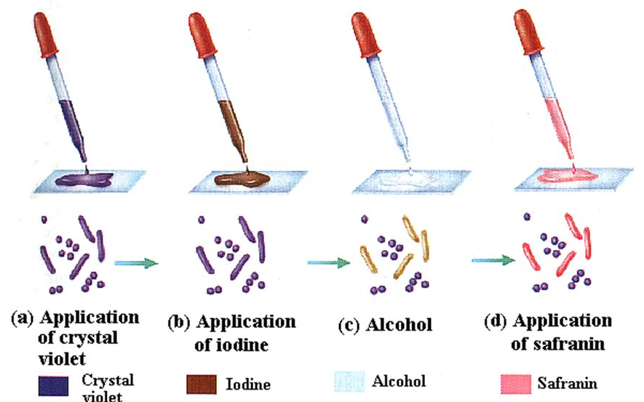
Gram Stain Reaction
Developed in 1884 by Danish bacteriologist, HC Gram. Common laboratory test for identifying bacteria at site of suspected infection.
Based on the ability of the bacterial cell wall to retain a purple (crystal violet) stain after being treated with EtOH. Different stains are due to structural differences in the cell wall of bacteria.
Direct smears are made by emulsifying a colony from culture in saline on a slide, or by transfer of inoculum from a sample swab to a slide.
They are then stained with crystal violet, which forms complexes in the peptidoglycan with iodine.
EtOH is applied to the slide and the complexed crystal violet and iodine either resist or are decolourized with EtOH.
Safranin is used as a counterstain (pink).
Notes:
Gram positive and negative bacteria react different due to their structure. Gram positive bacteria resist decolourisation due to presence of a thick peptidoglycan layer in their cell wall (purple). Gram negative decolourize and retains the counterstain (pink).

Slide 9
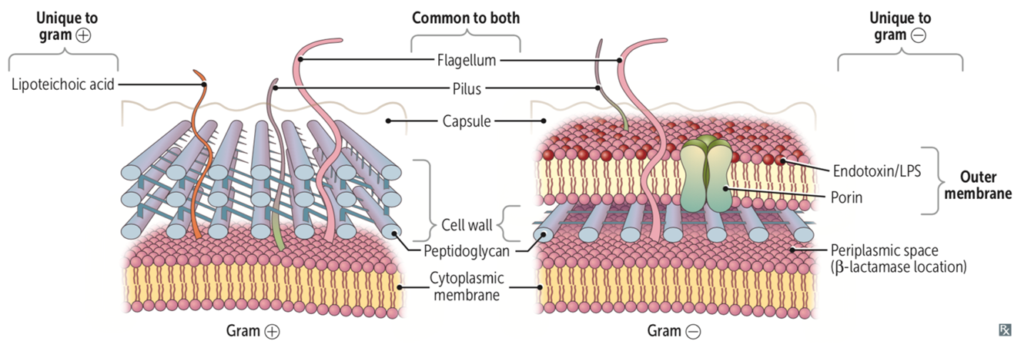
Gram Positive vs. Gram Negative
Bacteria with a THICK peptidoglycan layer retain the PurPle crystal violet stain - Gram Positive ⊕
Bacteria with a THIN peptidoglycan layer stain PiNk - Gram Negative ⊝
Characteristic | Gram Positive | Gram Negative
Number of Layers | ONE (thick peptidoglycan layer) | TWO (thin peptidoglycan layer + outer membrane )
Composition | Peptidoglycan, Teichoic acids | Peptidoglycan, Lipopolysaccharides (LPS)
Outer Membrane | Absent | Present
Porins | Absent | Present
Permeability | More permeable | Less permeable
Notes:
‹#›

Slide 10
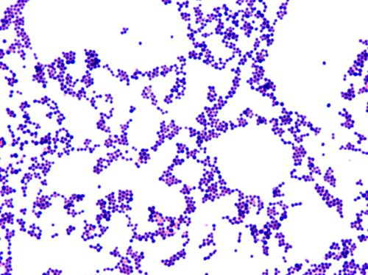
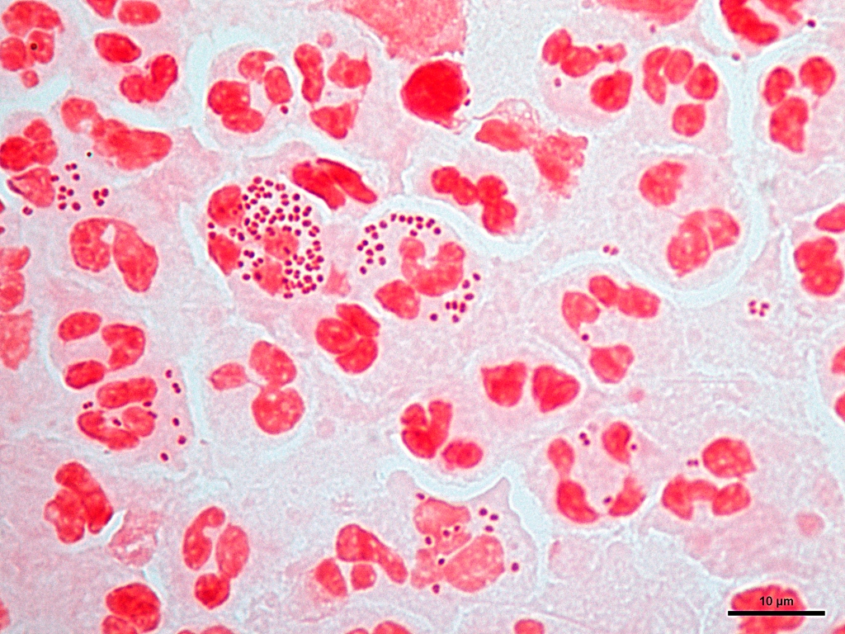
Examples
Gram Positive Cocci (In Clusters)
E.g. Staphylococcus Aureus
Gram Negative Diplococci
E.g. Neisseria Gonorrhoea
Gram Positive Bacilli
E.g. Lactobacilli

Slide 11
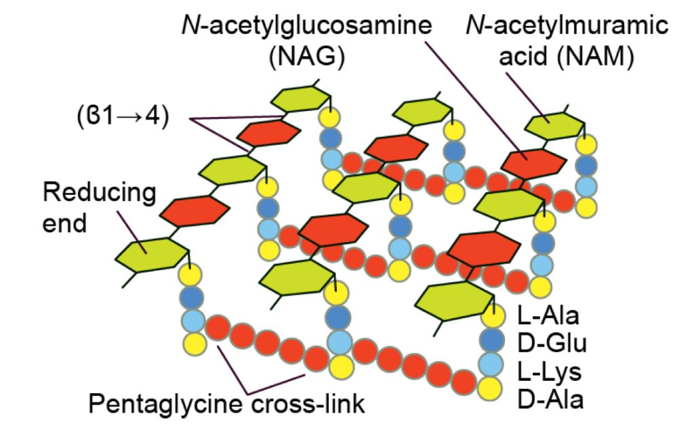
Cell Wall Synthesis
Peptidoglycan is a major component of the cell wall
Complex cross-linked structure - long glycan chains cross-linked by short peptides - that provide stability
Glycan chains: alternating N-acetylglucosamine (NAG) and N-acetylmuramic acid (NAM) residues, linked by peptide bonds
Enzyme that catalyses this reaction is called transpeptidase or penicillin binding protien (inner cytoplasmic membrane)
Gram-positive bacteria (thick) has extensive cross linking of the amino acid side chains
Gram-negative cell walls (thin) have a simpler cross-linking pattern
Notes:
3 Stages:
1. Cytoplasmic Stage –synthesis of precursors N-acetylmuramic acid (NAM) and N-acetylglucosamine (NAG)
2. Membrane stage – transfer of the precursors from cytosol to membrane and incorporation into the growing peptidoglycan
3. Extracellular stage – crosslinking of linear chains of peptidoglycans by membrane-bound transpeptidases

Slide 12
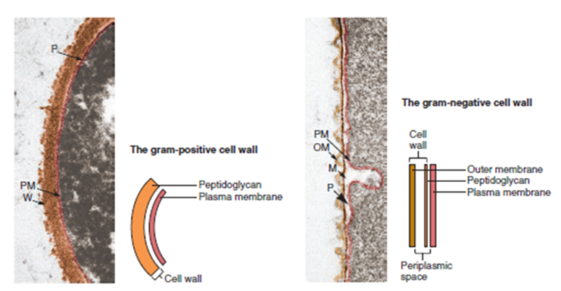
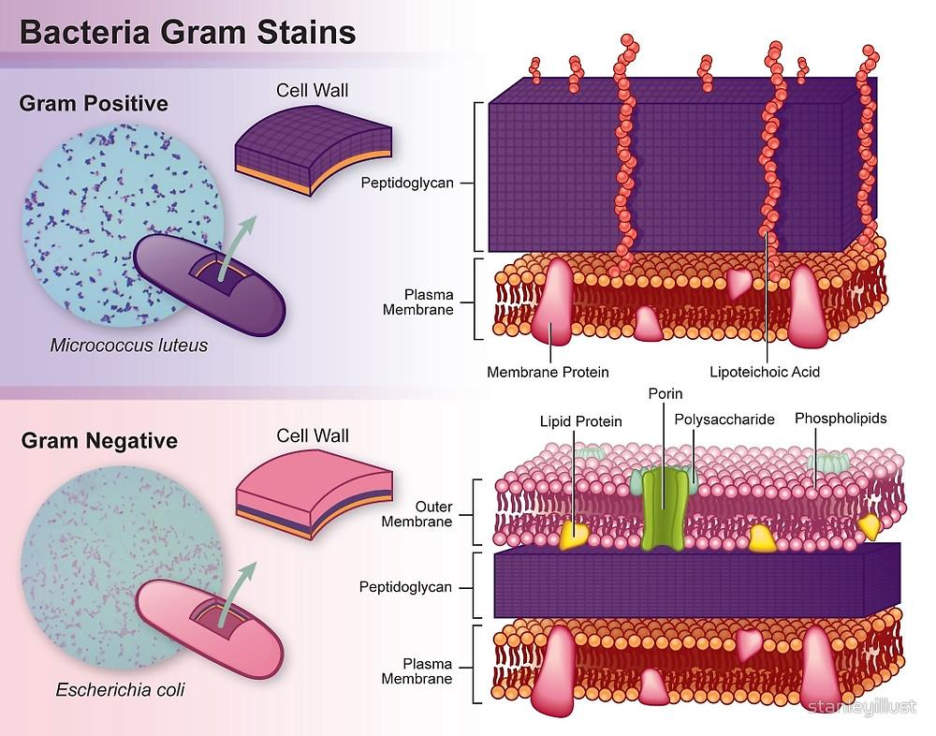
Bacterial Cell Wall
Clinical relevance as antibiotic treatments for infections can differ based on the gram status of the bacteria

Slide 13
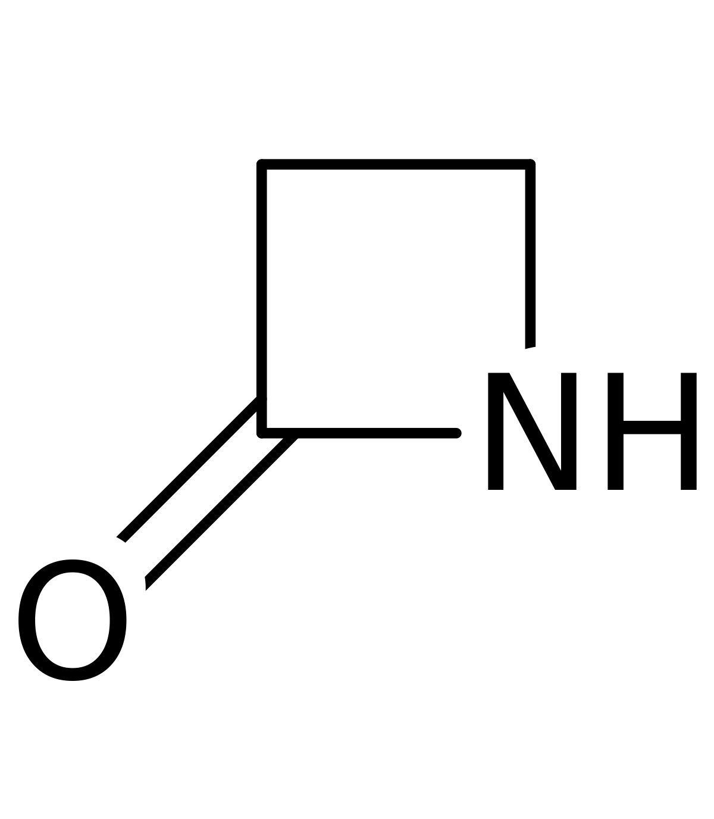
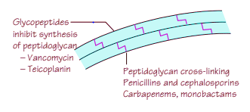
Cell Wall Synthesis Inhibitors (Antibiotics)
β-lactam antibiotics target bacterial cell wall synthesis.
Selective (need the β-lactam ring to act on). Do not act on human cells.
Target: Peptidoglycan
Penicillin, Amoxicillin, Cephalosporins – bind penicillin-binding protein (transpeptidase) which impairs cross-linking
Cell loses its transmembrane osmotic gradient leading to swelling, lysis, and cell death
Useful for gram-positive bacteria
Monobactams and Carbapenems – useful in penicillin allergies and gram-negative bacteria
Non β-lactams such as vancomycin (a glycopeptide which prevents transpeptidation and transglycosylation by binding D-ALA, D-ALA sequences in the cell wall)
β-lactam Ring
Notes:
β-lactam antibiotics such as amoxicillin, penicillin, cephalosporins binds onto the penicillin-binding protein, stimulating it to activate autolytic enzymes which break the peptide bonds, altering the overall structure of the cell wall. Transpeptidases are inhibited from cross-linking pentapeptides → peptide chains are disrupted.
Bacteria that possess beta-lactamases are resistant to β-lactam antibiotics
Mainly effective against gram positive bacteria, streptococcal bacteria, syphilis. Some gram negative bacteria are affected.
β-lactams are not active against species that lack a cell wall (e.g. Mycoplasma) or those with very impenetrable walls such as mycobacteria, or intracellular pathogens such as Brucella, Legionella, and Chlamydia. Vancomycin (a tricyclic glycopeptide antibiotic) can be used, and it disrupts peptidoglycan cross-linkage without needing a β-lactam ring.

Slide 14
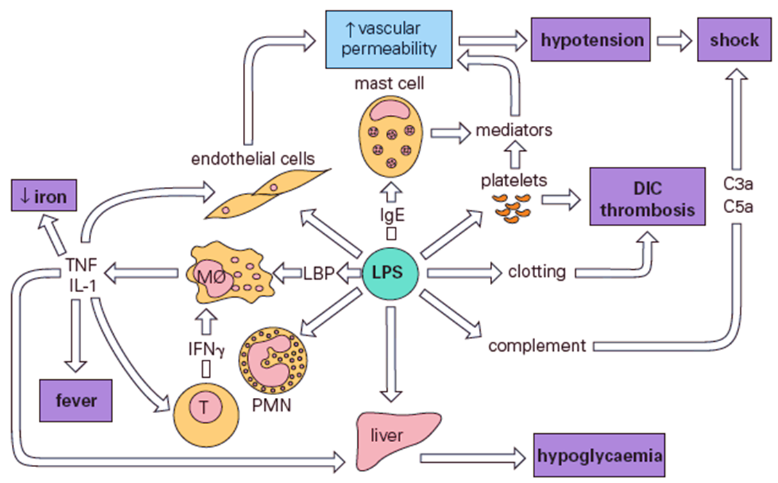
Lipopolysaccharide (LPS)
LPS found in gram-negative bacteria and are composed of:
Outer carbohydrate O-antigen
Core oligosaccharide
Lipid A disaccharide with multiple fatty acid chains
Lipid A is toxic to humans and known as the gram negative endotoxin which produces a strong immune response
IL-1
TNF-α
Notes:
When bacterial cells are lysed by our efficiently working immune system, fragments of membrane containing lipid A are released into the circulation, causing fever, diarrhoea, and possibly fatal endotoxic shock (also called septic shock).

Slide 15
Endotoxins vs. Exotoxins
Toxins are specific metabolic products of an organism that damages the host (directly or by triggering a response).
ENDOTOXIN | EXOTOXIN
Cell wall components of Gram (-) bacteria | Toxins released from living bacteria, Gram (+) and Gram (-) (outside the cell)
Moderately potent | Highly potent
Heat stable – remain toxic at > 60ºC for hours | Heat labile – loose toxicity at > 60ºC
Poorly antigenic (weakly immunogenic) | Highly Antigenic (highly toxic and will stimulate production of anti-toxin)
Bind specific receptors not found on cells | Usually bind to specific cell receptors
Lipopolysaccharides (LPS) – Lipid A is the toxic element | Polypeptides
Synthesis directed by genes in bacterial chromosome | Controlled by genes in plasmid, extrachromosomal DNA
Produces fever in the host via IL-1 and TNF-alpha | Generally do not induce fever in the host
Not always toxic, can induce immune response via TLRs | Classes: neurotoxins, enterotoxins, and cytotoxins
Notes:
‹#›

Slide 16
Virulence Factors
Bacteria can also have structures called virulence factors that allow them to cause infection more easily.
Capsule: polysaccharide outer coating that provide protection from phagocytosis.
Slime layer: extracellular polysaccharide that allow bacteria to stick to smooth surfaces.
Pili: projections that allow bacteria to adhere to host tissue. Allow bacteria to transfer DNA between themselves (antibacterial resistance)..
Toxins: increase damage to host and ability of bacteria to evade the immune system.
Spores: non-replicating form that is resistant to environmental stressors for long periods of time (e.g., high temperatures, low nutrient availability)
Flagella: provide bacteria with motility
Notes:
Encapsulated bacteria: SHiNE SKiS – Salmonella, Hemophilus Influenza B, Neisseria meningitidis, E.coli, Strep pneumonia, Klebsiella pneumonia, Group B strep (strep agalactiae)

Slide 17
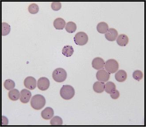
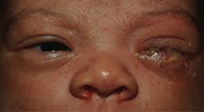
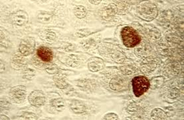
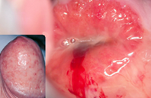
Atypical Bacteria
Bacteria that do not colour with gram-staining (colourless) resulting in a classification that is neither Gram(-) nor Gram(+).
Chlamydiaceae (Chlamydia Pneumoniae)
Legionella (Legionalle pneumophila)
Mycoplasmataceae (Mycoplasma pneumoniae)
Rickettsiaceae
Some lack a peptidoglycan layer so they do not retain crystal violet or safranin stain
Can be naturally resistant (peptidoglycan is the site of β-lactam antibiotics)
Macrolides (erythromycin) can be effective (target protein synthesis)
Notes:
‹#›

Slide 18
Treatment of Atypical Bacteria
Community‐acquired pneumonia (CAP) is caused by various pathogens, traditionally divided into 'typical' and 'atypical'. Initial antibiotic treatment of CAP covers both typical and atypical pathogens.
 | Macrolides (Erythromycin) | Tetracyclines (Doxycycline) | Quinolones (Levofloxacin, Moxifloxacin) | Chloramphenicol
MECHANISM | Inhibits 50S Subunit | Inhibits 30S Subunit | Inhibits DNA Synthesis | Inhibits 50S Subunit
Mycoplasma | ++ | ++ | ++ | ++
Chlamydia/Chlamydophila | ++ | ++ | ++ | ++
Rickettsia | - | ++ | - | ++
Legionella | ++ | + | ++ | ?

Slide 19
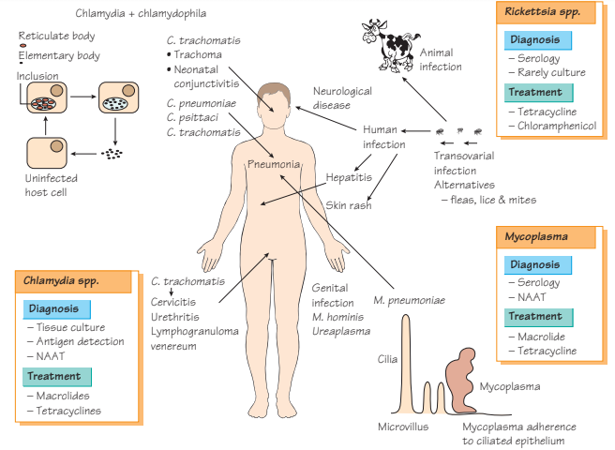

Slide 20
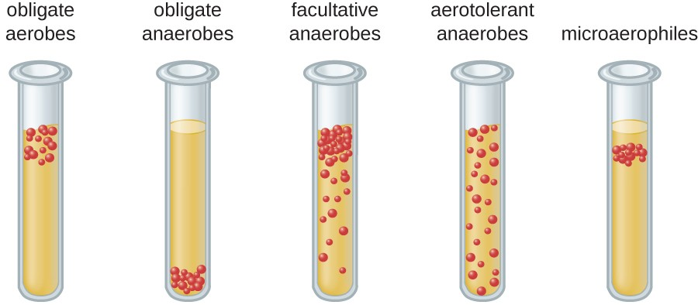
Aerobe vs. Anaerobe
 | Obligate Aerobe | Facultative Anaerobe | Obligate Anaerobe | Aerotolerant Anaerobes | Microaerophiles
O2 Requirement (metabolism) | Aerobic (require oxygen) | Both aerobic and anaerobic | Anaerobic (O₂ is toxic) | Anaerobic growth, can survive in presence of O₂ | Aerobic only (O₂ required)
Growth | High [O₂] | Presence or Absence of O₂ | Absence of O₂ | O₂ has no effect on growth pattern | Low [O₂]
Infective Sites | Skin, lungs, blood | Most infections | GI, abscesses | Vaginal canal | H. Pylori in stomach
Example | Mycobacterium Tuberculosis | Escherichia Coli | Clostridium Difficile | Lactobacilli

Slide 21
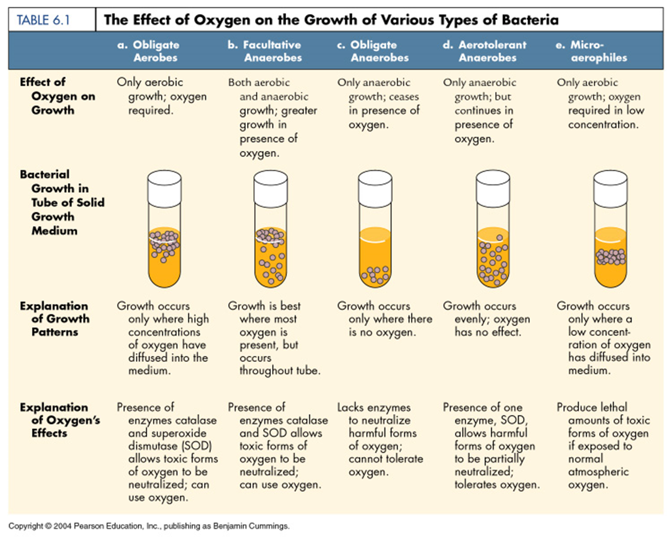

Slide 22
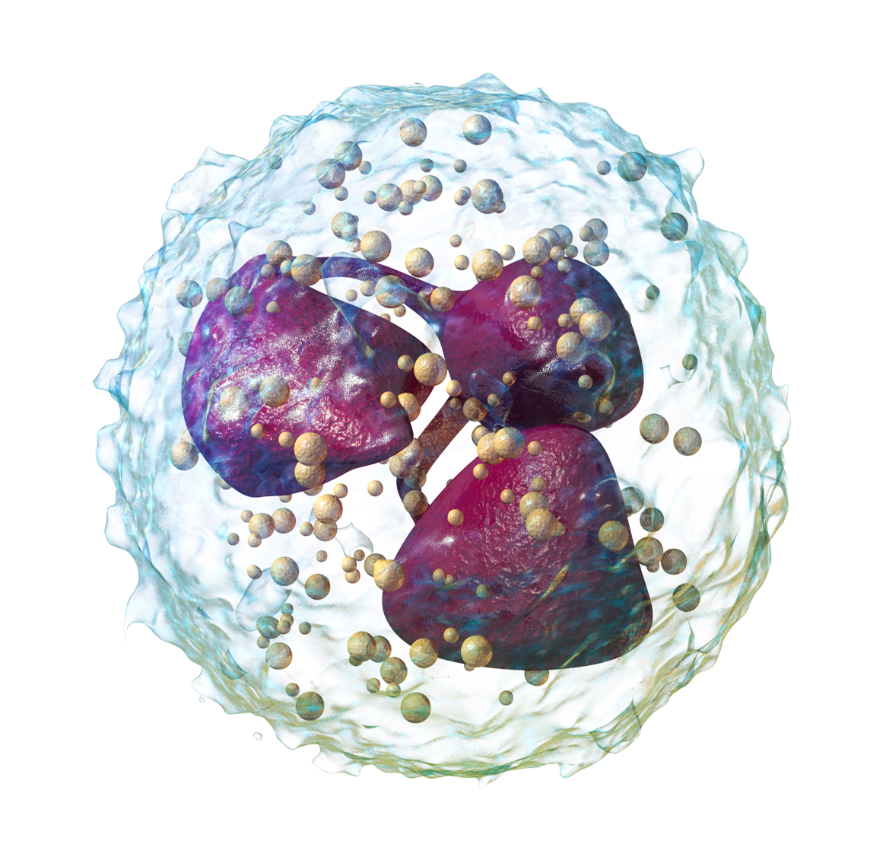
Immune Response: Innate vs. Adaptive
There are two systems that work together to mount an effective immune response to pathogens.
Characteristics | INNATE | ADAPTIVE (Hummoral or Cell-Mediated)
Specificity | Structures shared by groups of pathogens | Antigens specific to microbial and non-microbial agents
Response | Non-specific, Rapid (min-hrs) | Highly specific, slow (days)
Memory | None | YES
Self-Reactivity | None | None (abnormal - autoimmunity)
Cells Involved | Neutrophils, Phagocytes, NK Cells | Lymphocytes (T and B Cells)
Anatomic Components | Skin (tight junctions), Mucosa | Lymph nodes, spleen, MALT
Pathogen Recognition | Toll-like Receptors (TLR) detect Pathogen Associated Molecular Patterns (PAMPS) | Antigen presentation and memory. Second exposure is a faster response.
Blood Proteins | Complement system, CRP | Antibodies
Examples of PAMPS
LPS
Flagellin
Nucleic acids (viruses)

Slide 23
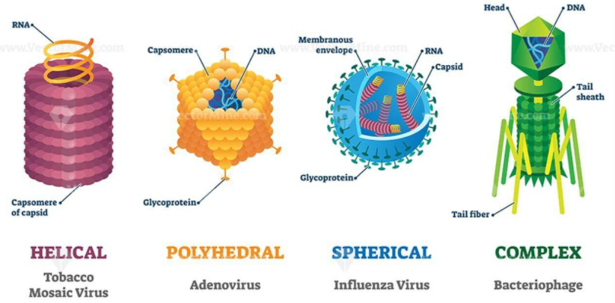
Virology
Viruses are obligate intracellular parasites, meaning they require a host cell for metabolism and replication.
Smallest infectious agents that contain a nucleic acid genome (RNA or DNA).
Viron (infectious unit): nucleic acid enclosed in a protein shell (capsid), surrounded by a lipid membrane (envelope).
Replicate only in living cells. Genome contains ‘instructions’ for utilzing host cell machinery to synthesize viral proteins that continue the viral life cycle.
DNA viruses (replicate in nucleus) are mostly double-stranded, while RNA viruses (replicate in cytoplasm) are single-stranded.
DNA viruses are stable while RNA viruses are unstable.
Notes:
Capsid: The protein shell, or coat, that encloses the nucleic acid genome.
Envelope: A lipid-containing membrane that surrounds some virus particles. It is acquired during viral maturation.
Nucleocapsid: The protein–nucleic acid complex representing the packaged form of the viral genome.
Virion: The complete virus particle.

Slide 24
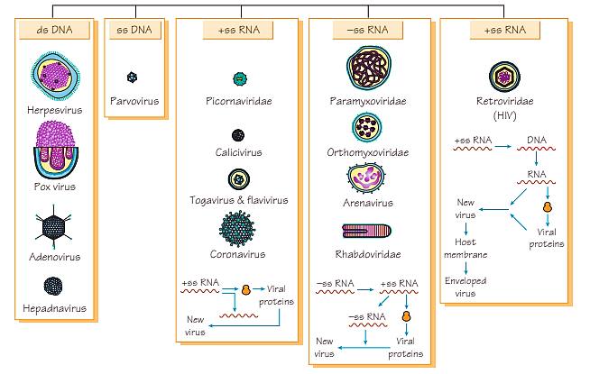

Slide 25
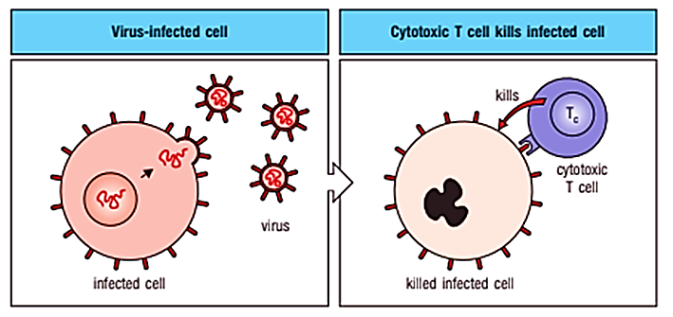
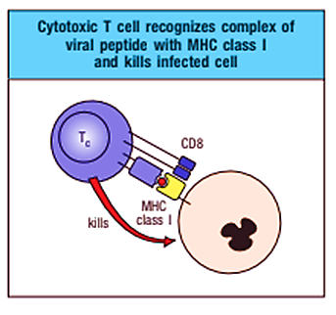
Immune Response to Viruses
Notes:
The aim of the immune response in a viral infection is to eliminate both the virus and the host cells harbouring or replicating the virus. Interferons, NK cells, CD4 TH1 responses, and CD8 cytotoxic killer T cells are more important for viral infections than for bacterial infections.
Viral RNA (especially dsRNA) and DNA, are potent activators of TLRs and other pathogen pattern receptors to initiate these interferon and cytokine responses. Interferons and other cytokines trigger early local and systemic responses. Induction of fever and stimulation of the immune system are two of these systemic effects.
T cell–mediated/Adaptive immunity promotes antibody and inflammatory responses (CD4 helper T cells) and kills infected cells (CD8 cytotoxic T cells). CD8 killer T cells promote apoptosis in infected cells after their T-cell receptor binds to a viral peptide presented by a class I MHC protein. The peptides expressed on class I MHC antigens are obtained from viral proteins synthesized within the infected cell (endogenous route).
Interactions of the TCR and MHC I creates a space into which perforin and granzymes (degradative enzymes) are released to induce apoptosis in the target cell. CTLs kill infected cells and, as a result, eliminate the source of new virus. Cell-mediated immunity is especially important for resolving infections by syncytia-forming viruses (e.g., measles, herpes simplex virus, varicella-zoster virus, HIV), which can spread from cell to cell without exposure to antibody, and by noncytolytic viruses (e.g., hepatitis A and measles viruses).

Slide 26
Antigenic Drift vs. Antigenic Shift
Feature | Antigenic Drift | Antigenic Shift
Mechanism | Small mutations during replication lead to changes in the genes. | Viruses swap whole sections of their genomes, leading to changes in genes.
Changes to genome | Small or point mutations. | Large changes to sections of genome.
Result | Can help viruses gradually evolve and evade immune systems. | Can produce entirely new virus strains.

Slide 27
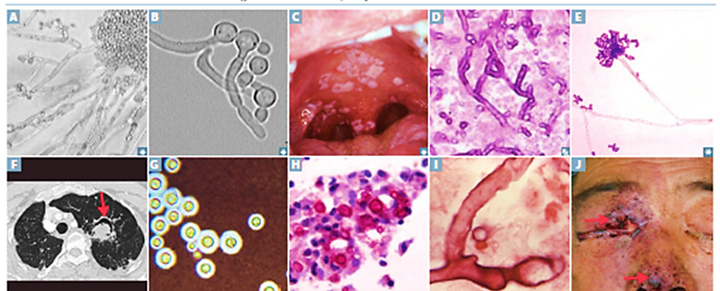
Mycology
Definition: the study of fungi (group of spore-producing organisms feeding on organic matter)
Diverse in terms shape, size, and means of infecting humans
Eukaryotes (true nucleus and complex internal structures)
Often found as environmentally resistant spores and moulds, but can cause humans disease (skin infections and pneumonia)
CD4 T-cell responses stimulate neutrophils and macrophages. Therefore, fungi are particularly dangerous to immunocompromised individuals
OPPORTUNISTIC MYCOSIS
Candidiasis
Aspergillosis
Mucormycosis
Fusariosis
In immunocompromised individuals.
SYSTEMIC MYCOSIS
Histoplasma Capsulatum
Blastomyces Dermatitidis
Coccidioides Immitis
In healthy or immunocompetent individuals.
Notes:
Many fungi are opportunists and are usually not pathogenic except in an immunocompromised host. Causes of immunocompromise include AIDS, azotemia, diabetes mellitus, lymphoma, leukemia, other hematologic cancers, burns, and therapy with corticosteroids, immunosuppressants, or antimetabolites. Patients who spend more than several days in an intensive care unit can become compromised because of medical procedures, underlying disorders, and/or undernutrition.
CD4 T-cell responses stimulate neutrophil and macrophage responses in immunity against fungi. Patients deficient in neutrophils or these CD4 T cell–mediated responses (e.g., patients with AIDS) are most susceptible to fungal (opportunistic) infections. Fungal infections can be held in check, undetectable for decades, by effective T cell–induced immune and neutrophil responses, only to awaken upon neutrophil or T-cell deficiency and become lethal.
Common Antifungals;
Azoles e.g. Fluconazole
Allylamine derivatives e.g. Terbinafine
Echinocandins e.g. Caspofungin
Pyrimidine derivatives e.g. Flucytosine
Polyenes e.g. Amphotericin B

Slide 28
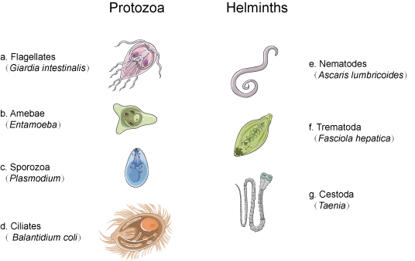
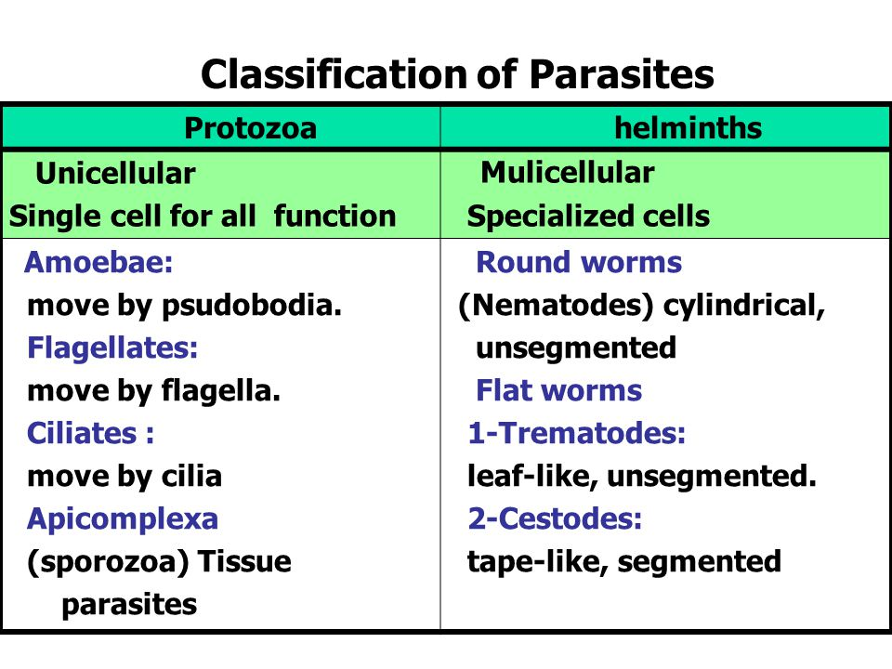
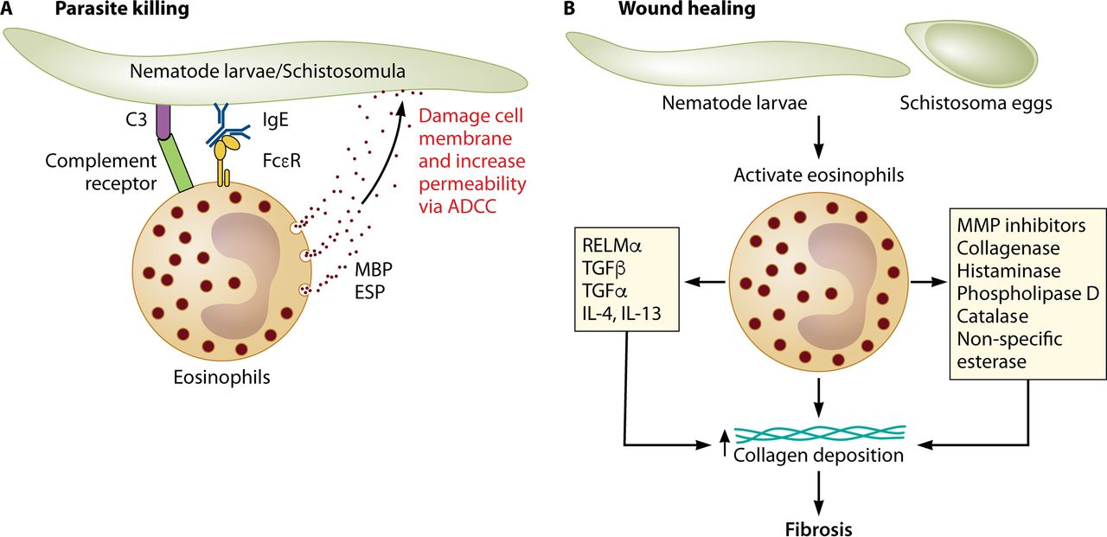
PARASITES
Parasites are complex microbes that live on or in a host organism, and get its food at the expense of its host.
Classified as eukaryotic (can be unicellular and multicellular)
Range in size (protozoa that are 4 to 5 µm in diameter to tapeworms that are up to 10 meters in length)
IgE, eosinophil, and mast cell action is triggered by helminth infections and important for elimination

Slide 29
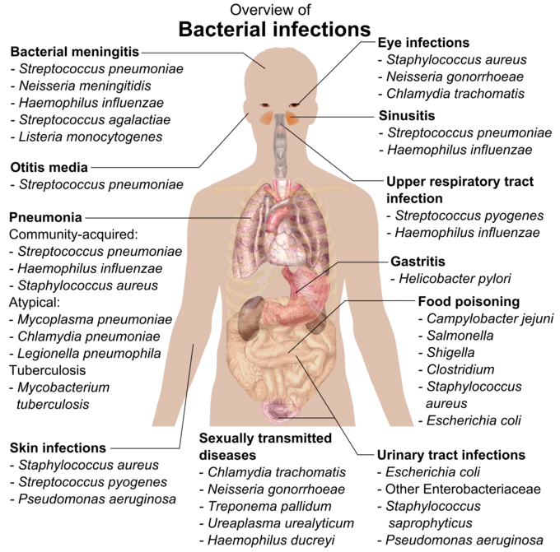

Slide 30
THANK YOU!

