Slide 1
Neurology 1
Brief overview of the basics of the Brain and CNS
Presented by: Arany Umasuthan

Slide 2
What we will be going through today:
LEARNING OUTCOMES
01
04
General Overview
Blood Brain Barrier
02
05
Cells of PNS
Ventricular System overview
03
06
Cells of CNS
Cranial Nerves + Meninges

Slide 3
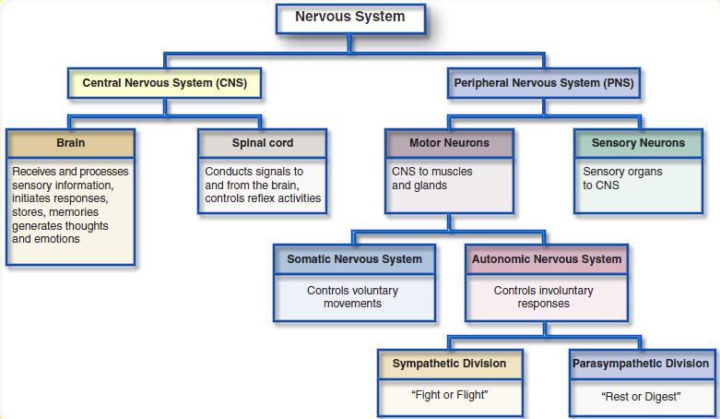
THE NERVOUS SYSTEM BREAKDOWN
Efferent
Afferent

Slide 5
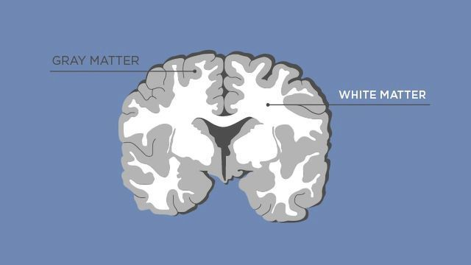
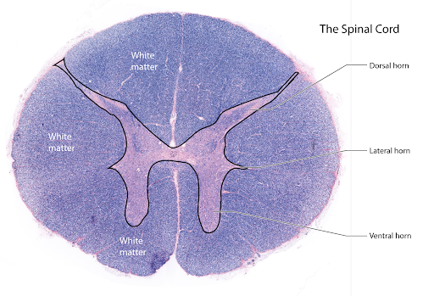
Understanding Terminology
Term | Meaning
Gray Matter | Collection of Unmyelinated dendrites and cell bodies
White matter | Collection of myelinated fibers
Ganglion | Collection of Cell bodies outside of the CNS

Slide 6
Definitions:
Somatic : to or from skin and skeletal tissue
Visceral : to or from internal organs
Special : If it travels from our special senses (i.e.: sight, smell, taste, hearing and balance -
NOT touch)
Notes:
MAYBE brachial?

Slide 7
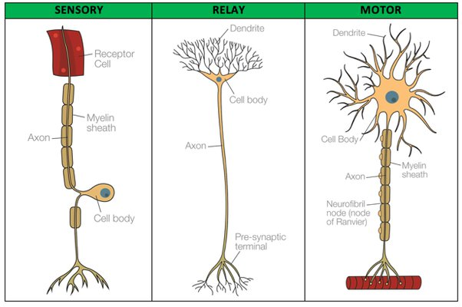
Understanding Terminology
Term | Meaning
Motor Neuron | Efferent General Somatic = Spinal General Visceral = Autonomic UMN and LMN
Sensory Neuron | Afferent General Somatic = Spinal General Visceral = Autonomic
Interneurons | Relay information between sensory and motor
Notes:
GSE- general somatic efferents carry motor information to skeletal muscle fibres and cause the muscles to contract. The cell bodies of these motor neurons are found in the ventral/anterior horn of the spinal cord or the anterior regions of the brainstem.
GVE - General Visceral efferents on the other hand are neurons of the autonomic nervous system carrying involuntary motor information. Specifically, the general visceral motor efferents can be classified as sympathetic or parasympathetic neurons. They carry efferent motor information to cardiac muscle, smooth muscle, or visceral organs and blood vessels and glands.
GSA- neurons have their cell bodies in the posterior portion of the spinal cord (dorsal horn) or posterior root ganglia. The sensory receptors for GSA do not originate in smooth muscle cell, cardiac or exocrine glands. They originate from skin, skeletal muscle, bone, ligaments and special cense organs.
GVA – sensory cell bodies are associated with the autonomic nervous system and they are located again in the dorsal root ganglia. They transmit information from visceral organs to the CNS – They transmit visceral pain, nausea, stretch information, pressure, chemical stimulation etc. The sensory receptors for general visceral afferents are in visceral organs, blood vessels and glands.

Slide 8
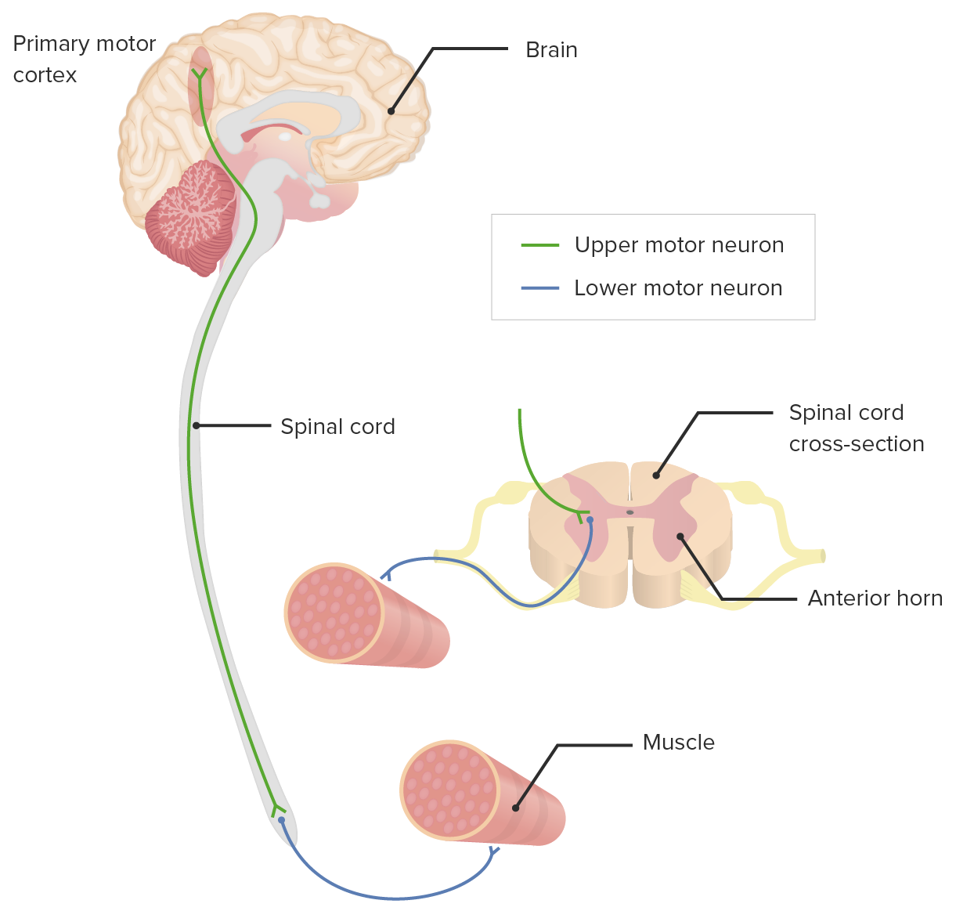
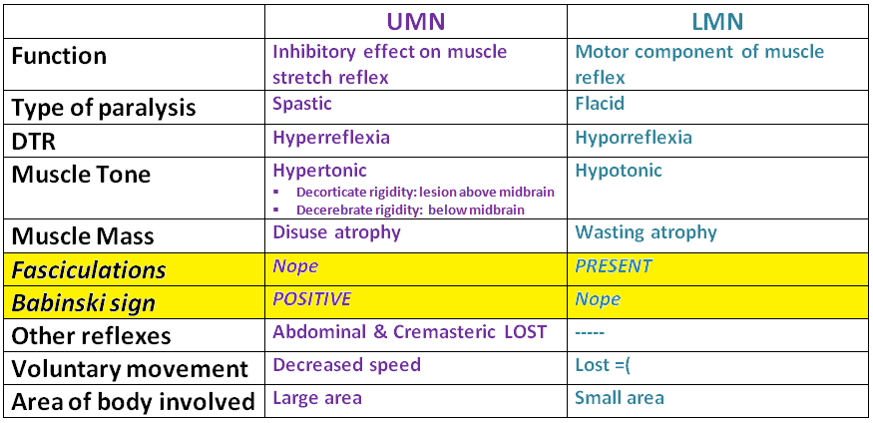
UMN vs LMN

Slide 9
Understanding Terminology
Term | Meaning
Special Motor | Special visceral motor muscles derived from pharyngeal arches (Mastication, facial expression etc.)
Special Sensory | Special somatic sensory senses derived from ectoderm (e.g. sight, sound, balance). Special visceral sensory senses derived from endoderm (e.g. taste, smell)

Slide 10
WHAT ARE THE CELLS OF THE NERVOUS SYSTEM?

Slide 11
Neuron
Functional unit of the nervous system responsible for transmitting signals to and from the CNS and PNS
DENDRITES
SOMA
Projections of the neuron - receive information from adjacent neurons
Contains nucleus and functional organelles
Nissl Bodies
MYELIN SHEATH
AXON
SCHWANN/
OLIGODENDROCYTE
CELL
NERVE ENDING
area of neurotransmitter release

Slide 12
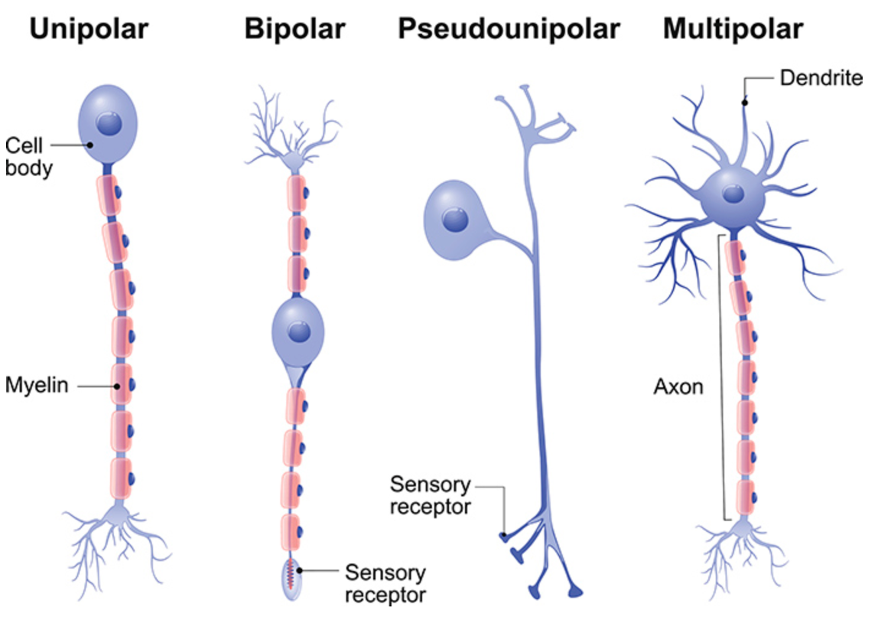
Types of Neurons
Notes:
There are a number of structurally different neurons presents throughout the cns.
1) A unipolar neuron is a type of neuron in which only one neurite process extends from the cell body Unipolar brush cells are found in the cerebellum and in the granule region of the dorsal cochlear nucleus.
2) A bipolar neuron has two extensions – these are specialized sensory neurons that mediate the transmission of special senses such as smell, sight, taste, hearing, vestibular function. Such neurons are found in the retina, and in the ganglia of the vestibulocochlear nerve.
3) A pseudounipolar neuron, is a type of sensory neuron found in the peripheral nervous system which is split into two branches – one branch running to the periphery and the other to the spinal cord. These types of neurons are special because they have a single branched process that serves two function- one branch carries peripheral sensory input and the other carries central input from the body to the spinal cord. These neurons are found in the dorsal root ganglia as well as in the sensory ganglia of cranial nerves V,VII, IX, X and all the mixed cranial nerves.
4) Multipolar neurons posses a single axon and many dendrites allowing for multiple information integration. These types of neurons consist the majority of the neural cells in the central nervous system,.

Slide 13
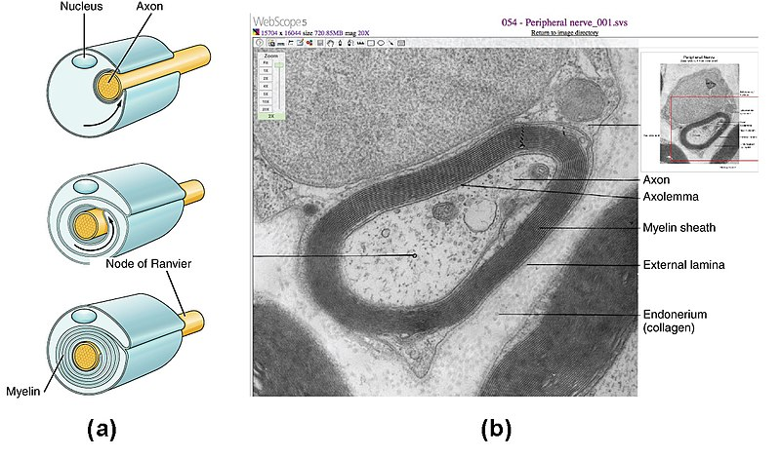
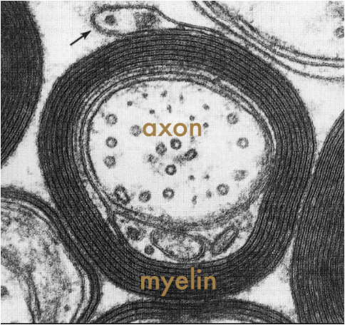
The Axon
Axon hillock - where action potential is generated
Axolemma - plasma membrane of the axon, maintains the
membrane potential
Cytoskeleton - microtubules (dynein and kinesin) responsible for
rapid axon transport anterograde and retrograde

Slide 14
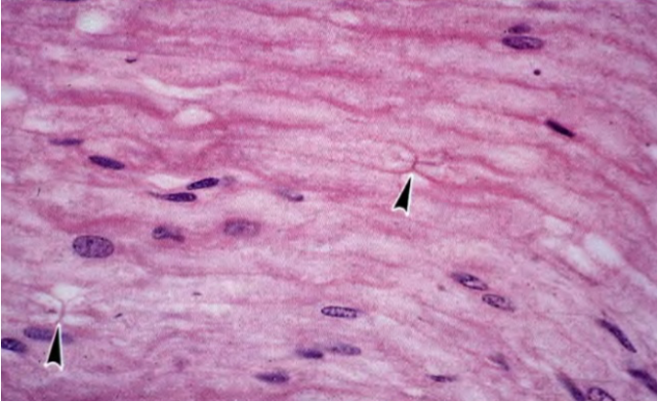
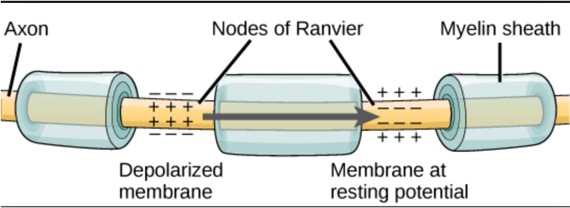
Nodes of Ranvier
Nodes of Ranvier are gaps between sections of myelination and act as “booster” stations to give strong depolarization (can boost conduction speed by 100X) = Saltatory Conduction

Slide 15
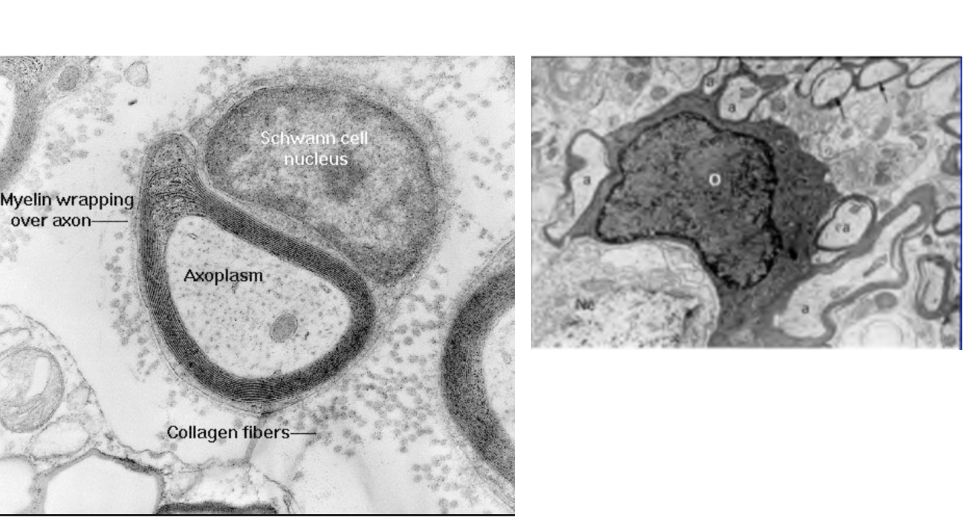
Myelin
Myelin contains 70-85% lipid and 15-30% protein and therefore has a high lipid to protein ratio
In the CNS, the oligodendrocyte sends cell processes to myelinate multiple segments on many axons.
In the PNS, one Schwann cell forms a single myelin sheath

Slide 16
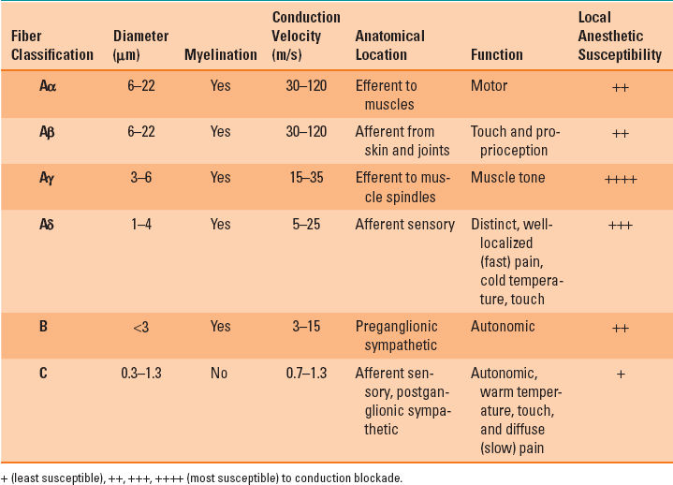
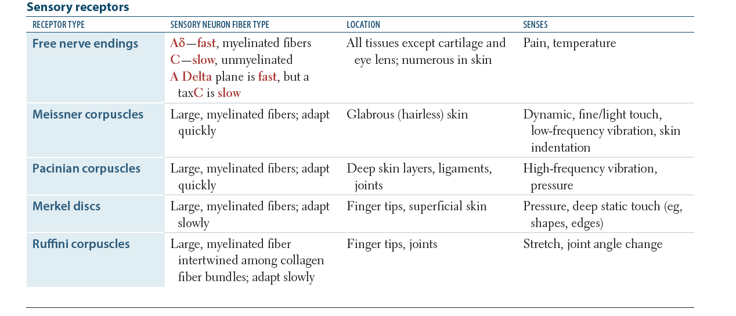
ARE ALL NERVES COVERED IN MYELIN?
No!! They can be either myelinated or unmyelinated. This will affect their speed of conduction and time that it takes for central processing

Slide 17
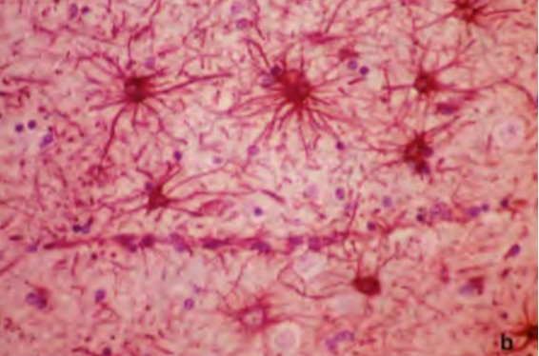
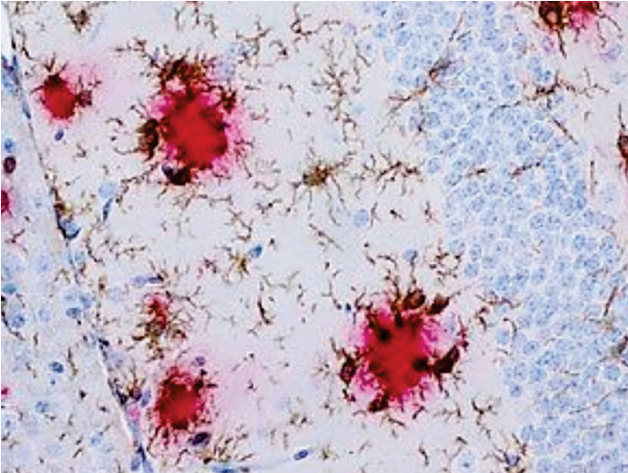
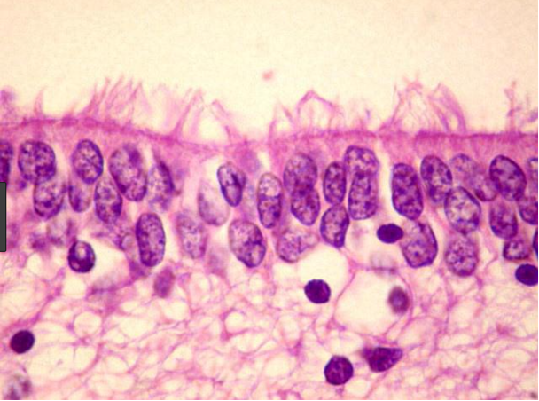
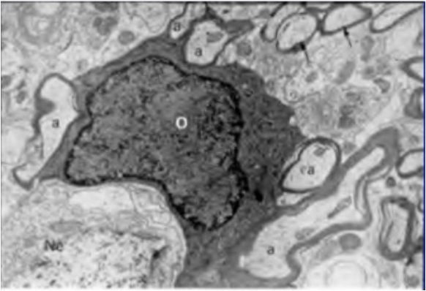
CNS GLIAL CELLS
Glial cells are about 10x more abundant than neuronal cell
Derived from the neuroepithelium in neural tube
Four types of Cells
Astrocytes
Oligodendrocytes
Microglia
Ependymal Cells
Line the blood brain barrier
Responsible for myelination
Resident macrophages of the CNS
Secretory epithelium that lines the ventricles
Provide structural support
Respond to cellular injury
Produces cerebrospinal fluid (CSF)

Slide 18
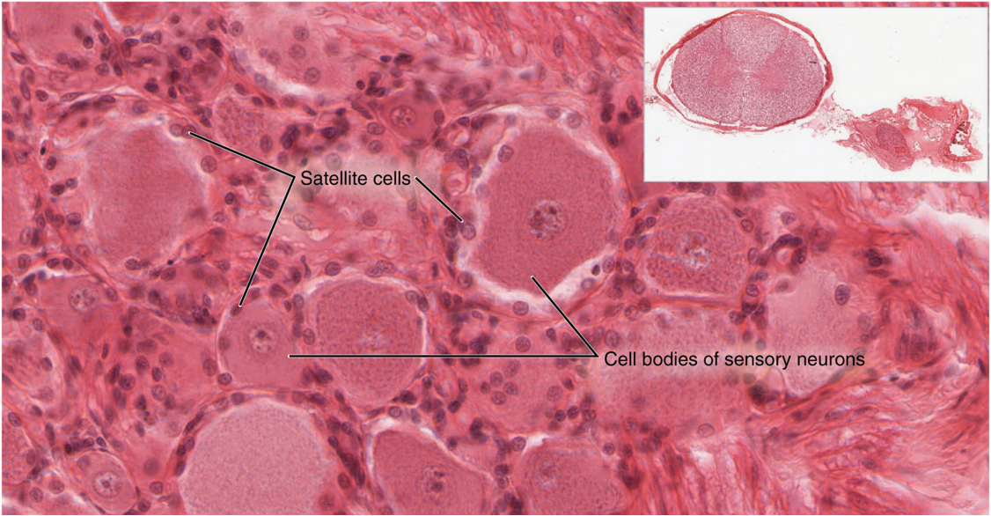
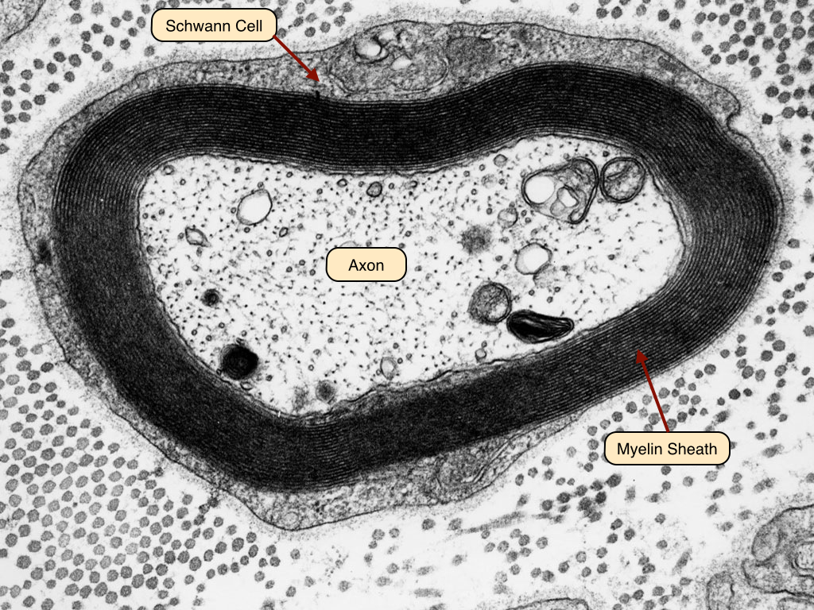
PNS GLIAL CELLS
Satellite cells
Neural Crest Origin
Supply nutrients to the surrounding neurons
Some structural function
Protective, cushioning cells
Schwann Cells
Neural Crest Origin

Slide 19
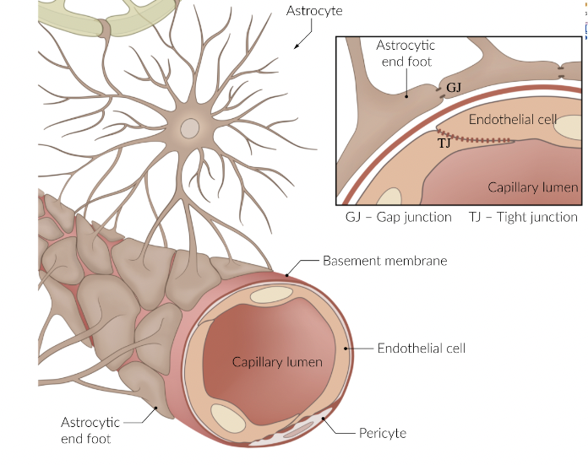
BLOOD BRAIN BARRIER
Made up of :
Capillary endothelial cells
Basal lamina/basal membrane
Astrocytes
Pericytes
Provides protection and selective transport of the CNS
Notes:
ƒ Tight junctions between nonfenestrated
capillary endothelial cells
ƒ Basement membrane
ƒ Pericytes
ƒ Astrocyte foot processes
Glucose and amino acids cross slowly by carrier mediated
transport mechanisms.
Nonpolar/lipid-soluble substances cross rapidly
via diffusion.

Slide 20
Are there exceptions to the BBB?

Slide 21
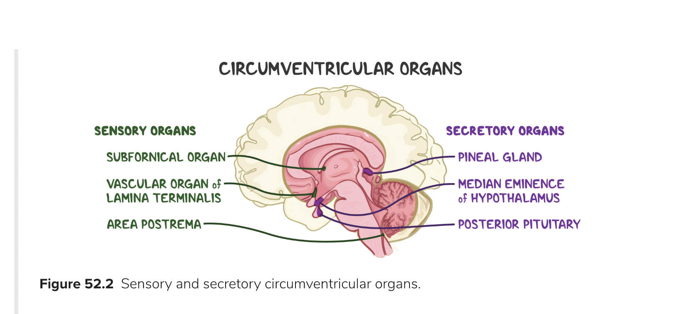
Circumventricular organs
YES!
A group of structures lacking a blood-brain barrier that are centered around the ventricles of the brain:
Neurohypophysis and medial eminence
Release and control of pituitary hormones
Area postrema
Chemotactic trigger zone, causes vomiting by detecting circulating toxins
Pineal gland
Melatonin and circadian rhythm control
Subcommissural organ, organ vasculosum & subfornical organ
OVLT- osmoreceptors
Notes:
OVLT - [organum vasculosum lamina terminalis]

Slide 22
Ventricular System

Slide 23
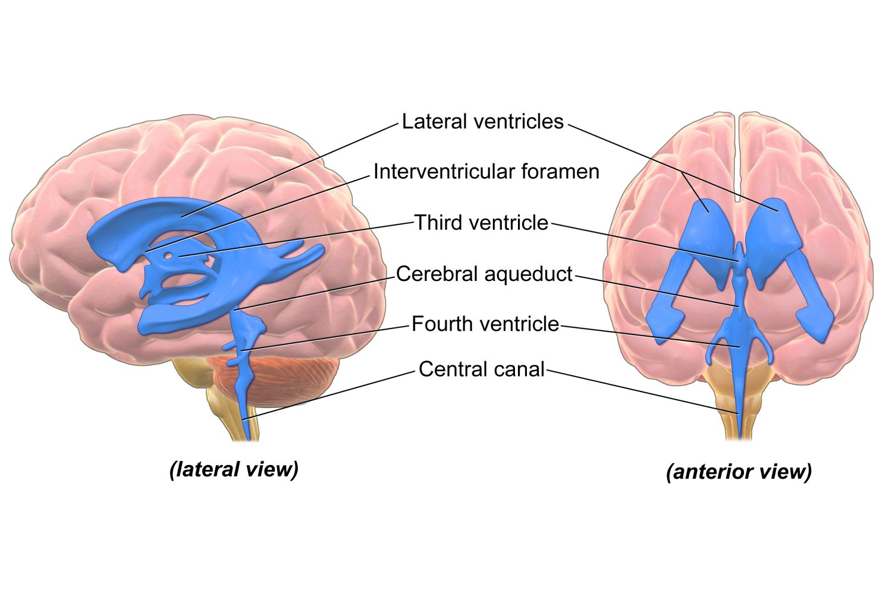
WHAT IS IT?
A set of communicating cavities within the brain
Responsible for the production, transport and removal of cerebrospinal fluid, which bathes the central nervous system

Slide 24
WHAT FLUID IS FOUND IN THE VENTRICULAR SYSTEM?
Cerebrospinal Fluid: a clear, colorless fluid. Composed of very few cells, minimal proteins and different electrolytes.
Functions:
Protection
Buoyancy
Chemical stability
Waste Clearance
Homeostasis (Nutrients)
How is it produced?
Produced in the Choroid plexus
Found in 3rd, 4th and lateral ventricle
By Ependymal cells: simple columnar glial cells which line the ventricles
Notes:
Protection – acts as a cushion for the brain, limiting neural damage in cranial injuries.
Buoyancy – by being immersed in CSF, the net weight of the brain is reduced to approximately 25 grams. This prevents excessive pressure on the base of the brain.
Chemical stability – the CSF creates an environment to allow for proper functioning of the brain, e.g. maintaining low extracellular K+ for synaptic transmission.
Production
Production is continuous and fluid is circulated, reabsorbed and drained into the Dural venous sinuses

Slide 25
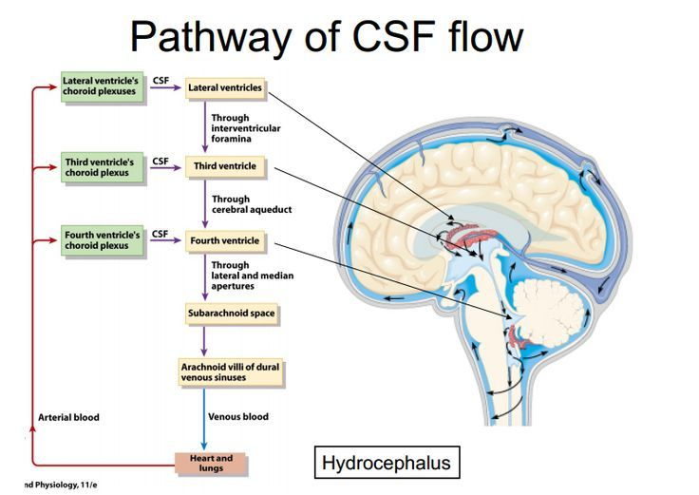
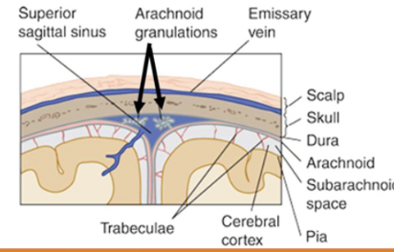
CSF PATHWAY
Reabsorption: from subarachnoid space→ reabsorption in the arachnoid granulations → drainage into the Dural venous sinuses
Notes:
into subarachnoid space via median aperture (foramen of Megendie) and lateral apertures (Foramina of Luschka) AND drains
into the central canal of the spinal cord

Slide 26
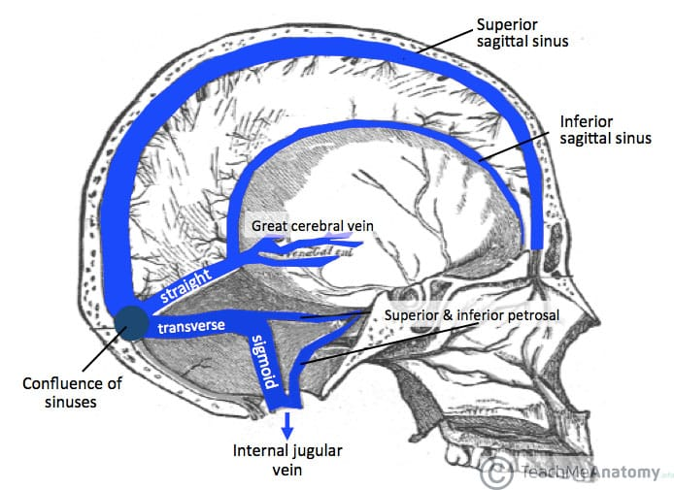
Dural Sinuses

Slide 27
HYDROCEPHALUS
Dilation of ventricles or subarachnoid space due to CSF excess
Four types:
Communicating/non-obstructive Decreased CSF resorption or increased CSF production at the arachnoid villi
Etiology: meningitis, brain tumor
Non-communicating/obstructive Obstructed passage of CSF through the ventricles, proximal to the arachnoid granulation
Etiology: congenital (Arnold Chiari Malformation) tumor, hemorrhage
Normal pressure chronic communicating hydrocephalus - ventricular dilation with normal CSF pressure
“Wet, Wacky & Wobbly” : Urinary incontinence, dementia, frequent falls
Hydrocephalus ex vacuo Ventricular enlargement due to atrophy of the brain (secondary enlargement) - associated with normal aging

Slide 28
Intracranial Pressure
The skull is a fixed space and the ICP is the total volume inside that space
Made up of : Brain, CSF and Blood
Small changes in ICP = compensation in any of the three constitutes

Slide 29
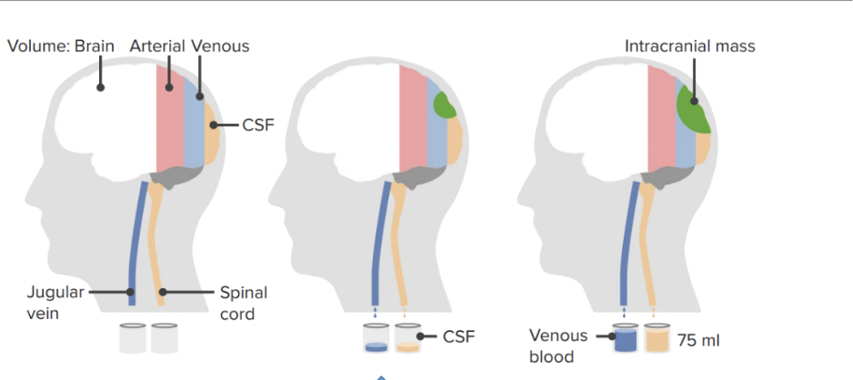
What is the Monro-Kellie Doctrine Hypothesis?
STATES: The fixed cranial compartment is
made up of a volume consisting of blood, CSF and brain tissue
These three components are in equilibrium to maintain a normal ICP
Therefore when one increases the
other must compensate to balance
the pressure.
So what?
As intracranial pressure rises, there is decreased cerebral perfusion, leading to ischemia and cell death
Notes:
The intracranial pressure is inversely related to the
cerebral perfusion pressure (CPP = MAP – ICP)
Image 1 = normal
Image 2 = Intracranial mass → increased ICP → compensation, leading to decreased CSF
and venous blood → ICP maintained
Image 3 = Intracranial mass has grown larger → no more compensation → ICP increased →
arterial blood loss and herniation

Slide 30
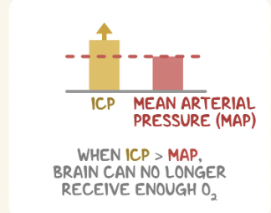
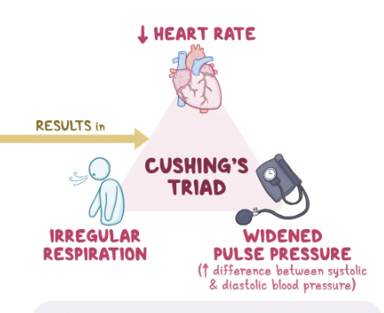
What happens when the ICP is beyond compensation?
In response to an increased ICP = Cushing triad/Cushing Reflex
Bradycardia
Irregular Breathing
Widened Pulse Pressure
Notes:
Once ICP increases beyond compensation 🡪 arterial blood must be decreased
to compensate 🡪 lack of O2 and ischemia to brain tissue
Bradycardia:
SNS 🡪 increases BP & HR 🡪 baroreceptor response due to
Hypertension🡪 PNS activation 🡪 Bradycardia (reflex bradycardia)
Irregular breathing:
increased ICP pushed on the brainstem 🡪 dysfunction of the
respiratory center leading to irregular breathing (Cheyne-Stokes
respiration: rapid breathing followed by apnea)
Widened pulse pressure:
Increased difference between the systolic blood pressure and the
diastolic blood pressure

Slide 31
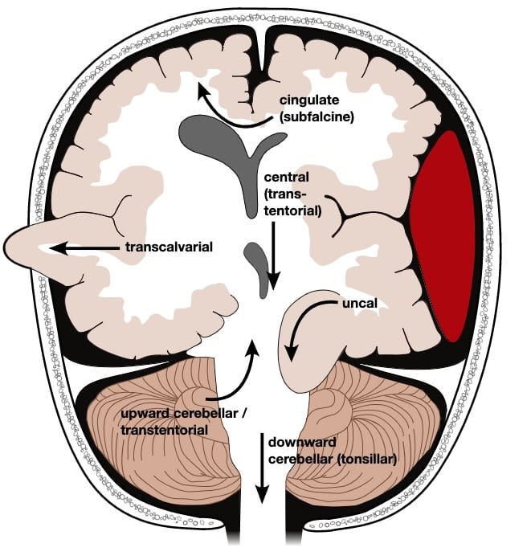
What if ICP continues to increase and Cushings Triad is left untreated?
Herniation
Displacement of brain tissue from one compartment into another or outside the skull
Subfalcine Herniation (most common form): Increased pressure pushing the hemisphere, specifically cingulate
gyrus into and under the falx cerebri
Central herniation: Downward displacement of the brain, specifically the temporal lobes → can pull on CN VI (Abducens)
Cerebellar tonsillar herniation: Caused severe central herniation → cerebellar tonsils herniating through the foramen magnum
Compresses medulla: respiratory arrest, BP instability and death
Transtentorial/uncal: Herniation of the medial temporal lobe, specifically the uncus through the tentorial notch
Leads to: Blown pupil (CNIII), hemiplegia & coma

Slide 32
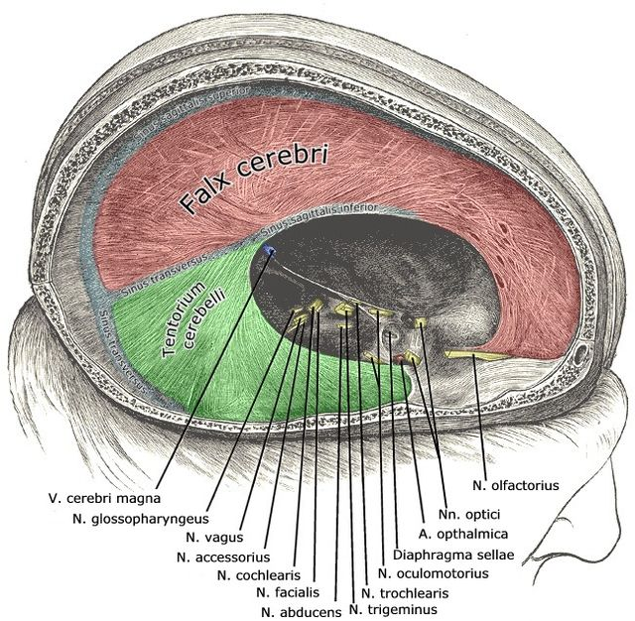

Slide 33
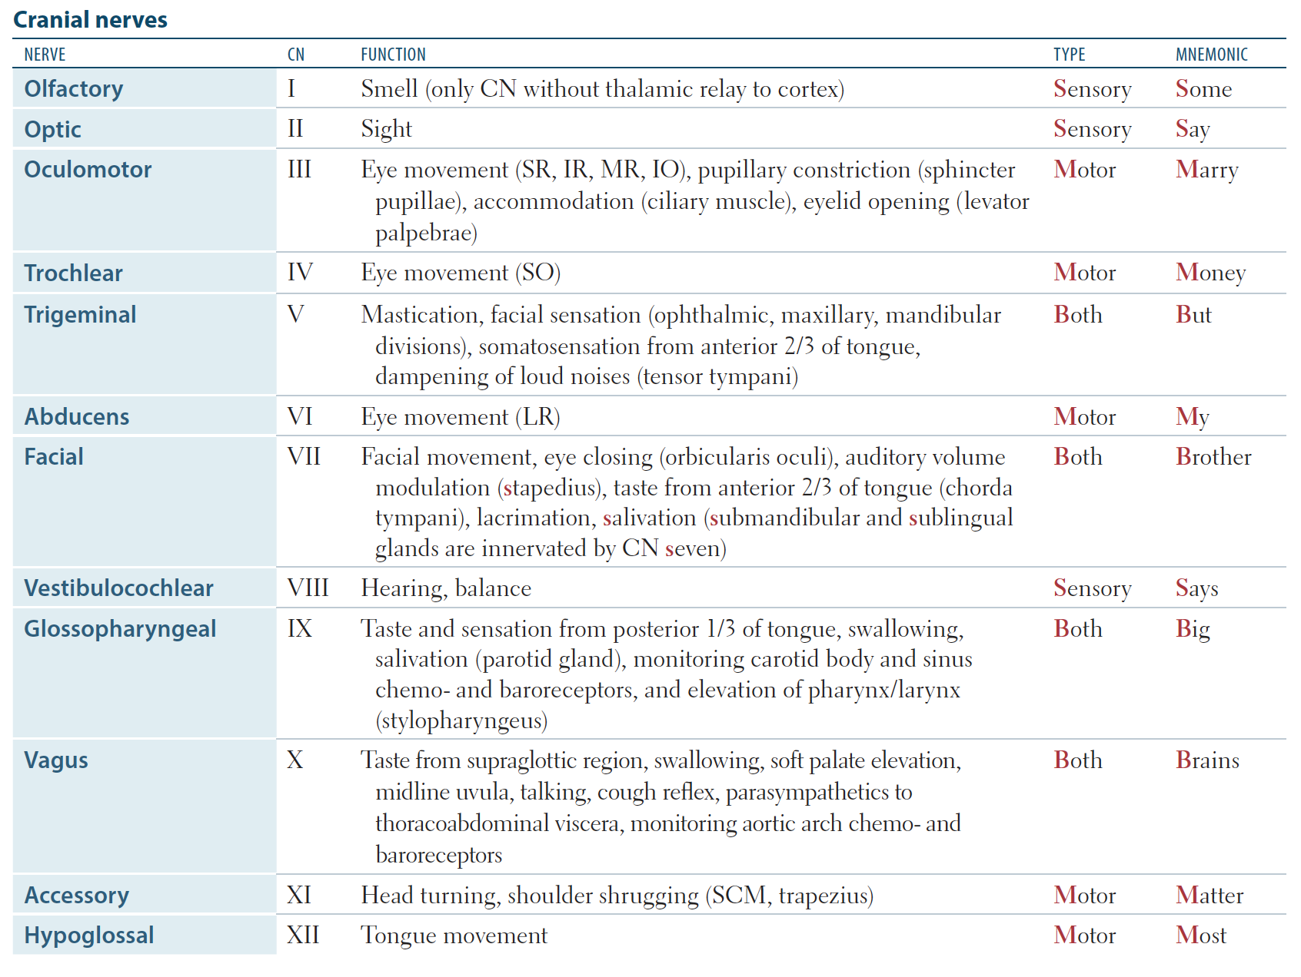
Cranial nerves can be mixed, or just motor or just sensory
Notes:
Spinal nerves are always mixed (meaning motor and sensory)

Slide 34
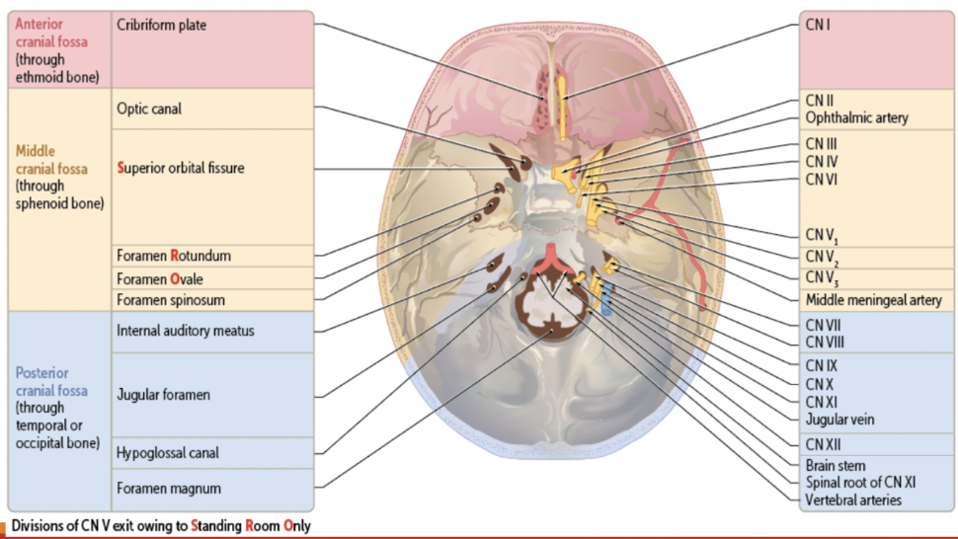
REMEMBER WHICH NERVES COME FROM WHERE

Slide 35
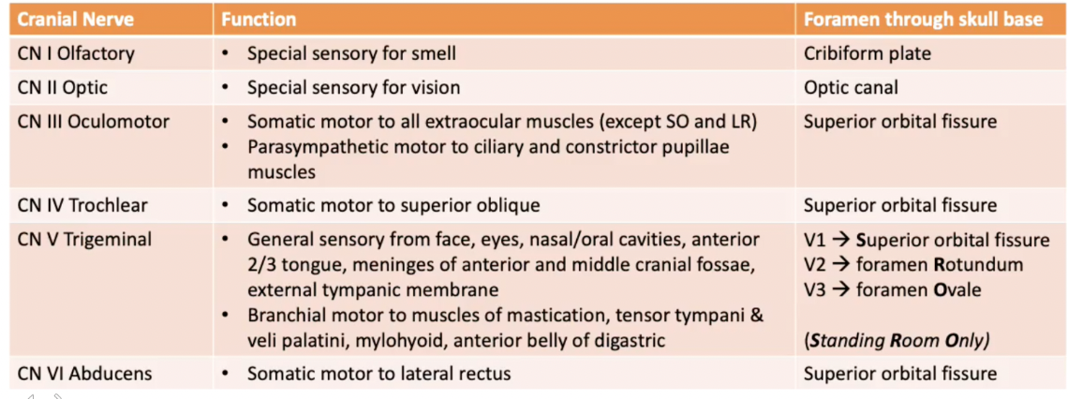
OVERVIEW OF CN

Slide 36
OVERVIEW OF CN

Slide 37
Overview of CN

Slide 38
Meninges

Slide 39
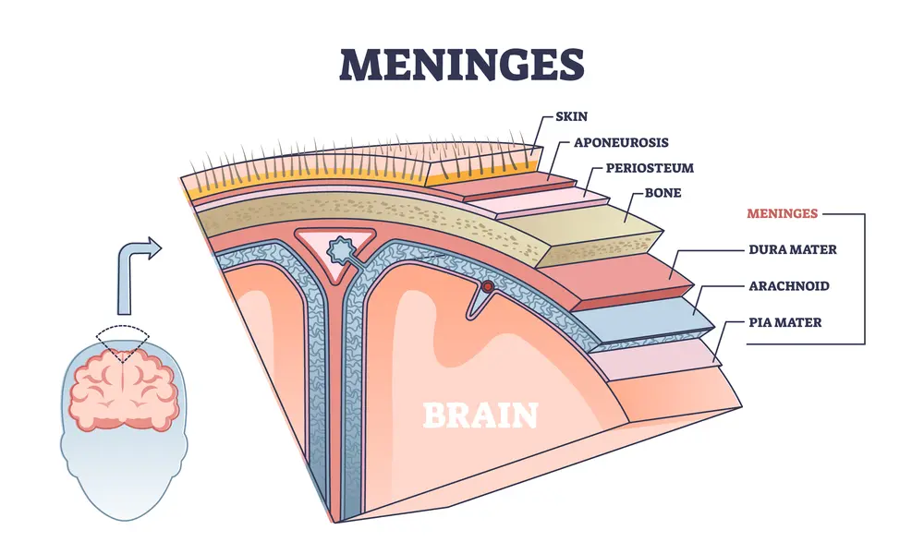
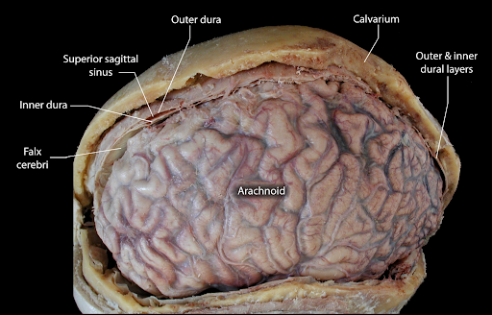
What are they?
THE LAYERS
Membranes that line the cranium and spinal canal
Function: protection and nourishment of the CNS structures
Dura = outermost layer, connected to the skull
2 layers --> periosteal layer & meningeal layer in SKULL ONLY (Spine = only meningeal)
Arachnoid = spider-like, middle layer
Projections from this layer form the arachnoid granulation responsible for resorption of CSF
Pia = innermost layer, adheres tightly to the brain and follows the gyri and sulci

Slide 40
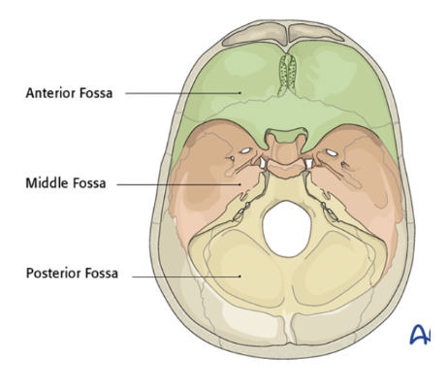
Pain Distribution of Meninges and Parenchyma
Parenchyma of the brain doesn’t have sensors for pain
Only the meninges and the vessels around the brain are innervated to feel pain
Anterior cranial Fossa
Innervation of dura: General sensory via CN V
Trigeminal (meningeal branch)
Middle cranial fossa
Innervation of dura: General sensory via CN V
Trigeminal (meningeal branch)
Posterior cranial fossa
Innervation of dura: General sensory via CN X Vagus (meningeal branch)

Slide 41
THANK YOU!

