Slide 1
Cardiology
By: Fatemeh Zevari

Slide 2
LOs covered today
Sean Power
Describe the anatomy of the heart including surface anatomy and its circulation (PBL)
Define angina and myocardial infarction. (PBL T1)
Describe the ECG abnormalities a patient with a myocardial infarction (N.B. Diagnosis of infarct location is not required at this stage). (PBL T1)
Describe the key events in the cardiac cycle. (PBL T1)
Describe the initiation, conduction and autonomic regulation of the electrical activity of the heart. (PBL T1)
Outline the pathogenesis of coronary atherosclerosis and coronary thrombosis and the factors that influence their development.
Outline the pathology of myocardial infarction, describing the effects of acute ischemia on cardiac muscle and the time course of healing processes. (PBL T1)
Outline the possible clinical complications of MI, including impaired cardiac function, left ventricular failure and cardiac rupture. (PBL T2)
Explain the pharmacology of anti-platelet agents, nitro-vasodilators and thrombolytics including DOAC’s. (PBL T1 and T2)
Describe two types of treatment which relieve cardiac pain i.e. pharmacological and surgical treatments. (PBL T1 and T2)

Slide 3
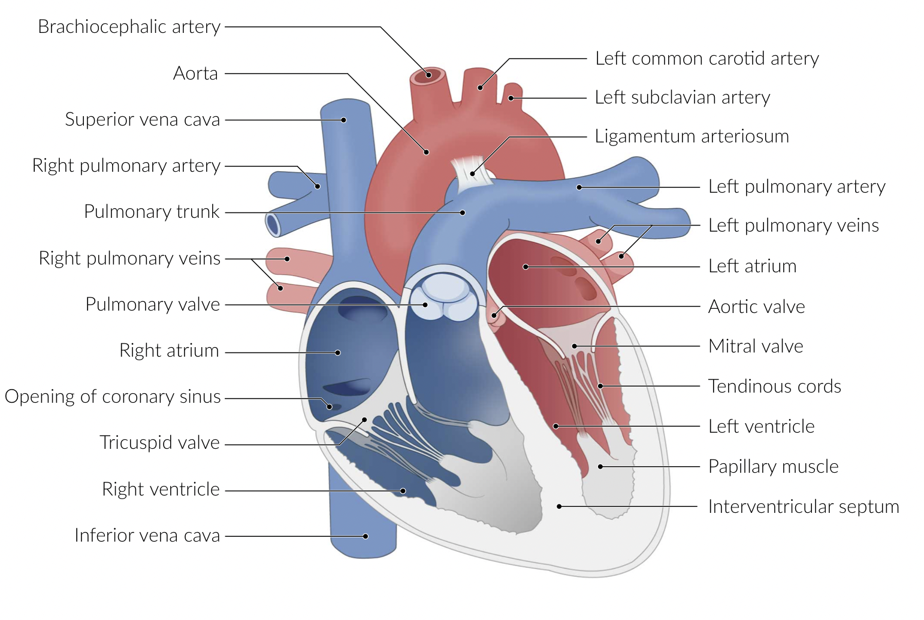
Anatomy of the Heart
Heart: the muscular organ that is located in the middle mediastinum and pumps blood throughout the circulatory system
Connects the systemic and pulmonary circulation
4 chambers:
Right Atrium & Right Ventricle
Separated by the tricuspid valve
Left Atrium & Left Ventricle
Separated by the mitral (or bicuspid valve)
Four Valves:
Tricuspid – AV Valve
Pulmonary – Semilunar Valve
Mitral (AKA Bicuspid) – AV Valve
Aortic – Semilunar Valve

Slide 4
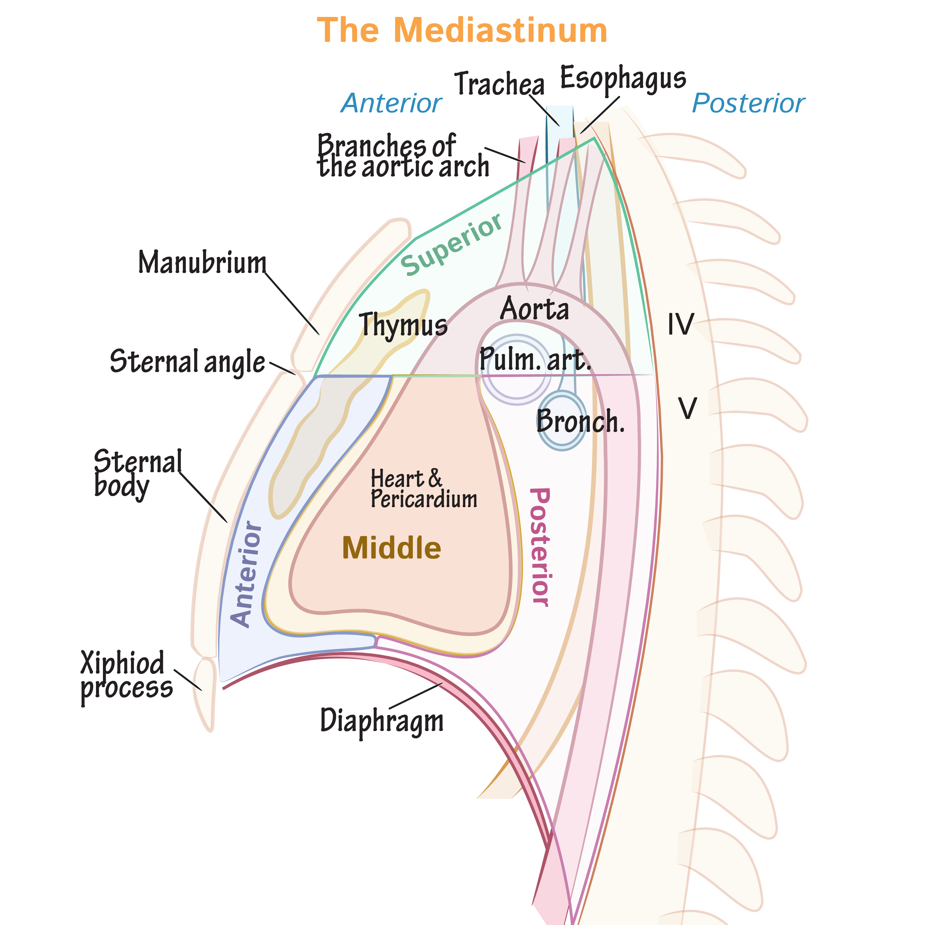
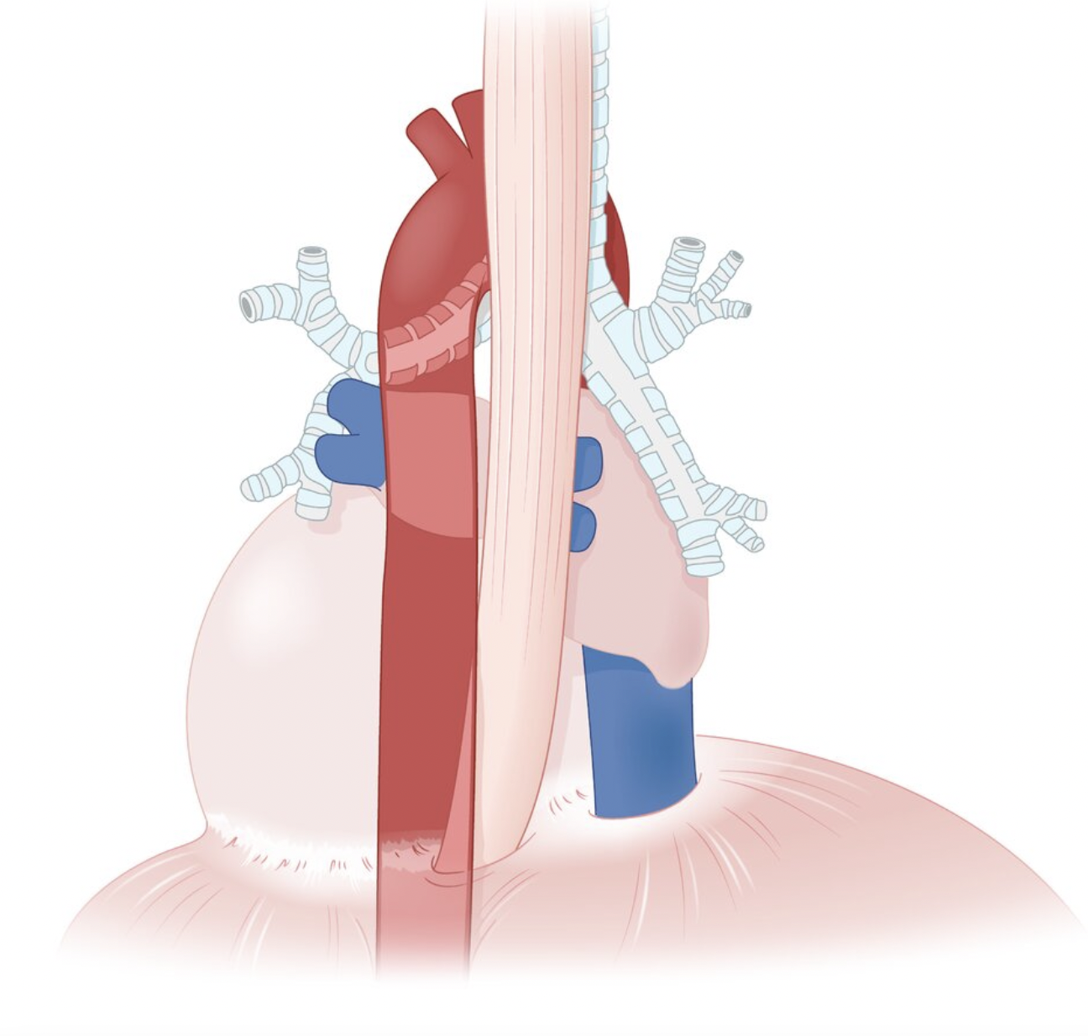
Anatomy of the Heart - Location
Location: in the thorax within the middle mediastinum between the lungs
Anterior to the heart: sternum, ribcage
Posterior to the heart: descending aorta, esophagus, carina of trachea & primary bronchi, vertebral column
Notes:
Image on right from: https://ditki.com/course/gross-anatomy/glossary/gross-anatomic-microscopic-structure/the-mediastinum

Slide 5
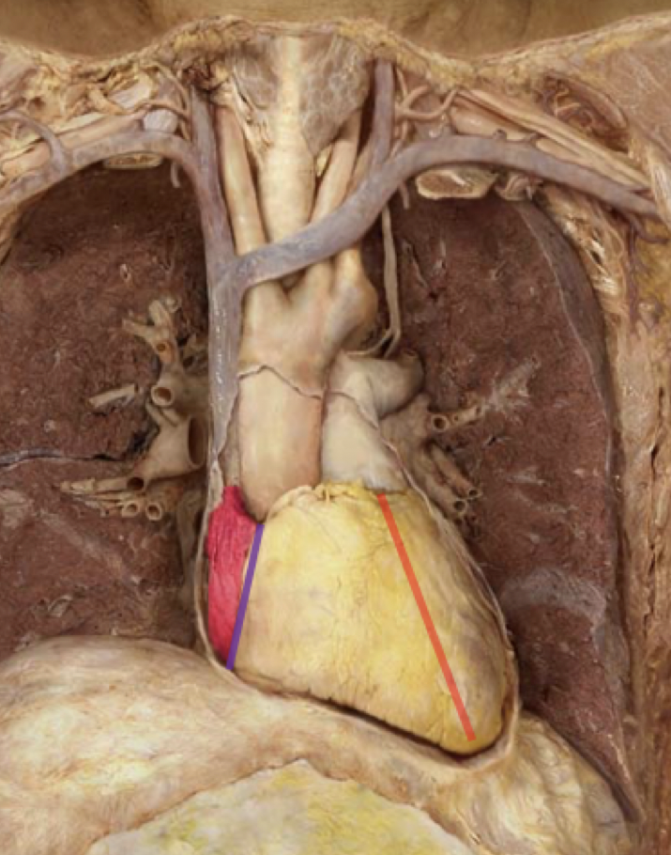
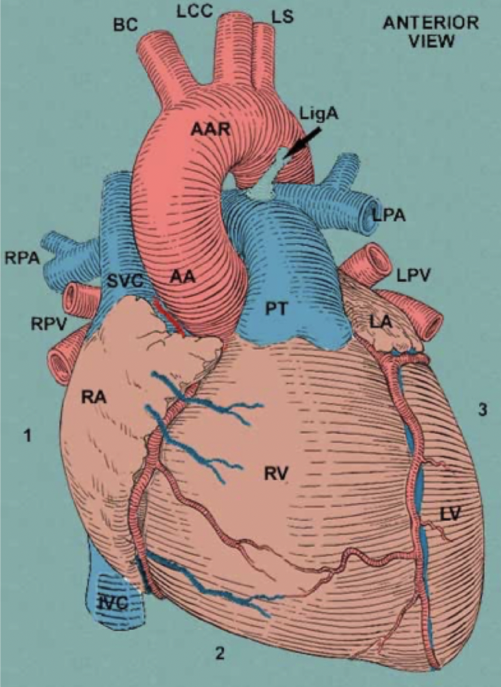
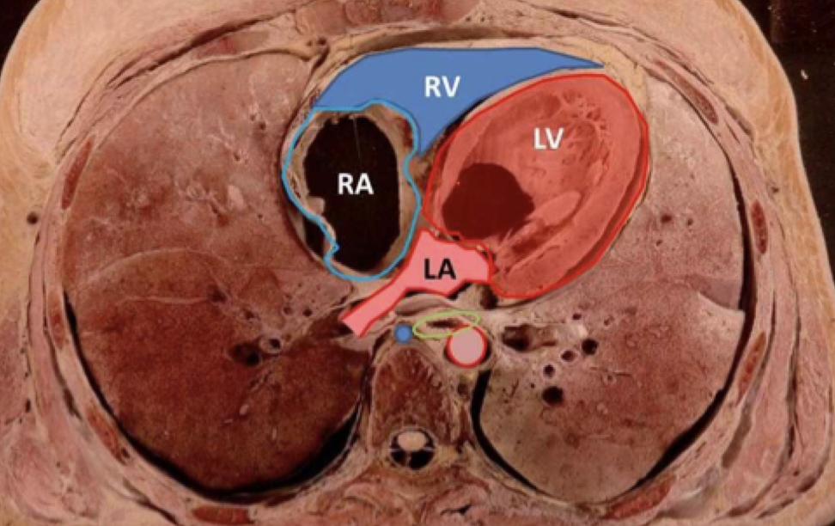
Anatomy of the Heart - Surface Anatomy
Sternocostal View of Heart:
The heart sits obliquely in the chest with the apex of the LV facing inferiorly (obliquely) and to the left
Notes:
Highlighted in pink: Right Atrium receiving blood from the SVC (cannot see the IVC in this picture)
Blue line: coronary sulcus
Red line: anterior interventricular sulcus
Between blue and red: right ventricle
From red line all the way to the left: left ventricle

Slide 6
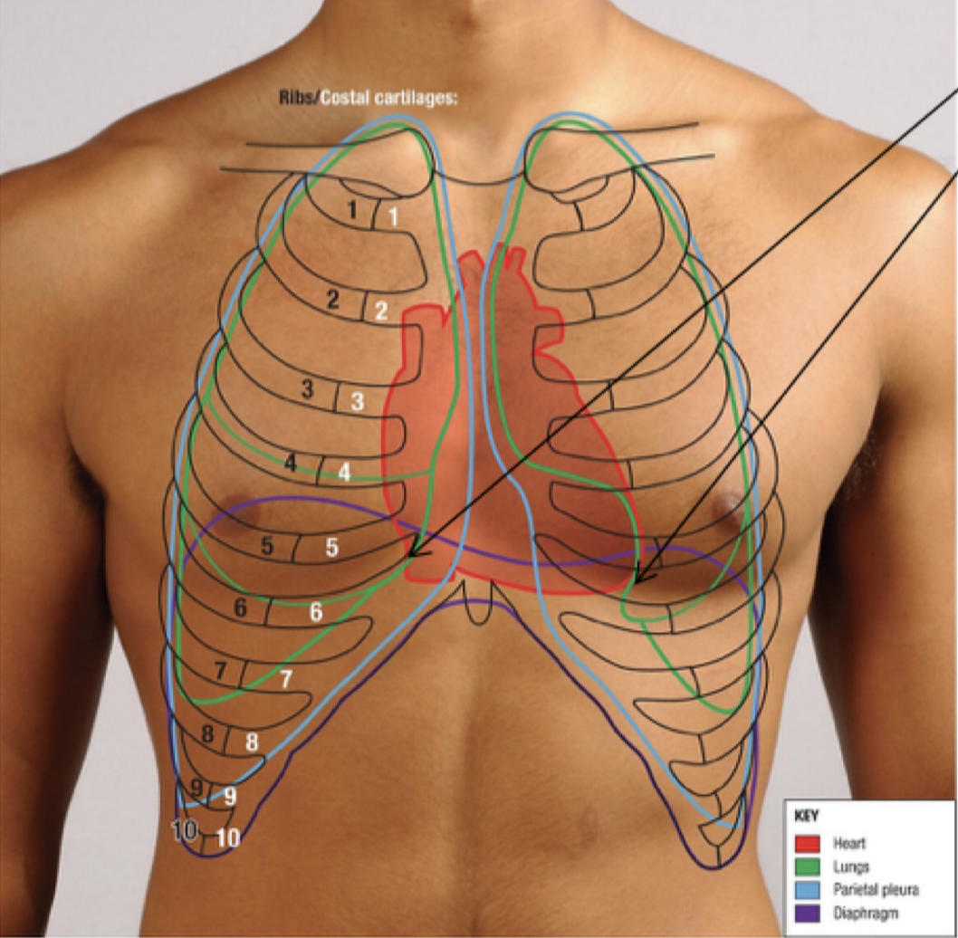
Anatomy of the Heart - Surface Anatomy
Great Vessels
2nd CC
LA
LV
3nd CC
RA
5th ICS MCL
RV
6th CC

Slide 7
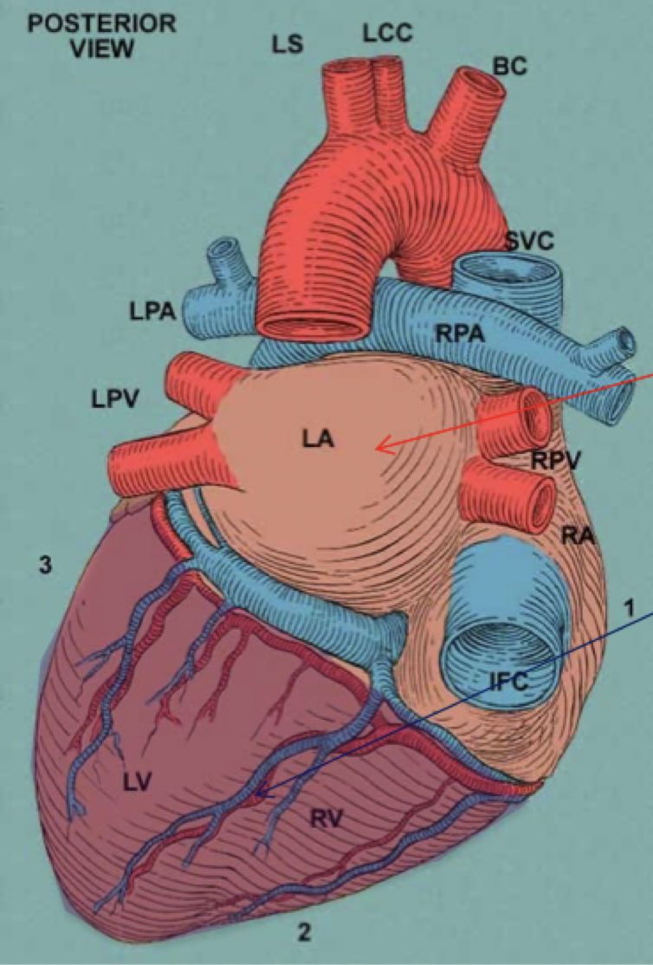
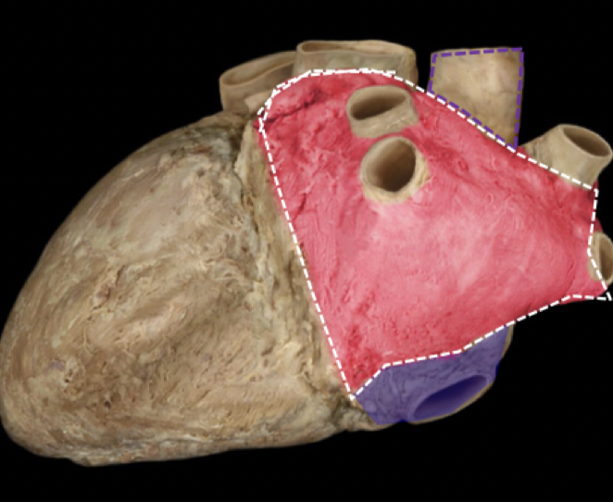
Anatomy of the Heart - Inferoposterior Surface
Base of the Heart: red arrow - faces posteriorly from T6-T9
Left atrium (mainly) with a small contribution from the RA
Diaphragmatic Surface of Heart: blue arrow
This is the true inferior surface
Contribution from the LV and RV
NOTE: the cartoon image on the right sort
shows the posterior and inferior surfaces of the
heart in the same plane when in reality they are not
Notes:
Pink structure: LA with 4 pulmonary veins entering
Purple structure: RA with IVC entering

Slide 8
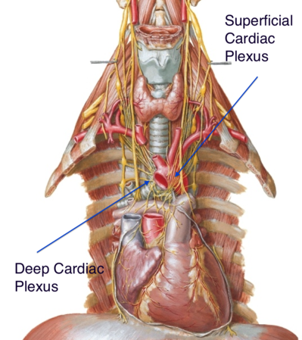
Innervation
Efferent
SNS: T1-T5 → synapse at PVSG* → (Cardiac nerves) → via cardiac plexus: NA/A onto B1(one) receptors on SA, AV and cardiomyocytes
Decrease chrono-, dromo- and inotropy
PSNS: Vagus Nerve → cardiac plexus: Ach onto M2 Receptors on SA, AV, cardiomyocytes
Decrease chrono-, dromo- and inotropy + vasoconstriction of coronary arteries
SNS and PSNS → Cardiac plexus
Notes:
Peripheral innervation of vasculature:
SNS:
NA/A onto a1 skin/viscra--- vasoconstrict
B2 of SkM----Vasodilate
B1 of JGA (Kidney)---- vasoconstrict
PSNS:
Ach onto M3 on Endothelium of BV --- NO produced--- SM relaxed: vasodilate
*PSVG: Paravertebral Sympathetic Ganglion
Most T1-5 spinal nerves go up the PSVG and synapse at the cervical region.
Martina will go into greater detail about the anatomy of the SNS innervation of the heart
Chronotropy: HR
Dromotropy: conduction speed
Inotropy: corce of contrantion
Cardiac plexus:
superficial part is below aortic arch and b/w aortic arch and the pulmonary trunk
deep part is b/w aortic arch and the tracheal bifurcation
Source of image: https://www.researchgate.net/figure/Anatomy-of-the-sympathetic-and-parasympathetic-innervation-of-the-heart-AV_fig1_321702138
https://www.kenhub.com/en/library/anatomy/innervation-of-the-heart

Slide 9
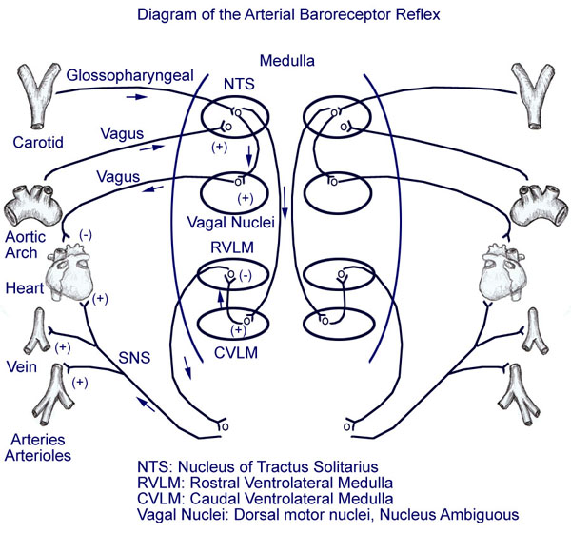
Baroreceptor Referlex
Stretch → baroreceptors in AA and CS → NTS of Medulla →
Vagal Nuclei→ Vagus Nerve → PSNS response to the heart (e.g. lower HR, FOC)
CVLM: inhibit RVLM
Lower SNS activity: vasodilation, lower HR, etc.
RVLM can’t induce SNS (e.g vasoconstrict)
Notes:
AA: Aortic Arch
CS: Carotid Sinus
Barorecepors are sensitive to stretch, changes in pressure and the rate of change of pressure.

Slide 10
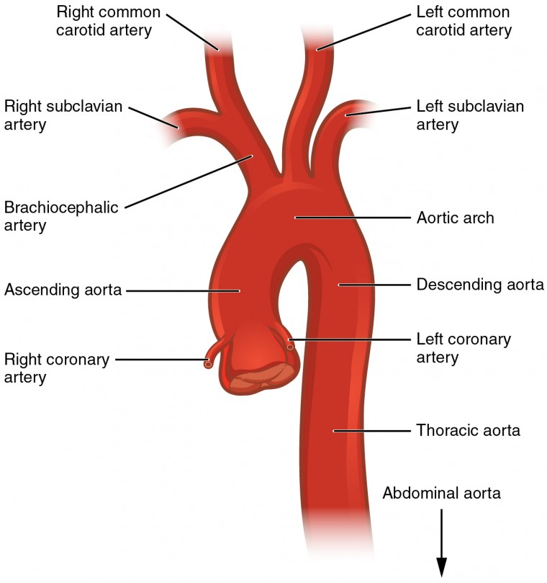
Blood Supply and Drainage
Aorta right + left coronary arteries
Notes:
Coronary Arteries & Circulation
ARTERIES:
Aorta --- right + left coronary arteries (1st branches off asc aorta)
* Blood enters RCA and LCA during diastole because that is when the aortic valve shuts and backflow of blood in the aorta allows blood to flow into coronary arteries

Slide 11
Coronary Arteries
Branches:
RCA PDA (posterior) + RMA
LCA LAD + LCx
LCx LMA
Areas Supplied:
RCA + RMA: SA/AV nodes & RA/RV
PDA: inferior wall of LV (*variation in notes below), Post. 1/3rd of IV septum
LCA: LA/LV
LAD: Anterior wall of LV, Ant. 2/3rd of IV septum, Apex of LV
LCx: lateral wall of LV (think: “lateral circumflex”)
Arteries most frequently occluded: LAD>RCA>LCX
First Aid 2018 Pg. 277; Boards & Beyond
Fatemeh Zevari, Doctorials 2023/24
Notes:
RCA: Right Coronary Artery
PDA: posterior Descending Artery
RMA: Right Marginal Artery
LAD: L Anterior Descending
LCx: Left Circumflex
Right coronary + marginal artery: Supplies RA/RV and SA/AV nodes (infarction may cause a nodal dysfunction; bradycardia or heart block) *Right posterior descending artery (PDA) in the posterior/right ventricle: inferior wall of LV, Posterior 2/3rd of IV septum Right dominant heart (85%) if the PDA arises from the RCA Left dominant heart (8%) if PDA arises from LCX Codominant heart (7%) if PDA arises from both the LCX and RCA
Left coronary artery: Supplies left atrium/ventricle
Left anterior descending (LAD)/interventricular artery (anterior): Supplies anterior wall of LV. Ant. 2/3rd of IV septum + Apex of LV.
**Coronary artery occlusion most commonly occurs in the LAD
Circumflex artery (posterior/left atrium): supplies lateral wall of LV
The LAD and the PDA anastomose on the posterior IV groove of the heart in 90% of people
MI location and corresponding coronary artery occlusion:
Anterior wall/apex → LAD
Lateral wall → LCX
Inferior wall → PDA (RCA 90% of time)
**Occlusion occurs LAD>RCA>LCX

Slide 12
Coronary Veins
Drain into Coronary Sinus:
Parallels RCA:
Small Cardiac Vein
Middle Cardiac Vein
Parallels LAD:
Great Cardiac Vein
Directly into RA
Anterior Cardiac Vein
First Aid 2018 Pg. 277; Boards & Beyond
Fatemeh Zevari, Doctorials 2023/24
Notes:
VEINS: Coronary sinus + anterior vein brings deoxygenated blood back to the right atrium
All deoxygenated blood travels through the coronary sinus except the anterior vein (directly to the right atrium)
Parallels RCA:
Small Cardiac Vein: drains RA and RV
Middle Cardiac Vein: drains posterior surface of IV septum
Parallels LAD:
Great Cardiac Vein: drains anterior aspect of the heart

Slide 13
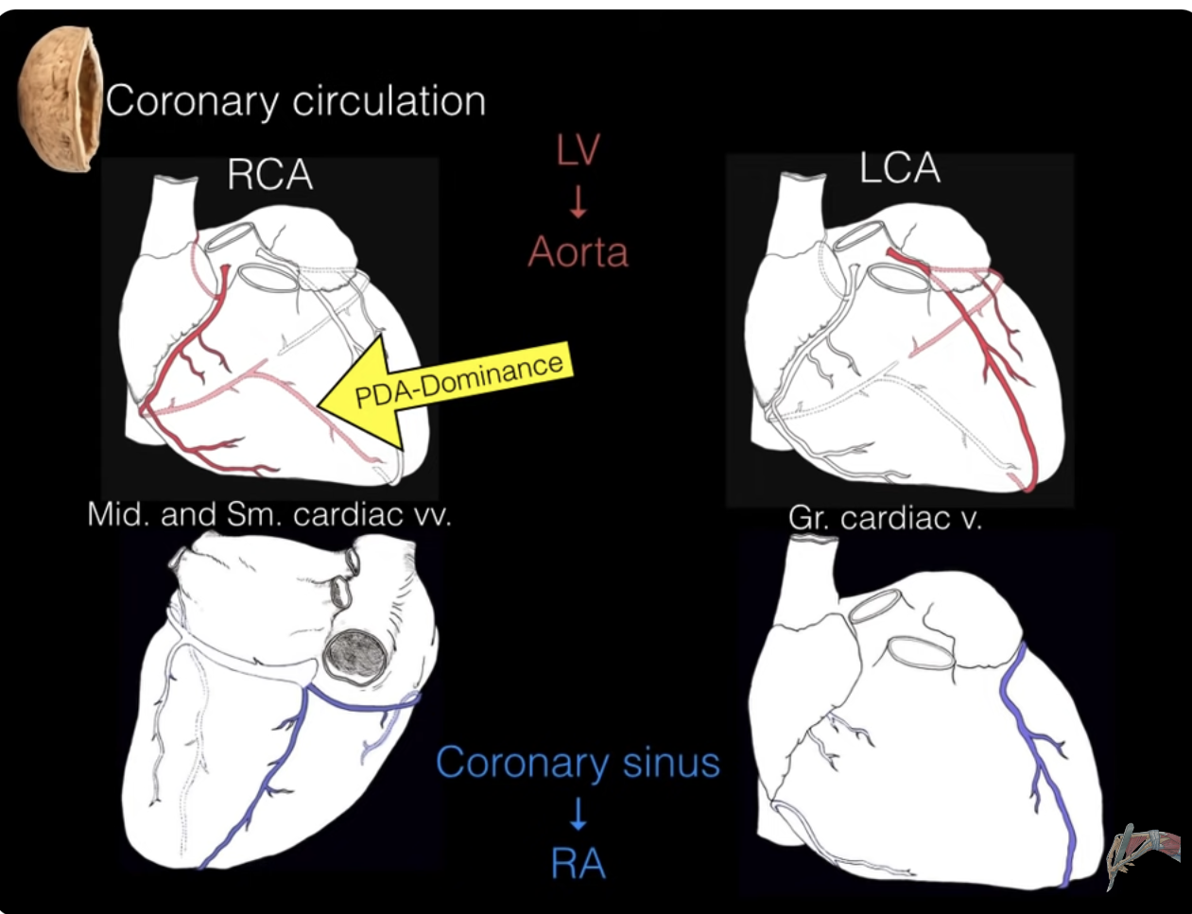
Coronary Circulation
Notes:
“Coronary circulation of the heart” The Noted Anatomist, Youtube https://www.youtube.com/watch?v=xSnFf62GDBI
Veins:
Small and middle cardiac veins the same area the RCA supplies
Small cardiac vein drains the R side of heart
Middle cardiac vein drains the posterior IV septum
Both drain into the coronary sinus
Great cardiac vein drains the same area the LAD supplies
Arises from the apex of heart, anterior surface of IV septum, around coronary sulcus at front and then to the back where it drains into the coronary sinus

Slide 14
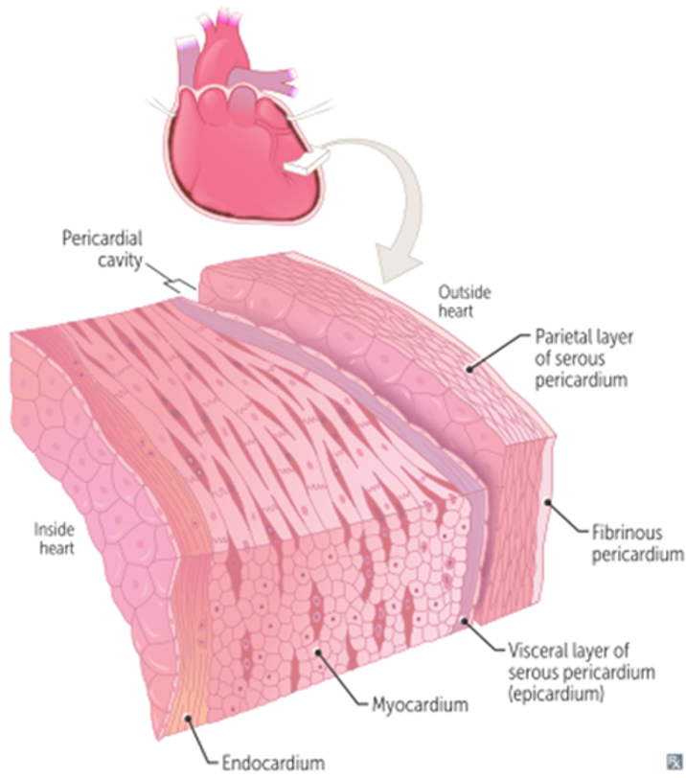
Anatomy of the Heart - Layers of the Heart
Endocardium: innermost layer and contacts the blood in the heart chambers
Composed of simple squamous epithelium and connective tissue
Sub-Endocardial Layer: lies between and joins the endocardium and myocardium
Consists of loose fibrous tissue
Purkinje fibers (conducting system) located in this layer
Farthest layer from the coronary arteries which are in the Epicardium
Damage here can lead to arrhythmia
Vascular occlusion (such as in an MI) S.E. tissue ischemia/necrosis arrhythmia detected on ECG
Myocardium: middle and thickest layer composed of myocytes and contractile cells
Epicardium: outermost layer
Formed by visceral layer of serous pericardium
Site of nerves (cardiac plexus) and blood vessels (coronary arteries) that supply the heart
Pericardium
Fibrous Pericardium: continuous with central tendon of diaphragm; made of tough connective tissue,
non-distensible; prevents overfilling of heart
Serous Pericardium: divided into outer parietal layer and inner visceral layer; each layer made up of mesothelium
Pericardial cavity between two layers = lubricating layer, serous fluid
Notes:
As the subendocardial layer houses the conducting system of the heart, damage to this layer can result in various arrhythmias.
Note: Endocardium can receive blood supply from the blood in the heart chambers. The subendocardial layer tends not to in order to preserve the environment of the myocardium for proper contraction.
The cardiac plexus is in the Epicardium but the Conducting system (SA, AV, Purkinje, etc.) are in the subendocardial layer

Slide 15
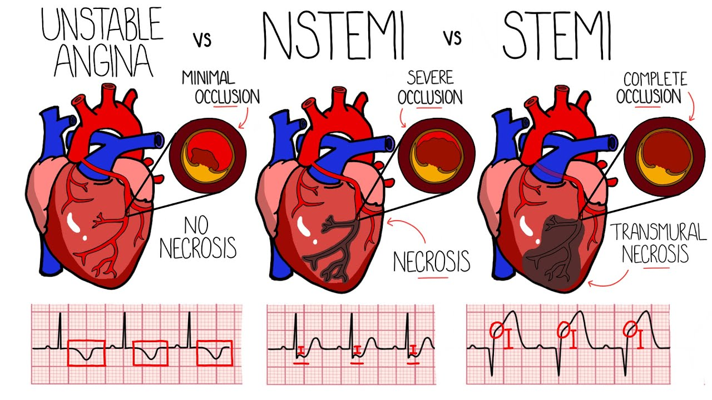
Define angina and myocardial infarction
Angina
Chest pain due to myocardial ischemia
Oxygen vs. supply demand mismatch
NO MYOCARDIAL NECROSIS
Stable: unable to meet increased demand for O2
Pain ONLY during exertion and relieved by rest/vasodilators
75% of cases involve stenosis in coronary arteries (decreased ST segment)
Unstable/crescendo angina: pain at rest that increases in frequency and duration
Plaque disruption with incomplete mural thrombi resulting in transient coronary blockage in blood flow
Prinzmetal (variant): due to vasospasm without fixed atherosclerotic disease
At rest, sleeping, or w/ exposure to cold
younger patients >>
MI
Necrosis of myocardial tissue as a result of ischemia, and reduction in coronary blood supply
Caused by coronary atherosclerosis
Types
Transmural: complete occlusion of a major extramural coronary artery (STEMI)
Subendocardial: limit to inner 1/3 of the ventricular wall (NSTEMI)

Slide 16
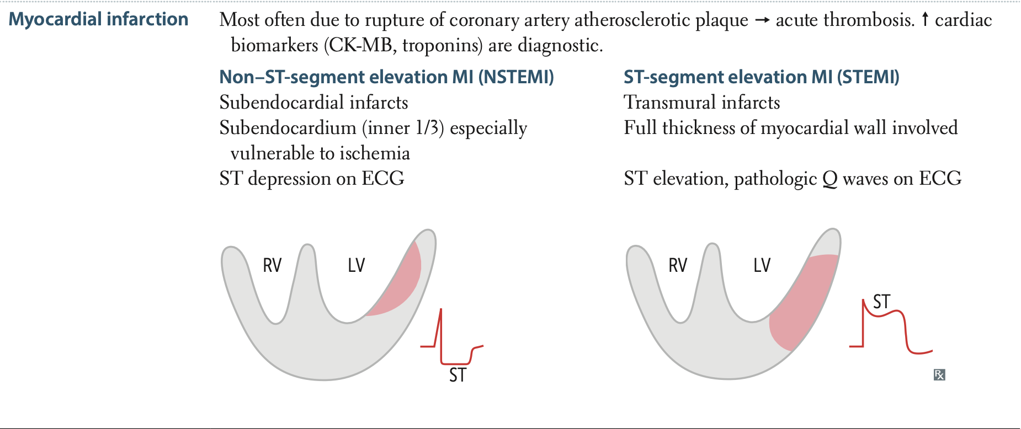
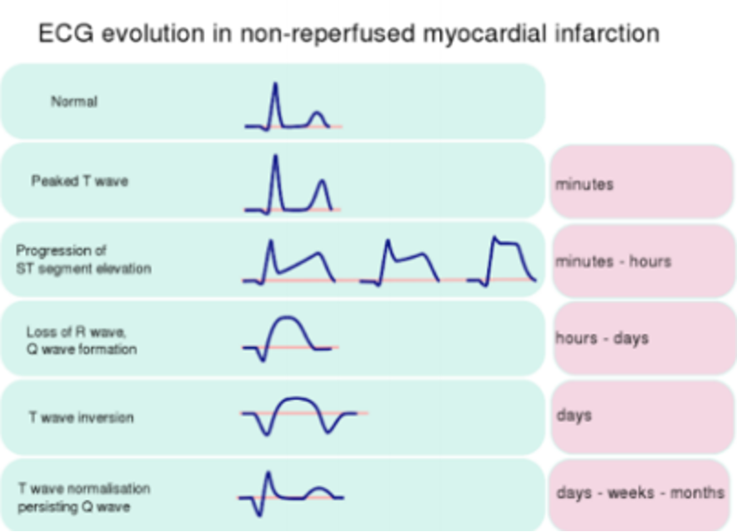
Describe the ECG abnormalities in a patient with myocardial infarction
The distinction previously mentioned between a transmural and subendocardial myocardial infarct can be noticed most simply through an ECG
The common name given to these types of infarcts are ST-elevated MI and non-ST-elevated MI
STEMI’s involve the full thickness of the heart wall while the NSTEMI is limited to the subendocardial portion of the heart wall
The reason for ST elevation and depression is due to the changes in electrolytes when ischemia occurs (video explaining linked below)
Other more minor changes can be seen with ischemia as ST elevation and depression can be quite acute in MI and will resolve eventually, leaving a less obvious ECG tracing
These can include: subtle ST segment changes, T wave inversions, pathological Q waves
Notes:
This video is from 2 australian physiologists, it explains the underlying electrolyte changes that precipitate ST segment changes on ECG https://www.youtube.com/watch?v=vSrW4jg8Zq8
Pathological Q waves: abnormally wide (>0.2 second)
Or abnormally deep (>5 mm)
(>5 m

Slide 17
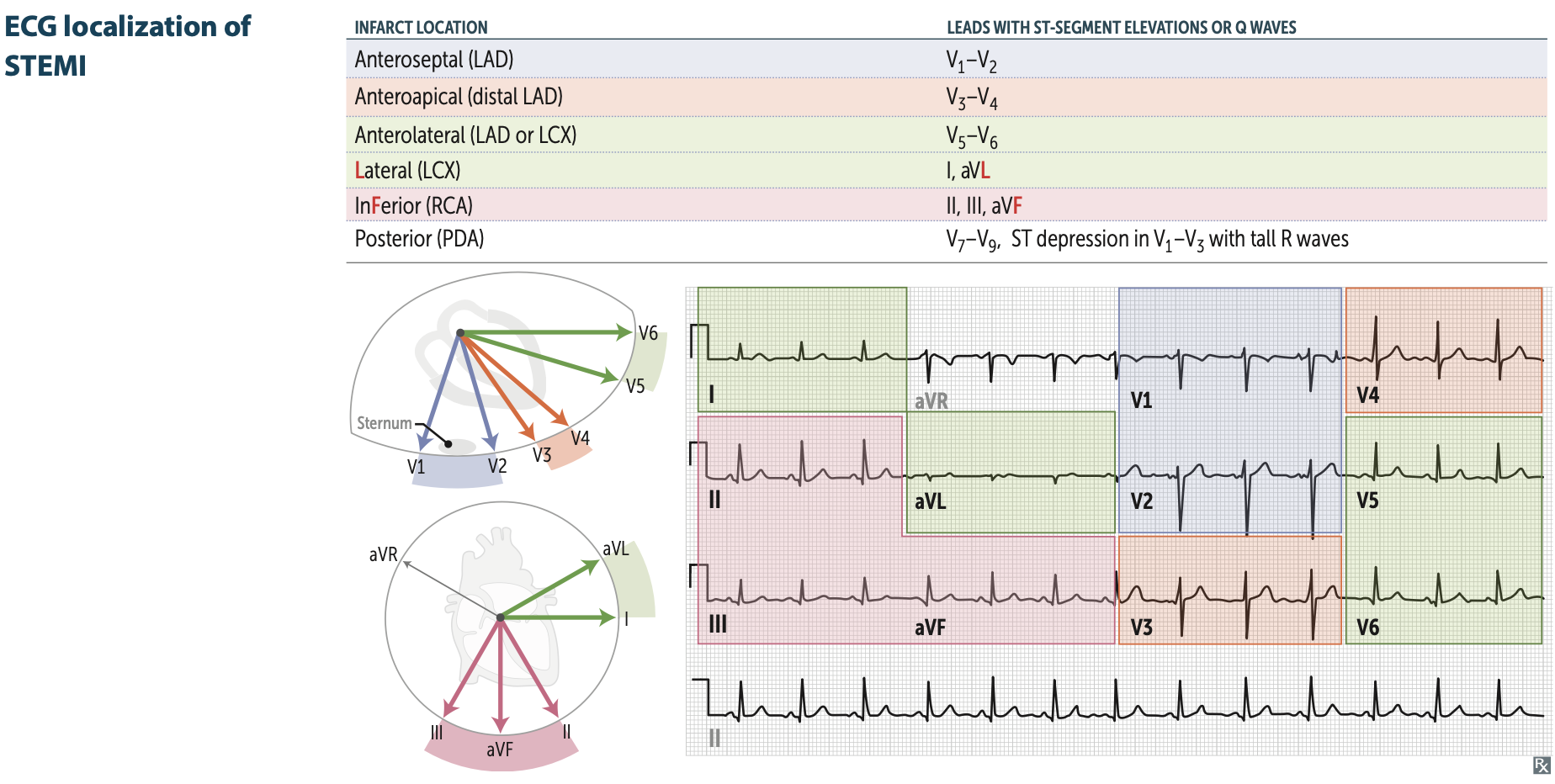
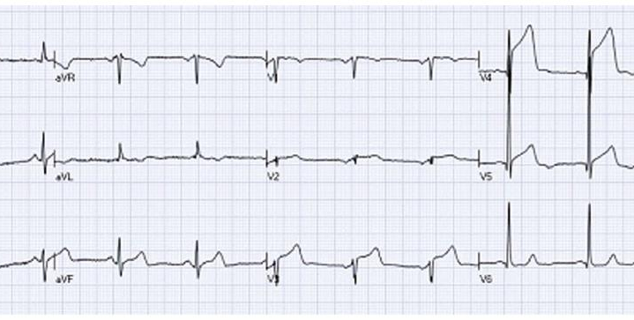
ECG localization
Localization of the source of blockage in MI is important for interventional therapy and can be achieved based on the changes in specific leads in the ECG
Example ECG: ST elevation in V3-V5
Corresponds to mid-LAD infarct
Angiogram
Notes:
Important to be aware of the most common lead changes seen on ECG in the case of a STEMI (anterior MI, inferior MI, lateral MI)
Example ECG taken from: https://www.wjgnet.com/1949-8462/full/v6/i10/1067.htm

Slide 18
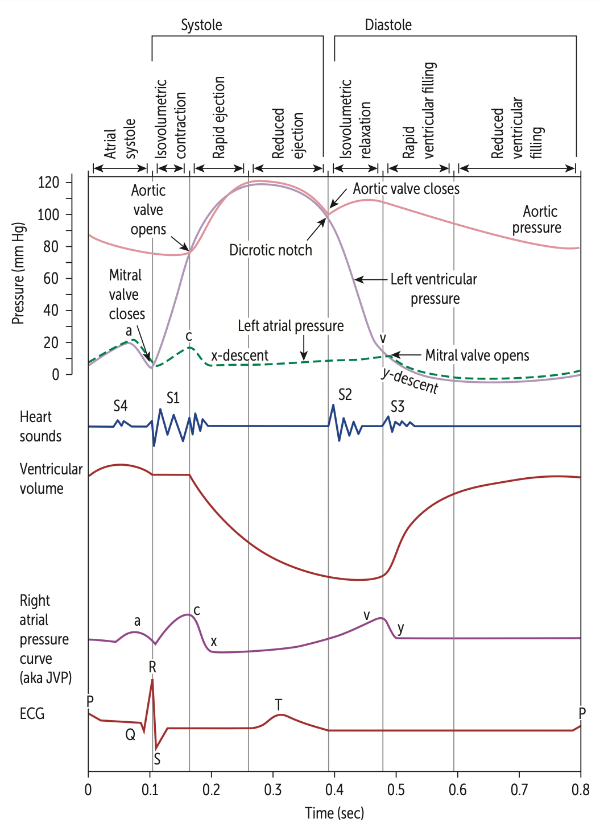
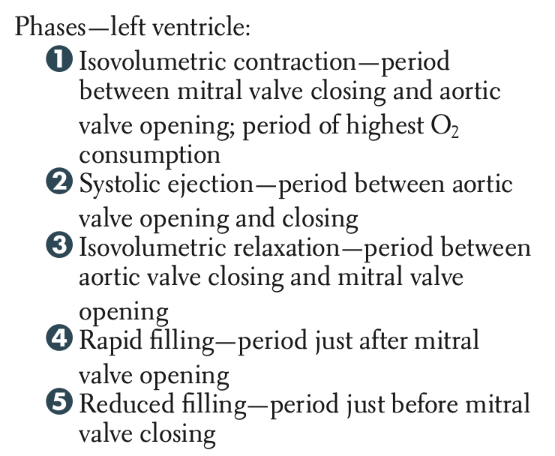
Describe the key events in the cardiac cycle
Notes:
This is your first introduction to Wiggers diagram (the diagram above) which includes a number of things such as the ECG, venous pressure curve, heart sounds etc.

Slide 19
Phases of the cardiac cycle
1. Isovolumetric Ventricular Contraction
pV>pAt → AV closes → S1 (one)
2a. Systolic Ejection
pV>pAorta → Aort/pulm valves open → blood leaves
2b. Reduced ventricular ejection
pAorta>Ventricles
V begin to relax
Blood left over = ESV
Notes:
1. Isovolumetric Ventricular Contraction (pV>pAt—AV closes)
QRS complex represents the depolarization of the ventricles and the ventricles begin contracting
Pressure begins to build in the ventricles
Ventricular pressure exceeds atrial pressure
The AV valve closes producing the first heart sound (S1)
All valves are closed and therefore no change in volume occurs
Ventricular pressure still lower than aortic pressure
2.a) Ejection (pV>pAorta---Aort/pulm valves open—blood leaves)
Ventricles continue to contract
Eventually the ventricular pressure exceeds aortic pressure
Aortic and pulmonary valves open and blood leaves the ventricles
Ventricular volume decreases
The T wave occurs when the ventricles repolarize
2.b) Reduced ventricular ejection
Ventricles begin to relax
Ventricular pressure falls slightly
Aortic pressure is higher that ventricular pressure since blood continues to move into the aorta with considerable inertia
Very little blood leaves the ventricles during this period
The amount of blood that remains after ventricular contraction is called ESV

Slide 20
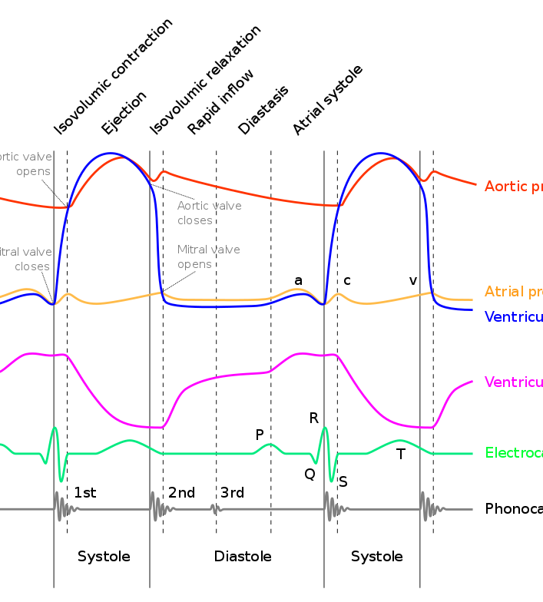
Phases of the cardiac cycle
3. Isovolumetric Ventricular Relaxation
pV<Aorta → Aortic/Pulmonary Valves close → S2
4. Rapid ventricular filling
pV<pAtria → AV valves open
5. Diastasis (reduced ventricular filling)
Rapid inflow + diastasis = 70% of ventricular filling
6. Atrial Systole (Atria contract)
last 30% of ventricular filling
Notes:
Isovolumetric Ventricular Relaxation (pV<Aorta—Aortic/Pulmonary Valves close—S2)
The ventricles continue to relax and ventricular pressure drops below aortic pressure causing the aortic and pulmonary valves to close producing the second heart sound (S2)
Ventricular pressure is still greater than atrial pressure so the AV valves stay closed
All valves are close so there is no change in ventricular volume
Rapid ventricular filling (pV<pAtria—AV valves open)
Ventricles continue to relax
Ventricular pressure drops below atrial pressure and the AV valves open as a result
Blood rapidly enters the ventricles and ventricular volume increases
Diastasis (reduced ventricular filling) (AV valves open)
Ventricles relaxed
Ventricular pressure still below atrial pressure so the AV valves remain open
Blood continues to enter the ventricles but more slowly
Between rapid inflow and diastasis 70% of ventricular filling occurs
Longest segment of the cardiac cycle
Atrial Systole (Atria contract)
The P wave represents atrial depolarization leading to atrial contraction
Atrial pressure is greater than ventricular pressure (the AV valves are already open)
The last 30% of ventricular filling occurs
The amount of blood in the ventricles at the end of ventricular diastole is called EDV

Slide 21
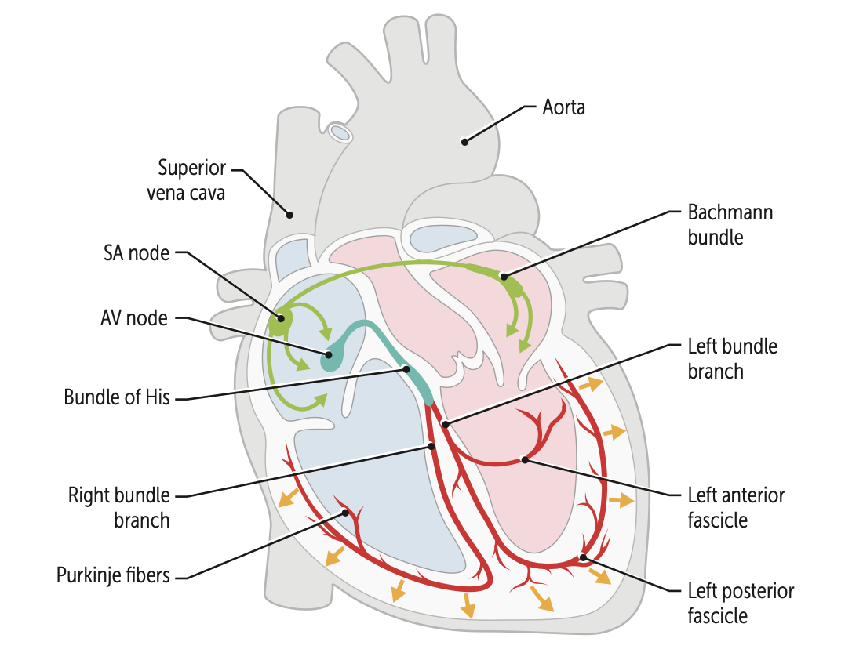
Describe the initiation, conduction and autonomic regulation of the electrical activity in the heart
Conduction through the heart:
SA node
AV node
Bundle of His
L and R Bundle Branches
Purkinje Fibres
Notes:
Conduction
SA node
Action potential is directed through the atria toward the AV node
Action potentials are directed toward the left atria via Bachmann’s bundle for coordinated atrial contraction
SA nodal potentials in the right atrium are conducted to the AV node via anterior, middle and posterior internodal tracts
Gap junctions and intercalated discs allow for propagation of action potential through cardiac myocytes
AV node
Slowed conduction velocity through the AV node to allow for sufficient filling times before ventricular contraction
Bundle of His/purkinjie fibers
Action potential enters the common bundle toward the individual right and left bundle branches
Past the right and left bundle branches it enters the purkinje fiber system to distribute to the rest of the ventricles

Slide 22
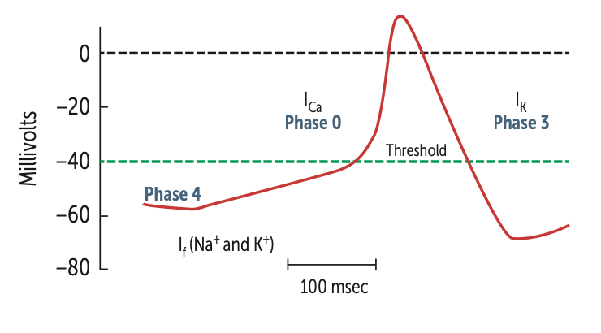
Describe the initiation, conduction and autonomic regulation of the electrical activity in the heart
Initiation (SA node action potential):
Phase 4: Spontaneous depolarization (pacemaker)
Most negative membrane potential at -60 mV
Inward Funny Na+ channel Na+ in –40mV (threshold)
Phase 0: upstroke of the AP
L-type Ca2+ channels open Ca2+ in +10
Phase 1 and 2 do not occur
Phase 3: repolarization
Delayed rectifier K+ channels opens K+ out -60mV
L type Ca2+ channels inactivated
Notes:
Initiation (SA node action potential):
Phase 4: spontaneous depolarization (pacemaker potential)
Most negative value of the membrane potential is about –60mV but doesn't stay at this value
Slow depolarization is produced by inward Na+ current through Na+ channels
Funny Na+ channels are open to bring the depolarization to membrane threshold potential of –40mV
Phase 0: upstroke of the AP
Ionic basis for the upstroke is due to L-type Ca2+ channels up to +10
Phase 1 and 2 do not occur
Phase 3: repolarization
Repolarization is due to delayed rectifier K+ channels opening resulting in an outward K+ current
L type Ca2+ channels inactivated
Note: Sinoatrial node action potentials do not contain all sections of the myocardial action potential as they are specialized to have autorhythmic capacity
The upstroke is slower in the SA node once it reaches its threshold potential of -40 as the SA nodal cells do not have the required membrane potential of less than around -80 to be able to open the fast sodium channels present in the myocardial cells
There are fewer delayed rectifier K+ channels which is why membrane potential never gets lower than -60mV

Slide 23
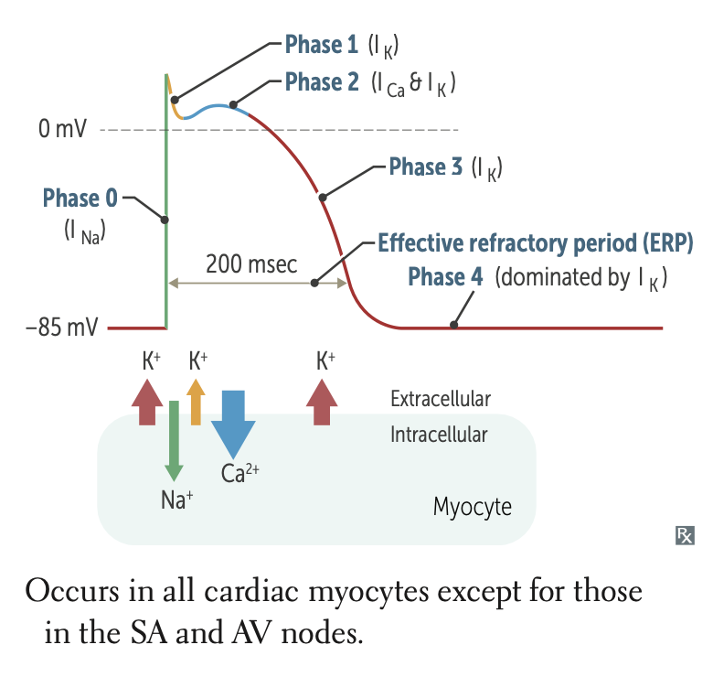
Action potential of cardiac muscle fibers
Action potential in cardiac muscle fibers
Depolarization
Membrane potential: -90mV* → VG sodium channels opens → Na+ in → +20-30mV
Rapid repolarization
Cl- channels begin to open → Cl- in
VG K+ channels open cause → K+ out
Plateau phase
Chloride channels close
slow L-type calcium channels → Ca 2+ slowly in
K+ out and Ca2+ in → steady membrane potential
Restoration of resting potential
Slow L-type calcium channels begin to close
K+ efflux continues → membrane potential to -90 mV
Notes:
Action potential in cardiac muscle fibers
Depolarization
Action potential from neighbouring cells causes opening of VG sodium channels
Increases permeability for sodium and causes rapid sodium influx
Interior of cell becomes positive relative to the outside (20-30 mV)
Rapid repolarization
The fast sodium channels begin to close and Cl- channels begin to open
Inward movement of Cl- combined with opening of K+ VG channels cause the cell to being repolarizing rapidly
Plateau phase
Chloride channels close
The AP causes opening of slow L-type calcium channels causing slow inward movement of calcium
This almost balances the efflux of K+ and results in a relatively steady membrane potential
Restoration of resting potential
Slow L-type calcium channels begin to close and inward movement of calcium slows while K+ efflux continues
K+ efflux restores the resting membrane potential of -90 mV
Rapid repolarization is dominated by the opening of the potassium channels, the chloride channels are mentioned for completeness
*Different resources have different resting membrane potentials for cardiac myoctes, it is between -85 and -90, both are equally correct

Slide 24
Outline the pathogenesis of coronary atherosclerosis and coronary thrombosis and the factors that influence their development.

Slide 25
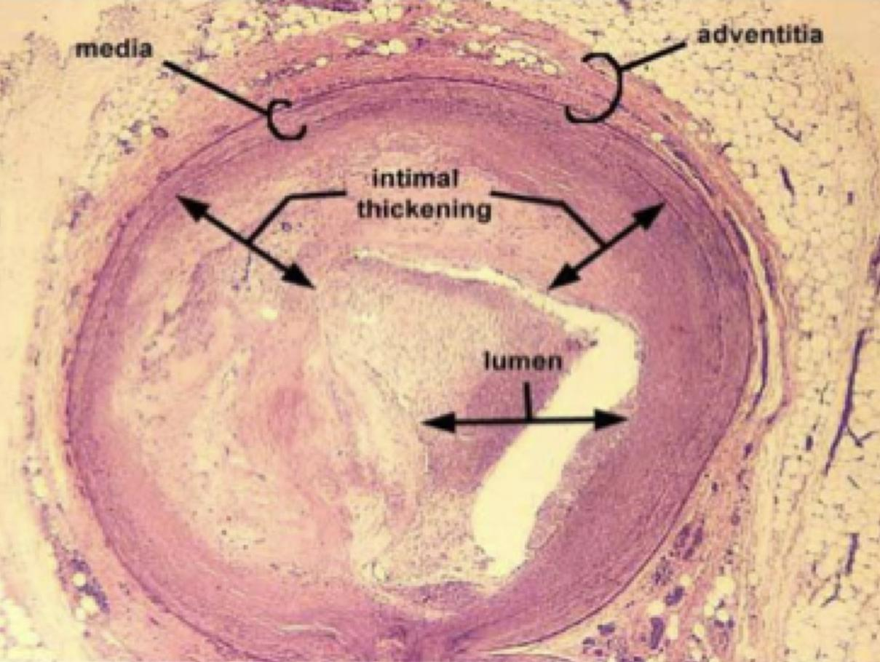
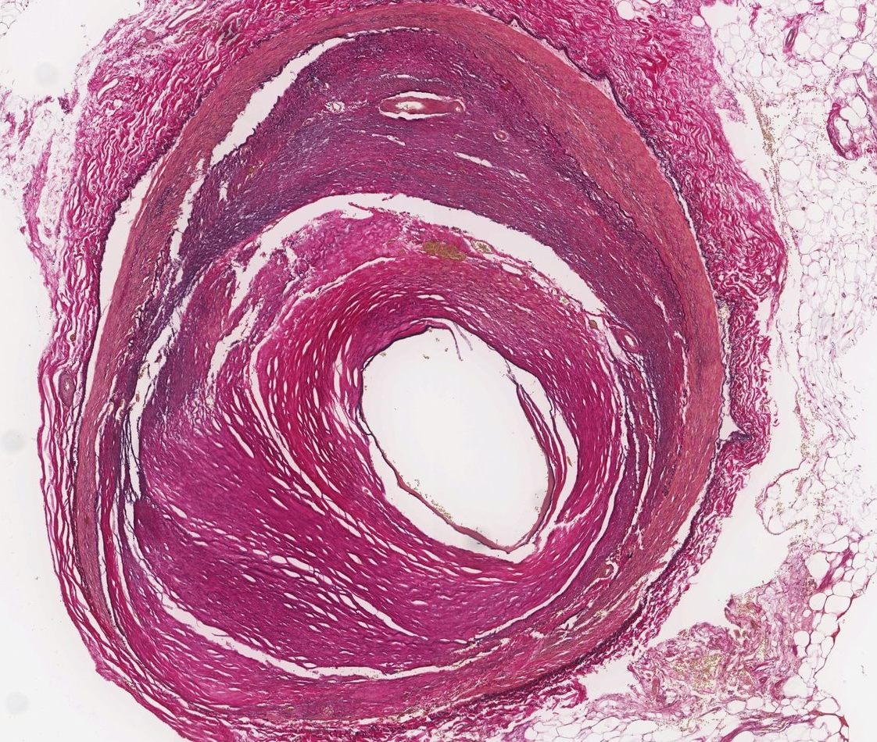
Atherosclerotic Plaque Formation
Atherosclerosis: arterial wall thickening (hardening) and elasticity loss with variable pathogenesis
Inflammatory disease of the intima
Lesions → atheromas
Buildup of cholesterol plaques in the tunica intima
Affects elastic arteries and large/medium-sized muscular arteries
Do not confuse with arteriosclerosis → hardening of small arteries and arterioles
Leading cause of vascular disease worldwide
Most commonly affected sites: circle of willis, carotid arteries, popliteal arteries, coronary arteries, abdominal aorta
Atherosclerosis of coronary artery
Notes:
Large elastic arteries: aorta and major branches, pulmonary arteries etc
Medium muscular arteries: femoral, popliteal, radial, ulnar, external carotid arteries etc

Slide 26
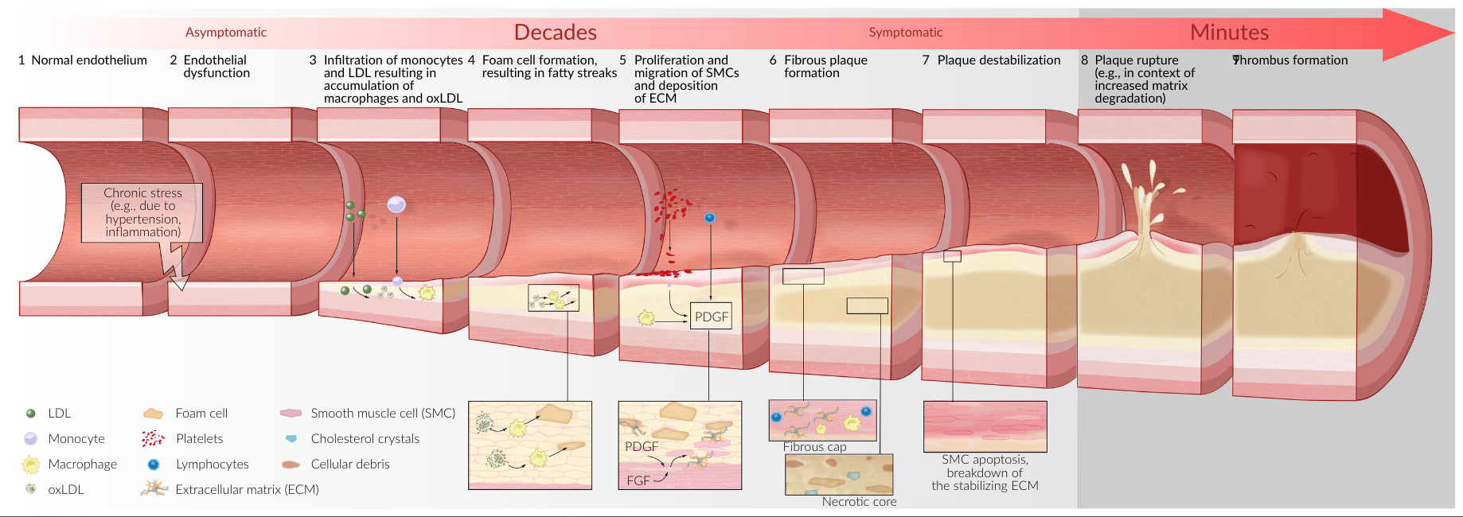
Pathogenesis of Atherosclerosis **VERY HIGH YIELD**

Slide 27
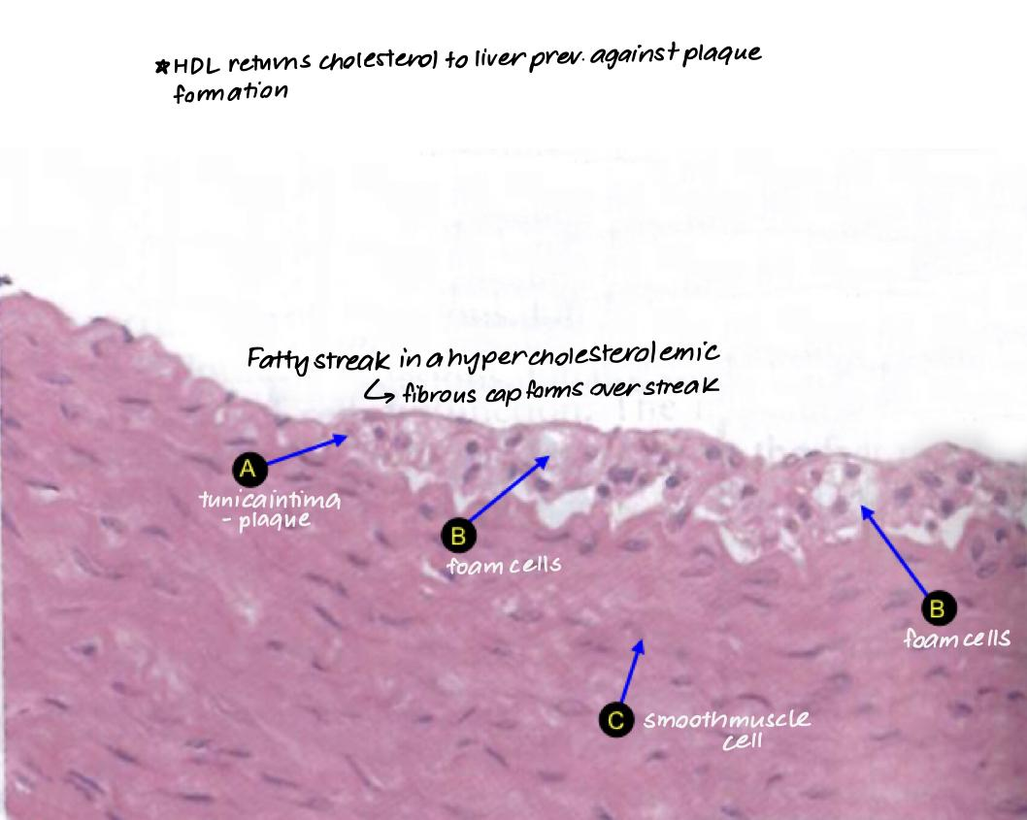
Pathophysiology of Atherosclerosis **VERY HIGH YIELD**
Endothelial injury
Leads to increased vascular permeability, leukocyte adhesion and thrombosis
Lipoprotein accumulation
LDL (low density lipoprotein (high in cholesterol)) enters intima and is oxidized and trapped
Monocyte adhesion to endothelium
Oxidized LDL pulls monocytes into intima → differentiate into macrophages*
Macrophages ingest LDL and become foam cells → early lesions
Platelet adhesion and thrombus formation
Activated platelets and macrophages release chemokines, cytokines, IGF-1, TNF
Smooth muscle cell proliferation
Secrete ECM and collagen fibers → stabilization of plaque
Lipid accumulation
Formation of fatty streaks
Plaque is necrotic at the core and fibrous at the cap
Notes:
*Recall macrophages circulate as monocytes and only differentiate into macrophages in tissue

Slide 28
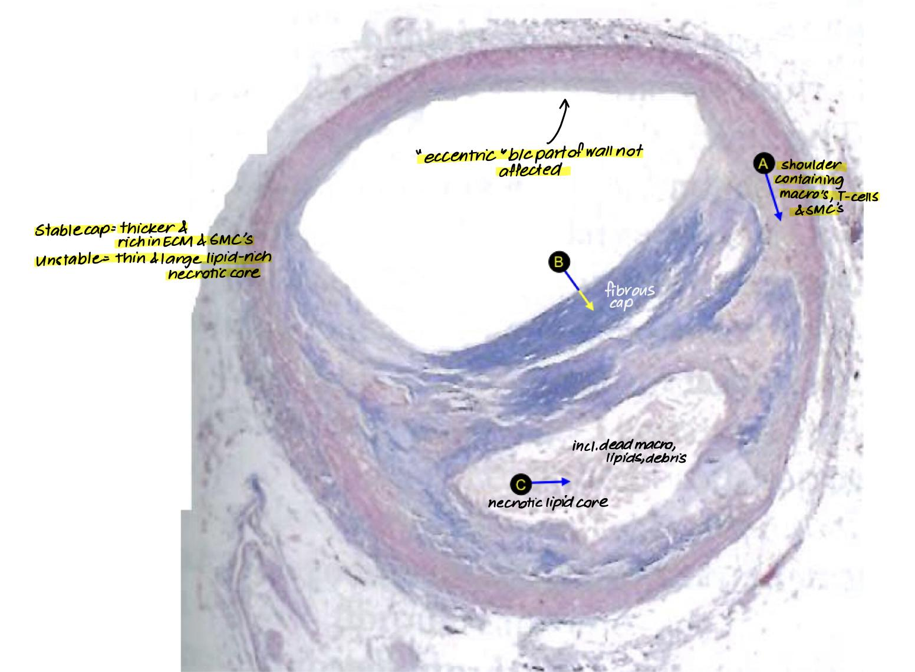
Pathophysiology of Atherosclerosis continued…
Endothelial injury
Leads to increased vascular permeability, leukocyte adhesion and thrombosis
Lipoprotein accumulation
LDL (low density lipoprotein (high in cholesterol)) enters intima and is oxidized
Oxidation prevents it from escaping
Monocyte adhesion to endothelium
Oxidized LDL pulls monocytes into intima → differentiate into macrophages*
Macrophages ingest LDL and become foam cells → early lesions
Platelet adhesion and thrombus formation
Activated platelets and macrophages release chemokines, cytokines, IGF-1, TNF
Smooth muscle cell proliferation
Secrete ECM and collagen fibers → stabilization of plaque
Lipid accumulation
Formation of fatty streaks
Plaque is necrotic at the core and fibrous at the cap
Notes:
Fatty streaks are aggregates of foam cells

Slide 29
Fibrous Cap
Inflammatory cells in the atheroma e.g. macrophages secrete matrix metalloproteinases → weaken the fibrous cap due to breakdown of the ECM
Minor stress can also rupture plaque
Plaque rupture: exposure of thrombogenic material e.g. collagen
Thrombus superimposition & vascular occlusion
Unstable plaques are the biggest risk
Notes:
a. Chronic stress on the endothelium
i. Can be due to arterial hypertension and turbulence
b. Endothelial dysfunction (type of non-obstructive coronary artery disease (CAD) in which there are no heart artery blockages, but the large blood vessels on the heart's surface constrict (narrow) instead of dilating (opening)) that leads to:
i. Invasion of inflammatory cells (mainly monocytes and lymphocytes) through disrupted endothelial barrier
ii. Adhesion of platelets to the damaged vessel wall --> platelets release inflammatory mediators (cytokines) and platelet-derived growth factor (PDGF)
iii. PDGF stimulates the proliferation and migration of smooth muscle cells (SMC) in the tunica intima and mediates differentiation of fibroblasts into myofibroblasts
c. Inflammation of the vessel wall
d. Macrophages and SMCs ingest cholesterol from oxidized LDL and transform into foam cells
i. LDL enters through damaged vessel wall, accumulates, and is oxidized by free radicals
e. Foam cells accumulate to form fatty streaks (early atherosclerotic lesions)
f. Lipid-laden macrophages and SMCs produce ECM (collagen) --> development of fibrous plaque (atheroma)
i. Macrophages, SMCs, lymphocytes, and ECM form fibrous cap covering a necrotic center consisting of foam cells, free cholesterol crystals, and cellular debris
g. Inflammatory cells in the atheroma (e.g. macrophages) secrete matrix metalloproteinases= weakening of the fibrous cap of the plaque due to breakdown of ECM= minor stress ruptures the cap, apoptosis of SMC
h. Calcification of the intima
i. The amount and pattern of calcification affect risk of complications
i. Plaque rupture= exposure of thrombogenic material (e.g. collagen)= thrombus formation with vascular occlusion or spreading of thrombogenic material
i. Unstable plaques biggest risk
ii. Rupture occurs even at sites with moderate stenosis (<50%)

Slide 30
THROMBOSIS

Slide 31
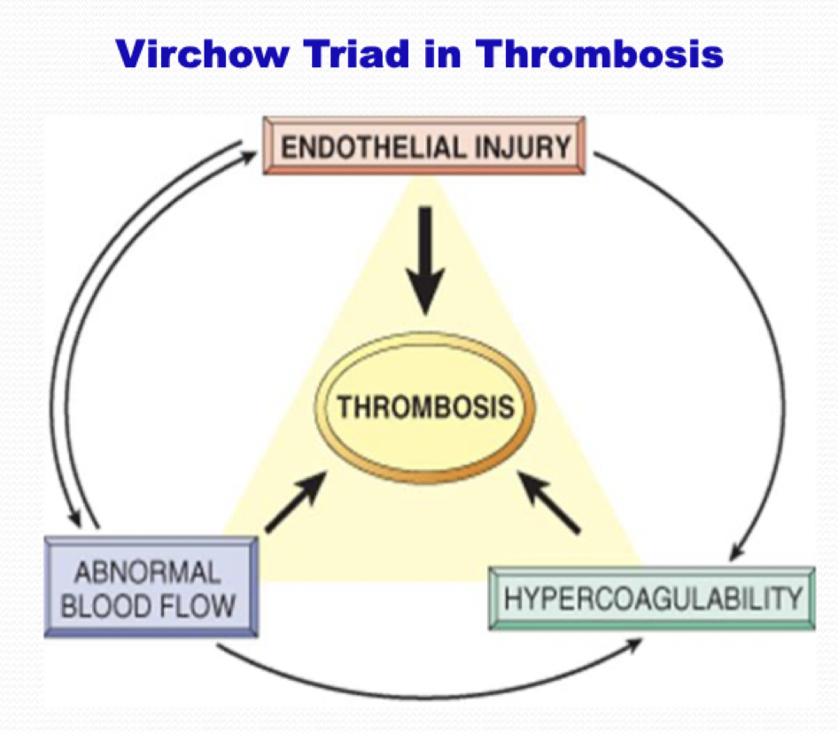
Factors that Influence Thrombus Formation
Virchow’s Triad:
3 main pathophysiological components of thrombus formation “HAE 👋”
Hypercoagulability
Need coagulation factors, platelets, etc. for thrombus formation in general
Hypercoagulable states include pregnancy, COCP users, thrombophilia (ex: Factor V Leiden Mutation)
Endothelial Damage
Inflammatory or traumatic vessel injuries → exposed subendothelial collagen
Abnormal Blood Flow
Stasis or turbulence

Slide 32
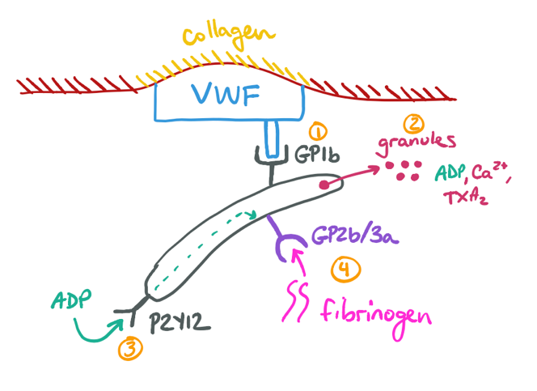
Primary Hemostasis: Temporary Platelet Plug
Endothelial Injury
Endothelial damage followed by transient vasoconstriction (Endothelin 1 by ET cell + Neural stimulation reflex)
Injury exposes underlying connective tissues containing collagen
Exposure
von Willebrand factor (vWF) binds to exposed collagen
Adhesion
Activation
Aggregation
First Aid 2018 Pg. 401-403
Notes:
Damaged endothelial cells expose/secrete/display vWF (also secreted by platelet alpha granules) → bound to exposed subendothelial collagen
Platelets bind vWF via glycoprotein 1b receptor (GP1b)
Platelets are activated: change shape and release mediators that activate more platelets (positive feedback)
Adenosine Diphosphate: promotes adhesion of platelets to endothelium and fibrinogen → induced GpIIb/IIIa
Thromboxane A2: activates more platelets and promotes vasoconstriction in area
Calcium: required for secondary hemostasis, and also upregulates GpIIb/IIIa
Platelet-Activating Factor
Platelet Aggregation: formation of “white thrombus”/platelet plug
ADP binds to the P2Y12 receptor on platelets and induce the expression of GpIIb/IIIa receptors on their surface
GpIIb/IIIa receptors bind fibrinogen
Cross-linking of platelets and fibrinogen via GpIIb/IIIa = temporary platelet plug !

Slide 33
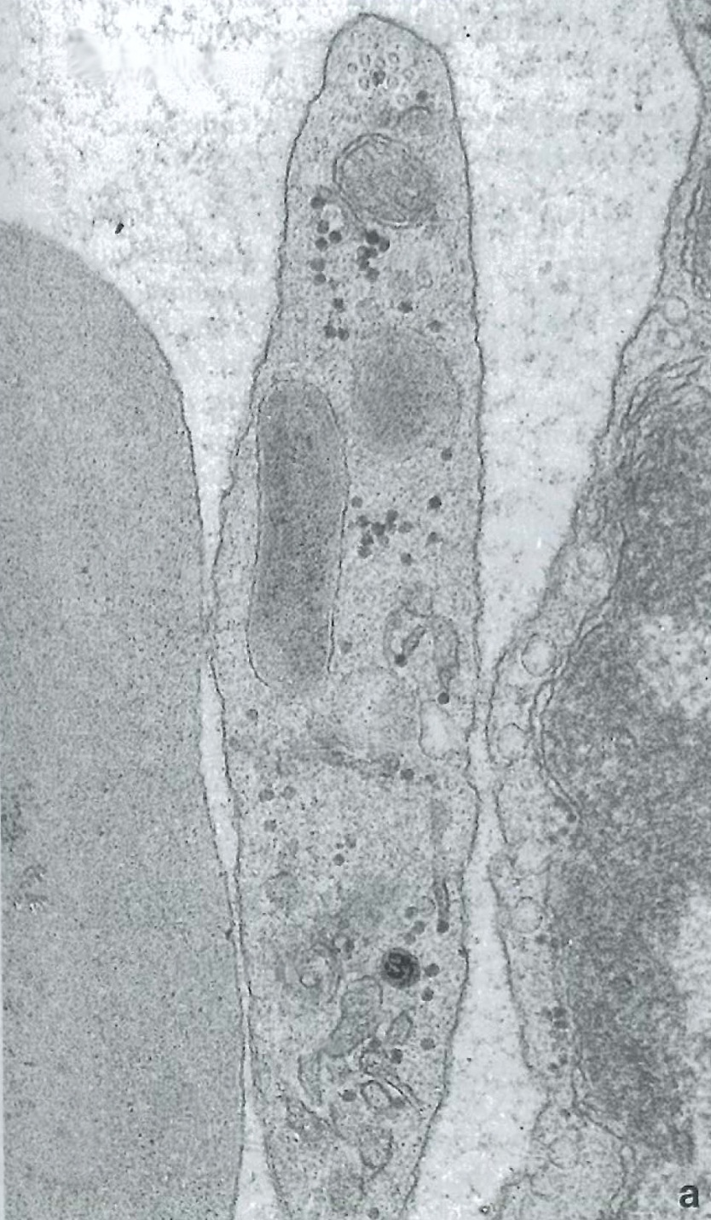
Primary Hemostasis: Temporary Platelet Plug
Endothelial Injury
Exposure
Adhesion
Platelets bind vWF via GpIb receptor at the site of injury. Platelets then undergo conformational change.
Binding of platelet causes release of alpha and delta granule contents
Alpha → vWF, fibrinogen, PDGF, and factors V and VIII
Delta → ADP, Calcium (important in fibrin clot formation), Serotonin
Thromboxane A2 (TxA2)
Activation
Aggregation
Alpha granule
Delta granule
First Aid 2018 Pg. 401-403
Fatemeh Zevari, Doctorials 2023/24
Notes:
INJURY
Endothelial damage followed by transient vasoconstriction via neural stimulation reflex and ET (released from damaged cell)
EXPOSURE
vWF (from Weibel-Palade bodies of endothelial cells and α-granules of platelets) binds to exposed collagen.
ADHESION
Platelets bind vWF via GpIb receptor at the site of injury only (specific)
Platelets then undergo conformational change
Platelets release ADP and Ca²⁺ (necessary for coagulation cascade), TXA2, Fibrinogen.
ACTIVATION
ADP binds P2Y12 receptor inducing GpIIb/IIIa expression at platelet surface.
AGGREGATION
Fibrinogen binds GpIIb/IIIa receptors and links platelets.
Week plugà temporary

Slide 34
Primary Hemostasis: Temporary Platelet Plug
Endothelial Injury
Exposure
Adhesion
Activation
ADP binds P2Y12 receptor inducing GpIIb/IIIa expression at platelet surface.
Aggregation
First Aid 2018 Pg. 401-403
Fatemeh Zevari, Doctorials 2023/24
Notes:
Shaira
INJURY
Endothelial damage followed by transient vasoconstriction via neural stimulation reflex and ET (released from damaged cell)
EXPOSURE
vWF (from Weibel-Palade bodies of endothelial cells and α-granules of platelets) binds to exposed collagen.
ADHESION
Platelets bind vWF via GpIb receptor at the site of injury only (specific)
Platelets then undergo conformational change
Platelets release ADP and Ca²⁺ (necessary for coagulation cascade), TXA2, Fibrinogen.
ACTIVATION
ADP binds P2Y12 receptor inducing GpIIb/IIIa expression at platelet surface.
AGGREGATION
Fibrinogen binds GpIIb/IIIa receptors and links platelets.
Week plugà temporary

Slide 35
Primary Hemostasis: Temporary Platelet Plug
Endothelial Injury
Exposure
Adhesion
Activation
Aggregation
Fibrinogen binds GpIIb/IIIa receptors and links other platelets → forms weak plug
Adjacent undamaged endothelium secretes PGI2 & NO to inhibit the formation of platelet plug in undamaged areas
First Aid 2018 Pg. 401-403
Fatemeh Zevari, Doctorials 2023/24
Notes:
INJURY
Endothelial damage followed by transient vasoconstriction via neural stimulation reflex and ET (released from damaged cell)
EXPOSURE
vWF (from Weibel-Palade bodies of endothelial cells and α-granules of platelets) binds to exposed collagen.
ADHESION
Platelets bind vWF via GpIb receptor at the site of injury only (specific)
Platelets then undergo conformational change
Platelets release ADP and Ca²⁺ (necessary for coagulation cascade), TXA2, Fibrinogen.
ACTIVATION
ADP binds P2Y12 receptor inducing GpIIb/IIIa expression at platelet surface.
AGGREGATION
Fibrinogen binds GpIIb/IIIa receptors and links platelets.
Weak plug (temporary)
--------------------------------------------------------------------------
Pro-Aggregation Factors:
TXA₂
Decreased Blood Flow
Anti-Aggregation Factors:
NO and Prostaglandins → Released by endothelial cells
Increased Blood Flow

Slide 36
Primary to Secondary Hemostasis
First Aid 2018 Pg. 401-403
Fatemeh Zevari, Doctorials 2023/24
Notes:
After initial platelet plug has been formed → the clotting cascade can be initiated to form stable fibrin mesh.

Slide 37
Secondary Hemostasis: Coagulation Cascade
Two separate pathways lead to the activation of factor Xa which initiates the common pathway:
Extrinsic Pathway (fast): triggered by tissue damage
Intrinsic Pathway (slow, reliable due to positive feedback): Endothelial/BV damage
First Aid 2018 Pg. 401-403
Fatemeh Zevari, Doctorials 2023/24
Notes:
Maddy

Slide 38
Secondary Hemostasis / The Clotting Cascade
Extrinsic Pathway:
TF (Factor III) + Ca²⁺ (binds to and activates) → Factor VII to VIIa (factor VIIa and TF form complex and activate) → Factor X to Xa (Xa then enters the common pathway)
Intrinsic Pathway: contact b/w blood and collagen → complex of HMW Kininogen + Prekallikrein + Factor XII
Activation of prekallikrein → kallikrein which activates bradykinin = increases vasodilation, permeability = increased inflammation
Activation of Factor XII → XIIa (which activates) → Factor XI to XIa (+ Ca²⁺ activates) → Factor IX to IXa → Complex of IXa + VIIIa + Ca²⁺ (TENASE COMPLEX) → converts Factor X to Xa (Xa then enters the common pathway)
Common Pathway:
Xa + Va (requiring III + Ca²⁺) → Complex of Xa and Va = Prothrombinase/Pro-thrombin Activator (+ Ca²⁺) converts Factor II (Prothrombin) to IIa (Thrombin) → Thrombin (+ Ca²⁺) converts Factor I (Fibrinogen) to Ia (Fibrin)
Crosslinks of fibrin network stabilized by Factor XIIIa → formation of fibrin mesh/network → stabilization of platelet plug
Thrombin (Factor IIa) also activates many factors such as factors V, VII, VIII, XI, XIII
Notes:
Extrinsic pathway: 3 + 7 = 10
Intrinsic pathway: 12, 11, 9, 8, 10

Slide 39
Coagulation Cascade: Extrinsic Pathway
Extrinsic Pathway (fast, but not reliable)
Damaged endothelium releases tissue factor which combines with Ca²⁺ to activate factor VIIa.
Factor VIIa can directly activate factor Xa (Common Pathway)
Extrinsic Pathway
VIIa
Ca²⁺
Ca²⁺
VII
+ III (tissue factor)
Common Pathway
X
First Aid 2018 Pg. 401-403
Fatemeh Zevari, Doctorials 2023/2024
Notes:
Easy way to remember: “3+7=10”

Slide 40
Coagulation Cascade: Intrinsic Pathway
Two separate pathways lead to the activation of factor 10a which initiates the common pathway:
Intrinsic Pathway (slow, but reliable due to positive feedback*) → “TENET”
Damaged endothelium exposes blood to collagen → leads to activation of XIIa → activates XIa → activates IXa with Ca²⁺ → IXa together with VIIIa and Ca²⁺ activates Xa
Thrombin will positively feedback and increase production of factors Va, VIIIa and IXa → this leads to a sustained intrinsic pathway
Intrinsic Pathway
TENET
XII
XIIa
XI
XIa
VIII + vWF
Ca²⁺
IX
IXa
VIIIa
Ca²⁺
X
Common Pathway
First Aid 2018 Pg. 401-403
Notes:
Easy way to remember: “12, 11, (skip 10) 9, 8, 10”
Role of HMW Kininogen:
*ET injury exposes SE collagen → activation of HMW Kininigen* (circulatory protein) →activate Factor XII → FXIIa → activates pre-kallikiren into Kallikiren → activates more FXII into FXIIa (positive feedback loop)
HMW Kininogen also triggers Bradykinin release which induces pain, vasodilation, vascular permeability → inflammation
HMW Kininigen: High Molecular Weight Kininogen

Slide 41
Coagulation Cascade: Common Pathway
Common Pathway (goal is to produce thrombin)
Xa with Va and Ca²⁺ will convert factor II (prothrombin) into IIa (thrombin)
Effects of IIa (thrombin):
Binds PLT Receptors → they change shape → connect with other platelets
Converts fibrinogen (I) → fibrin (Ia) → aggregate into fibrin mesh
Cleaves FXIII into FXIIIa → stabilizes fibrin chain
FVIIIa and IXa → Xa → feedback into intrinsic pathway → ++ Thrombin
FV → Va → feedback into common pathway → ++ Thrombin
First Aid 2018 Pg. 401-403
Fatemeh Zevari, Doctorials 2023/24
Notes:
Prothrombinase complex (Xa + Va + Ca²⁺ )activates 1000s of factor II (prothrombin) into IIa (thrombin)

Slide 42
Secondary Hemostasis: Coagulation Cascade
Intrinsic Pathway
Extrinsic Pathway
TENET
XII
XIIa
Ca²⁺
VIIa
VII
VIII + vWF
+ III (tissue factor)
XI
XIa
Ca²⁺
Ca²⁺
IXa
IX
VIIIa
Fibrinolytic System
Ca²⁺
Ca²⁺
XIII
Plasminogen
X
Xa
Ca²⁺
Va
V
tPA
Common Pathway
Ca²⁺
II (prothrombin)
IIa (thrombin)
XIIIa
Plasmin
Fibrin Degradation Products
I (fibrinogen)
Ia (fibrin)
Fibrin mesh
First Aid 2018 Pg. 401-403
Shaira Wignarajah & Madeline Stever, Doctorials 2019/2020
Notes:
Xa with Va and Ca²⁺ will convert factor II into IIa (thrombin)
Thrombin will convert fibrinogen (I) into fibrin (Ia) which can now aggregate to form fibrin mesh that is stabilized by XIIIa.
Thrombin will positively feedback and increase production of factors Va, VIIIa and IXa → this leads to a sustained intrinsic pathway

Slide 43
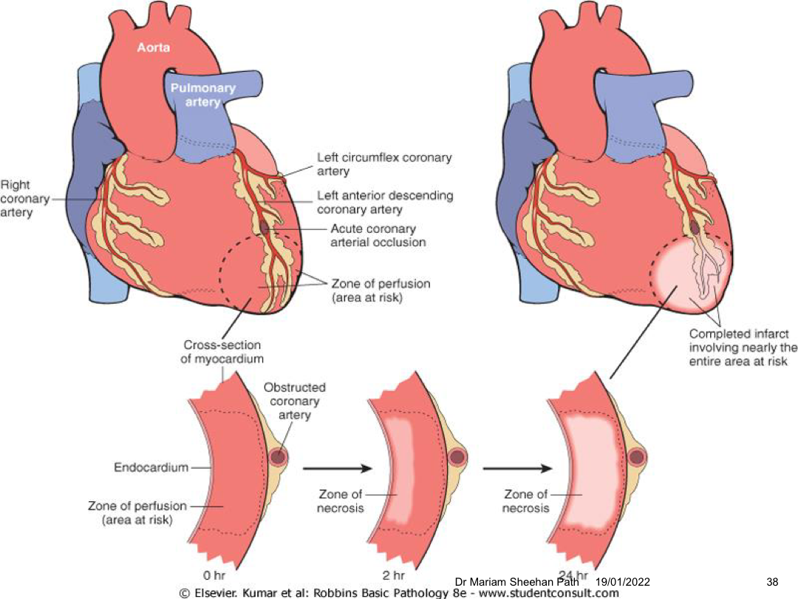
Outline the pathology of myocardial infarction, describing the effects of acute ischemia on cardiac muscle and the time course of healing processes
Mechanisms of MI
Increased demand (hypertrophy or exercise)
Decreased O2 transport (anemia or lung disease)
Occlusion or reduced pressure of coronary flow (shock or aortic valve disease)
Pathogenesis
Disruption of pre-existing atherosclerotic plaque leads to thrombus generation and subsequent vascular occlusion and infarct of downstream myocardium
Coronary artery occlusion sequence
Disruption of atheromatous plaque by intraplaque hemorrhage or mechanical force
Exposes sub endothelial collagen and necrotic plaque to blood
Platelet adherence, aggregation and activation
Activation of coagulation and subsequent increase in thrombus size
Thrombus can completely occlude coronary artery lumen

Slide 44
Outline the pathology of myocardial infarction, describing the effects of acute ischemia on cardiac muscle and the time course of healing processes
Myocardial response to ischemia
Short term (seconds to minutes)
Switch from aerobic to anaerobic respiration leading to accumulation of lactic acid and drop in ATP
Leads to loss of contractility, ischemia, cellular changes
Death occurs first in the endocardium as its the last to receive blood flow from pericardial vessels
In the case of reperfusion may cause injury to myocytes due to mitochondrial dysfunction, myocyte hypercontracture (increase intracellular Ca2+), free radical damage, leukocyte aggregation, platelet/complement activation
Long term (minutes to hours to days)
Infarct reaches full extent in 3-6 hours
Severe ischemia lasting 20-40 minutes can cause irreversible damage and myocyte death
Microvascular injury occurs after 1 hour

Slide 45
Outline the pathology of myocardial infarction, describing the effects of acute ischemia on cardiac muscle and the time course of healing processes
Notes:
0-4 hours: there are no changes
4-12 hours: mottled appearance
12-24 hours: hyperemia (bright red)

Slide 46
Outline the pathology of myocardial infarction, describing the effects of acute ischemia on cardiac muscle and the time course of healing processes
Notes:
24 hours
PMN infiltration of necrotic myocytes
3 weeks
Granulation tissue in periphery of infarct
Necrotic debris being removed
Small amount of collagen has been laid down
Still prone to rupture *
3 months
Infarct region is replaced by scar tissue

Slide 47
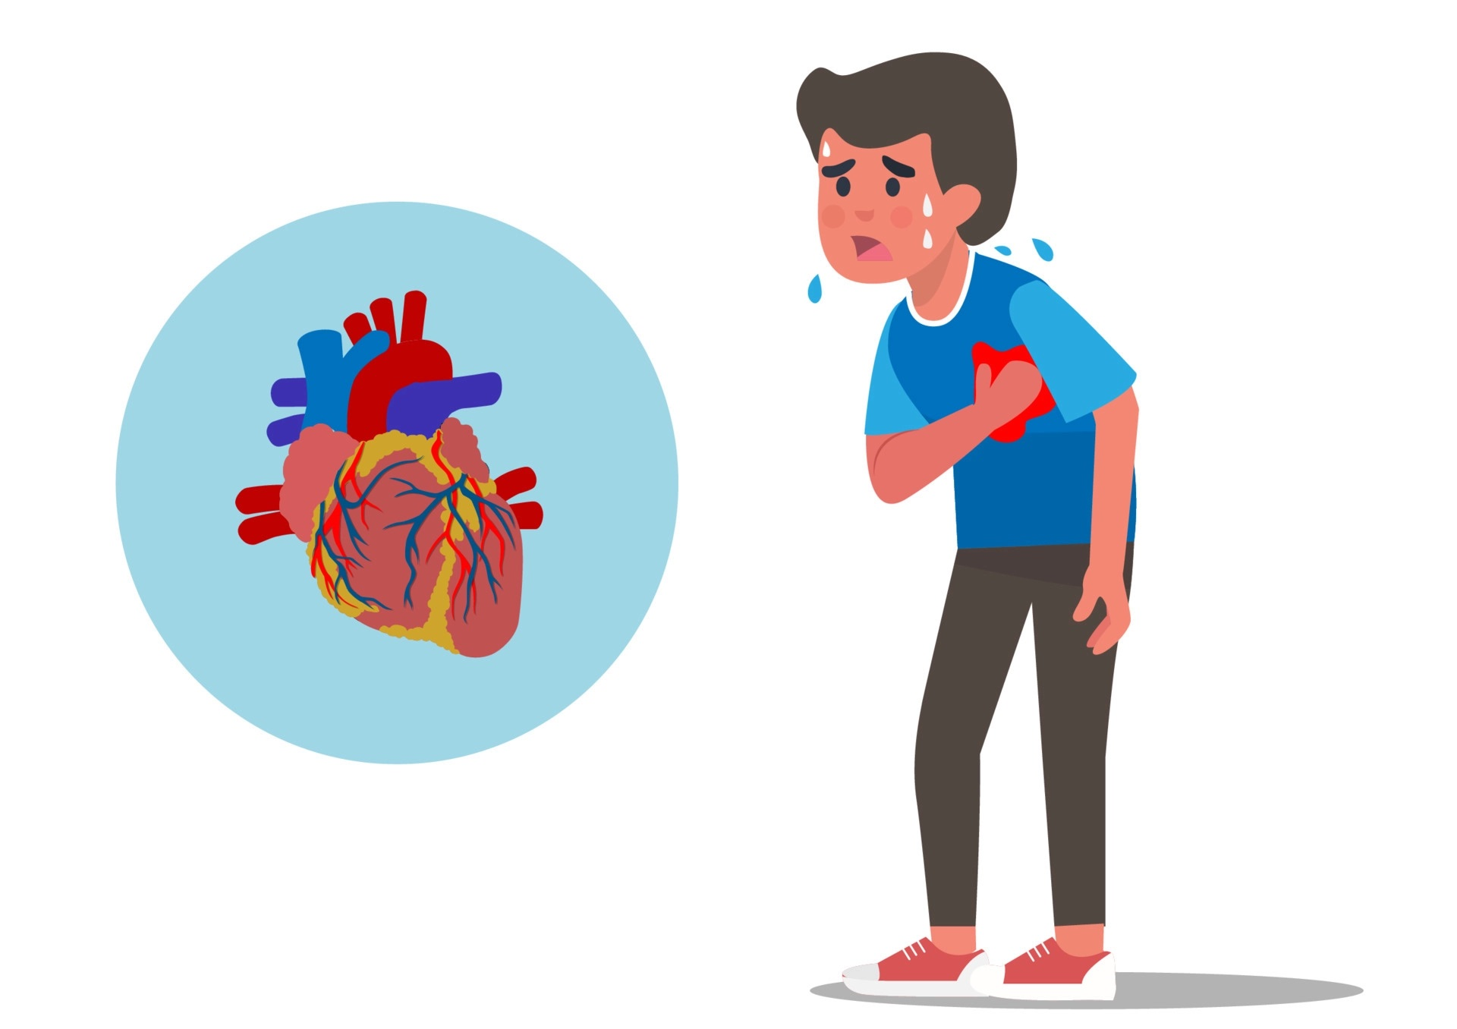
Possible Consequences of Myocardial Infarction
Early Complications of MI → due to myocardial ischemia and necrosis
Late Complications of MI → due to inflammation and healing processes of necrotic tissue

Slide 48
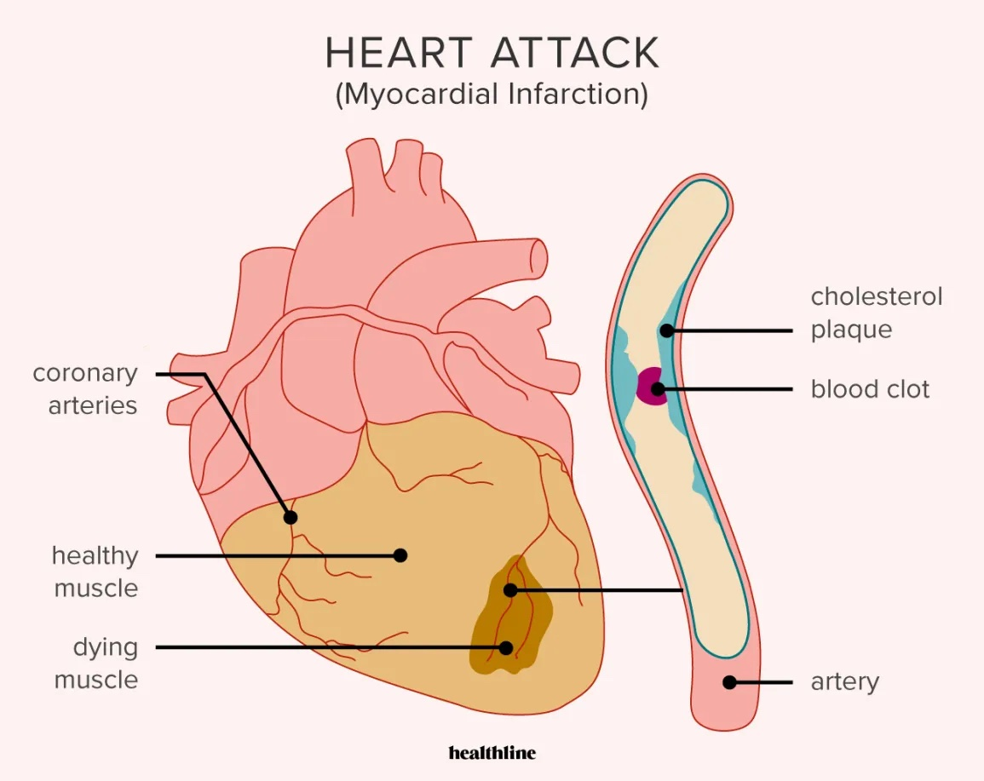
Possible Consequences of Myocardial Infarction
0-24h Post-MI:
Sudden Cardiac Death (SCD): cardiac arrhythmia or hemodynamic catastrophe
Often from a fatal ventricular arrhythmia
Arrhythmias: often ventricular tachyarrhythmias
Acute Left Heart Failure: +/- pulmonary edema
Cardiogenic Shock: circulatory failure due to the heart’s inability to maintain CO
1-3 Days Post-MI:
Early Infarct-Associated Pericarditis: friction rub if infarct is close to pericardium

Slide 49
Possible Consequences of Myocardial Infarction Cont’d
3-14 Days Post-MI:
Papillary Muscle Rupture: 2-7 days
Leads to mitral regurgitation (LV → LA)
Ventricular Septal Rupture: 3-5 days
Due to macrophage degradation of the septum during healing processes
Left Ventricular Free Wall Rupture: 5-14 days
During macrophage removal of necrotic tissue
Cardiac tamponade: hemorrhage into pericardial space → restriction of ventricle filling→ death
Left-Ventricular Pseudoaneurysm: outpouching of wall
2 Weeks - Months Post-MI:
Atrial & Ventricular Aneurysms: due to dyskinetic movements of damaged/scarred tissue
Dressler Syndrome: 2-10 weeks
Pericarditis – thought to be autoimmune cause in nature
Arrhythmias
Congestive Heart Failure
Re-Infarction

Slide 50
Possible Consequences of Myocardial Infarction
For all you acronym-lovers out there:
D - Death
A - Arrhythmias R - Rupture T - Tamponade H - Heart Failure
V - Valve Disease A - Aneurysm D - Dressler Syndrome E - Embolism R - Regurgitation (Mitral) OR Recurrence

Slide 51
Explain the pharmacology of anti-platelet agents, nitro-vasodilators and thrombolytics including DOAC’s.
Nitrates | Metabolized to NO → NO activates guanylyl cyclase → $↑$ cGMP → activates protein kinase G → activates myosin-light-chain phosphatase and inactivates myosin-light-chain kinase → $↑$ dephosphorylated myosin light chain (inactive form) + sequestration of intracellular Ca²⁺ → SM relaxation Decreases myocardial O2 consumption Vasodilates coronary arteries
Asprin | Acetylates a serine residue in the COX binding site Irreversibly inhibits COX-1 and inhibits platelet aggregation
Clopidogrel | Prodrug - active metabolite binds irreversibly to the purinergic - P2Y12 receptor for ADP on the platelet cell surface Reduces expression of GPIIb/IIIa receptors
Warfarin | Competitively antagonizes vit K by binding to and inhibiting the enzyme VKORC1 - vit K epoxide reductase Binding decreases hepatic synthesis of vit K Decreased carboxylation of residues 2/7/ 9/ 10 Also protein C and S
DOAC | Dabigatran; direct thrombin inhibitors Rivaroxaban/ apixaban; direct Xa inhibitors
Notes:
DOAC; direct acting oral anti-coagulant
Warfarin; Vit K needed to produce clotting factor II (prothrombin)/ VII/IX/X
Glycoproteins w/ γ-carboxyglutamin acid residues
γ-carboxyglutamin of residues catalysed by carboxylase enzyme - requires reduced vit K as cofactor

Slide 52
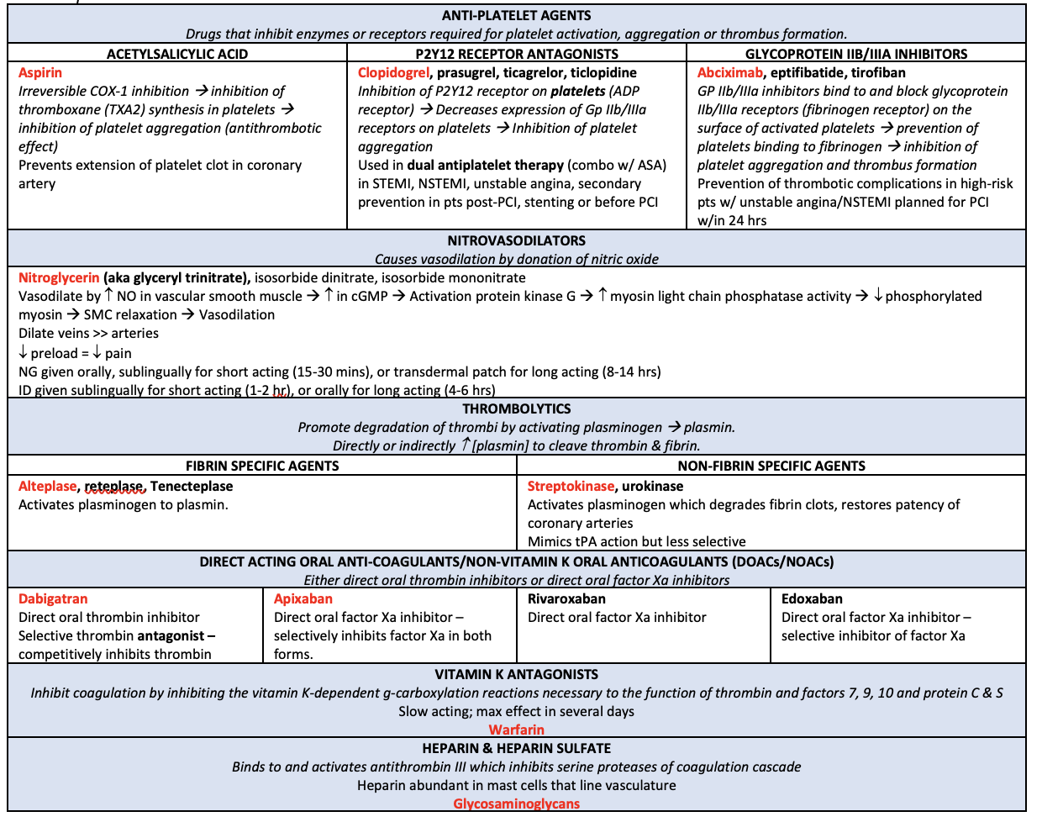
Notes:
Alteplase = tPA

Slide 53
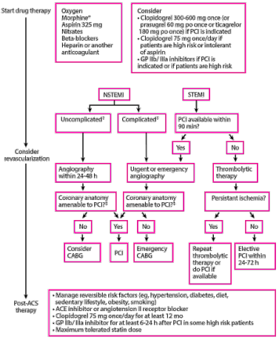
Define two types of treatment which relieve cardiac pain i.e. pharmacological and surgical treatments
In MI, revascularization “TIME IS MUSCLE”
Pharmacological
Immediate treatment of MI: MONA-BASH mnemonic
Morphine
Oxygen therapy
Nitrate
Antiplatelet drugs (aspirin 300mg + ADP-receptor antagonist)
Beta-blockers
Ace inhibitors/ ARBs
Statins
Heparin
Thrombolysis
Using a drug should be done in less than 30 minutes (door to needle time)
Notes:
http://www.pathophys.org/acs/ -Explanations for all the pharmacological treatments!

Slide 54
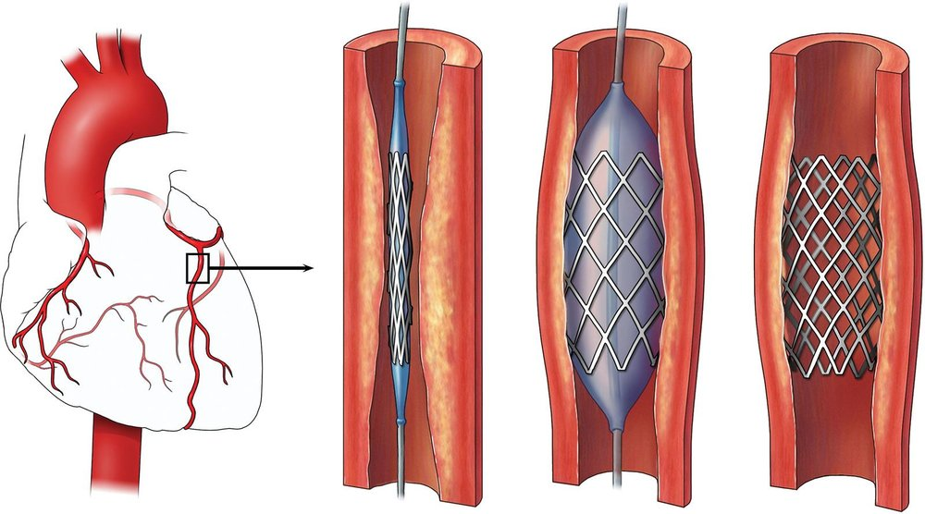
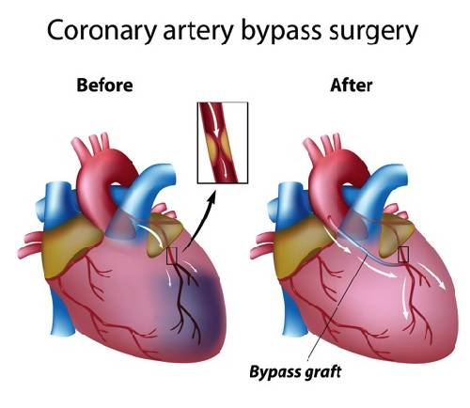
Define two types of treatment which relieve cardiac pain i.e. pharmacological and surgical treatments
Surgical
Percutaneous Coronary Intervention (PCI):
Reshape blood vessel using a catheter to relieve narrowing in coronary vessel and restore blood flow
Balloon catheter used to dilate and coronary stent may/ may not be placed
Should be done in less than 90 minutes (door to balloon time)
Coronary Artery Bypass Graft (CABG):
Used to treat patients with significant, symptomatic stenosis
Stenosed segment is bypassed using an arterial or venous (great saphenous vein) autograft to re-establish blood flow to areas of the myocardium

Slide 55
Best of luck and thank you!

