Slide 1
Nephrology II
Alan O’Doherty, 2023-24

Slide 2
List of topics for today
Acute Kidney Injury
Chronic Kidney Disease
Nephrotic Syndromes
Nephritic Syndromes
Nephrolithiasis
Polycystic Kidney Disease

Slide 3
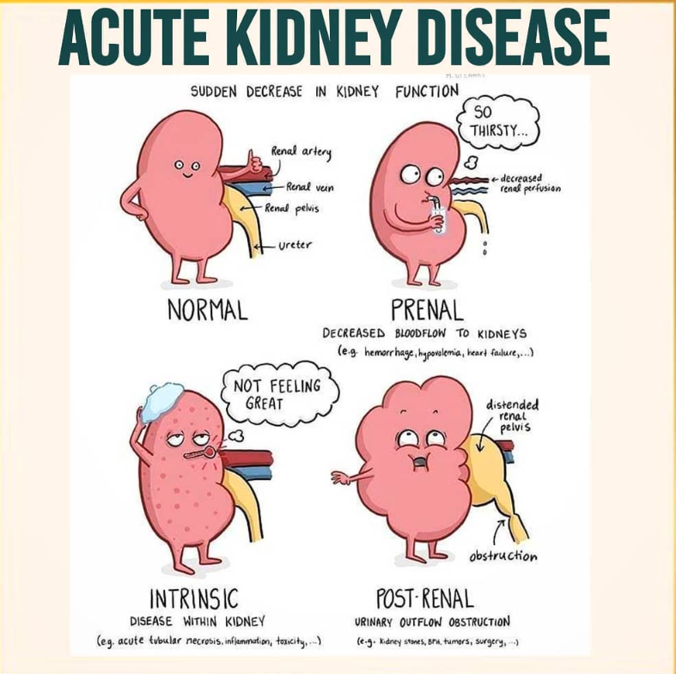

Slide 4
AKI: Acute Kidney Injury
AKI defined as an abrupt deterioration in renal function, usually over a period of hours-days. It is usually but not always reversible.
How is this detected clinically?
The serum creatinine and Blood Urea Nitrogen (BUN) levels rise. Accompanied with oliguria or anuria.
Diagnostic criteria:
Increase in serum creatinine by 26.5micro mol/L within 48 hours.
Increase in serum creatinine to >1.5x baseline within 7 days
Decrease in urine output to <0.5 mL/kg/hour for > 6 hours.
3 types of AKI based on the pathophysiology
Prerenal→ 60% of cases
Intrinsic→ 35% of cases
Postrenal→ 5% of cases
Notes:
Increase in serum creatinine by 26.5micro mol/L within 48 hours.
Increase in serum creatinine to > 1.5x baseline within 7 days
Decrease in urine output to <0.5 mL/kg/hour for > 6 hours.
Reference: 2012 Kidney Disease Improving Global Outcomes (KDIGO) Clinical Practice Guideline for Acute Kidney Injury.
Defined as a sudden loss of renal function. Seen clinically as a rise in serum creatinine and blood urea nitrogen(BUN), as well as oliguria or anuria.
Occurs acutely over a period of hours or days
There are many ways to classify it – Can classify from least to most severe based on highest creatinine level or lowest urine output
Often classified into three categories based on the specific pathophysiology:
Prerenal – 60% of cases
Intrinsic - 35% of cases
Postrenal – 5% of cases
What does Azotemia mean?
Azotemia is a medical condition characterized by abnormally high levels of nitrogen-containing compounds (such as urea, creatinine, various body waste compounds, and other nitrogen-rich compounds) in the blood.

Slide 5
Prerenal- AKI. 60% of cases- Massive!!
Not enough blood is getting to the kidneys, Thirsty
Name some conditions which cause poor renal perfusion
Decreased CO, Hypotension, Hypovolaemia, Renal Artery Stenosis and drugs (NSAIDs, ACE-Is)
What happens to kidney function? Hoover, takes up all the water
Decreased blood flow→ renal vascular autoregulation fails to maintain renal perfusion→ decreased GFR
Less BUN/Cr filtered into urine→ $↑↑$ BUN/Cr in blood
RAAS activation→ Aldosterone secretion→ Na⁺/H₂O resorption→ $↑↑$ urine osmolality, $↓$ Urine Na⁺ & Fe_{Na}
ADH secretion→ H₂O + Urea resorption in the collecting duct
Urea/BUN levels increase >>> Cr levels→ $↑↑$BUN/Cr
Kidney function remains intact despite decreased perfusion
Types | Urine Osmolality (mOsm/Kg) | Urine Na⁺ (mEq/L) | Fe_{Na} | Serum BUN/Cr
Normal | >500 (50-1200 range) | <20 | <1% | 15
Prerenal | >500 | <20 | <1% | >20
Alan O’Doherty-Nephrology II
Doctorials: 2023/24.
Notes:
Know NORMAL!!
Urine OSM: Kidneys ability to concentrate the urine, normally high >500
Urine Na: Kidneys ability to reabsorb sodium, normally low levels in urine
Fractional excretion, similar to above: Higher fractional excretion seen with damage to kidneys due to less reabsorption and more sodium loss in urine
Serum BUN/Cr: Blood urea nitrogen is reabsorbed, and Cr is excreted so you will see higher ratio due to elevated nitrogen when the kidneys are functional
FEna = Na+ excreted/Na+ filtered
DIRTYUSMLE: https://www.youtube.com/watch?v=-QZ2u5JBqN0
Reference Range
Urine osmolality is used to measure the number of dissolved particles per unit of water in the urine. As a measure of urine concentration, it is more accurate than specific gravity. Urine osmolality is useful in diagnosing disorders of urinary concentration such diabetes insipidous and in assessing hydration status. Often, the assessment of any disorder involving antidiuretic hormone (ADH) will require both serum and urine osmolality to assess concentrating ability of the kidney.
Normal urine osmolality is as follows ^{[1]} :
12- to 14-hour fluid restriction: >850 mOsm/kg H ₂O (SI units)
Random specimen: 50-1200 mOsm/kg H ₂O, depending on fluid intake, or 50-1200 mmol/kg (SI units)
Reference: Medscape
Reference Range
Urine sodium (Na) analysis is usually ordered when it is necessary to distinguish between various forms of renal failure and to classify hyponatremia. ^{[1]}
Normal urine sodium values include the following ^{[2]} :
Reference range: 40-220 mEq/day or 40-220 mmol/day (SI units)
Spot urine: >20 mEq/L
Fractional excretion of sodium (FE _{Na}): 1-2%

Slide 6
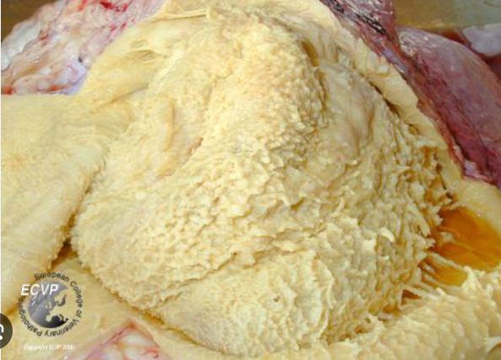
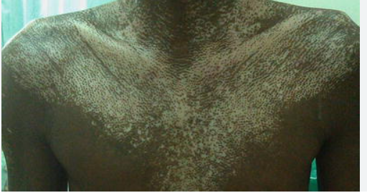
Terms to know
Azotemia: Accumulation of nitrogenous based products within the blood due to insufficient filtration of the blood by the kidneys
Uraemia: Azotemia with Uraemic Symptoms
Uraemic Symptoms: Nausea/Vomiting, Anorexia, Fibrinous Pericarditis (Bread and butter appearance), Platelet dysfunction (bleeding), Asterixis, Encephalopathy, Uraemic frost.
Why normal PT & aPTT but abnormal bleeding time?
Alan O’Doherty-Nephrology II
Doctorials: 2023/24.
Notes:
Why normal PT and PTT but abnormal bleeding time?
PT and PTT are related to clotting factors but bleeding time related to platelets
Over time as kidneys decline PT and PTT will eventually go up due to liver failure
Asterixis/encephalopathy – ammonia absorbed by astrocytes causing increased glutamate production inducing osmotic swelling; increase in GABA= decreased energy to brain

Slide 7
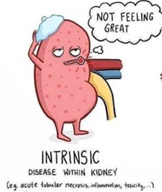
Intrarenal-AKI. 35% of Cases.
What’s going wrong here?
Intrarenal AKI is caused by damage to the vascular or tubular component of the nephrons
This leads to necrosis or apoptosis of tubular cells and hence tubular cell dysfunction
Decreased resorption of Water, Urea and Solutes→ inability to concentrate urine
$↓↓$ Urine Osmolality, $↑$ Urine Na⁺ & Fe_{Na}
No extra rise in BUN due to reduced Urea resorption in collecting tubules
What are some common causes?
Acute Tubular Necrosis
Acute Interstitial Nephritis
Others: Vascular→ HUS, TTP and malignant HTN.
Types | Urine Osmolality (mOsm/Kg) | Urine Na⁺ (mEq/L) | Fe_{Na} | Serum BUN/Cr
Normal | >500 (50-1200 range) | <20 | <1% | 15
Intrarenal | <350 | >40 | >2% | <15
Alan O’Doherty-Nephrology II
Doctorials: 2023/24.
Notes:
Tubules and interstitial:
Acute tubular necrosis (Ischaemia), nephrotoxic drugs and endogenous nephrotoxins (Myoglobin in rhabdomyolysis, Bence-jones proteins)
Acute interstitial nephritis: caused by medications (NSAIDs, PPIs, antibiotics), infections (Streptococcus, Legionella, Hep C, CMV and HIV) and diseases (sarcoidosis, amyloidosis)
Glomerulus
Acute glomerulonephritis
Vascular:
Vasculitis
Chronic hypertension
TTP-HUS
Damage to tubular or component of the nephron→ necrosis/apoptosis of tubular cells→ Cell slough off the basement membrane blocking the renal tubule→ Decreased H₂O + electrolyte reabsorption capacity→ Increased water in urine→ Decreased urine osmolality

Slide 8
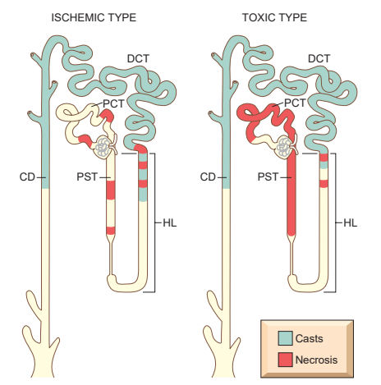
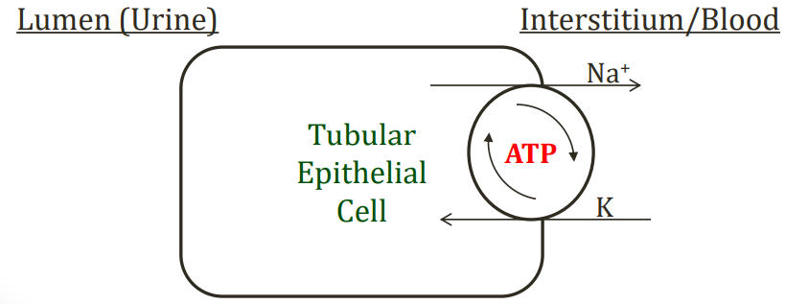
Acute Tubular Injury/Necrosis- A closer look
Ischaemic: Reduced/interrupted blood flow
Intrarenal vasoconstriction→ reduced GFR and oxygen delivery to the important straight segment of the proximal tubule and the thick ascending limb.
Why are these cells at risk?
These cells have a high rate of metabolism and oxygen consumption required for transport and resorption functions.
NB: Ischaemia induces “loss of polarity” in tubular cells→ redistribution of membrane proteins from basolateral to the apical membrane
E.g., Na⁺-K⁺ ATPase is now on apical membrane→ more Na⁺ is pumped into urine→ $↑$ Na⁺ in DCT and macula densa→ Tubuloglomerular feedback→ vasoconstriction
Na⁺
Alan O’Doherty-Nephrology II
Doctorials: 2023/24.

Slide 9
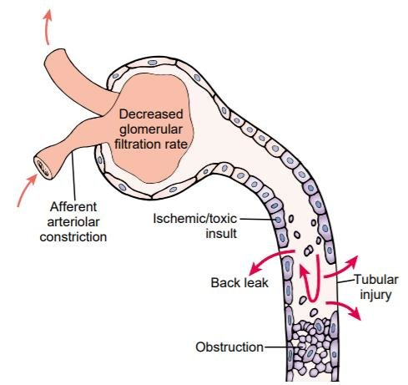
Acute Tubular Injury/Necrosis- A closer look
Toxic:
Endogenous: Myoglobin, Haemoglobin, Light chains (MM)
Exogenous: Drugs (cisplatin), radiocontrast, Ethylene Glycol (Anti-freeze)
PCT is mainly damaged
Brush border→ $↑$ Surface Area for resorption of solutes→ $↑$ chance of absorbing toxic substance into cells here.
Cells fall off!!!
Cells detach from the basement membrane (Slough off)→ luminal obstruction→ increase intratubular pressure, leakage into interstitium→ further damage.
Muddy Brown casts in Urine
Alan O’Doherty-Nephrology II
Doctorials: 2023/24.

Slide 10
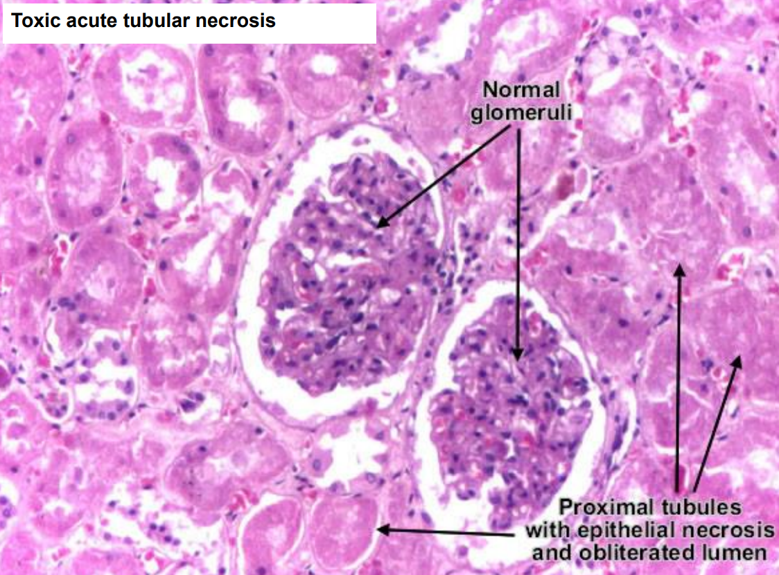
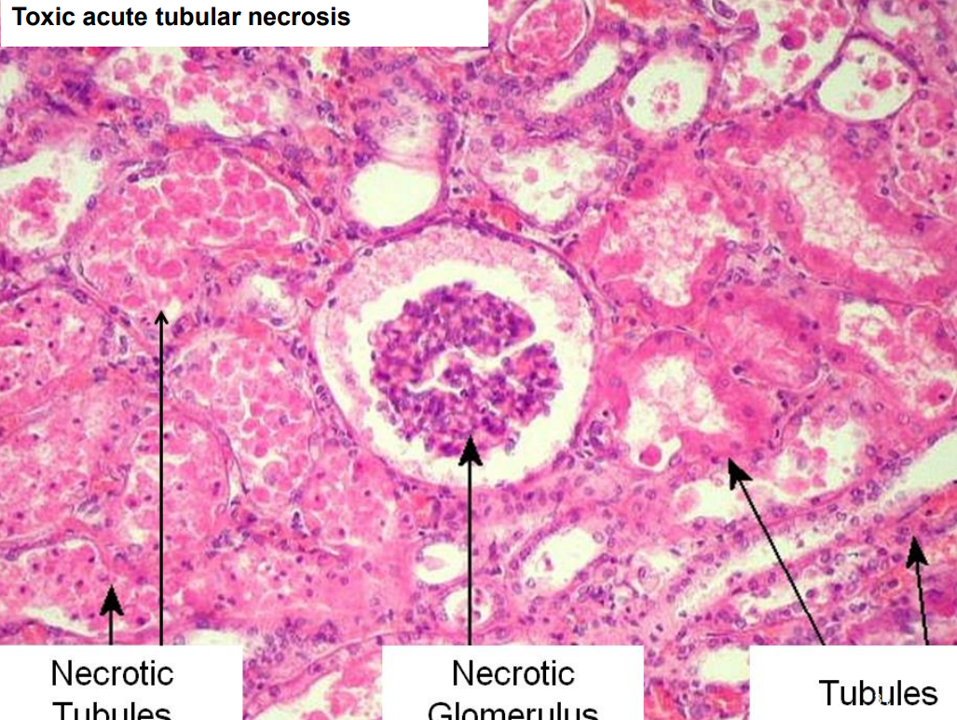

Slide 11
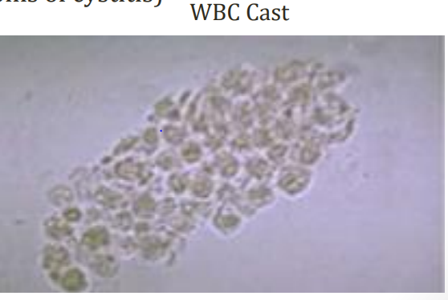
Acute Interstitial Nephritis
Acute inflammation of the renal interstitium
Secondary to a type IV (Delayed T-cell) hypersensitivity reaction , often associated with specific drugs which act as haptens
What is a Hapten?
A molecule (drug) once bound to a protein, elicits an immune response
Drugs: RSVP- Rifampin, Sulfa drugs and the 5(V) P’s: Pain killers (NSAIDS), Pee drugs (diuretics), PPI’s, Penicillin's and Phenytoin
Clinical Features:
Fever, Rash, Flank pain & Haematuria
Pyuria (eosinophils) and azotemia
Pyuria: the presence of WBCs in the urine→ WBC Casts
Question Vignette for USMLE:
Fever, maculopapular rash and acute renal failure occurring 1-3 weeks after beginning a new medication
Alan O’Doherty-Nephrology II
Doctorials: 2023/24.

Slide 12
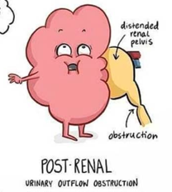
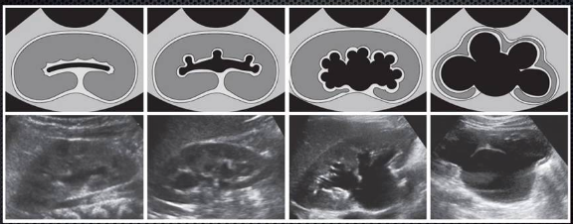
Postrenal-AKI. 5% of Cases
How does Kidney blockage, lead to AKI?
Uni/Bilateral urinary outflow obstruction→ $↑$ retrograde hydrostatic pressure
Fluid accumulation→ $↓$ GFR→ Kidney cannot filter blood
Kidney’s methods of resorption are damaged
Clinical Presentation:
Anuria
Compression of nephron→ Hydronephrosis
What are some common causes?
BPH, Stones, Neoplasm, Congenital (posterior urethral valves)
Hydronephrosis:
Dilation of the renal pelvis and/or calyces
Can cause compression and possible atrophy of renal cortex and medulla
Alan O’Doherty-Nephrology II
Doctorials: 2023/24.

Slide 13
Postrenal-AKI. 5% of Cases
Let’s study the numbers!!
Early Stage: Function of tubule intact (FE_{Na} <1%; urine Osm >500)
↑ tubular pressure “forces” urea into blood = ↑ BUN/Cr ratio
Resembles Prerenal
Late Stage: Long standing obstruction leads to tubular damage (FE_{Na} >2%; urine Osm <350).
↓ reabsorption of BUN, H₂O Na⁺ (i.e., requires an intact tubule) = ↓ BUN/Cr ration and U Na⁺ >40
Inability to concentrate urine→ Resembles Intrarenal
Types | Urine Osmolality (mOsm/Kg) | Urine Na⁺ (mEq/L) | Fe_{Na} | Serum BUN/Cr
Normal | >500 (50-1200 range) | <20 | <1% | 15
Postrenal (early) | >500 | <20 | <1% | >20
Postrenal (late) | <350 | >40 | >2% | <15
Alan O’Doherty-Nephrology II
Doctorials: 2023/24.

Slide 14
Phases of AKI
Initial Injury/Inciting event: Hours to days
Symptoms of underlying illness
Slight decline in urine output with a subtle rise in BUN→ may be explained by reduced blood flow and GFR
Oliguric or anuric phase:1-3 weeks:
Progressive deterioration of kidney function
Low urine output (oliguria) and increased retention of urea and creatinine (azotemia)
Complications: Hyperkalaemia, metabolic acidosis and uraemia symptoms
Polyuric/diuretic phase: Around 2 weeks:
Glomerular function has returned – increased urine production BUT the tubules take a little longer to heal = increased filtration but no reabsorption recovery = polyuria – risk of electrolytes loss (hypokalemia) and dehydration
Recovery: months to years:
Kidney function and urine production fully back to normal
Slowly creatinine and BUN levels return to normal
Alan O’Doherty-Nephrology II
Doctorials: 2023/24.

Slide 15
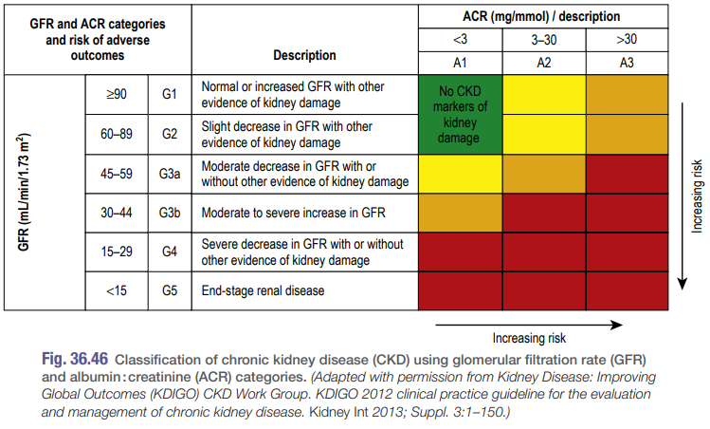
Chronic Kidney Disease- NB for PBL
Definition: CKD is the progressive and irreversible loss of kidney function. A GFR less 60ml/min/1.73m² for at least 3 months from any cause and/or albumuria is required for diagnosis. In stages 1-3, kidney function doesn’t/very gradually declines with time and generally these patients don’t die as a direct result of kidney disease
CKD is categorised according to GFR and ACR ration (Albumin: Creatinine).
Patients are required to reach at least stage 3 for CKD diagnosis.
Stages
Stage 1: GFR >90 but some kidney damage present
Stage 2: GFR 60-89
Stage 3: GFR 30-59
Stage 4: GFR 15-29
Stage 5: GFR <15; end-stage renal disease - dialysis required
Alan O’Doherty-Nephrology II
Doctorials: 2023/24.

Slide 16
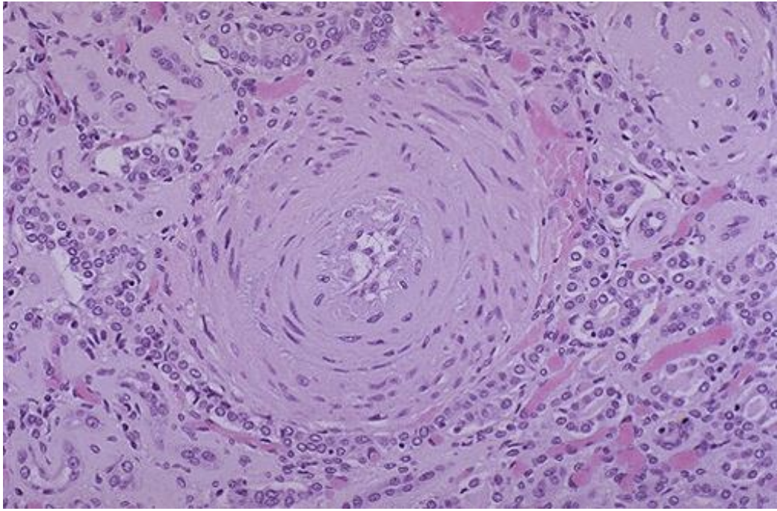
Chronic Kidney Disease
What causes CKD?- Previous SAQ
Hypertension, Diabetic Nephropathy, Glomerulonephritis, Polycystic Kidney Disease- See notes for more detailed explanation
Progression to ESKD
CKD generally progresses to ESKD, but the rate of progression can be slow/rapid depending on the underlying nephropathy and blood pressure control.
Normal kidneys have 1 million nephrons. When kidneys are damaged, numerous nephrons are damaged and no longer function.
The remaining nephrons must filter more fluid to maintain GFR→ experience hyperfiltration. This causes the nephrons to adapt via hyaline arteriolosclerosis (Ischaemia), glomerular hypertrophy (GBM thickening) and reduced arteriolar resistance.
The increased blood flow, increased pressure and stress causes an increase in intraglomerular capillary pressure and strain, damaging the GBM accelerating the failure of the remaining nephrons. This acts as a vicious cycle.
Filtered albumin (often carrying FAs, growth factors and cytokines) are reabsorbed in the PCT, become oxidised and activate further inflammation.
This is why the GFR only begins to fall once a large proportion of nephrons have already been lost
Alan O’Doherty-Nephrology II
Doctorials: 2023/24.
Notes:
The pathophysiology depends on what underlying condition caused the damage, but a progressive, cyclic loss of nephrons is what causes the symptoms
As nephrons die, the remaining nephrons take over the workload to maintain GFR. As the remaining nephrons become overworked or exposed to the same insult, they too die, leaving behind less and less nephrons to maintain GFR
This is why the GFR only begins to fall once a large proportion of nephrons have already been lost
HTN: Increased blood pressure and blood flow into the AA causing increases the GFR causing hyperfiltration. To compensate, the blood vessels form thicker walls. This hyaline arteriolosclerosis makes it more difficult for O₂ to diffuse across the vessel wall to supply cells of the nephron, resulting in Ischaemia/necrosis. Mesangial cells secrete TGF-ß, causing EXCM deposition/fibrosis around the glomerulus, known as Glomerular Sclerosis. Increased width of the GBM→ Decreased GFR→ CKD.
Diabetic nephropathy: High glucose levels in the blood cause Glucose to bind to lipids forming proinflammatory molecules called advanced glycosylation end products (Non-enzymatic glycosylation). This damages the efferent arteriole causing arteriolosclerosis (Hyaline (protein) and atherosclerosis (lipids)).
The E.A. narrowed lumen causes an increased P_{GC} → Increased GFR→ Mesangial cells secrete TGF-B→ fibrosis→ Glomerular sclerosis→ Thickening of the GBM→ Decreasing GFR→ CKD
The peritubular capillaries and vasa recta beyond the E.A. receive reduced blood flow→ Decreased O₂→ Ischaemia→ Damage to tubular cells→ Decreased absorption and secretion via tubular disease.
Glomerulonephritis: Antibody-antigen complexes are deposited into the GBM. This causes an immune reaction, activating the immune cells, complement system etc. This causes damage to the endothelial cells, basement membrane and the podocytes→ the GBM becomes more Porous. This causes hyperfiltration and short term GFR increase. Mesangial cells→ TGF-B→ Glomerular sclerosis→ decreased GFR.
Polycystic kidney disease: Cysts composed of portions of the renal tubules grow and compress renal vasculature. Can either cause ischaemia to other tubular cells or decrease the GFR if the AA is compressed. Decreased GFR is detected by the Macula Densa→ Renin secretion→ RAAS→ Secondary HTN→ Glomerulosclerosis
NSAID overuse: PGE₂ and PGI₂ cause vasodilation of AA, these prostaglandins are inhibited→ vasoconstriction→ decreased RPF→ Decreased GFR.

Slide 17
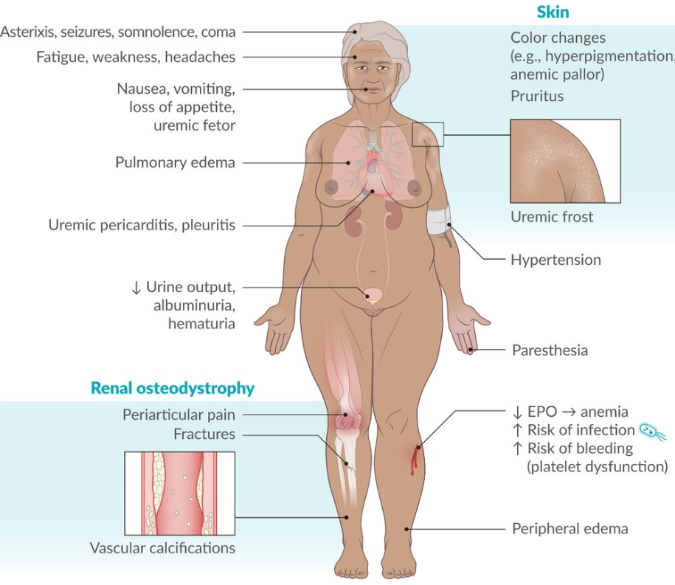
CKD-Complications
Consequences of Renal Failure: “MAD HUNGER”
Metabolic Acidosis – ↓ excretion of H⁺
Dyslipidemia (especially ↑ triglycerides) – ↓ oncotic pressure = ↑ lipoprotein synthesis
Hyperkalemia – ↓ excretion of K⁺ (What would you see on an ECG?)
Uremia— due to failure of excretion; clinical syndrome marked by ↑ BUN:
Na⁺/H₂O retention (HF, pulmonary oedema, hypertension, peripheral oedema)
Growth retardation and developmental delay
Erythropoietin failure (normochromic normocytic anaemia; uraemia can shorten lifespan of RBC also causing anaemia)
Renal osteodystrophy – NB.
Alan O’Doherty-Nephrology II
Doctorials: 2023/24.
Notes:
Dyslipidemia - CKD leads to a down regulation of lipoprotein lipase and the LDL-receptor, and increased triglycerides delayed catabolism of triglyceride rich lipoproteins (i.e. loss of protein from kidney sends liver into overdrive)
What would we see on ECG?
Hyperkalemia shows up as peaked T waves on ECG
Why normal PT and PTT but abnormal bleeding time?
PT and PTT are related to clotting factors but bleeding time related to platelets
Over time as kidneys decline PT and PTT will eventually go up due to liver failure
Asterixis/encephalopathy – ammonia absorbed by astrocytes causing increased glutamate production inducing osmotic swelling; increase in GABA= decreased energy to brain

Slide 18
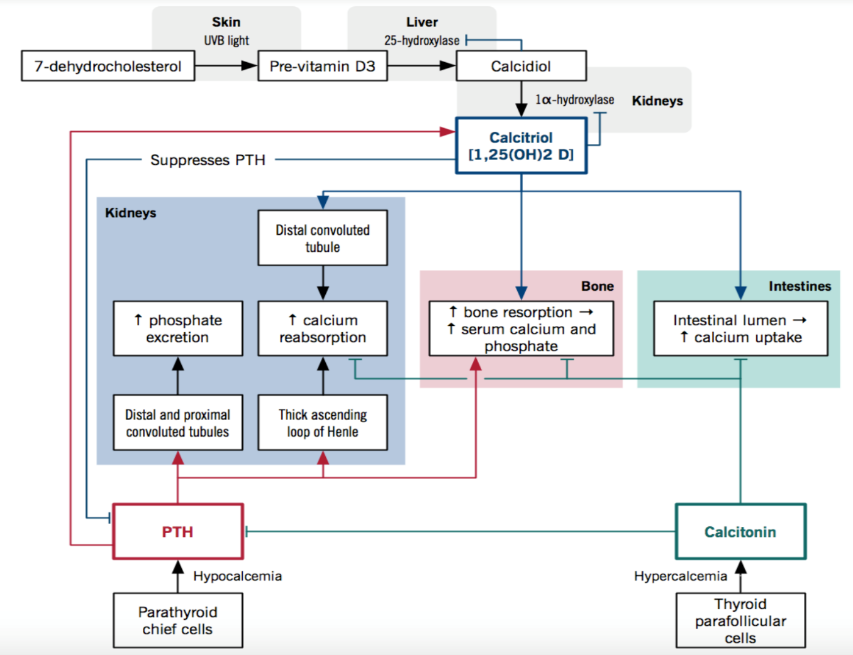
Renal Osteodystrophy- NB for GEMS
How does CKD cause Hypocalcaemia?
Renal failure→ $↓$ phosphate secretion→ Hyperphosphataemia→ $↑$ serum phosphate binds to more calcium→ $↓$ serum calcium levels→ PTH secretion.
Renal failure→ $↓$ 1$α$-hydroxylase production necessary for activation of vitamin D/Calcitriol/ 1,25- (OH₂)→ $↓$ Ca²⁺ resorption from the intestine or renal tubules→ Hypocalcaemia and low Vitamin D levels→ Increased PTH secretion.
Chronically decreased calcium leads to secondary hyperparathyroidism – PTH is stimulated and leads to increased bone resorption→ weakening the bone
What is the difference between primary and secondary hyperparathyroidism?
Primary: Overproduction of PTH by parathyroid chief cells→ Hypercalcaemia (Renal stones, polyuria, bone pain and anxiety.
Usually caused by parathyroid adenoma or hyperplasia.
Tertiary occurs when secondary hyperparathyroidism has been corrected but the parathyroid gland is refractory to the restoration of conditions and continues to secrete large amounts of PTH
Alan O’Doherty-Nephrology II
Doctorials: 2023/24.
Notes:
Treatment:
Surgery, primary hyperparathyroidism: Removal of parathyroid glands to stop PTH secretion.
Medical:
Calcimimetics→ Cinacalcet. Modulates the calcium-sensitive receptor in parathyroid glands→ Increased sensitivity of the receptor to circulating Ca²⁺→ inhibition of PTH release.
ADR: Hypocalcaemia
Phosphate binders→ Sevelamer. Nonabsorbable phosphate binder that prevents phosphate absorption from the GI tract.
Clinical use: Hyperphosphataemia in CKD. Hypophosphataemia.
Vitamin D deficiency: Ergocalciferol.
Bisphosphonates: Inhibit osteoclast-mediated bone resorption. E.g. Zoledronic acid.

Slide 19
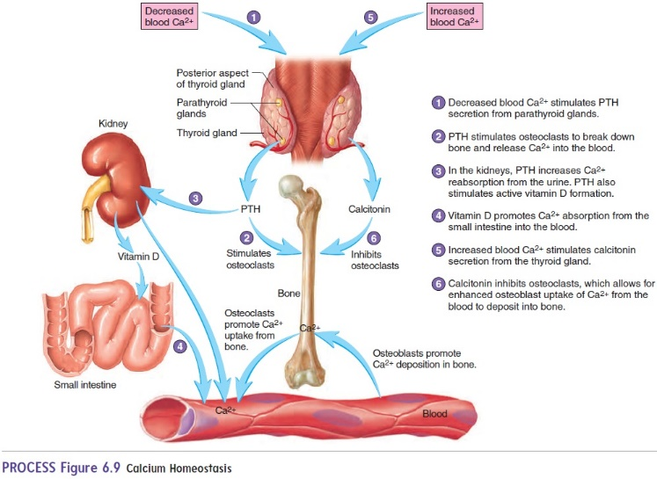
Renal Osteodystrophy- NB for GEMS
What is meant by Renal Osteodystrophy?
Renal Osteodystrophy: alteration in bone morphology in patients with CKD, commonly due to hypocalcaemia.
Osteitis Fibrosa Cystica: Decreased vitamin D→ Hypocalcaemia→ increased production of PTH (secondary Hyperparathyroidism)→ resorption of Ca²⁺ from bone→ fibrosis and cyst formation in the bone to replace the calcium
Osteomalacia: Decreased mineralisation/organic bone matrix production by osteoblasts due to hypovitaminosis D→ Fragile bones
Osteoporosis: Loss of organic bone matrix and minerals (Ca²⁺ from bone) due to metabolic acidosis.
Alan O’Doherty-Nephrology II
Doctorials: 2023/24.

Slide 20
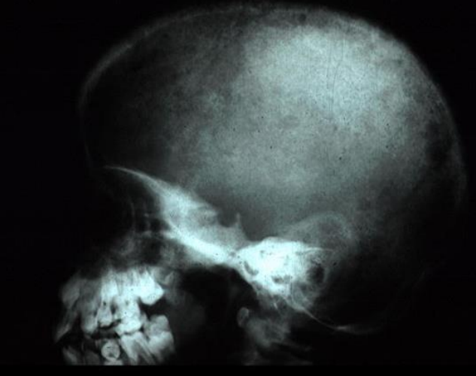
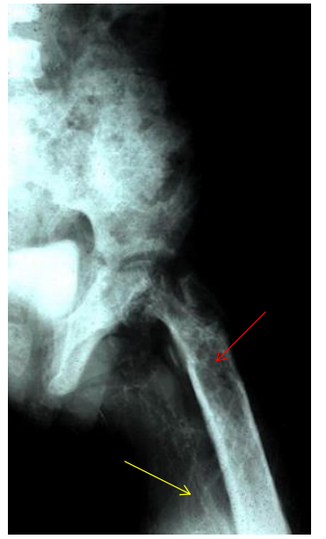
Renal Osteodystrophy- NB for GEMS
Femur: Increased lucency due to resorption of bone calcium→ Calcium deposition in the artery adjacent to the femur
Osteitis Fibrosa Cystica: Calcium resorption with fibrosis and cysts formation to replace calcium removed.
“Salt and Pepper” pattern of irregular lucencies.
Alan O’Doherty-Nephrology II
Doctorials: 2023/24.

Slide 21
Nephrotic Syndrome
Nephrotic syndrome:
Podocyte damage or epithelial side of GBM only (no exposure to blood)
No inflammation)→ impaired charge barrier (-ve charge is lost)
Proteins not repelled→ massive proteinuria (>3.5g/day).
RBCs are not filtered.
Clinical Features:
Decreased blood protein levels→ Proteinuria→ Frothy urine
Hypoalbuminaemia→ Oedema & Decreased GFR→ RAAS→ Na⁺/H2O retention→ Oedema is exacerbated.
Increased liver activity to compensate for low albumin→ Hyperlipidaemia→ Fatty casts (lipids in urine) and oval fat bodies (lipid surrounded by plasma membrane of degenerated epithelial cells) in urine. (Fat droplets appear as a Maltese cross under UV light)
Decreased anticoagulants→ $↓$ Antithrombin 3→ Thrombosis
Decreased protein levels→ $↓$ Ig → Susceptible to Infection
Alan O’Doherty-Nephrology II
Doctorials: 2023/24.

Slide 22
Minimal Change Disease
Minimal Change disease:
Cytokine damage to podocytes
Podocytes collapse/effacement of foot processes→ Loss of the –ve charge barrier (Heparan sulphate proteoglycans)→ Protein flows into urine, specifically Albumin.
Associated with Hodgkin’s Lymphoma.
Most common nephrotic syndrome in children.
Likely caused by a URI (viral infection), Allergic reaction or recent immunisation.
Responds very well to steroids/glucocorticoids→ Decreases cytokines which are causing the damage.
LM—Normal glomeruli
IF—⊝ (no immune complex deposits)
EM—effacement of podocyte foot processes
Alan O’Doherty-Nephrology II
Doctorials: 2023/24.

Slide 23
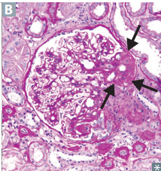
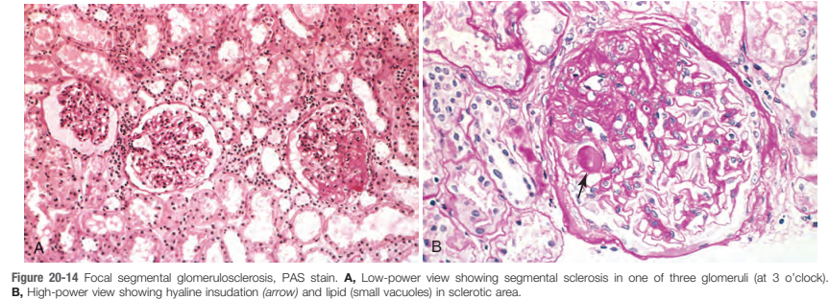
Focal Segmental Glomerulosclerosis
Focal Segmental Glomerulosclerosis: Parts of Glomerulus damaged→ FSGS
Sclerosis causes collapse of basement membranes and hyaline deposition. Foot process effacement.
A more serious version of minimal change→ often progresses to ESKD.
Idiopathic (1°) but many (2°) causes: HIV, Sickle cell, Heroin users, Obesity and hepatitis B.
LM: Segmental sclerosis and hyalinosis (B)
IF: Usually negative, sometimes +ve for IgM, C3 and C1.
EM: Effacement of foot processes/podocytes (Similar to Minimal Change)
Alan O’Doherty-Nephrology II
Doctorials: 2023/24.

Slide 24
Membranous Nephropathy
Membranous Nephropathy: Forms a Thick GBM but no hypercellularity (distinct from membrano-proliferative).
ICs deposit between the epithelial layer and basement membrane (Subepithelial layer)→ filter is affected. New cells will be laid down, providing the “spike and dome” appearance on the EM.
Autoantibodies bind phospholipase A2 receptor on the subepithelial layer, as it is identified as an antigen by immune system.
Once bound ICs activate complement→ C5b-C9 form the membrane attack complex→ cause epithelial and mesangial cells to proliferate→ Effacement of foot processes→ Filter is no longer effective.
Appear in patients with Malignant tumours, infections (Hep B & C), Drugs for RA (Gold, NSAIDs and Penicillamine) and (SLE)
Associated with DVT
LM: Diffuse capillary and GBM thickening
IF: Granular appearance, IC deposition.
EM: Spike and Dome appearance.
Alan O’Doherty-Nephrology II
Doctorials: 2023/24.

Slide 25
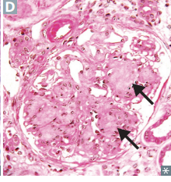
Diabetes Mellitus
DIABETES MELLITUS
Most common cause of end-stage renal disease in most developed countries.
High serum glucose leads to nonenzymatic glycosylation of the GBM resulting in hyaline arteriosclerosis (Pink).
GBM thickening and ↑ permeability
Preferential hyaline arteriosclerosis of the efferent arteriole decreases lumen diameter→ increasing the back pressure on the glomerulus causing hyperfiltration (↑ GFR).
Progresses to Nephrotic Syndrome
What drug would slow the progression of hyperfiltration-induced damage?
ACE-Inhibitors
LM—Mesangial expansion, GBM thickening, eosinophilic nodular glomerulosclerosis
What are arrows pointing at?
Kimmelstiel-Wilson nodules
Alan O’Doherty-Nephrology II
Doctorials: 2023/24.
Notes:
Major cause of End Stage Renal Disease – seen in patients with longstanding chronic hyperglycemia
Non-enzymatic glycosylation of the basement membrane: increased permeability and thickening of the basement membrane
Hyaline arteriosclerosis of the efferent arteriole
Can lead to Hyalinization of the glomerulus – glomerulosclerosis
What is the definition of Hyalinization according to Dr. Mariam Sheehan?
See Kimmelstiel-Wilson nodules on LM -> due to sclerosis of the
mesangium
Treatment – glycemic control and RAAS inhibitors

Slide 26
Systemic Amyloidosis
Systemic Amyloidosis:
Extracellular accumulation of amyloid proteins- deposited in the glomeruli and Mesangium.
Mesangial expansion and nodular sclerosis→ Proteinuria
LM: Apple-green birefringence on Congo red stain due to Amyloid deposition in the Mesangium.
What kinds of diseases would you see this in?
Multiple myeloma
Rheumatoid Arthritis
IBD
Inflammatory conditions
Alan O’Doherty-Nephrology II
Doctorials: 2023/24.

Slide 27
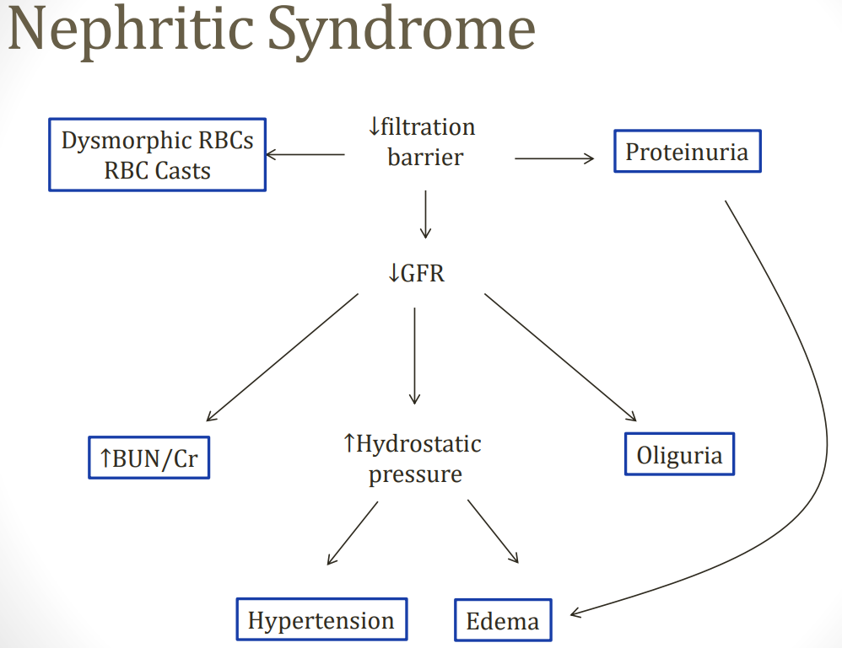
Nephritic Syndrome
Nephritic syndrome: Glomerular disease characterised by inflammation.
Underlying lesion causes damage to endothelial and mesangial cells
Exposed to elements of blood
Glomerular inflammation due to WBC influx
GBM damage making it more porous→ Leakage of proteins & RBCs into glomerulus and urine (<3.5g/day).
Decreased GFR as less blood is being filtered as it is being lost in urine.
Clinical Features :
Haematuria with dysmorphic RBCs and RBC casts in the urine→ Dark Urine
Proteinuria (<3.5 g/day)→ less than nephrotic syndrome as there is a lower GFR. Less protein in blood→ Reduced oncotic pressure→ Oedema
Decreased GFR→ Less plasma is being filtered→ Increased BUN/Cr → Fatigue and Uraemia
Oliguria
Decreased GFR→ More fluid in vascular system→ $↑$ P_{GC}→ HTN and Oedema. Exacerbated by RAAS activation.
Alan O’Doherty-Nephrology II
Doctorials: 2023/24.
Notes:
Nephritic syndrome causes hypertension due to increased RAAS activation causing sodium reabsorption. RAAS activation greatly increases due to decreased GFR. Blockage of the tubular lumen due to hematuria and RBC cast formation leads to decreased luminal flow that is detected as decreased glomerular filtration.
The main cause of hyperlipidemia is probably increased hepatic lipogenesis, a non-specific reaction to falling oncotic pressure secondary to hypoalbuminemia.

Slide 28
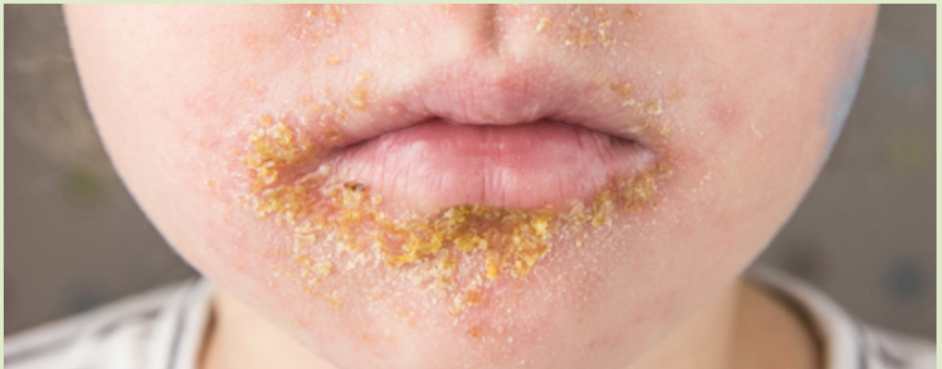
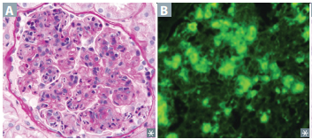
Post-streptococcal Glomerulonephritis
Post-streptococcal GN: Group A Streptococcus- $β$ Haemolytic→ Streptococcus Pyogenes
Type 3 hypersensitivity reaction: Immune complexes deposit in the kidney in response to GAS/SLE→ Activate complement→ Attract PMNs/Neutrophils→ Nephritis.
Complement is used→ Hypocomplementemia (↓ ↓ C3 levels). .
Common in children: Child, 2-3 weeks following strep throat/skin infection→ Nephritic syndrome.
Usually presents as Impetigo (Honey-crusted rash) and Pharyngitis/Tonsillitis.
Hypertension, periorbital oedema
Tea-Coloured urine
Adults: Caused by Staph. Aureus. Worse outcome.
LM: Glomeruli are enlarged and hypercellular (due to Leukocyte infiltrate) (A)
IF: Granular appearance due to IgG, IgM and C3 deposition along the GBM and Mesangium. (B)
EM: Subepithelial Immune complex Humps.
What else can GAS lead to?
Alan O’Doherty-Nephrology II
Doctorials: 2023/24.
Notes:
Rheumatic fever

Slide 29
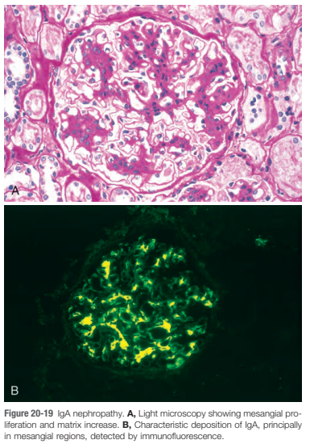
IgA Nephropathy/Berger disease
IgA Nephropathy/Berger disease: Most common glomerulonephritis globally.
Haematuria occurring within 5 days of a Resp/GI infection.
IgA synthesis from mucosal linings due to Resp/GI infections→ IgA immune complex deposition in the Mesangium→ inflammation and nephritis.
The IgA immune complex activates the alternative/lectin pathways, no hypocomplementemia.
LM: Mesangial proliferation
IF: Granular appearance. IgA IC deposition in the Mesangium. Stains yellow.
Clinical Relevance
Henoch-Schönlein purpura is the most common childhood systemic vasculitis. Presents with the triad of palpable purpura on the buttocks and legs, arthralgias and abdominal pain. 2° to IgA immune complex deposition.
Alan O’Doherty-Nephrology II
Doctorials: 2023/24.

Slide 30
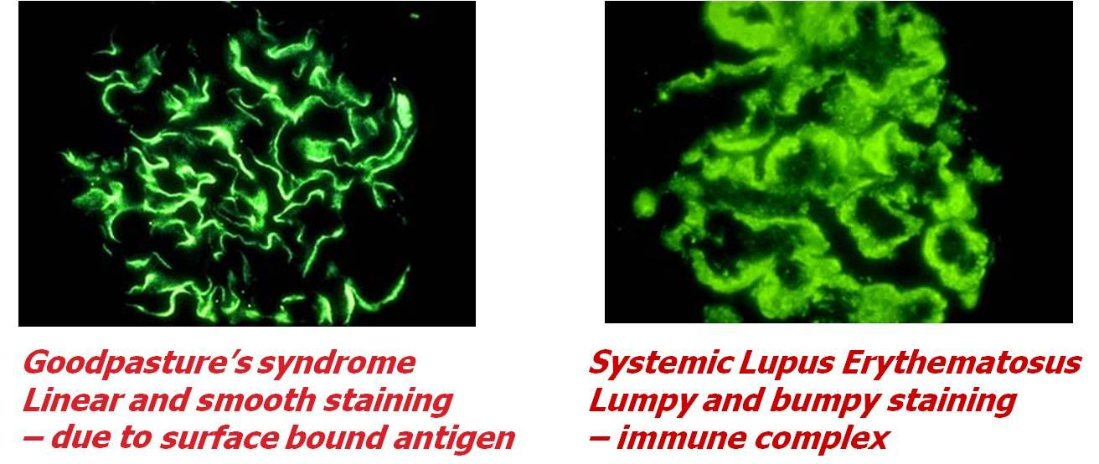
Alport Syndrome
Alport syndrome/Hereditary Nephritis:
Type-4 Collagen Defect
X-linked inheritance→ more common in boys.
Classic presentation: Child with Haematuria, hearing loss and eye problems. (Can’t see, can’t hear, can’t pee.)
EM: “Basket-Weave” appearance due to irregular thinning and thickening of GBM.
Goodpasture Syndrome:
Antibodies against type IV collagen! = Type II Hypersensitivity reaction!
Pulmonary haemorrhage and haemoptysis as alveoli are also affected.
On IM – linear deposition of IgG along the basement membrane
Alan O’Doherty-Nephrology II
Doctorials: 2023/24.

Slide 31
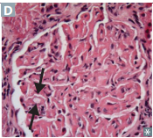
Diffuse Proliferative Glomerulonephritis
Diffuse proliferative glomerulonephritis (DPGN): Caused by SLE.
Type 3 Lupus nephritis is <50% of glomeruli involvement, hence Focal PGN.
Type 4 Lupus nephritis as >50% of the glomeruli are involved, hence Diffuse PGN.
Often presents with other features of SLE: Fever, rash and arthritis.
Anti-dsDNA IC deposition in the subendothelial layer of the glomeruli (nephritic syndrome)→ Inflammation & hypocomplementemia.
LM: Thickened (wire looping) capillaries. (D)
IF: Granular due to ICs. Full house= IgG, IgA, IgM, C3 and C1q.
EM: Subendothelial IgG based immune complex deposition
Alan O’Doherty-Nephrology II
Doctorials: 2023/24.

Slide 32
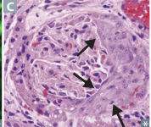
Rapidly Progressive Glomerulonephritis
Rapidly Progressive (Crescentic) glomerulonephritis (RPGN):
Severe form, progressive loss of renal function with rapid onset→ Multiple causes of this type of inflammation.
IF used to determine cause:
Linear IF:
Goodpasture Syndrome (type II hypersensitivity reaction)
Antibodies to GBM and alveolar basement membrane
Haematuria and haemoptysis
Negative IF/Pauci-immune: (no IC deposition)
Granulomatosis with polyangiitis (Wegener) – c-ANCA
Sinusitis, haemoptysis, haematuria
Microscopic polyangiitis— p-ANCA (Anti- Myeloperoxidase
Lungs & Kidney
Churg-Strauss syndrome – p-ANCA
Eosinophilic Granulomatous inflammation, Asthma.
Granular IF:
PSGN, DPGN.
LM: Crescent moon shape- formed via inflammation. Formed from
monocytes/macrophages and fibrin.
Alan O’Doherty-Nephrology II
Doctorials: 2023/24.

Slide 33
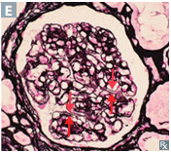
Membranoproliferative Glomerulonephritis
Membranoproliferative glomerulonephritis:
MPGN is a nephritic syndrome which often co-presents with nephrotic syndrome.
Thick basement membrane with proliferation of the Mesangium (thickened glomeruli).
Type I may be 2° to hepatitis B or C infection. May also be idiopathic.
Subendothelial immune complex deposits with granular IF.
Type II is associated with C3 nephritic factor (IgG antibody that stabilizes the enzyme C3 convertase leading to persistent complement activation and ↓ C3 levels).
Intramembranous (dense) deposits along the BM of the glomerulus and tubules.
Poor response to steroids→ Progresses to chronic renal failure.
H&E—Thick GBM often with tram track appearance.
Alan O’Doherty-Nephrology II
Doctorials: 2023/24.

Slide 34
Nephrolithiasis
Renal Casts vs Renal Stones:
Renal Casts: particles seen in the urine on light microscopy that can be useful in identifying kidney disease
Muddy brown/ Granular casts = acute tubular necrosis, glomerulonephritis (stasis in the nephron)
Hemoglobin casts = intravascular hemolysis
Fatty casts (Maltese cross) = nephrotic syndrome – see picture
WBC casts = acute pyelonephritis, interstitialnephritis OR transplant rejection
Waxy casts – CKD
Renal stones: crystal aggregates that form stones in the collecting ducts
Calcium oxalate – most common (75%)
Uric acid
Struvite
Cysteine
Alan O’Doherty-Nephrology II
Doctorials: 2023/24.

Slide 35
Nephrolithiasis
COMPOSITION | PRECIPITATES WITH | RADIOLOGY | URINE CRYSTAL SHAPE | NOTES
Calcium Oxalate | Hypocitraturia (citrate normally complexes with calcium in the urine, increasing its solubility and reducing free [Ca²⁺] in the urine) | Radiopaque (X-ray cannot pass through→ appears white) | Envelope or Dumbbell | Most common kidney stone presentation is a calcium oxalate stone in patient with hypercalciuria and normocalcaemia. Can result from ethylene glycol (antifreeze) ingestion, vitamin C abuse, hypocitraturia, malabsorption. Treatment: thiazides, citrate, low-sodium diet.
How does Crohn’s disease result in stones?
Ammonium Magnesium Phosphate (Struvite) | ↑ pH | Radiopaque | Coffin Lid | Caused by infection with urease ⊕ bugs (eg, Proteus mirabilis, Staphylococcus saprophyticus, Klebsiella) that hydrolyze urea to ammonia leading to urine alkalinization. Commonly form staghorn calculi. Treatment: eradication of underlying infection (to prevent recurrence), surgical removal of stone (due to size).
Calcium Phosphate | ↑ pH | Radiopaque | Wedge-Shaped Prism | Treatment: low-sodium diet, thiazides.
Alan O’Doherty-Nephrology II
Doctorials: 2023/24.
Notes:
Hypercalciuria is the most common risk factor for the development of calcium stones in adults. In most patients, the hypercalciuria is often idiopathic and thought to be due to increased GI absorption, increased mobilization of calcium from bone or decreased renal tubular calcium reabsorption. These patients remain normocalcaemic due to intact regulation of serum calcium levels by vitamin D and PTH.
How does Crohn’s disease result in stones?
Inflammation of the GI tract, transmural→ Terminal Ileum effected
Bile acids cannot be absorbed and lost in faeces→ fat malabsorption
Excess lipids in GI tract bind to Ca²⁺ ions
Healthy bowel: Ca²⁺ binds to oxalate forming an insoluble compound, excreted in faeces.
Inflamed bowel: Ca²⁺ binds to lipids. Oxalate doesn’t bind Ca²⁺, it is reabsorbed→ increasing chance of Ca²⁺ oxalate kidney stones formation.

Slide 36
Nephrolithiasis
Na⁺/Cl⁻ cotransporter allows for the reabsorption of Na⁺ and Cl⁻ into the tubular cells from the lumen.
Impermeable to H₂O. Makes urine fully dilute (hypotonic).
Regulation:
PTH upregulates the expression of Na⁺/Ca²⁺ on basolateral membrane,
thereby ↑ Ca²⁺ resorption.
Medication: The DCT is the main site of action of Thiazides.
How do thiazides help treat calcium stones?
Decreased NaCl reabsorption leads to the diuretic effect.
Simultaneously, there is decreased intracellular Na⁺ concentrations.
This drives action of the Na⁺/Ca²⁺ exchanger on the basolateral membrane.
This increases Ca²⁺ reabsorption via the Ca²⁺ channel on the apical membrane
Decreasing calcinuria and kidney stone formation.
Alan O’Doherty-Nephrology II
Doctorials: 2023/24.

Slide 37
Nephrolithiasis
COMPOSITION | PRECIPITATES WITH | RADIOLOGY | URINE CRYSTAL SHAPE | NOTES
Uric Acid | ↓ pH | Radiolucent | Rhomboid or Rosettes | Strong association with hyperuricemia (eg, gout). Often seen in diseases with ↑ cell turnover (eg, leukemia or myeloproliferative disorders). RFs: include hot, arid climates, low urine volume and acidic pH. Treatment: alkalinization of urine, allopurinol.
How does allopurinol work?
Cystine | ↓ pH | Radiopaque | Hexagonal “SIXtine” stones have SIX sides | Autosomal recessive condition that leads to ↓ cystine, ornithine, lysine and arginine (COLA) reabsorption. PCT transporter loses function. Because cystine is poorly water soluble, it precipitates in the urine. Usually begins in childhood. Can form staghorn calculi. Sodium cyanide nitroprusside test + Treatment: low Na⁺ diet, alkalinization of urine, chelating agents if refractory.
What drug can we use to achieve alkalinization of the urine?
Alan O’Doherty-Nephrology II
Doctorials: 2023/24.
Notes:
How does allopurinol work?
Allopurinol is a xanthine oxidase inhibitor that decreases uric acid production.
What drug can we use to achieve alkalinization of the urine?
Acetazolamide and Bicarbonate (2nd line)

Slide 38
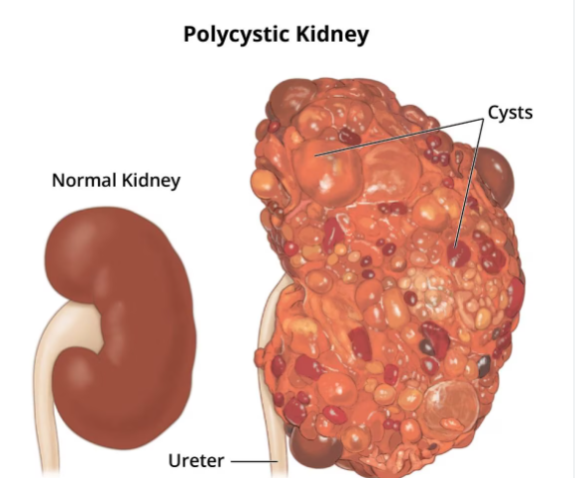
Polycystic Kidney Disease
A disease characterised by the formation of multiple cysts within the kidney
Cysts enlarge, destroy kidney parenchyma→ CKD
Two form: Autosomal Recessive (ARPKD) and Autosomal Dominant (ADPKD)
ARPKD:
Onset usually in infancy/ChildRen
Obvious protruding abdomen, bilateral enlarged kidneys
Chronic renal failure – haematuria, proteinuria, oliguria – growth delay
Can lead to Potter sequence in utero:
Hypertension
ADPKD:
Effects ADults
Gross haematuria, Flank pain, Recurrent UTI’s, Nephrolithiasis
Extra-renal manifestations
Hepatic cysts, Berry Aneurysm, HTN (increased RAAS activation)
Alan O’Doherty-Nephrology II
Doctorials: 2023/24.

Slide 39
References
First Aid 2022
Pathoma
Boards and Beyond
Robbins
Amboss
Medscape

