Slide 1

Respirology Part I
The Basics- Embryology, Anatomy & Physiology
Kieran Moloney, 21150427@studentmail.ul.ie, 2024/25

Slide 2
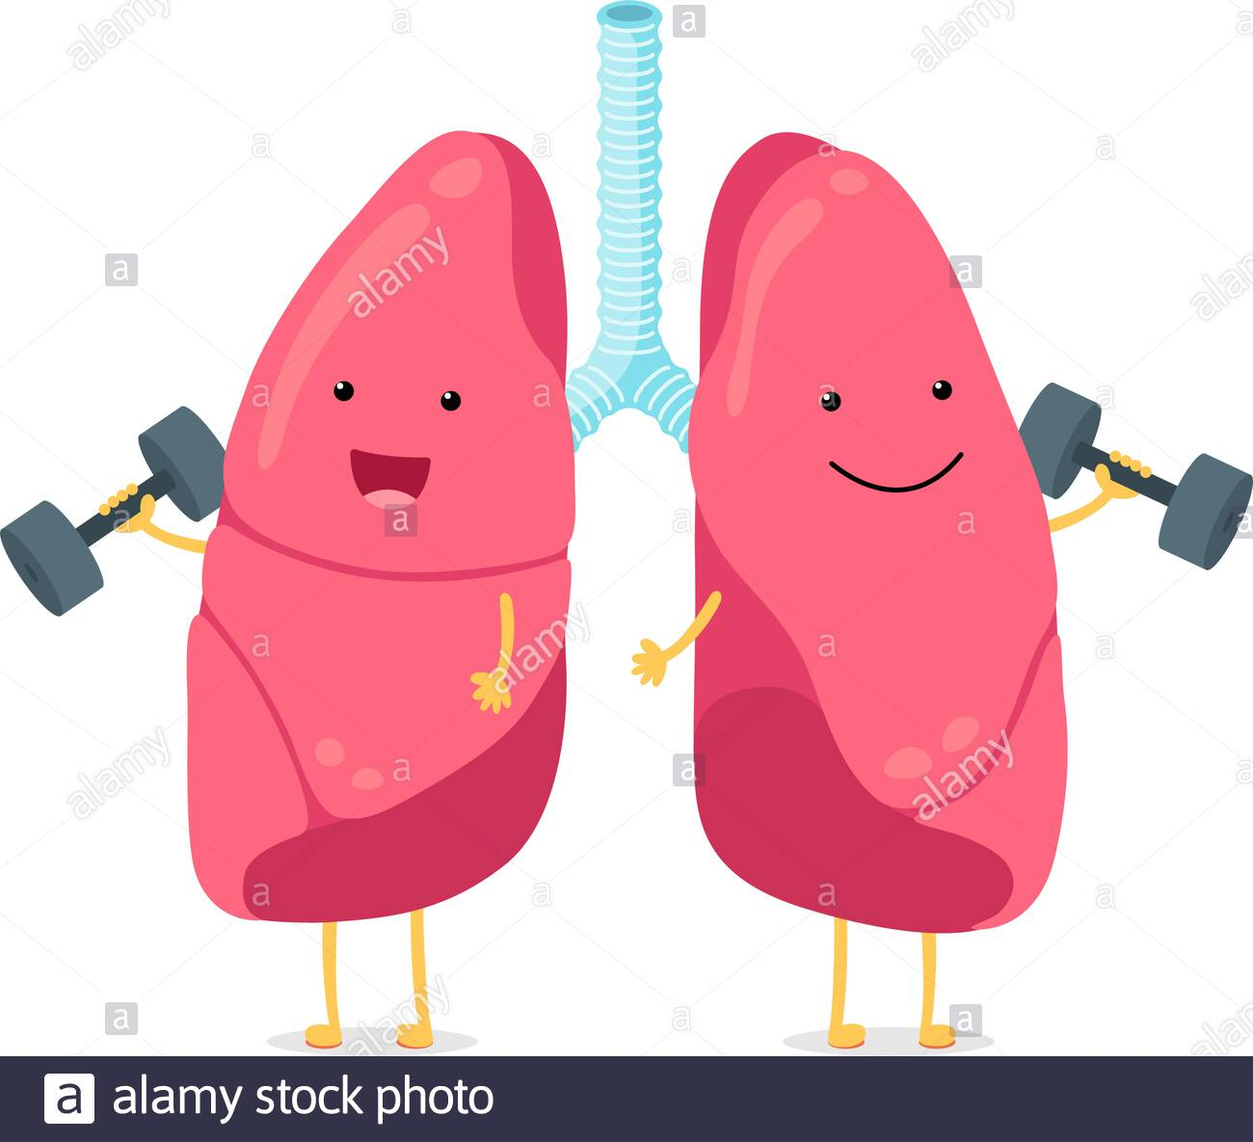
What we are going to cover (LO’s)
  Lung Embryology and Anatomy (Diaphragm as well)
  Microanatomy and Cell types
  Mechanism of Breathing
  Lung Volume and Capacitance - Restrictive VS Obstructive Lung Disease
  Anatomic Vs Physiologic Dead Space
  Diffusion, Perfusion and Ventilation
  O2-Hb Dissociation Curve and Respiratory adaptation
  V/Q Mismatch, A-a Gradients and ABG’s

Slide 3
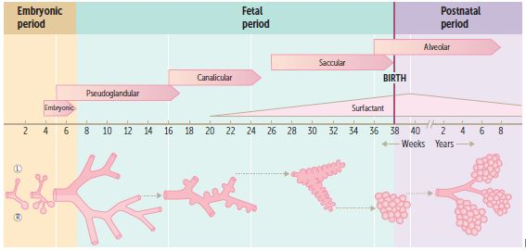
Embryological Development
Lung development usually begins during Week 4 in utero
Occurs in 5 Stages (Mnemonic* Every Pulmonologist Can See Alveoli)
Embryonic Stage (weeks 4-7)
  Lung bud develops into → trachea and bronchial buds
Pseudoglandular Stage (weeks 5-17)
  Endodermal tubules form → bronchioles and terminal bronchioles
  Lung capillaries begin to form
Canalicular Stage (weeks 16-25)
  Terminal bronchioles → respiratory bronchioles and alveolar ducts (prominent capillary network)
  *Type II Pneumocytes begin to form (20 weeks)
Saccular Stage (weeks 26-birth)
  Alveolar sacs → terminal sacs (separated by 1⁰ septa)
Alveolar Stage (weeks 36-8 years)
  Terminal sacs develop into → adult alveoli (separated by 2⁰ septa)
First Aid 2018, 646
Notes:
2. Pseudoglandular stage: respiration impossible (incompatible with life)
3. Canalicular stage: airways increase in diameter *Respiration capable at 25 weeks
5. Alveolar stage: in utero, breathing occurs via aspiration/expulsion of amniotic fluid (INCREASED vascular resistance in lungs)
**At BIRTH -> first breath, fluid replaced with air, and DECREASED pulmonary vascular resistance

Slide 4
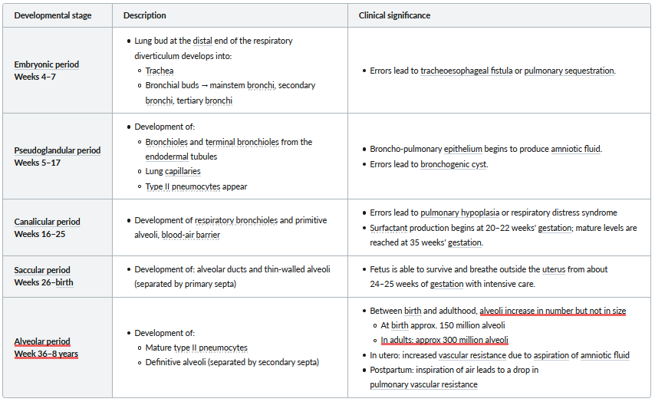
AMBOSS Embryology Table
AMBOSS, Airways & Lungs (Embryology)
Notes:
-Remember* Every Pulmonologist Can See Alveoli
Some *NB Developmental Errors:
Embryonic Stage -> errors lead to tracheoesophageal fistula (or pulmonary sequestration IE: segmental lung that has no connection with bronchial tree/pulmonary arteries)
Pseudoglandular Stage -> errors lead to bronchogenic cyst (ie: abnormal budding of foregut and dilation of terminal or large bronchi)
Canalicular Stage -> errors lead to RDS and hypoplasia (poorly developed bronchial tree with abnormal histology)
*Fetus can survive outside the uterus at about 25 weeks gestation (with ICU assistance)- Canalicular Stage
-With age, Alveoli increase in Number (but not in size); from approx. 150 million (birth) to 300 million (adults)

Slide 5
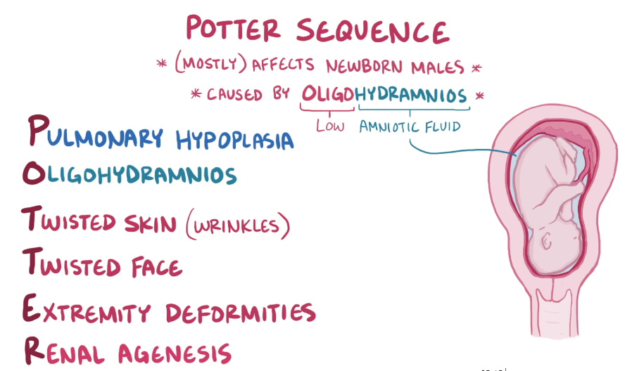
Congenital Malformations
Polyhydramnios | Oligohydramnios
“Too much” amniotic fluid | “Too little” amniotic fluid
Occurs in Embryonic period (4-7 weeks) | Occurs in 2nd Trimester (13-27 weeks)
Caused by tracheoesophageal fistula | Caused by CDH (left side), renal agenesis
Potter Sequence
Oligohydramnios causes → Compression of fetus
Pulmonary hypoplasia is most common cause of death
Causes:
  Autosomal Recessive Polycystic Kidney Disease (ARPKD)
  Obstructive uropathy (more common M > F)
  Bilateral renal agenesis
  Chronic placental insufficiency
First Aid 2018, 566; Osmosis Video (Potter Sequence)
Notes:
Oligohydramnios leads to compression of developing fetus *(Congenital Diaphragmatic Hernia- most common cause is Bochdalek hernia -> hole in postero-lateral corner of the diaphragm)
Results in:
-limb deformities
-facial anomalies (eg: low-set ears, retrognathia, flattened nose)
-compression of chest (lack of amniotic fluid aspiration)
*CAUTION: another possible cause is Maternal use of ACE inhibitors or ARB’s -> leads to fetal renal maldevelopment

Slide 6

Some Embryo Questions
When do Type II Pneumocytes begin to form?
  Answer: Around 20 weeks gestation (During Canalicular Stage)
At what stage can the fetus survive outside the womb?
  Answer: Between 24-25 weeks
What is one of the causes of Oligohydramnios?
  Answer: Renal Agenesis (Remember* what POTTER stands for)
How many alveoli does the average adult have?
  Answer: Approximately 300 million alveoli (increase in number from birth)
First Aid 2018, 566, 646
Notes:
1. Canalicular Stage (weeks 16-25)
2. Fetal respirations cannot occur independently until about 24-25 weeks (also has to do with Surfactant -> we will discuss this later)
3. Another cause is CDH, intra uterine infections, premature rupture of membrane, Drugs (COXi, ACEi); POTTER -> Pulmonary hypoplasia, Oligohydramnios, Twisted skin, Twisted face, Extremity Deformities, Renal Agenesis
4. We are born with approx. 150 million alveoli (Adults 300-500 million alveoli)

Slide 7
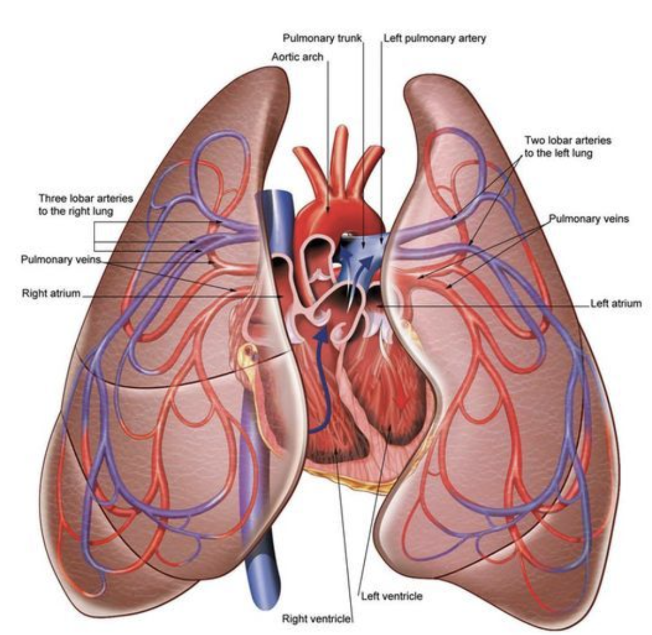

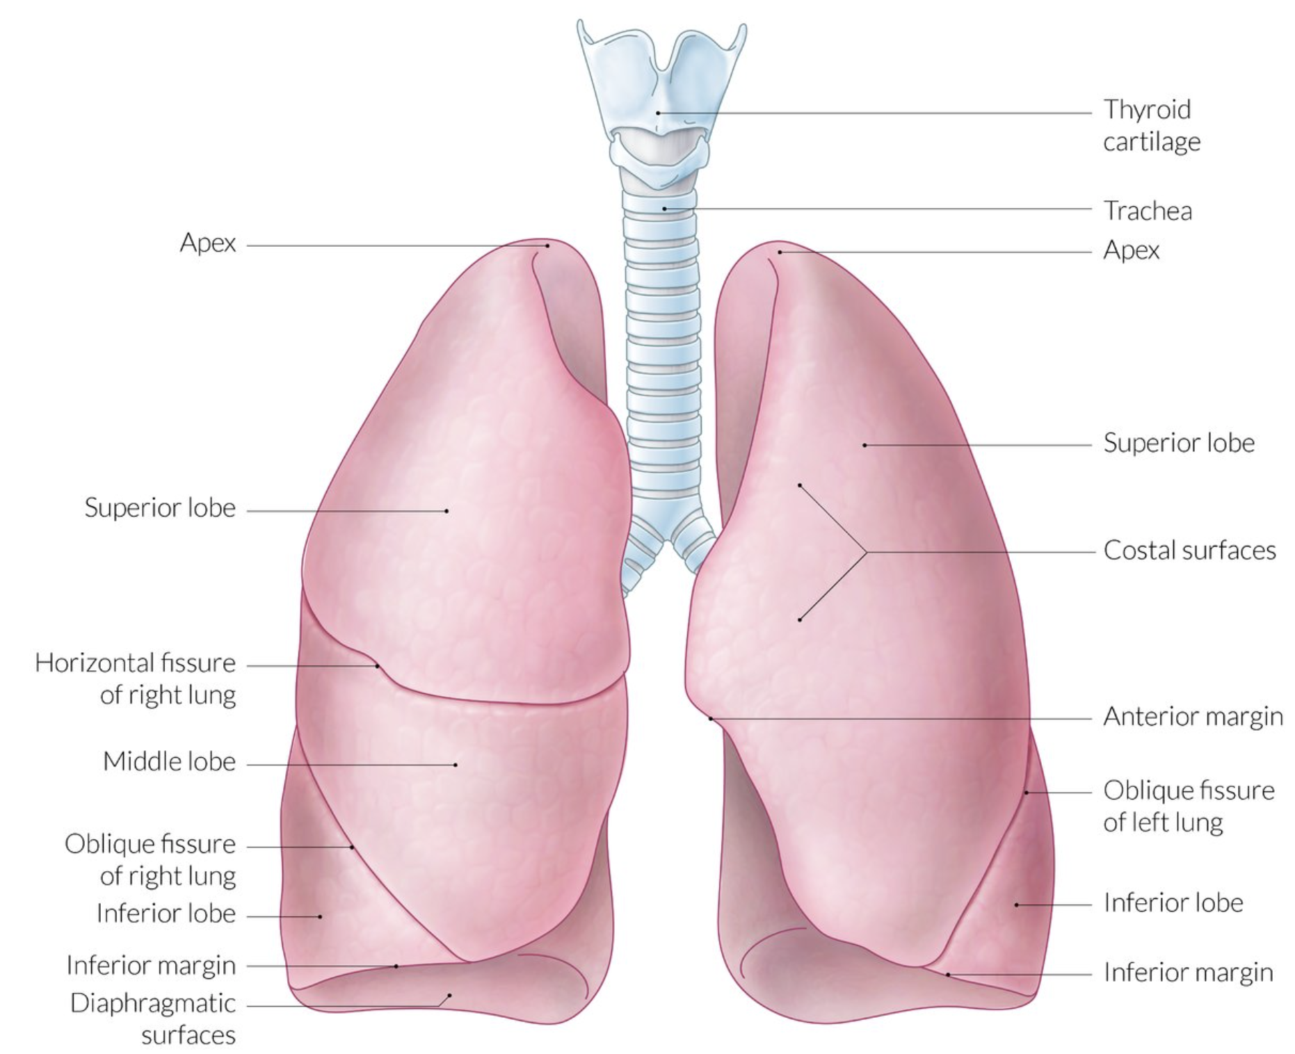
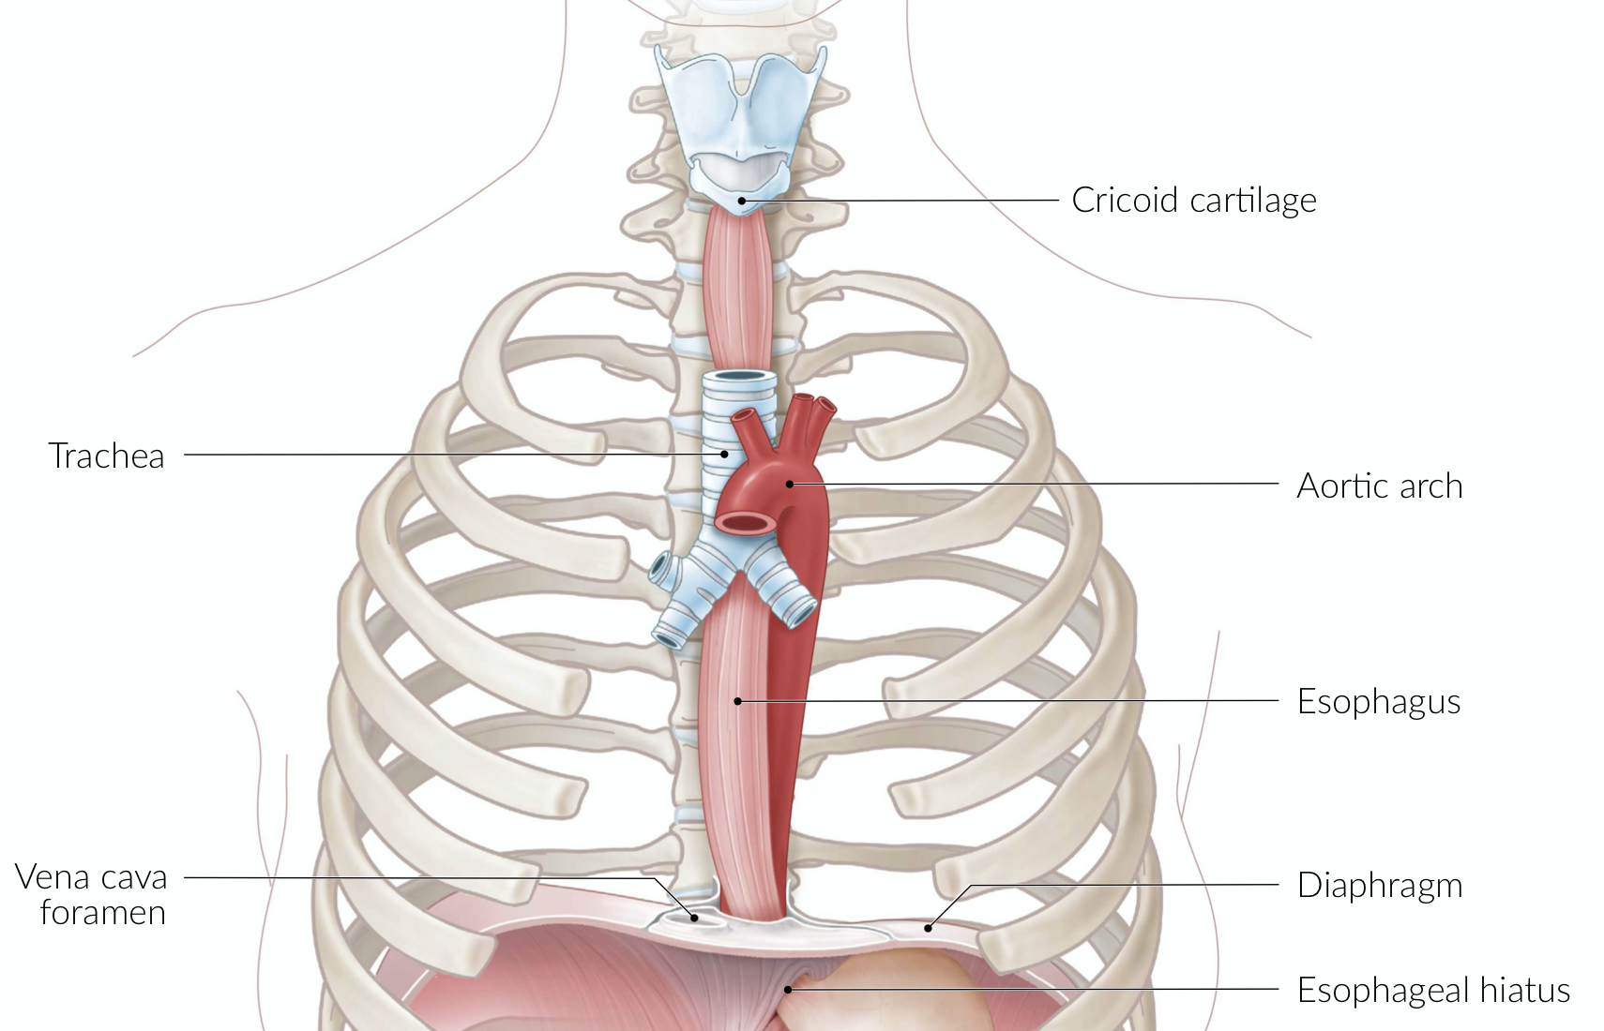
Where are the lungs?
Each lung has an Apex, Base & 3 surfaces:
Costal surface
Diaphragmatic Surface
Mediastinal surface
Notes:
Upper respiratory tract
Nasopharynx
larynx
Lower respiratory tract
Trachea
Bronchi, bronchioles
Lungs: located in the thoracic cavity (protected by the rib cage)
Between the lungs: inferior mediastinum (including heart, large vessels, tracheal bifurcation, esophagus)
Superior to the lungs: superior mediastinum
Inferior to the lungs: diaphragm
Anterior to the lungs: ribs
Posterior to the lungs: vertebral column, ribs

Slide 8
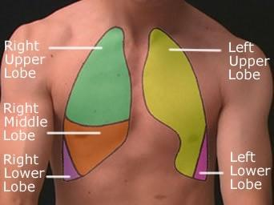
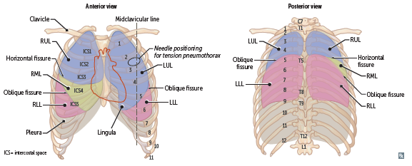
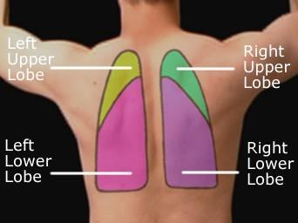
Lung Lobes & fissures
Right lung
Upper lobe
Middle lobe
Lower lobe
10 bronchopulmonary segments
Horizontal + Oblique fissures
Left lung
Upper lobe
* Cardiac notch
Lower lobe
8-10 bronchopulmonary segments
Oblique fissures
Notes:
-Oblique fissures (RIGHT ONLY): 6th CC (ant) -> 5th rib (mid-axillary line) -> 4th rib post
-Horizontal fissure: 4th CC (ant) -> 5th rib (mid-axillary line) - Not post
NOTE – common qs on spotter/emq about surface markings of fissures**
FUN FACT* -> Did you know each Bronchopulmonary segment can be surgically removed without affecting the function of the others!

Slide 9
Surface Anatomy of the Lungs
Landmarks ------------ Organ | Apex | Sternum & Midline | Mid-Clavicular | Mid-Axillary | Posteriorly
Lungs | 1 Inch above medial 1/3 of clavicle | Left: Ribs 2-4 Right: Ribs 2-6 (Why the difference?) | 6th Rib | 8th Rib | 10th Rib
Pleura | 1 Inch above medial 1/3 of clavicle | Left: Ribs 2-4 Right: Ribs 2-6 | 8th Rib | 10th Rib | 12th Rib
Horizontal Fissure: On the right side only! 4th CC (ant) -> 5th rib (mid-axillary line) -> Not posterior.
Oblique Fissure: Similar on left and right. 6th CC (ant) -> 5th rib (mid-axillary line) -> 4th rib post
After the 6th Rib, just add 2 Ribs and you've got your Pleura!
Notes:
CC = costal cartilage (rib)
Please double check with what the UL guide specifically recommends! (:

Slide 10
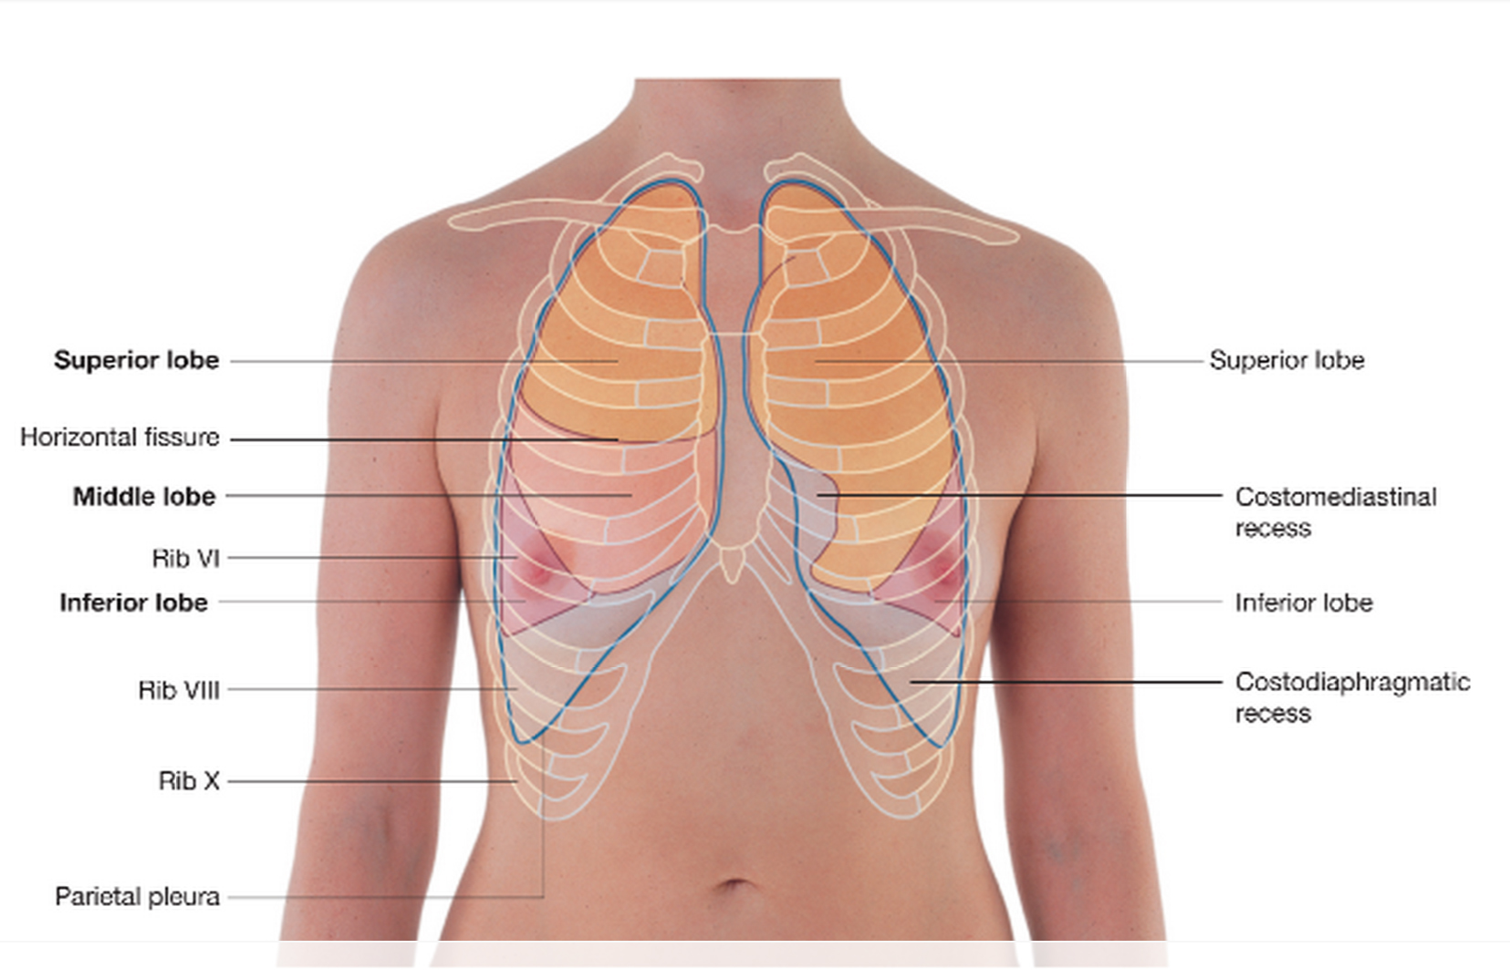
Surface Anatomy of the Lungs
RIGHT LUNG:
Anterior Auscultation:
  Upper Lobe: Above 4th CC (horizontal fissure)
  Middle Lobe: Between 4th and 6th CC
  Lower Lobe: Below the 6th CC (oblique fissure)
Posterior Auscultation:
  Upper Lobe: Above 4th CC
  Lower Lobe: Below 4th CC
LEFT LUNG:
Anterior Auscultation:
  Upper Lobe: Above 6th CC
  Lower Lobe: Below 6th CC
Posterior Auscultation:
  Upper Lobe: Above 4th CC
  Lower Lobe: Below 4th CC
Notes:
CC = costal cartilage (rib)
Litmann stethoscope app for auscultation!!
Please double check with what the UL guide specifically recommends! (:

Slide 11
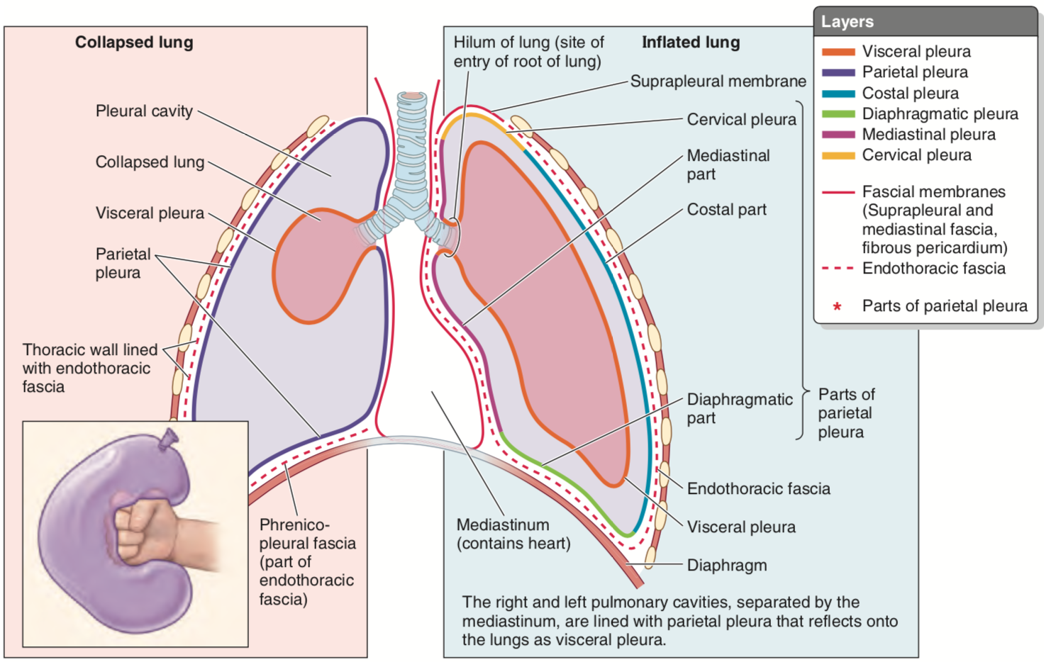
Pleura = a serous membrane lining the thoracic cavity which folds back onto itself to form a two-layered membranous pleural sac, enveloping the lungs
Parietal pleura:
  Costal
  Diaphragmatic
  mediastinal
Visceral pleura: Covers lungs, lines fissures, continuous with parietal pleura at hilum where it is reflected back
Pleural cavity: Potential space between the pleura that contains 5-10mL of fluid to facilitate frictionless movement
What are the different parts of the lungs innervated by?
Notes:
Intercostal nerves: Diaphragmatic and peripheral (costal) pleura
Phrenic nerve (C 3,4,5): Mediastinal pleura (where would pain be referred?....... Shoulder)
Somatic Afferents: Only in parietal pleura ∴ pain is only felt in parietal pleura.
Hemothorax = blood in pleural space, pneumothorax = air in pleural space, can cause lung to collapse; hemopneumothorax = blood and air

Slide 12
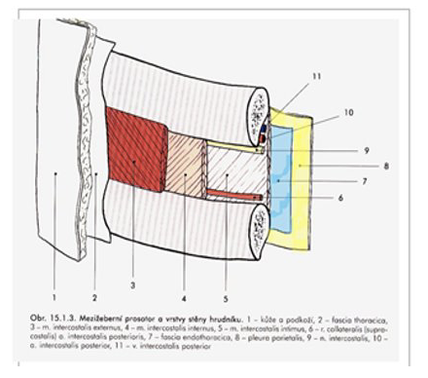
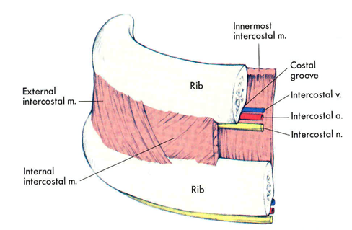
Intercostal Spaces
Layers: (image on right)
  1. Skin
  2. Fascia
  3. External intercostal muscle (Inhalation)
  4. Internal intercostal muscle (Exhalation)
  5. Innermost intercostal muscle
  7. Endothoracic fascia
  8. Parietal pleura
Neurovascular bundle
  Runs between middle and innermost layers of intercostal muscles
  Along the lower margin of the rib
  Where to insert a chest tube to relieve a pneumo- or hemo-thorax or pleural effusion?
Where would you want to insert the needle?
Notes:
Would want to insert a needle along the upper margin of the rib because of the neurovascular bundle underneath the ribs
Possible Q: what layers does needle pass through when inserting chest tube?
External Intercostals elevate the ribs and so increase volume, aiding inspiration
Internal Intercostals depress the ribs and help expiration

Slide 13
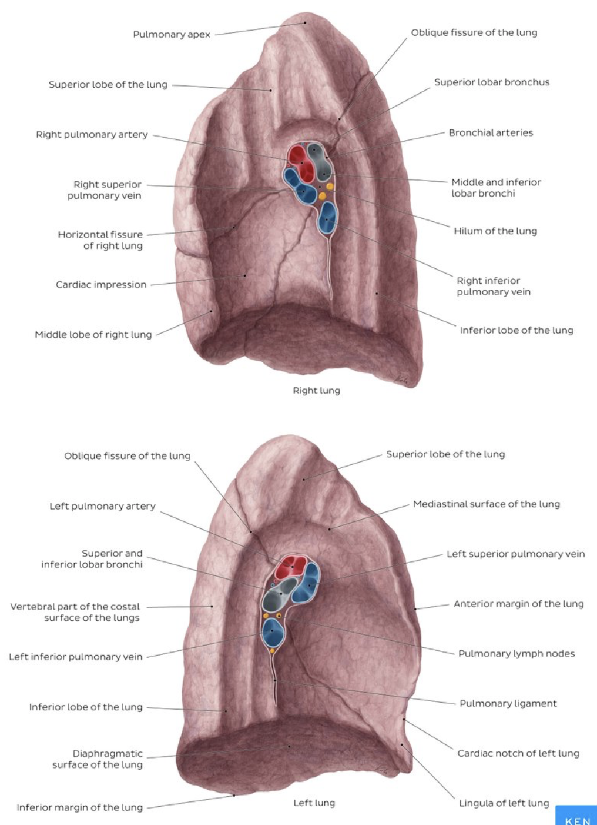
Hilum of the lung
= a wedge-shaped area on the mediastinal surface of each lung through which the structures forming the root of the lung pass to enter or exit the lung
Lung Root:
  Bronchi
  Pulmonary arteries (1 each lung)
  Pulmonary veins (2 each lung)
  The pulmonary plexuses of nerves (sympathetic, parasympathetic, and visceral afferent fibers)
  Lymphatic vessels
  *Bronchial arteries & veins
Lungs have dual blood supply!
Notes:
Pulmonary arteries (Arteries = Away from heart) → Surround lung parenchyma → pulmonary veins → Left Atrium
Dual blood supply – pulmonary circuit = from heart brings deox blood to lung for gas exchange and brings oxygenated blood back to heart to be redistributed to the rest of body; systemic circuit = oxygenated blood from heart to lung parenchyma that cant be supplied by simple diffusion
The bronchi, lung roots, visceral pleura and supporting lung tissues require an extra nutritive blood supply. This is delivered by the bronchial arteries, which arise from the descending aorta.
The bronchial veins provide venous drainage.
Deep bronchial veins = receive blood from the intrapulmonary bronchiolar plexuses and therefore drain the larger intrapulmonary bronchi. They form a common trunk which drains into the main pulmonary vein or sometimes directly into the left atrium.
Superficial bronchial veins = The right bronchial vein drains into the azygos vein, whilst the left drains into the accessory hemiazygos vein.
The communication between the bronchial and the pulmonary veins is important physiologically. The pulmonary veins are part of the pulmonary circulation, while the bronchial veins belong to the systemic circulation.

Slide 14
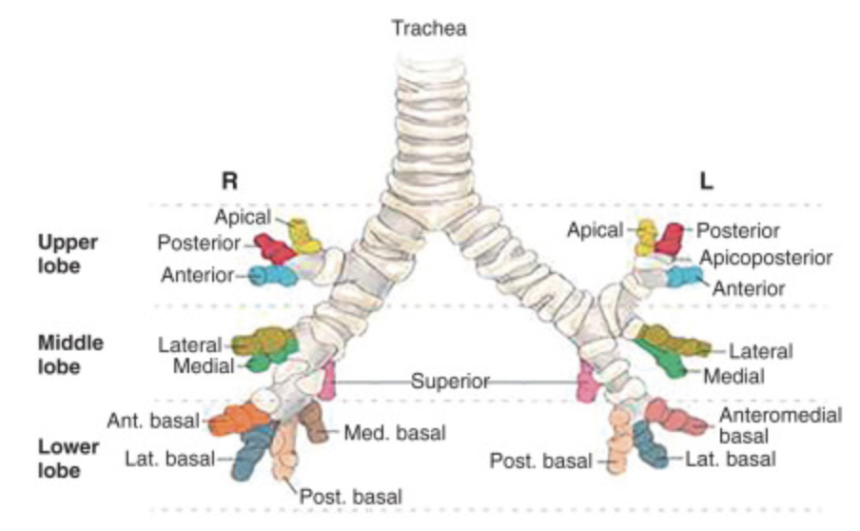
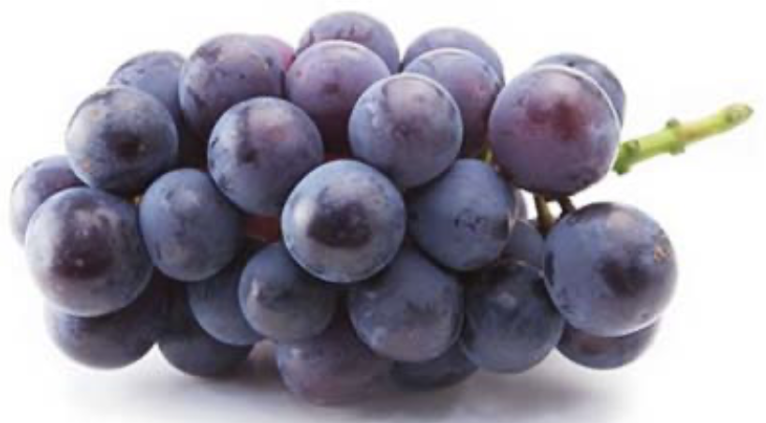
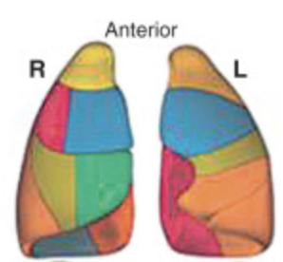
Tracheobronchial Tree
A. Trachea Bifurcates (biFOURcate) at T4 “carina”
  Left bronchi (left lung)
  Right bronchi (right lung)
B. Bronchi → lobar bronchi
  3 lobar bronchi (RIGHT)
  2 lobar bronchi (LEFT)
C. Lobar bronchi → segmental bronchi
  Supply 8-10 “bronchopulmonary segments” per lung
D. Segmental bronchi → conducting bronchioles → Terminal bronchioles → Respiratory bronchioles → Alveolar ducts → Alveolar sacs → Alveoli
Notes:
RIGHT MAIN BRONCHUS is MORE VERTICAL, SHORT & WIDER
Thus more likely to have aspiration in right bronchus
For more info on how bronchi and bronchioles are categorized: https://www.ncbi.nlm.nih.gov/books/NBK537353/
FUN FACT* -> Did you know each Bronchopulmonary segment can be surgically removed without affecting the function of the others!
biFOURcate – also works for abdominal aorta at L4!
Question: Where is needle inserted in management of Tension Pneumothorax?
Answer: Second Intercostal Space, Midclavicular line

Slide 15
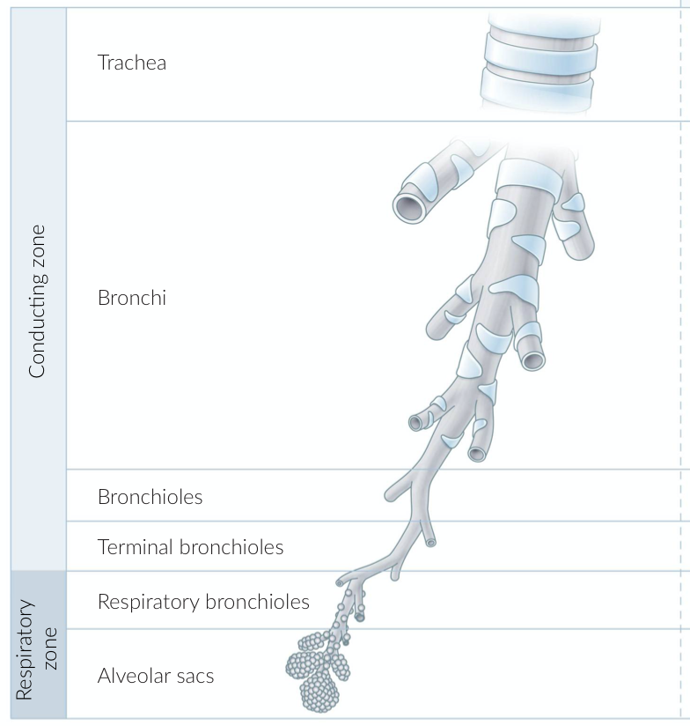
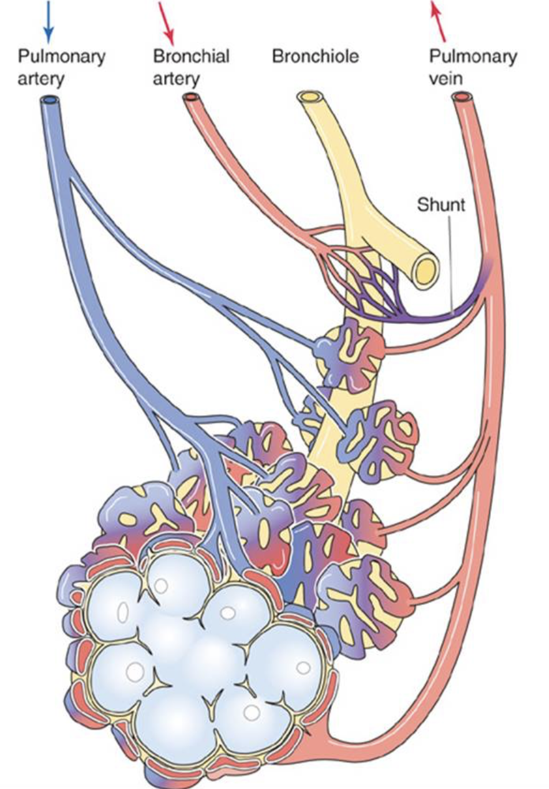
Notes:
Bronchial arteries = supply oxygenated blood to the lung conducting zones & visceral pleura
Bronchial veins = drain deoxygenated blood from conducting zone, hilum structures & visceral pleura.
(amboss)
Bronchial vessels = part of systemic circuit

Slide 16
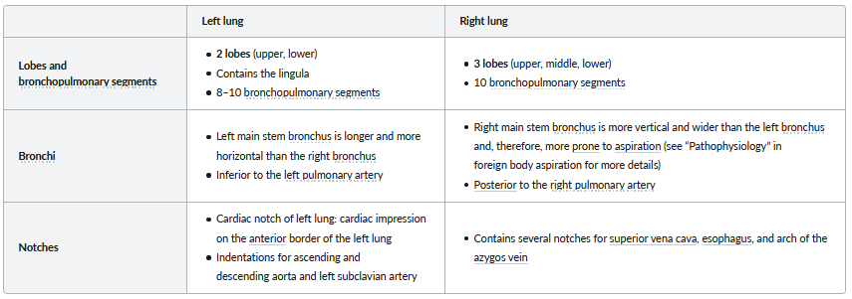
AMBOSS Lung Anatomy
AMBOSS, Airways & Lungs (Gross Anatomy)
Notes:
FUN FACT* -> Did you know each Bronchopulmonary segment can be surgically removed without affecting the function of the others!

Slide 17
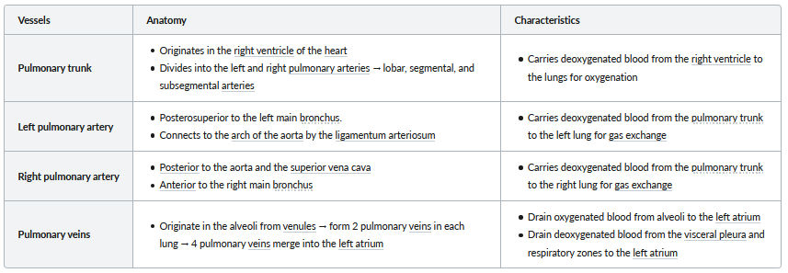
Pulmonary Circulation
AMBOSS, Airways & Lungs (Gross Anatomy)
Notes:
Another cool AMBOSS Anatomy Table!
-For your own knowledge -> Would focus more on Characteristics column but good to be aware of anatomy as well

Slide 18
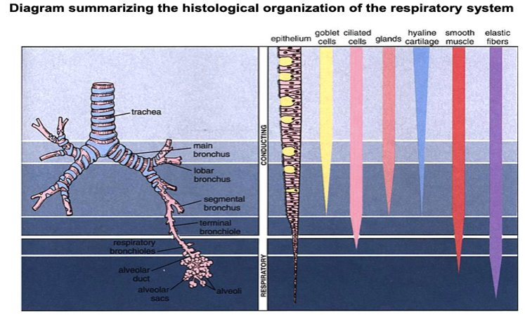
Respiratory Tree (Cell types)
Notes:
Cells and structures of lungs and airways
Overview of the different types of respiratory epithelium and components of the airway walls
The height of the epithelium decreases steadily from the trachea to the alveolar sacs and the distribution and prevalence of cell types and extracellular components changes throughout the airways.

Slide 19
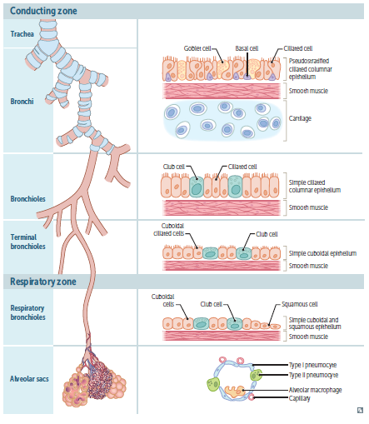
Nose, pharynx, larynx…
Conducting Zone
Trachea and Bronchi (PCCE, GC, BC, CC, SM, Cartilage)
Bronchioles (SCCoE, ClC, SM)
Terminal bronchioles (SCCuE, ClC, SM)
Function: Warms, humidifies and filters air, NO gas exchange
  *Airway Resistance highest in large/medium bronchi
Respiratory Zone
Respiratory bronchioles (ClC, SqC, SCSqE, SM)
Pulmonary alveoli (T1P, T2P, AM)
Function: Participates in Gas Exchange
  Alveolar macrophages (dust cells) involved in immune response
Notes:
-> Respiratory Tract/tree contains various zones as well cell types
Conducting zone:
Large airways consist of nose, pharynx, larynx, trachea, and bronchi
Airway resistance highest in the large- to medium-sized bronchi
Small airways consist of bronchioles that further divide into terminal bronchioles
Large numbers in parallel -> least airway resistance
Warms, humidifies, and filters air but does not participate in gas exchange
'anatomic dead space'
Cartilage and goblet cells extend to the end of the bronchi
Pseudostratified ciliated columnar cells primarily make up epithelium of bronchus and extend to beginning of terminal bronchioles, then transition to cuboidal cells
Clear mucus and debris from lungs (mucociliary escalator)
Airway smooth muscle cells extend to end of terminal bronchioles (sparse beyond this point)
Respiratory zone:
Lung parenchyma
Consists of respiratory bronchioles, alveolar ducts, and alveoli
Participates in gas exchange
Mostly cuboidal cells in respiratory bronchioles, then simple squamous cells up to alveoli
Cilia terminate in respiratory bronchioles
Alveolar macrophages clear debris and participate in immune response
ABBREVIATIONS:
PCCE- Pseudostratified ciliated columnar epithelium
ClC- Club cell (secrete glycosaminoglycans to protect the bronchiole lining -> protect the bronchiolar epithelium)
SqC- Squamous cell
GC- Goblet cell (secrete mucus in order to protect the mucus membranes)
BC- Basal cell (stem cells or progenitors of respiratory epithelium)
CC-Ciliated cell
SM- Smooth muscle
SCCoE- Simple ciliated columnar epithelium
SCCuE- Simple ciliated cuboidal epithelium
SCSqE- Simple cuboidal and squamous epithelium
T1P- Type I pneumocyte
T2P- Type II pneumocyte
AM- Alveolar macrophage

Slide 20
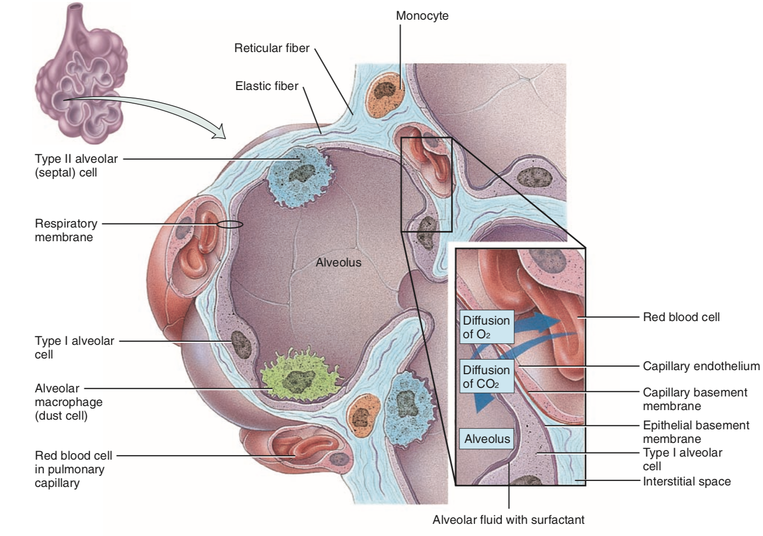

Alveoli
Alveoli consist of 3 main cell types:
Type I Pneumocytes – form the epithelium of the alveoli, site of gas exchange
Type II Pneumocytes – stem cells for Type I and produce Surfactant
Alveolar Dust cells – Macrophages that scavenger the alveoli for tissue debris, foreign material and anything that the mucociliary escalator missed.
Notes:
Surfactant is necessary to ‘break up’ this tension and to equalize the pressure within the alveoli. This prevents the alveoli from collapsing upon expiration, which is instrumental in decreasing our work of breathing.

Slide 21
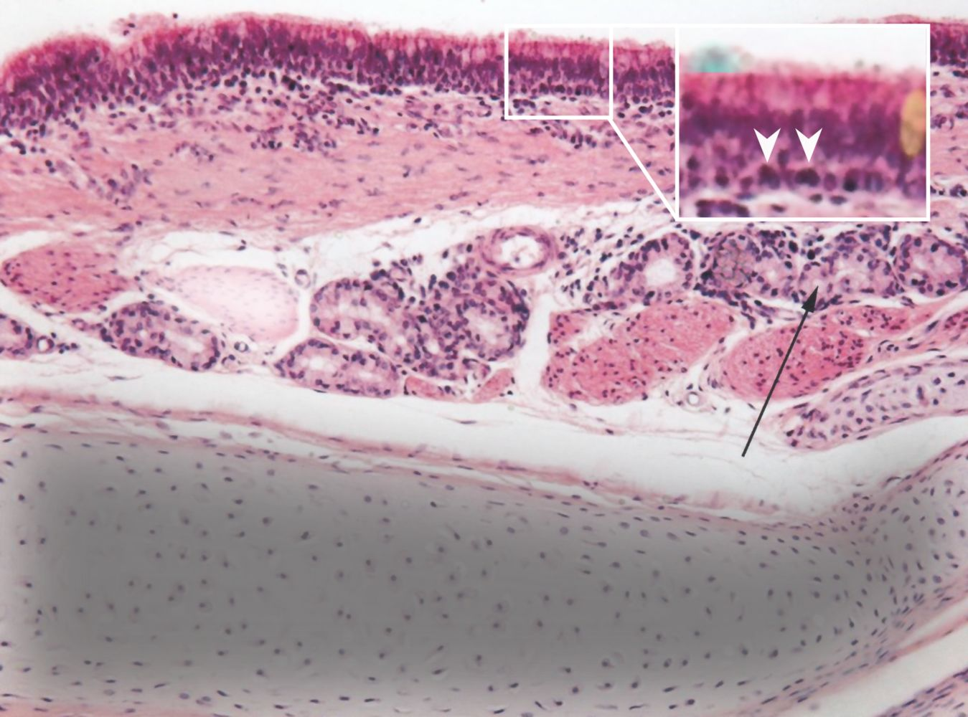
Pop Quiz!
Identify the structure
TRACHEA!!!
AMBOSS, Airways & Lungs (Microscopic Anatomy)
Notes:
TRACHEA
Photomicrograph of a tracheal biopsy specimen (H&E stain; 400x magnification)
Cell layers (from top to bottom):
– Mucosa: ciliated pseudostratified columnar epithelium with numerous goblet cells, resting on lamina propria, which contains elastic fibers and connective tissue
– Detail: cilia (example indicated by green overlay), nuclei (examples indicated by white arrowheads), goblet cell (examples indicated by orange overlay)
– Submucosa: numerous seromucous glands (black arrow) and smooth muscle cells with lamina propria underneath
– Hyaline cartilage: chondrocytes and lacunae surrounded by an extracellular matrix (grey overlay)
-Adventitia: loose areolar tissue (white band on the bottom right)
Reference: AMBOSS.com

Slide 22
Histology Summary of Tracheobronchial Tree
Types of Epithelium
At Bronchi
  Ciliated Pseudostratified Columnar Epithelium
At Bronchioles
  Simple Ciliated Columnar Epithelium
At Terminal Bronchioles
  Cuboidal Ciliated Epithelium
At Alveoli
  Simple Squamous Epithelium
Function of
Type I pneumocytes
  Interface for gas exchange
Type II pneumocytes
  Secrete surfactant
  Regenerate Type I pneumocytes
Goblet cells
  Produce and secrete mucus
Club cells
  Synthesize and secrete GAGs, proteins
  Protective role – degrade mucus and breakdown airborne toxins (via CYP)
Notes:
Conducting Zone – “Anatomic Dead Space”
• Cartilage and goblet cells extend to end of bronchi.
• Airway smooth muscle cells extend to end of terminal bronchioles (sparse beyond this point).
Respiratory Zone – Gas Exchange
Trachea Bifurcates - Main bronchi to each lung - main bronchi give rise to lobar bronchi (R3, L2) supplying the lobes of the lung - Lobar bronchi give rise to segmental bronchi supplying bronchopulmonary segments.
Segmental bronchi give rise to conducting bronchioles - Terminal bronchioles - Respiratory bronchioles - Alveolar ducts - Alveolar sacs - Alveoli

Slide 23
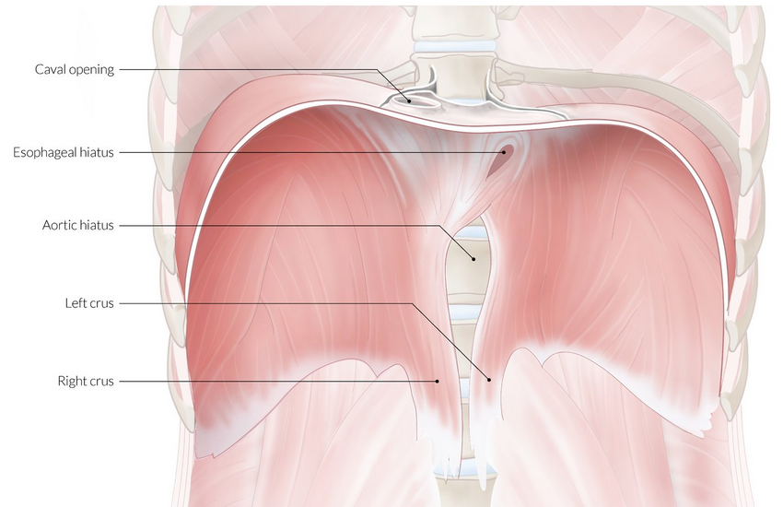
Diaphragm Anatomy
C-shaped musculotendinous structure
Separates thoracic cavity from abdominal cavity
Divided into left and right hemidiaphragm
  Right higher than left (due to liver)
*Key muscle of inspiration
Innervated by phrenic nerve
  “C3, 4, 5 Keeps the Diaphragm Alive!”
Structures passing through Diaphragm
T8 → IVC (Right phrenic nerve)
T10 → Esophagus (Vagus nerve)
T12 → Aorta, thoracic duct and azygos vein
  “T-1-2 is Red, White and Blue”
Q: What is the Mnemonic to Remember perforating structures?
A: I (IVC) ate (T8) ten (T10) eggs (Esophagus) at (Aorta) twelve (T12)
First Aid 2018, 649; AMBOSS Thoracic Cavity (Diaphragm)
Notes:
“C3, 4, 5 Keeps the Diaphragm Alive!”
AMBOSS NOTES (Diagram)
Diaphragm
Frontal view
The diaphragm is a dome-shaped muscular structure that separates the thorax from the abdomen. The two crura of the diaphragm arise from the lumbar vertebrae (L1–L3). The aortic hiatus lies between the two crura anteriorly and the lumbar vertebrae posteriorly, at vertebral level T12. The esophageal hiatus is an elliptical opening in the muscular portion of the posterior diaphragm at vertebral level T10. The caval opening lies on the right side of the central tendon at vertebral level T8.

Slide 24

Structures passing through Diaphragm
I 8 10 Eggs At 12
AMBOSS Thoracic Cavity (Diaphragm)
Notes:
FUN FACT!
-Did you know -> the protrusion of an abdominal structure/organ into the thorax through a lax diaphragmatic esophageal hiatus is referred to as a Hiatal Hernia

Slide 25
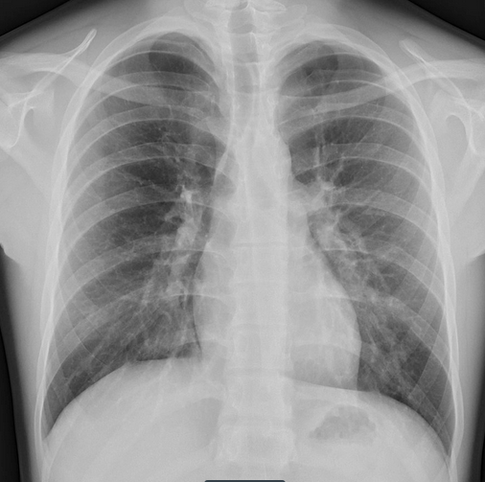

A Chest X-Ray
Q: How do we know? What should we look for?
Q: Is this a normal CXR?
A: YES!!
The ABCDE Approach
Airway- trachea, carina, bronchi, hilar structures
Breathing/Bones- lung, pleura
Cardiac- heart size, borders
Diaphragm- costophrenic angle
Everything else- mediastinal contours, soft tissue, tubes, valves, pacemakers, gastric bubble
AMBOSS Thoracic Cavity (Diaphragm), Geekymedics.com
Notes:
Chest X-ray showing diaphragm
Both hemidiaphragms should appear smooth and with clear margins.
Cardiac Ratio/Diaphragm -> ½ (Normal Ratio)
Reference: AMBOSS.com
https://litfl.com/abc-of-cxr-interpretation/

Slide 26
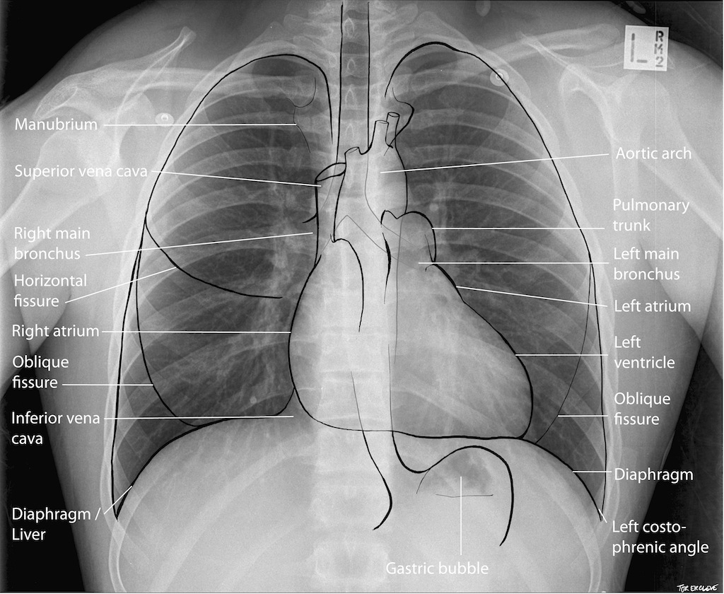
Chest X-ray (CXR)
3) A, B, C, D, E, F, G, H
Airway
  Midline or deviates
Bones
  Fractures, lytic lesions, signs of metastases
Cardiac Size
  50% of thoracic width
Diaphragm
  Normally clear and smooth
  Signs of herniation
Effusions
  Blunting of costophrenic angle
  Everything Else - Wires, tubes etc.
Fields (upper, middle, lower)
  Pulmonary oedema, pneumothorax, pneumonia
Gastric Bubble
Hilum
  Lymphadenopathy
Notes:
Clinical skills session on chest xrays (I think first year session) is amazing resource!!

Slide 27
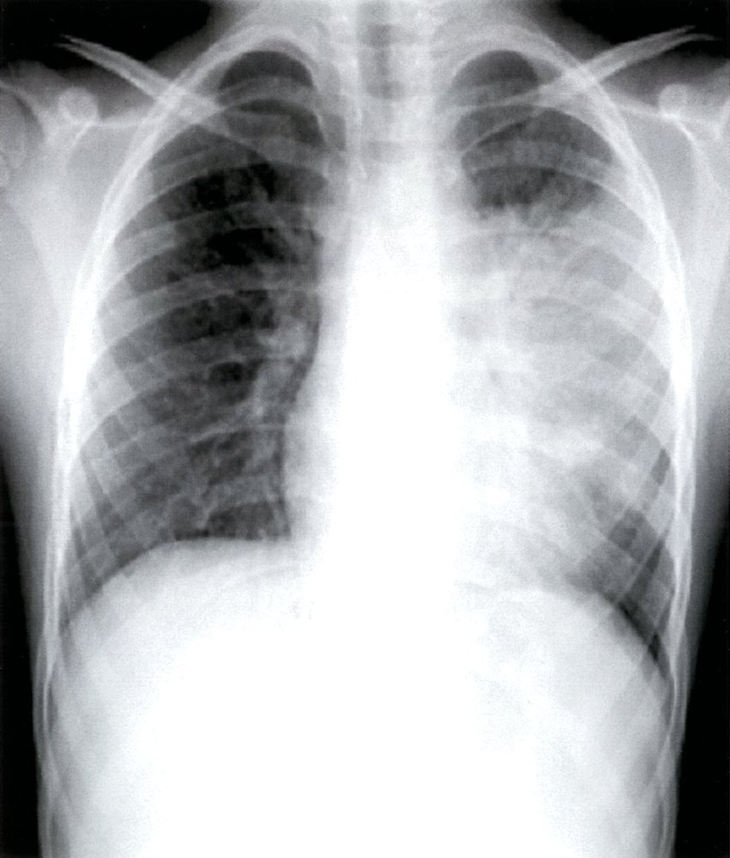
What about this CXR?
Is this a normal chest X-Ray?
AMBOSS, Thoracic Cavity (Diaphragm)
Notes:
Approach systematicallty ABCDE ect

Slide 28

What about this CXR?
Is this a normal chest X-Ray?
NO
AMBOSS, Thoracic Cavity (Diaphragm)
Notes:
A trachea midline
B lung fields entend all the way out bilaterally, consolidation on left upper lobe
C cardiac , heart appears normal size, obsured by consolidation , aortic notch ok
D diaphragm levels approx. equal, nice costophrenic angles
E everything else -> no wires or tubes visible

Slide 29
A Few Anatomy Questions
What is the surface anatomy of the cardiac notch?
Answer: 6th costal cartilage, 3 cm from left sternal edge
Where is the most common location of aspirate while supine?
Answer: Right lower lobe (superior segment)
What cell types are present in the terminal bronchioles?
Answer: Simple ciliated cuboidal epithelium, Club cells and smooth muscle
First Aid 2018, 646-649

Slide 30
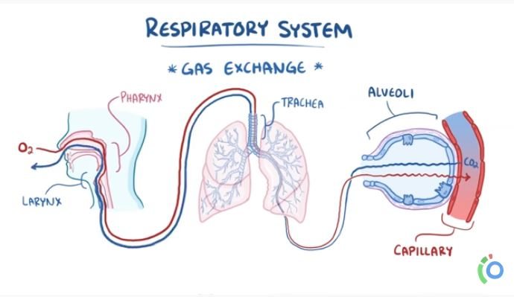
Physiology of Breathing- An Overview
The main function of the Respiratory System is Gas exchange (O2 and CO2)
Ventilation → is the movement of air through respiratory tract (Inspiration) and out of the respiratory zones (Expiration)
Perfusion is closely matched with Ventilation in order to maximize gas exchange (eg: V/Q mismatch)
Gas exchange (CO2, O2) occurs
via simple diffusion down pressure gradients
Inspiration is active process → controlled
by respiratory musculature
Expiration is passive at rest → driven by
elastic properties of lung tissue
AMBOSS Resp Physiology; Osmosis Video (Resp System A&P))

Slide 31
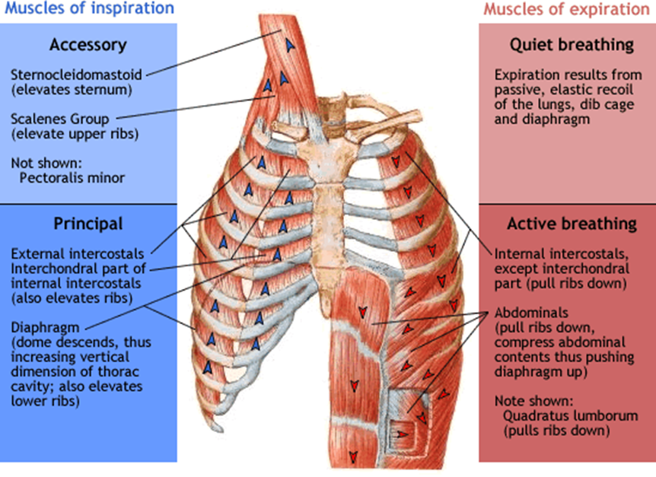
Muscles of Respiration
Principle Inspiration:
Diaphragm & external intercostal
Active Inspiration:
+ Sternocleidomastoid, scalenes, pectoralis
Quiet Expiration:
Passive from elastic recoil
Active Expiration:
+ Rectus abdominis, external oblique, internal oblique, transverse abdominis
Notes:
This is only a brief overview of the muscles involved.

Slide 32
Mechanism of Breathing
 | INSPIRATION | EXPIRATION
QUIET | Diaphragm | Passive process
 | External intercostal muscles | → Driven by elastic recoil
 | *Creates Negative pressure in lung
FORCED | Diaphragm | Abdominal muscles (Int and Ext Oblique, Rec and Transverse Abdominis)
 | External Intercostal muscles | → Compress abdominal cavity, push diaphragm up
 | Accessory muscles | Internal intercostal muscles
 | *Rib cage, parietal pleura pulled upwards | → Chest wall forced down and Diaphragm moves upward
Notes:
Normal inspiration is a result of contraction of the diaphragm and the external intercostal muscles with the abdominal wall being pushed outward
The dome shaped diaphragm flattens downward towards the abdomen, pressing the viscera and pushing the abdominal wall outward
The intercostals raise the ribs 🡪 increases the volume of the thoracic cavity
When the diaphragm is paralyzed, contraction of intercostal muscles causes it to be sucked upward and the abdominal wall being drawn inwards
Reference: Michael Pollock- Doctorials presentation 2018/19

Slide 33
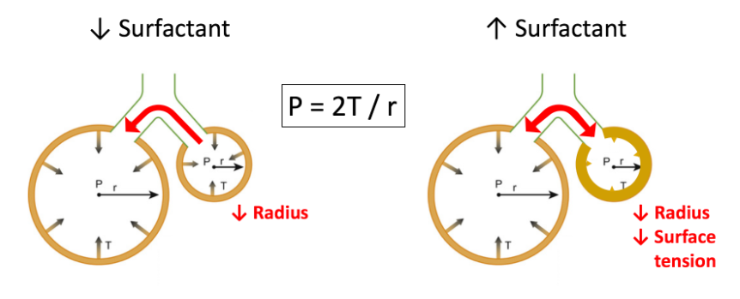
Physics and the Lung
Law of LaPlace – relationship between pressure, tension, and radius
Collapsing Pressure = 2 (Tension)/Radius
Effect on Alveoli
Alveoli have reduced radius and increased
surface tension
Thus, increased tendency to collapse (expire)
Decreased lung compliance = increased work
of breathing → fatigue → atelectasis
Q: What helps to solve this problem?
\
Notes:
Pressure = 2 X Surface Tension / Radius of alveolus
The Law of Laplace essentially states that the tension within the wall of a sphere filled to a particular pressure depends on the thickness of the sphere. Consequently, even at a constant pressure, the tension within a filled sphere can be decreased simply by increasing the thickness of the sphere's wall
Emily’s Notes
Collapsing pressure reflects the lung’s natural tendency to collapse inwards. It is the pressure of the alveoli ‘wanting’ to collapse.
THE LAW OF LAPLACE IS SO IMPORTANT. KNOW IT OFF BY HEART AND UNDERSTAND IT. Is commonly examined in the context of the lungs, the heart, and even surgery.
The larger the radius: the larger the tension but the smaller the pressure
The smaller the radius: the smaller the tension but the larger the pressure
(To explain why tension is increased the larger the radius becomes, it is helpful to think of a tightrope walker: If a tightrope walker walks a short rope (smaller radius), then less ‘taughtness’ (tension) in the rope is needed to hold their weight. If a tightrope walker walks a long rope (larger radius), then more ‘taughtness’ (tension) in the rope is needed to hold their weight and prevent the rope from sagging).
Thus, collapsing pressure is greatest in small alveoli.
Surfactant is necessary to ‘break up’ this tension and to equalize the pressure within the alveoli. This prevents the alveoli from collapsing upon expiration, which is instrumental in decreasing our work of breathing.
Babies begin to produce surfactant between 24 – 28 weeks gestation. This is completed around week 35.
When a baby is born premature, they will be deficient in surfactant. Without surfactant, the alveoli collapse with each and every breath, and it takes tremendous work of breathing for the baby to re-expand their lungs. This is known as Neonatal Respiratory Distress Syndrome.
Fetal lung maturity can be measured with the lecithin-sphingomyelin (L/S) ratio in amniotic fluid. A low ratio indicates less fetal lung maturity (>2 is healthy).
To better understand how much more the work of breathing is in collapsed alveoli, such as in neonates with RDS, recall a time when you ‘got the wind knocked out of you’. That feeling immediately afterwards where you are gasping for air and really working to catch a breath is how these babies feel with every single breath. In fact, ‘getting the wind knocked out of you’ is a physical external force collapsing some of your alveoli!
Reference: Emily’s Doctorials (2017)

Slide 34
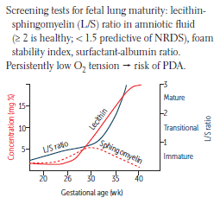
Surfactant and NRDS
Type I Pneumocytes | Type II Pneumocytes
Squamous cells | Cuboidal alveolar cells
Transcellular gas exchange | Regeneration and Surfactant production
Comprise 95% of alveoli | Comprise 5% of alveoli
Type II Pneumocytes
Secrete surfactant from lamellar bodies
↓ alveolar surface tension, ↓ lung recoil and ↑ compliance
→ Prevents alveolar collapse
Neonatal Respiratory Distress Syndrome
Surfactant deficiency, ↑ surface tension = Alveolar collapse
Fetal maturity → lecithin-sphingomyelin (L/S) ratio > 2
Question: What are some risk factors leading to NRDS?
First Aid 2018, 647
Notes:
Risk Factors for Development of NRDS
-Prematurity (if less than 24 weeks)
-Maternal diabetes (due to increased fetal insulin)
-C-section delivery (decreased release of fetal glucocorticoids)
TREATMENT
-maternal steroids before birth
-> Corticosteroids ↑ surfactant production by accelerating maturation of type II pneumocytes 🡪 give mother dexamethasone or betamethasone to prevent NRDS
-exogenous surfactant for infant

Slide 35
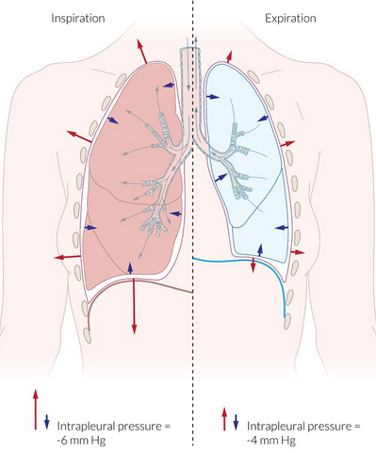
Compliance versus Elastance
Lung Compliance
The ability of the lungs to distend under pressure
Measurement → change in volume of the lung per
unit change in pressure (C= V/P)
Elastance
Tendency for the lungs to collapse inward and
chest wall to spring outward
Describes elastic properties → inverse of compliance
Elastance = P/V
FRC → inward pull of lung is balanced by outward pull of
chest wall → System pressure = Atmospheric
Q: What conditions have increased compliance? Decreased?
First Aid 2018, 651; AMBOSS, Respiratory Physiology
Notes:
FRC- Functional Residual Capacity
Increased Lung Compliance
-Emphysema (lung fill easier due to decreased elastance)
-Aging
Decreased Lung Compliance
-conditions with increased lung stiffness (eg: pulmonary fibrosis, pulmonary edema, ARDS, pneumonia)
Inspiration is an active process. The diaphragm contracts, allowing for a negative pressure to be created, which brings air into the lungs.
Expiration is a passive process. Muscles should not contract in non-distressed breathing. Expiration is accomplished by elastic recoil of the lungs.
Compliance is the ability of the lungs to stretch and expand. Elasticity is the ability of the lungs to resume their original position after being compressed = elastic recoil. The more elasticity there is in a tissue, the harder it is to stretch is (decreased compliance), but the larger the elastic recoil. This can be thought of as pulling a rubber band: Pulling one rubber band is easy to do, but there isn’t too much recoil. Pulling 10 rubber bands at once is harder to do, but the recoil is greater. When lung compliance is increased, such as in COPD, the elasticity of the lungs is decreased, meaning that expiration is more difficult to accomplish.
The natural tendency of the chest wall is to spring outwards. The natural tendency of the lungs is to collapse (see next slide ). The pleural fluid acts like glue to hold the opposing forces of the chest wall and the lung together, so that they move as a single unit. You can visualize how pleural fluid acts like a glue, while still remaining a lubricant, by thinking of a cold glass of water on a table in a hot day: Condensation accumulates around the glass and pools underneath the glass, creating a film between the glass and the table. When you go to take your next drink, the glass becomes difficult to lift off the table because of the surface tension created by the water underneath it.
Reference: Emily Doctorials 2017

Slide 36
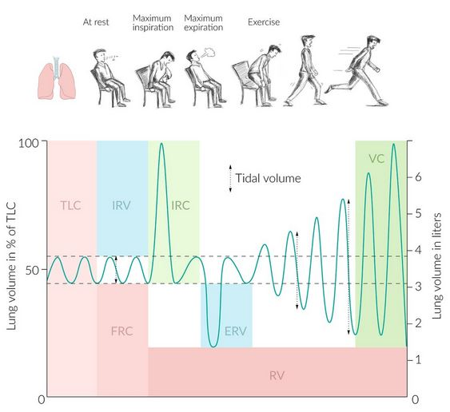
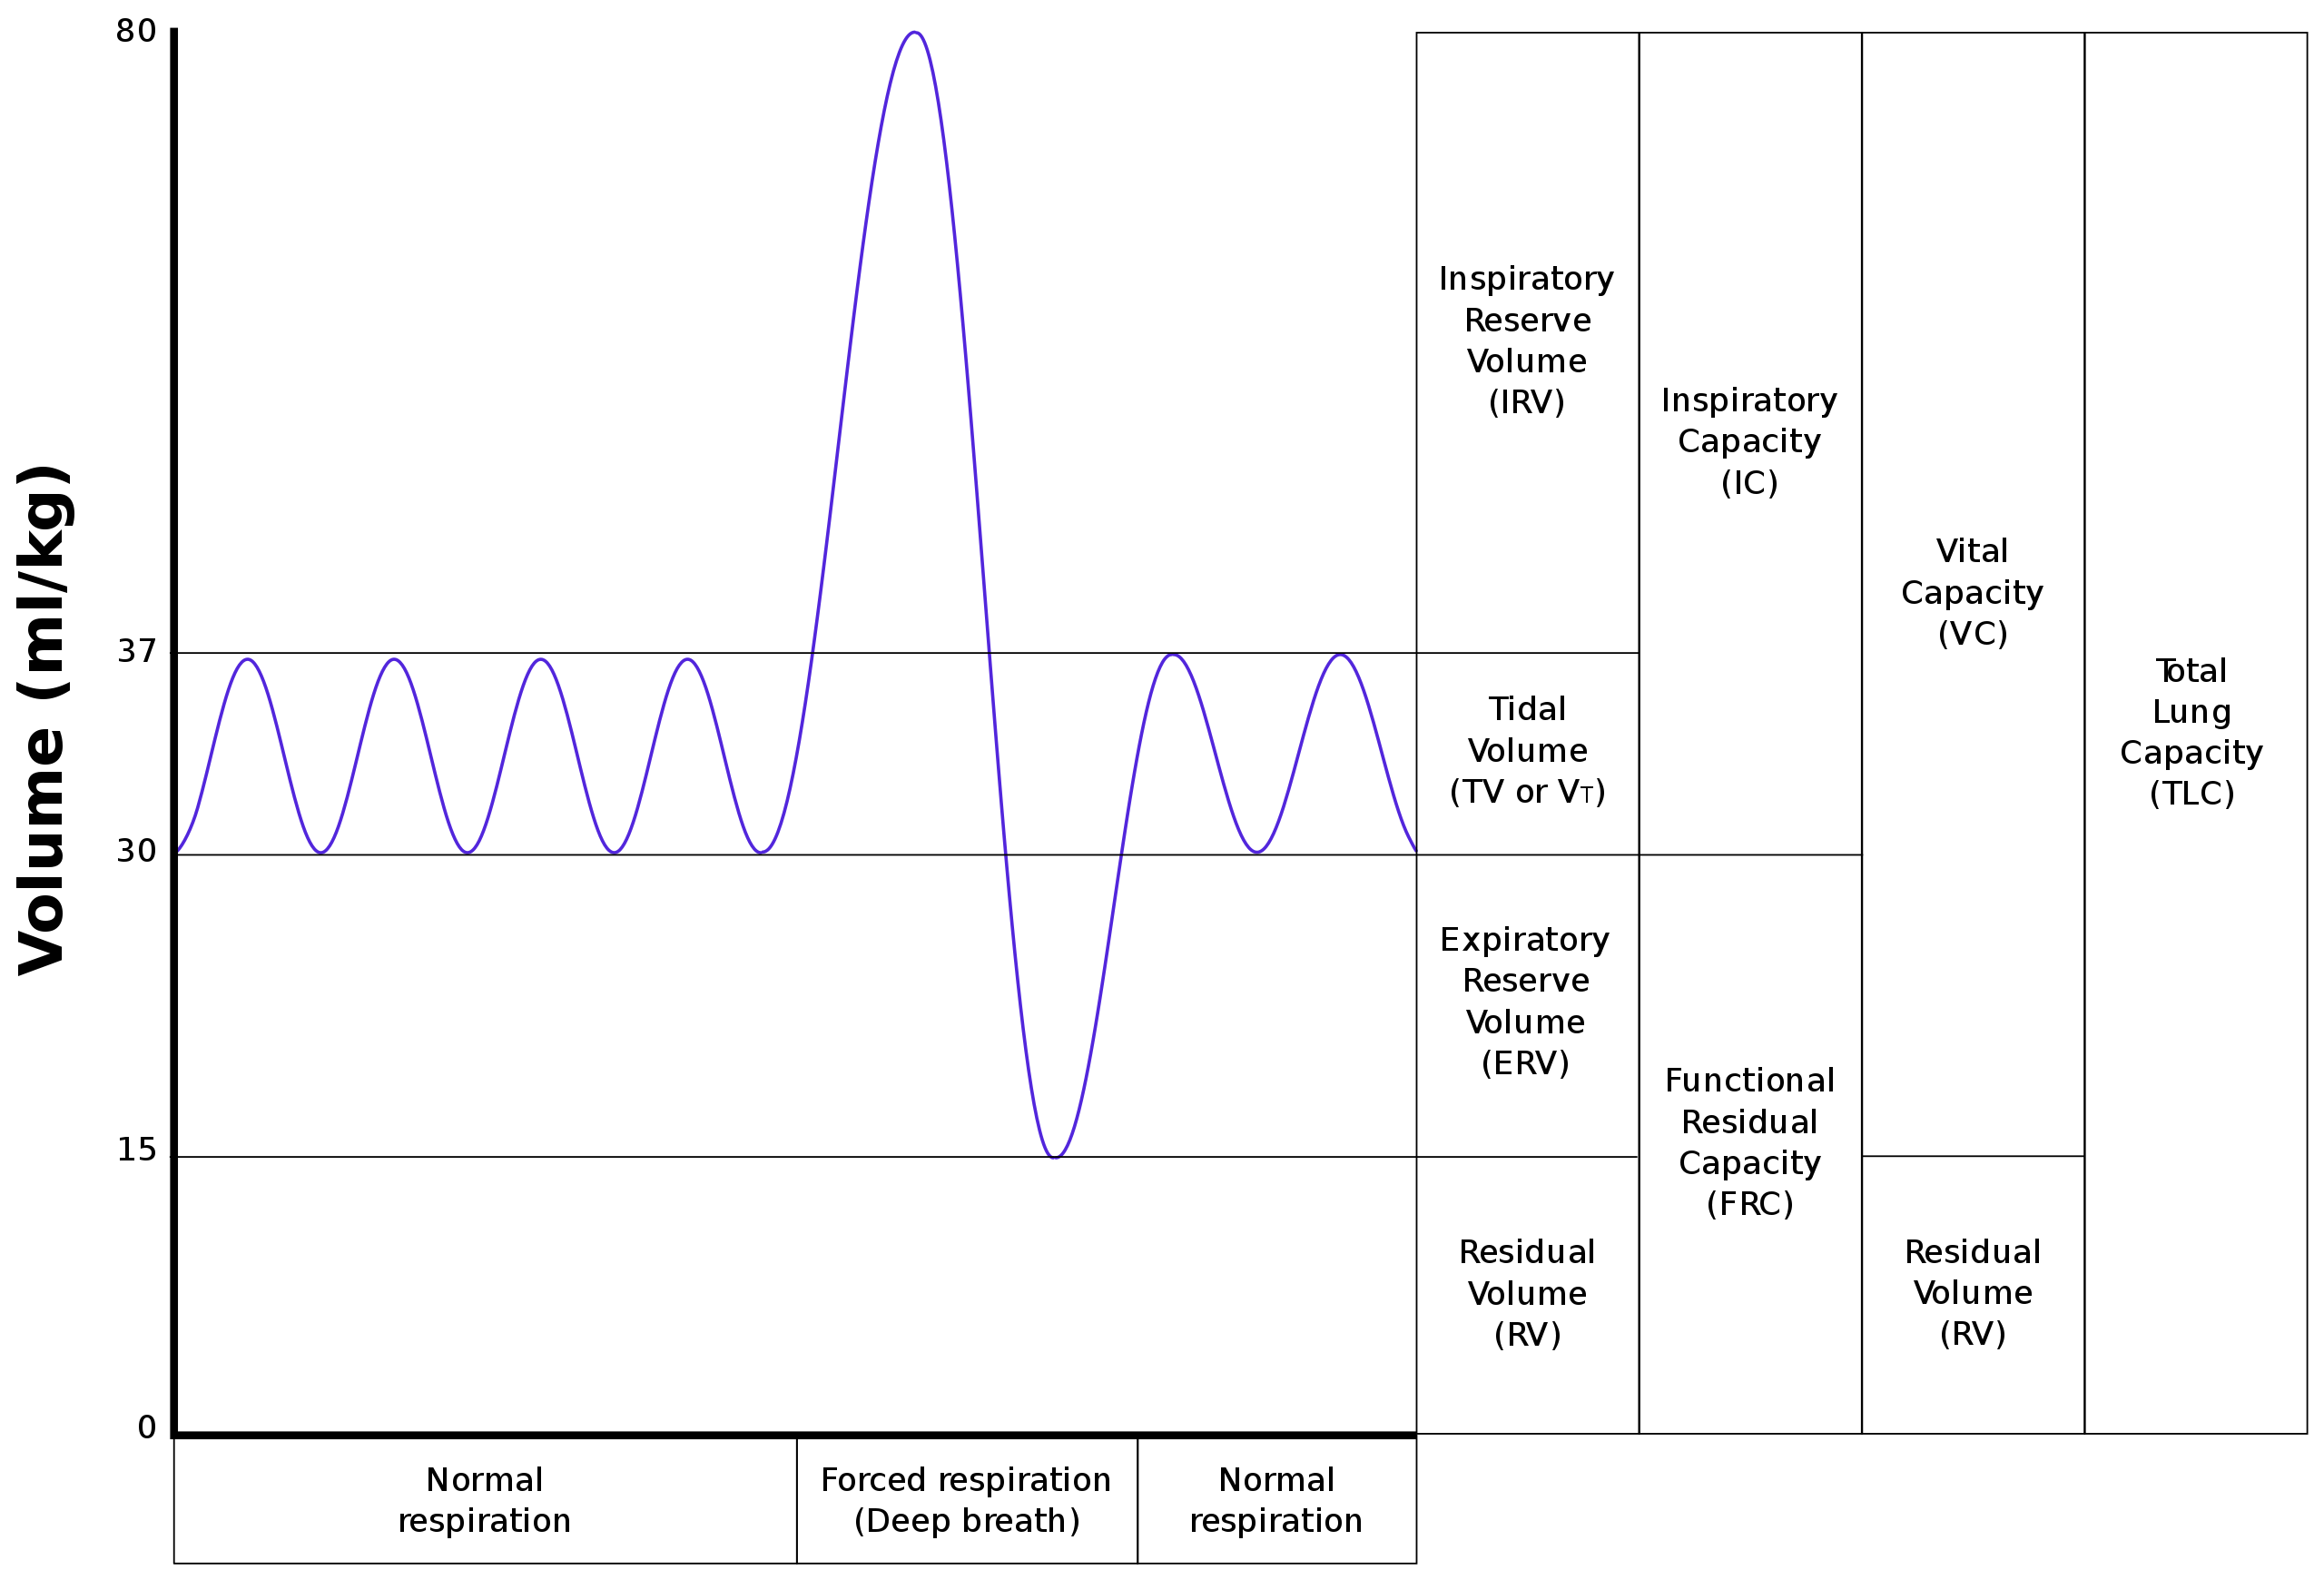
Lung Volumes and Spirometry
Notes:
Residual Volume
The amount of air left in the lungs after forced
expiration
Tidal Volume
The amount of air that moves into the lung
with each quiet respiration +/-500ml
Q: In what condition is Residual Volume increased?
Answer: In Severe Obstructive Lung Disease -> air becomes trapped in the lungs, thus RV increases
-and Total Lung Capacity also increases
Physiological lung volumes
(TLC) Total lung capacity
(IRV) Inspiratory reserve volume
(FRC) Functional residual capacity
(IRC) Inspiratory reserve capacity
(ERV) Expiratory reserve volumes
(RV) Residual volume
(VC) Vital capacity
Reference: AMBOSS.com
1)What is RV? -> RV is the amount of air left in the lungs at the end of forced expiration
2) When can RV change in a pt? -> RV should not change, unless there is pathology (ex. Air trapping)
Air trapping 🡪 increased RV and increased TLC
TLC, FRC, and RV are often increased in emphysematous lungs of patients with long-term history of cigarette smoking
3) What technique can be used to measure RV in clinic? -> Helium dilution technique is used to measure residual volume and functional residual capacity
4) What can decrease ERV? -> Morbid obesity decreases ERV

Slide 37
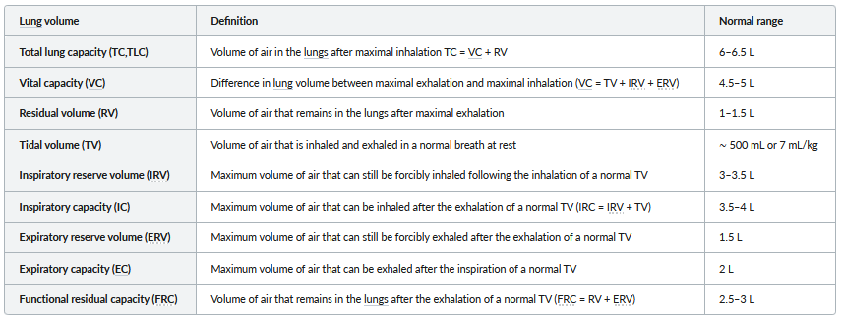
AMBOSS Lung Volume Table
AMBOSS, Respiratory Physiology (Ventilation)
Notes:
Residual volume CANNOT be measured by spirometry
-> Use full-body plethysmography or a gas dilution test
Elastic Recoil in Aging -> in old age, lung compliance increases due to loss of elastic recoil, while chest wall compliance decreases because the chest wall stiffnes

Slide 38
Review of Dead Space
Anatomic dead space:
  Air remaining in conducting portion of airway after inspiration that will not contribute to gas exchange
Physiologic dead space:
  Air remaining within the alveoli that does not participate in gas exchange
Pathological dead space:
  Air within the lungs that cannot participate in gas exchange due to a disease process interfering
Notes:
Dead space = tidal volume x fraction of CO2 remaining after expiration
How would dead space change in PE? ↑ alveolar dead space
How would pneumonia change the dead space? ↑ alveolar dead space
Conducting Zone of resp tree warms, humidifies and filters air, but does not participate in gas exchange 🡪 “anatomic dead space”

Slide 39
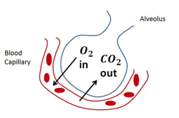
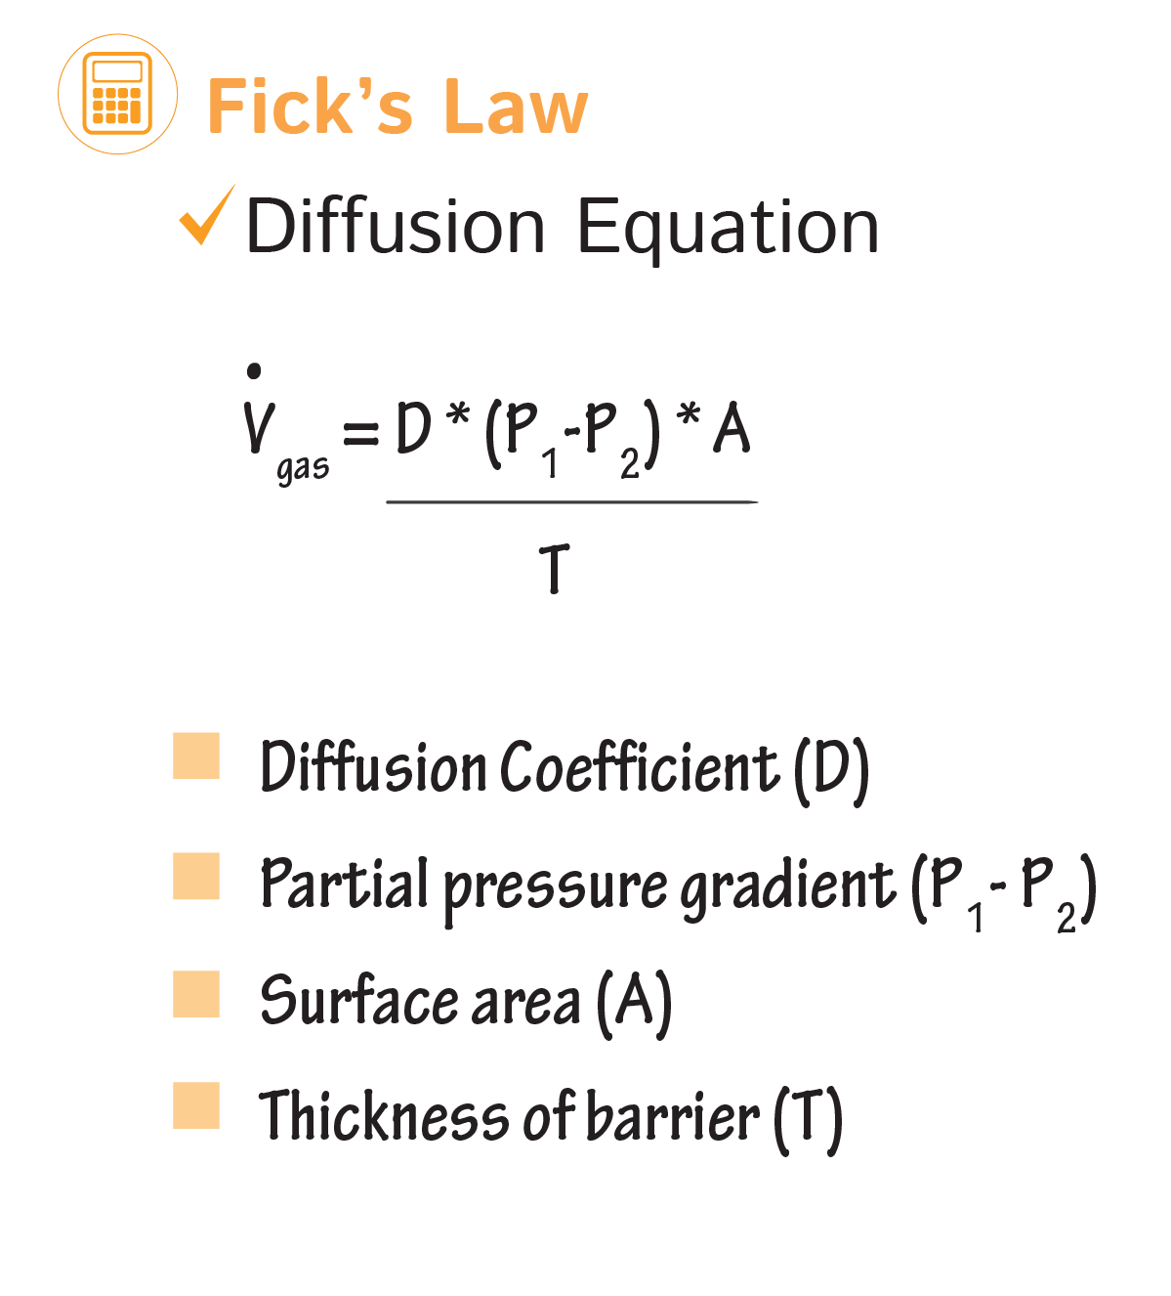
Fick’s Law (More Physics)?!
Diffusion of Gases
Movement of gases across cell membrane occurs via simple diffusion
Directly proportional to:
  Partial pressure of the gas (P1, P2)
  Surface Area (A)
Inversely proportional to:
  Thickness of the wall
Factors which promote increased diffusion
↑ surface area of alveoli
Large concentration gradient
Thin membrane walls
Diffusion Capacity → used to assess gas exchange across the blood-air barrier
Notes:
Some Pathology Examples
-Decreased diffusion capacity can occur when:
-the surface area of the blood-air barrier is reduced (eg: Emphysema)
-the diffusion distance is increased (eg: interstitial lung disease, pulmonary fibrosis, pulmonary edema) or
-the capacity to transport gases in blood is reduced (eg: anemia)
Reference: AMBOSS.com

Slide 40
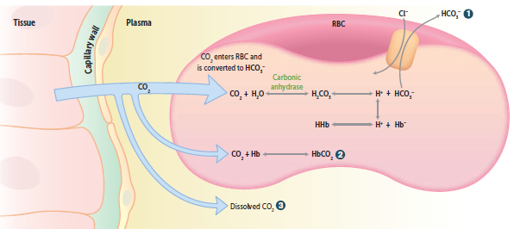
Carbon Dioxide Transport
Carbon Dioxide Blood Transport
Henry’s Law → [CO2] in blood is =
partial pressure X solubility of CO2
CO2 transported in 3 forms:
HCO3- 70%
Carbaminohemoglobin (HbCO2)- 20%
  Favors deoxygenated form (O2 unloaded)
Dissolved CO2 (5-9%)
Haldane Effect
In lungs, oxygenation of Hb promotes dissociation of H+ from Hb
→ shifts equilibrium toward CO2 formation (CO2 is released from RBCs)
Notes:
Henry’s Law -> [CO2] in blood = partial pressure X solubility of CO2
-solubility of CO2 = 0.07 ml CO2/100ml blood per mmHg
Thus -> concentration of dissolved CO2 in arterial blood is:
2.8 ml/CO2/100 mL blood (40 mmHg X 0.07 ml/CO2/100 mL blood per mmHg)
= approx. 5% of the total CO2 content of blood
Reference: Physiology text (Costanzo) 2018 p. 223-225
What is the Chloride shift?
Chloride shift: CO2 easily diffuses into the RBC, which has abundant amounts of carbonic anhydrase. CA converts CO2 into HCO3- and this is pumped out of the RBC into the plasma where it is carried in this form back to the lungs. In exchange for pumping this negative HCO3- ion into the plasma, another negative ion, Cl- is pumped into the RBC to maintain electrical neutrality. (Emily Doctorials, 2017)

Slide 41
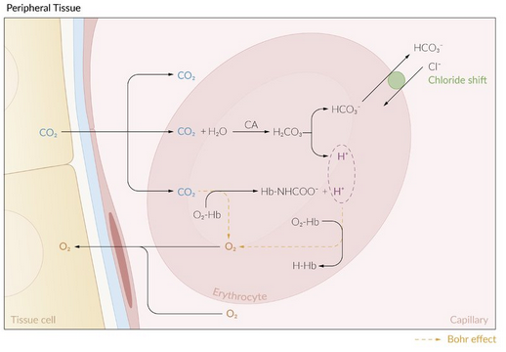
Oxygen Transport
Oxygen Transport in Blood
Oxygen is carried in two forms:
  Dissolved (2% of total blood O2 content)
  Bound to hemoglobin (98% to total blood O2)
Oxygen Binding Capacity and Tissue Delivery
O2-binding capacity → is the maximum amount of
O2 that can be bound to Hb per volume of blood
Measured at 100% saturation
Oxyhemoglobin → Hb with O2 bound to its heme component (oxygenated) = bright red color
  Oxygenated Hb has ~300X higher O2 affinity versus deoxygenated Hb (eg: Positive Cooperativity)
Deoxyhemoglobin
Hb with no oxygen bound to its heme component (deoxygenated) = dark red
  Demonstrates LOW affinity for O2 → release of oxygen is Promoted
What is the Bohr Effect??
Notes:
Bohr effect
High CO₂ and H⁺ concentrations (from tissue metabolism) cause decreased affinity for O₂. → O₂ that is bound to Hb is released to tissue (the O₂-Hb dissociation curve is shifted to the right).
HbO₂ + H⁺ ⇄ H⁺Hb + O₂
HbO₂ + CO₂ ⇄ Hb-COO⁻ + H⁺ + O₂
Reference: AMBOSS.com (Erythrocyte morphology & Hemoglobin)

Slide 42
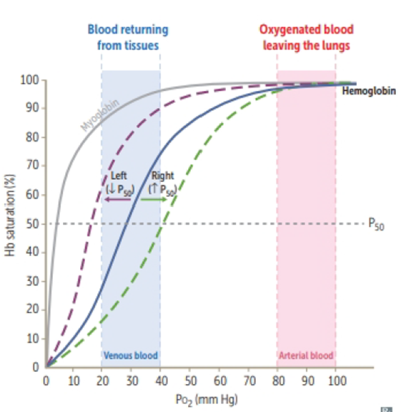
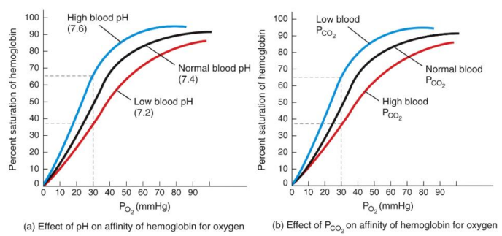
Oxygen-Hemoglobin Dissociation Curve
The O2-Hb dissociation curve shows the arterial partial pressure of O2 (PaO2) in relation to the percentage (%) saturation of Hb → ie: the binding affinity of Hb for O2
Q: Why does curve have a sigmoidal shape?
AMBOSS, Erythrocyte morphology & hemoglobin
Notes:
Answer: Sigmoidal shape due to POSITIVE COOPERATIVITY (ie: tetrameric Hb molecule can bind 4 O2 molecules and has higher affinity for each subsequent O2 molecule bound)
Q: How does this compare to Myoglobin??
*See Extra slides at end of ppt for answer
**REMEMBER** “CADETS shift Right”
OXY-HEMOGLOBIN DISSOCIATION CURVE = measures oxygen's affinity for hemoglobin depending on PO2
X axis = arterial partial pressure of O2
Y axis = percent saturation of hemoglobin
Curve is sigmoid shape, demonstrating binding affinity of hemoglobin for oxygen
Sigmoid (S) shaped due to positive cooperative binding
Binding one molecule of oxygen to hemoglobin increases affinity for oxygen which facilitates binding of more oxygen
Factors that influence oxyhemoglobin curve
CO2
H+ (acidity)
Temperature
2,3-BPG
Right shift = increase any of the above things, decrease oxygen affinity, easier to offload oxygen
CO2
Accumulates during exercise, want to shift right so tissues can more easily get oxygen
H+
Accumulates during exercise, can unload oxygen easier
NOTE Bohr effect =
Temperature
When exercise get hot, oxygen released at tissues more easily
2,3-BPG
Released by RBCs as they break down glucose for energy, released when O2 levels low, decreases affinity of hemoglobin for oxygen
OVERALL exercise causes a right shift
Left shift = decrease in any of above things, increase affinity for oxygen, hold oxygen more tightly
CO2
At altitude have low blood CO2 which increases pH and shifts curve left so can hold oxygen more tightly
Temperature
When hypothermic oxygen held more tightly

Slide 43

Physiological Lung Responses
Respiratory Adaptation in the setting of:
Exercise – exercise causes a right shift
↑ depth and rate of ventilation (hyperventilation)
↑ O2 consumption
↑ CO2 production
↑ Cardiac output (↑ pulmonary blood flow)
↓ Arterial pH (due to lactic acidosis)
High Altitude
↓ PaO2 → ↑ ventilation rate → ↓ PaCO2 and ↑ arterial pH
↑ Renal HCO3- excretion (compensation for Resp Alkalosis)
↑ Pulmonary vascular resistance
↑ Hb and hematocrit (due to chronic hypoxia → triggers ↑ EPO production)
↑ 2,3-BPG concentration → ↓ Hb affinity to O2 (↑ number of mitochondria)
AMBOSS, Respiratory Physiology
Notes:
See EXTRA slides for answer to Resp adaptation in Elderly population
Exercise: Hyperventilation
-> PaCO2 and PaO2 remain NORMAL despite hyperventilation
-> increased venous CO2 and decreased venous O2
High Altitude
-decreased PaO2 leads to decreased PaCO2, increased arterial pH = RESP ALKALOSIS
-increased Pulmonary vascular resistance -> chronic Hypoxia -> pulmonary vasoconstriction -> pulmonary HTN -> right ventricular hypertrophy
Q: What drug can be given for altitude sickness? Why?
-carbonic anhydrase inhibitors (e.g., acetazolamide) → ↑ renal HCO3- excretion and create a metabolic acidosis, which can be used to "acclimate" someone going to a higher altitude because they will naturally increase ventilation to compensate for metabolic acidosis
(M. Pollock Doctorials 2018-19)

Slide 44
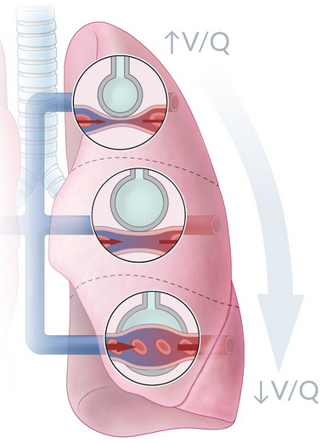
Ventilation and Perfusion
Ventilation
Is the amount of air entering and leaving the lungs (volume/min)
With each breath, some air does not reach alveoli (gas exchange area)
  → Dead Space (physiologic)
Perfusion
Is the amount of blood flow to the alveoli
Distribution of blood flow → depends on the position of the body
→ precisely regulated in relation to ventilation (optimize gas exchange)
Q: What occurs when there is an imbalance between total lung ventilation and total lung perfusion?
AMBOSS, Respiratory Physiology
Notes:
Where in the lung are there higher O2 partial pressures?
-> the APICES of the lung -> because the perfusion in these lung segments is lower than the ventilation and thus less O2 diffuses from the alveoli into the bloodstream
**Some micoorganisms (eg: M. tuberculosis) favor APICAL LUNG segments due to higher O2 content
Minute ventilation (V_{E}): volume of air that a person breathes per minute (i.e., the product of tidal volume and respiratory rate; V_{E} = V_{T} x RR)
Dead Space: Part of the Resp system that conducts air but does NOT participate in gas exchange (includes the nose, pharynx, trachea and bronchioles)
Ventilation is the movement of air into and out of the lungs (volume per minute). Some air with each breath never reaches the alveoli, or gas exchange areas = dead space. The ventilatory volume that renews the air within the alveoli = alveolar ventilation.
Alveolar ventilation is an important determining factor of the concentrations of O2 and CO2 in the alveoli, and thus the blood. Increased ventilation 🡪 increased PAO2 (oxygen in alveoli) 🡪 increased rates of gas exchange 🡪 increased CO2 expelled. Net effect = increased O2 and decreased CO2 in alveoli. Similarly, decreased ventilation 🡪 decreased O2 🡪 decreased gas exchange 🡪 decreased CO2 expelled. Net effect = decreased O2 and increased CO2 in alveoli. Alveolar ventilation is proportional to the rate of CO2 exhaled, and inversely proportional to PaCO2 (arterial CO2). Doubling the rate of alveolar ventilation halves the PaCO2 and vice versa. Thus, modulation of alveolar ventilation powerfully affects PaCO2 (and pH!)
Dead space can be anatomical = air within the conducting airways, not participating in gas exchange, or physiologic = alveoli that are not perfused, but are still ventilated.
(Reference: Emily Doctorials, 2017)
Normal ventilation/perfusion ratio (normal V/Q ratio)
The V/Q ratio is higher at the lung apex (V/Q ≈ 3) and lower at the lung base (V/Q ≈ 0.6) in comparison to the middle portions of the lung (V/Q ≈ 1, approx. at the height of the 3rd rib.) in an upright position. The average V/Q ratio is 0.8.
The ideal V/Q ratio is 1 (meaning same amount of airflow and blood flow), whereas V/Q ratios greater or smaller than 1 represent a V/Q mismatch, which is seen physiologically in the described lung areas (mainly due to gravity). Also, V/Q changes can occur in all lung areas due to pathologic lung conditions.
In general, airflow and blood flow increase from the lung apex towards the lung base. However, the rate of blood flow increases stronger (due to gravity, circulation is highest in the lung base) than the rate of airflow, which leads to a decreased V/Q ratio (more perfusion than ventilation) at the lung base.
At the lung apex the airflow is higher in relation to the blood flow causing an increased V/Q ratio (more ventilation than perfusion).
Reference: AMBOSS.com

Slide 45
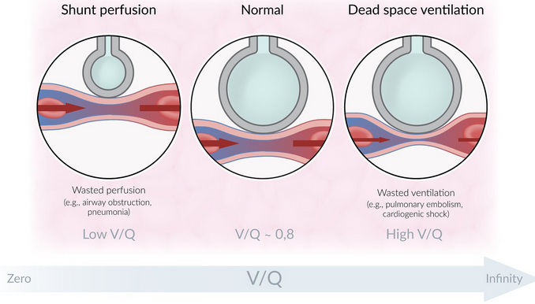
V/Q Mismatch
An imbalance between total lung ventilation (airflow, V) and total lung perfusion (blood flow, Q)
Most common cause of hypoxemia
Increased V/Q ratio (Dead Space)
Ventilation of poorly perfused alveoli
→ blood flow obstruction (PE, CV shock)
→ V/Q= ∞
Decreased V/Q ratio (Shunt)
Perfusion of poorly ventilated alveoli
→ airway obstruction (eg: foreign body aspirate)
→ pneumonia, atelectasis, CF, pulmonary edema; V/Q= 0
V/Q mismatch can be characterized by an increased A-a gradient
AMBOSS, Respiratory Physiology
Notes:
Normal V/Q Ratio (Nb to Know)
Ideal is a V/Q ratio = 1
Average V/Q ratio: 0.8 (ranges from 3 at the apex (V > Q) to 0.6 at the base (Q > V) since lung bases are better ventilated and perfused than the apices in an upright position)
Ventilation/perfusion mismatch (V/Q mismatch)
Pathologic lung conditions can alter V/Q ratios.
Decreased ventilation leads to shunt perfusion (wasted perfusion) and a low V/Q ratio. In lung areas with no ventilation left (V = 0), V/Q ratio equals zero.
Decreased perfusion leads to dead space ventilation (wasted ventilation) and a high V/Q ratio. In lung areas with no perfusion left (Q = 0), V/Q ratio equals infinity.
Reference: AMBOSS.com (Resp physiology)

Slide 46
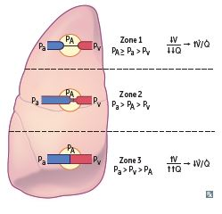
A-a Gradients
Is the difference between the partial pressure of oxygen in the alveoli (A) and the arterial (a) partial pressure of oxygen
Both ventilation and perfusion are greater at lung base
Normal = 75-100 mmHg
A-a gradient = PAO2 – PaO2
PAO2 = PiO2 – (PaCO2/R)
  Can be used to: measure oxygenation
→ determine cause of Hypoxemia (intra-/extrapulmonary)
Q: When is there an increase in A-a gradient?
Age | ↑ [inhaled oxygen]
Right-to-left shunt | Fluid in alveoli (eg: CHF)
V/Q mismatch (Eg PE, ↑ dead space) | Alveolar hypoventilation
First Aid 2018, 655; AMBOSS, Respiratory Physiology
Notes:
An increased A-a gradient may occur in hypoxemia due to shunting, ventilation-perfusion mismatch, or impaired gas diffusion across the alveoli due to fibrosis or edema
-The A-a gradient remains normal with hypoventilation due to CNS and neuromuscular disorders (no diffusion defect) and in high altitude (despite a lower fraction of inhaled O2)
-Patients with hypoventilation (eg: due to a drug overdose) usually present with increased CO2

Slide 47
Hypoxia versus Hypoxemia
Hypoxia | Hypoxemia
Reduced oxygen delivery to the tissues | Reduced oxygen in the blood = ↓ arterial PO2
CAUSES | CAUSES
↓ Cardiac Output | With normal A-a gradient
Anemia | High altitude
CO poisoning | Hypoventilation (eg: Opioid overuse)
*Hypoxemia | With ↑ A-a gradient
 | V/Q mismatch
 | Right-to-left shunt
 | Diffusion limitation (fibrosis)
Q: What does an increased A-a gradient indicate?
Notes:
Answer: Poor gas exchange
Hypoxia = lack of oxygen to the tissues
Hypoxemia = lack of oxygenation (of the blood)
Hypoxemia can be a cause of hypoxia, but there are also other causes of hypoxia!
A-a gradient = PAO2 (partial pressure of O2 in alveoli) – PaO2 (partial pressure of O2 in pulmonary capillaries), reflects the level of the gradient needed for diffusion/ gas exchange of O2, thus it reflects the level of hypoxia. An increased A-a gradient indicates poor gas exchange
Hypoxemia secondary to thickened diffusion barrier is rarely seen at rest. This is because the blood flow (perfusion) is slow enough at rest that full amounts of O2 can diffuse into the blood. In exercise, CO increases and so does the speed at which this blood flows through the pulmonary vasculature. There is not enough time for enough O2 to diffuse into the blood stream flowing at this increased pace.
Reference: Doctorials, 2017

Slide 48
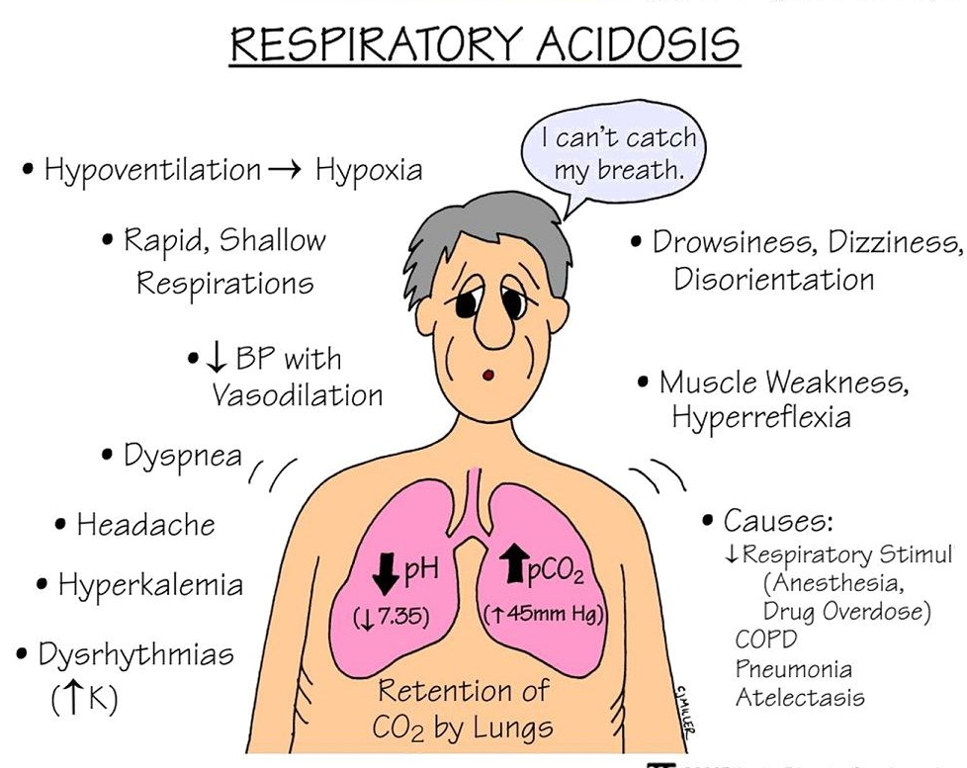
Hypoventilation
Reduced ventilation leading to decreased inspired O2 → Hypoxemia
A variety of causes:
Alveolar hypoventilation
Obstruction of upper airways (eg: COPD)
Neuromuscular disorder (eg: ALS) → ↓ inspiratory volume
Failure of brain chemoreceptors (eg: trauma, OD)
Q: What are some Signs & Symptoms?
Notes:
In hypoventilation, hypoxemia occurs because the rate at which fresh air is being brought into the lungs is too low to maintain blood oxygenation. The process of gas exchange itself is not affected, thus the A-a gradient is unchanged.
Type 1 respiratory failure is decreased O2 and hypoxemia. Type 2 respiratory failure is decreased O2/ hypoxemia plus increased PaCO2 (means worsening disease and impending total respiratory failure).
(Reference: Doctorials 2018)

Slide 49
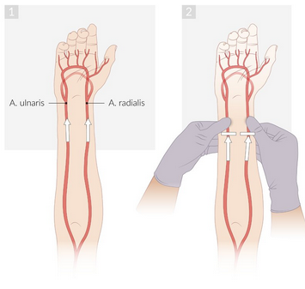
Arterial Blood Gas (ABG’s) Analysis
Arterial blood gas (ABG) analysis is a test regularly performed to measure:
Oxygen saturation
Carbon dioxide
Bicarbonate levels
→ Allows for quick assessment of gas exchange processes
and acid base balance
Physiological levels of oxygen saturation are usually >95%
Measurement of ABGs include:
  PO2 (normally >95)
  PCO2 (40 mmHg)
  pH (range 7.35-7.45)
AMBOSS, Arterial Blood Gas Analysis
Notes:
A sneak peak of what’s to come…
Clinical skills session and geeky medics good for ABG interpretation! Will be on data interp exam in June
https://geekymedics.com/abg-interpretation/

Slide 50
Arterial Blood Gas (ABG’s) Analysis
Reference ranges
pH: 7.35 – 7.45
PaCO₂: 4.7 – 6.0 kPa || 35.2 – 45 mmHg
PaO₂: 11 – 13 kPa || 82.5 – 97.5 mmHg
HCO₃–: 22 – 26 mEq/L
Base excess (BE): -2 to +2 mmol/L
Clinical context is important, you need to know is patient
on room air, or nonrebreather mask at 15L/min
What does ROME mean in the context of ABG’s
AMBOSS, Arterial Blood Gas Analysis
Notes:
A little “hack” to analyse ABG’s, Respiratory Opposites, Metabolic Equal, meaning if pH and HCO3 go in opposite directions, its likely to be a respiratory cause. If they go same direction likely to be metabolic
Quick thing about HCO3, its called bicarp, if this is out of range this implies at the very least partial compensation. Then you look at the pH and if this is in range that means its full compensation.
Why this matter is, Acute acidosis / alkoslysis is usually buffered by resp system, increasing or decreasing resp rate / volume. However chonic change in pH is buffered by the kidneys In the form of Bicarb (chemical reaction between CO2 + water forming HCO3-)
There are further slides on this later, or you can visit geekymedics in your own time
https://geekymedics.com/abg-interpretation/

Slide 51
Arterial Blood Gas (ABG’s) Analysis
Vignette
A 17-year-old patient presents to A&E complaining of a tight feeling in their chest, shortness of breath and some tingling in their fingers and around their mouth. They have no significant past medical history and are not on any regular medication. An ABG is performed on the patient (who is not currently receiving any oxygen therapy).
An ABG is performed and reveals the following:
PaO₂: 14 (11 – 13 kPa) || 105 mmHg (82.5 – 97.5 mmHg)
pH: 7.49 (7.35 – 7.45)
PaCO₂: 3.6 (4.7 – 6.0 kPa) || 27 mmHg (35.2 – 45 mmHg)
HCO₃–: 24 (22 – 26 mEq/L)
Q-> firstly is this alkalosis / acidosis?
Then is it resp / metabolic
AMBOSS, Arterial Blood Gas Analysis

Slide 52
Arterial Blood Gas (ABG’s) Analysis
Vignette
A 17-year-old patient presents to A&E complaining of a tight feeling in their chest, shortness of breath and some tingling in their fingers and around their mouth. They have no significant past medical history and are not on any regular medication. An ABG is performed on the patient (who is not currently receiving any oxygen therapy).
An ABG is performed and reveals the following:
PaO₂: 14 (11 – 13 kPa) || 105 mmHg (82.5 – 97.5 mmHg)
pH: 7.49 (7.35 – 7.45)
PaCO₂: 3.6 (4.7 – 6.0 kPa) || 27 mmHg (35.2 – 45 mmHg)
HCO₃–: 24 (22 – 26 mEq/L)
Q-> firstly is this alkalosis / acidosis?
Then is it resp / metabolic
AMBOSS, Arterial Blood Gas Analysis
Notes:
Answer respiratory alkalosis , due to pH being 7.49 (high), PaCO2 being low, being opposites, this indicated respiratory. Lastly HCO2 within range tells us no metabolic compensation

Slide 53

Notes:
Advice for 2nd years
Practise ABG interpretation and chest xray interpretations. You are examined on this in data interp but also on clinical placements in clinical years.
You will never be faulted on clinical placements for getting the answer incorrect as long as you approach it systematically

Slide 54

My Recommended Resources
FirstAid (get most up to date version)
Guyton hall physiology
Teach me anatomy / teach me physiology (online free)
Amboss ( good for summaries and for recap,
Osmosis, Armando and ninja nerd videos on youtube, in order of my preference
All of these resources should be available in PDF’s on an infamous google drive 😂
For those keen to practice auscultation (not useful in exams year 1+2) -> Litmann Stethoscope App
Facebook: Kieran Moloney
Email: 21150427@studentmail.ul.ie

Slide 55

References
First Aid 2018
AMBOSS.com
Physiology 2018 (Costanzo)
Uworld.com (Q Bank)
Past Doctorial presentations
  Catherine (2021)
  Kaithlyn (2023)
THANK YOU!

Slide 56
Extra Slides
For your viewing pleasure

Slide 57
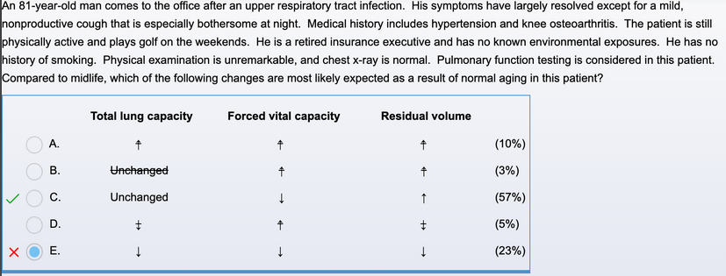
UWorld Question 1
CB 21-10-21
Uworld.com (Q-bank)
Notes:
Decrease, Increase or Unchanged?
Answer: TLC = Unchanged
FVC = Decrease
RV = Increase

Slide 58

UWorld Question 2
CB 21-10-21
Uworld.com (Q-bank)

Slide 59

Uworld Question 3
CB 21-10-21
Uworld.com (Q-bank)

Slide 60

Uworld Question 4
CB 21-10-21
Uworld.com (Q-bank)

Slide 61

Extra Diaphragm Figure
CB 21-10-21
AMBOSS, Thoracic Cavity (Diaphragm)
Notes:
Diaphragm (cranial view)
Peripheral muscular region (pink) has the following parts:
– Sternal part: originates from the posterior surface of the sternum
– Costal part: originates from the inner surface of the 7th–12th ribs
– Lumbar part: originates from L1–L3 vertebrae and the fascia over the quadratus lumborum and psoas major muscles
Central tendinous region (white) has the following openings:
– Caval hiatus (anterior): serves the inferior vena cava and the right phrenic nerve
– Esophageal hiatus (middle): serves the esophagus and the vagus nerve
– Aortic hiatus (posterior): serves the aorta, azygos vein, and the thoracic duct
– Sternocostal triangles (foramina of Morgagni; anterior, between the sternal and costal diaphragmatic origins): serve the internal thoracic vessels
– Lumbocostal triangles (Bochdalek foramina; posterior, between the lumbar and costal diaphragmatic origins): normally closed in adults
Reference: AMBOSS.com

Slide 62

Anatomy of Intercostal Muscles
CB 21-10-21
AMBOSS.com
Notes:
Reference: AMBOSS.com

Slide 63

Bohr and Haldane Effects
CB 21-10-21
AMBOSS.com
Notes:
Bohr and Haldane effects
The Bohr and Haldane effects are essential for CO₂ and O₂ transport within the blood and the appropriate exchange of these gases in the lungs and peripheral tissues. The key mechanism of both effects is the fact that Hb affinity to O₂ changes depending on the environment.
Bohr effect: The affinity of Hb for O₂ decreases as concentrations of CO₂ and/or H⁺ increase. This typically occurs in peripheral tissues and allows O₂ to be supplied more easily to the tissue (since O₂ is more readily released from Hb).
Haldane effect: Deoxygenated Hb has a higher affinity for CO₂ than oxygenated Hb. Since deoxygenated Hb is typically present in peripheral tissue (rather than in the lungs, where pO₂ is high), uptake of CO₂ is facilitated there. CO₂ is then transported to the lungs, where it easily dissociates from Hb and is exhaled.
Reference: AMBOSS.com

Slide 64
Bicarbonate Buffer System
Bicarbonate buffer system
RBCs carry carbonic anhydrase, which converts HCO₃⁻ and H⁺ to H₂O and CO₂ in the following steps: HCO₃⁻ + H⁺ ⇄ H₂CO₃ ⇄ H₂O + CO₂
Ultimately, excess H⁺ during acidic states is eliminated through conversion to CO₂, which can be exhaled.
During basic states, the bicarbonate buffer system can reverse so that CO₂ is converted to HCO₃⁻ + H⁺.
  Chloride shift: Excess intracellular HCO₃⁻ produced this way is released into the plasma in exchange for Cl⁻.
This phenomenon makes HCO₃⁻ the most important buffer in the body.
→ For more details on the buffering mechanisms of the body, see compensation in acid-base disorders.
CB 21-10-21
AMBOSS.com

Slide 65

O2 Dissociation Curve (Hb versus Myoglobin)
CB 21-10-21
AMBOSS.com
Notes:
Oxygen dissociation curves for hemoglobin and myoglobin
The oxygen dissociation curves of hemoglobin and myoglobin show different affinities for O₂ in venous blood from peripheral tissues. Increasing partial oxygen pressure (pO2) corresponds with a sharp increase in the O₂ affinity of myoglobin (red curve). The increase then levels off. In venous blood from peripheral tissue, myoglobin O₂ affinity is high. While the oxygen affinity for myoglobin sharply increases at low partial oxygen pressure levels, the hemoglobin curve (green curve) has a sigmoidal shape (s shape). At low partial oxygen pressure levels, the curve increases gradually, whereas it is significantly steeper at higher partial oxygen pressure levels, as in venous blood from peripheral tissue. The hemoglobin oxygen dissociation curve then reaches a plateau at higher partial oxygen pressure levels. In arterial blood from the lungs, the partial oxygen pressure level is rather high, which corresponds to a high oxygen affinity in both myoglobin and hemoglobin.
Reference: AMBOSS.com (Erythrocyte morphology and Hemoglobin)

Slide 66

Hemoglobin versus Myoglobin Table
CB 21-10-21
AMBOSS (Erythrocyte morphology and Hemoglobin

Slide 67
Respiratory Adaptation in Elderly Population
Respiratory adaptation in the elderly population
↓ Chest wall compliance
↑ Lung compliance
↓ PaO₂ and ↑ A-a gradient
↑ V/Q mismatch
↓ FVC
↑ Susceptibility to aspiration and infections
Please see aging changes in the respiratory system for details.
CB 21-10-21
AMBOSS, Respiratory Physiology

Slide 68

Adaptations in Pregnancy
CB 21-10-21
Uworld Question Bank

Slide 69
A Few More Perfusion Definitions
Definitions
Mean pulmonary arterial pressure (mPAP): normal 10–14 mmHg
Pulmonary vascular resistance (PVR): the resistance offered by the pulmonary circulatory system that must be overcome to create blood flow (R = ΔP / Q)
  PVR = (pulmonary arterial pressure - pulmonary capillary wedge pressure) / cardiac output
Pulmonary blood flow
Distribution of blood flow: depends on the position of the body and is precisely regulated in relation to the ventilation to optimize gas exchange
  due to gravity, circulation is highest in the lung base
Regulation of pulmonary blood flow
If a lung section is perfused but not ventilated, there is a drop in the oxygen concentration in the blood → hypoxic vasoconstriction (Euler-Liljestrand mechanism)
CB 21-10-21
AMBOSS, Respiratory Physiology

